Slide 1
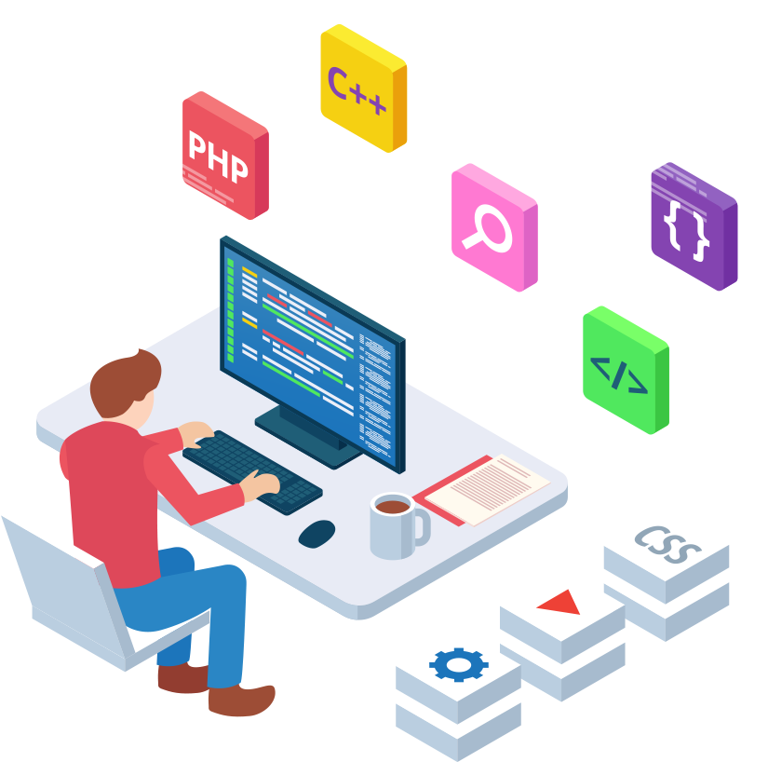
Hotel Management Website

Slide 2

Submitted by:
HARSH JAIN(171500120)
KARTIKEYA MISHRA(171500157)
MANISH KUMAR(171500180)
NAMAN MITTAL(171500199)
DEPARTMENT OF COMPUTER ENGINEERING APPLICATIONS
INSTITUE OF ENGINEERING AND TECHNOLOGY
GLA University
Mathura-281406, INDIA
2020

Slide 3

CONTENT
INTRODUCTION TO WEB DEVELOPMENT
ABOUT THE PROJECT
SYSTEM REQUIREMENT
TECHNOLOGY USED
BRIEF TO THE LANGUAGE USED
IMPEMENTATION
CONCLUSION

Slide 4
INTRODUCTION TO WEB DEVELOPMENT
Web development refers to building, creating, and an maintaining websites
It includes aspects such as
Web Design
Web Publishing
Web Programming
Database Management
A web developer may be involved in designing a website, but may also write web scripts in languages such as PHP and ASP. Additionally, a web developer may help maintain and update a database used by a dynamic website

Slide 5
ABOUT THE PROJECT
This project is aimed at developing a Web application that depicts online Hotel booking
. This system is designed using HTML, CSS and JavaScript as a frontend and SQL server as the secured backend database
In this project, details are maintained like customer details, reservation details, booking details and billing details
Hotel Management Website is a desktop and android application. This application is entitled to solve a specific business problem.

Slide 6

SYSTEM REQUIREMENT
Hardware Requirement
Personal computer with internet connection
i3 Processor Based Computer Or Higher
Memory: 2 GB RAM(Minimum)
Hard Drive: 30 GB(Minimum)
Software Requirement
Windows 7 Or Higher
Google Chrome Version 40.0.2214 Or Higher
Any Web Editor Like Sublime Text Or Brackets
SQL Server 2008 Or Above

Slide 7

TECHNOLOGY USED:
Front-end Tools
HTML
CSS
JAVASCRIPT
BOOTSTRAP
Back-end Tools
PHP
MySQL

Slide 8
BRIEF TO THE LANGUAGE USED
HTML
Hypertext Mark-up Language (HTML) is the standard mark up language for documents designed to be displayed in a web browser.
CSS
Cascading Style Sheets (CSS) is a style sheet language used for describing the presentation of a document written in a mark up language like HTML.
JAVASCRIPT
JS, is a high-level, interpreted scripting language. We use Java Script to define the major functionality for specific element.

Slide 9
BOOTSTRAP
Bootstrap is a powerful front-end framework for
faster and easier web development. It includes HTML and CSS based design templates.
PHP
Hypertext Pre-processor (or simply PHP) is a general-purpose programming language originally designed for web development.
MySQL
MySQL is a relational database management
system based on SQL – Structured Query Language

Slide 10
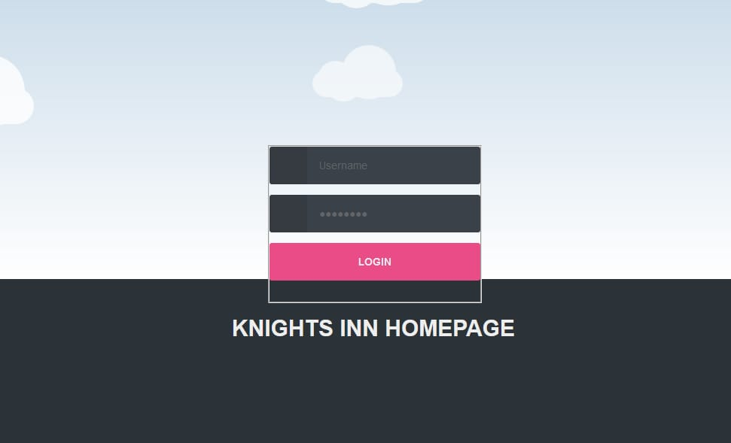
IMPLEMENTATION
Modules
1- Staff Login page

Slide 11
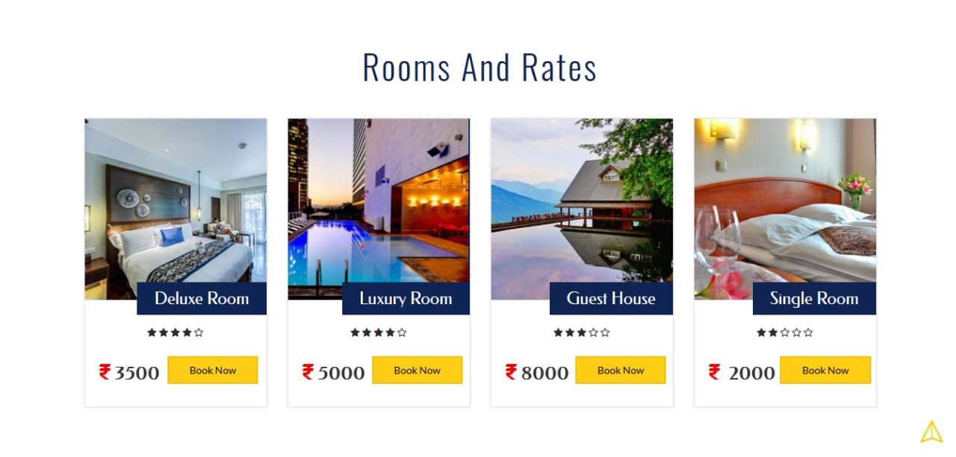
2- Rooms

Slide 12
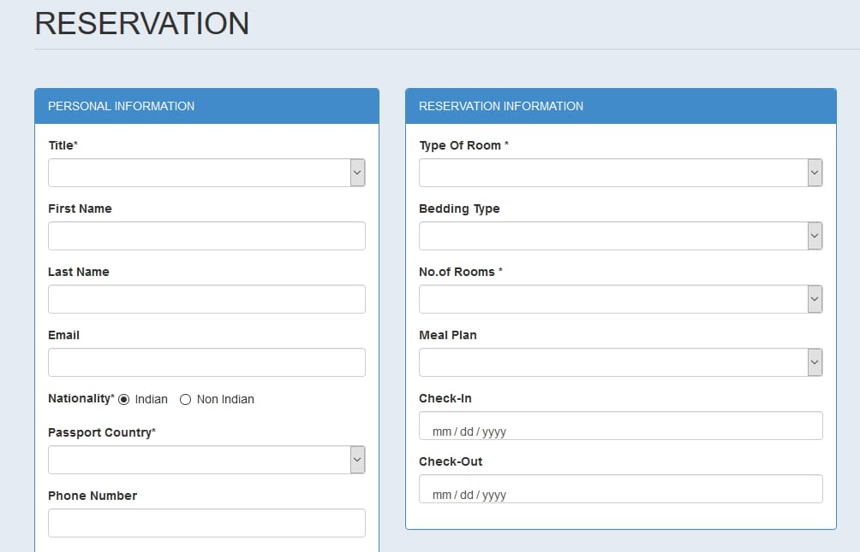
3- Reservation

Slide 13
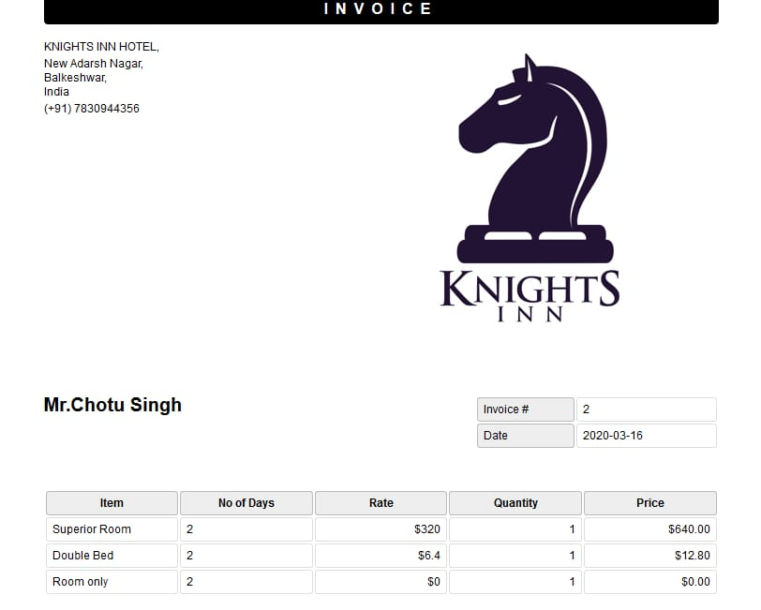
4 - Invoice

Slide 14
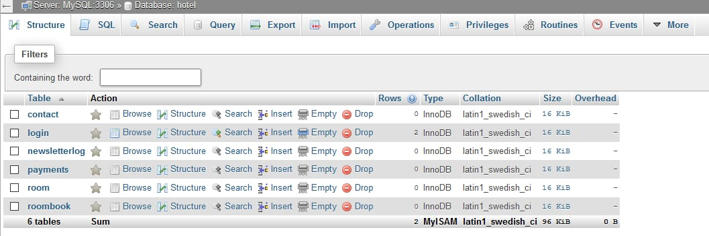
5- Database

Slide 15
CONCLUSION
After the completion of project, customer can view the overall website of our hotel but cannot book any room without giving his details. Finally, in online hotel management website, we have developed a secure, user-friendly Hotel Management website. This System can take care of each member whether its Owner or Customer.
This System will help them to properly manage their Hotel and help in growth without creating and hassle. This System is completely secure since every user is provided with user ID and Password so there is no chance of any unauthorised access.
Online Payment, Booking and cancellation make it easier to use. So, using this system will help in reducing the labour and provide more facility for Customer to like Hotel and visit again and again.

Slide 16
Thank You

Slide 17
Any question

