Slide 1

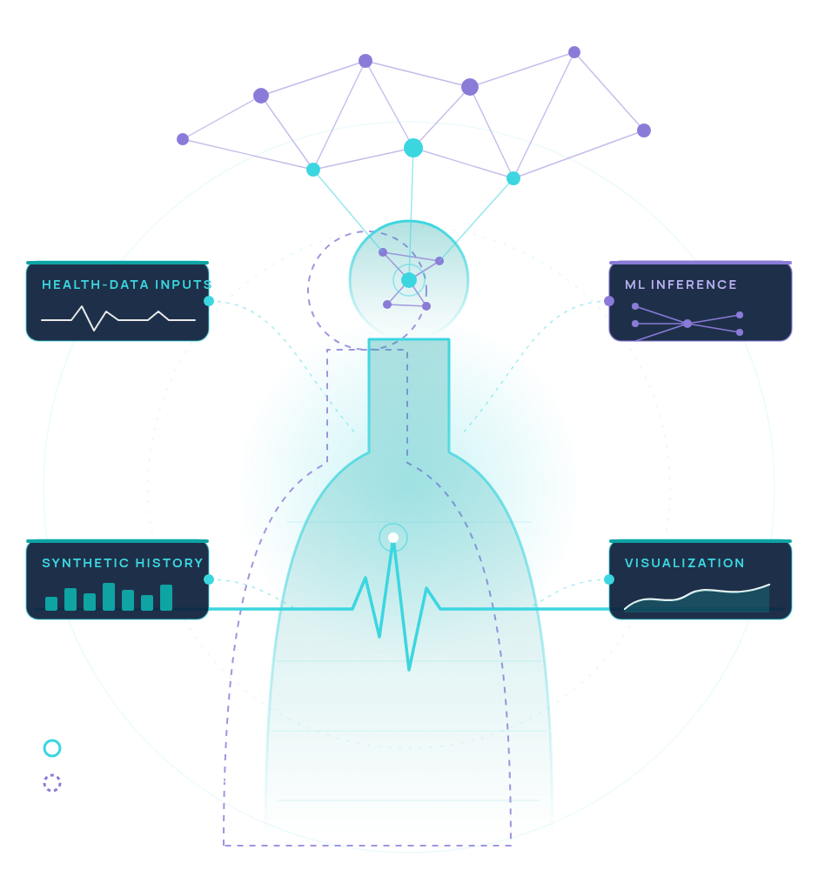

PROJECT INTRODUCTION · DIGITAL HEALTH TWIN
NeuroRhythmTwin
An AI-Assisted Digital Health Twin Prototype
EDUCATIONAL PROTOTYPE
CONCEPTUAL ILLUSTRATION
TEAM
Alpha Monarchs
Harsha Vardhan
Yashash Krishna
Amrita Vishwa Vidyapeetham, Amritapuri Campus
Annamacharya Institute of Technology, Rajampet Campus
CONCEPTUAL ILLUSTRATION, NOT APPLICATION OUTPUT
EDUCATIONAL PROTOTYPE, NOT A MEDICAL DEVICE
TEAM ALPHA MONARCHS
01 / 14

Slide 2

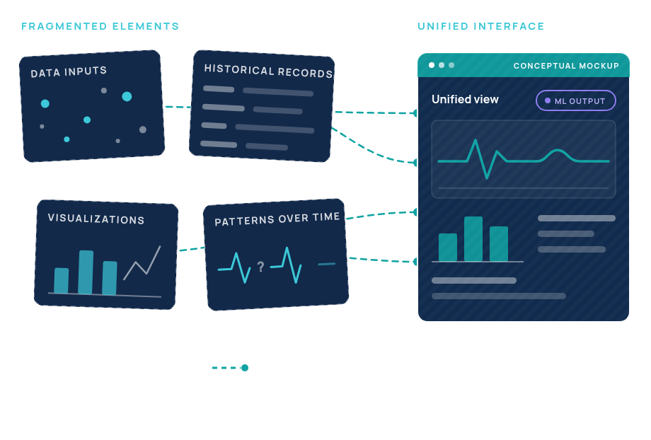
02 / 14 · PROBLEM & MOTIVATION
NEURORHYTHM TWIN
The Challenge:Interpreting Health-Related Patterns
01
FRAGMENTED DATA
Synthesizing diverse health-related data over time is difficult.
02
HARD-TO-READ HISTORY
Historical records and complex visualizations are hard to interpret together.
03
OUR MOTIVATION
NeuroRhythm Twin is a prototype built to explore how these issues might be addressed.
Framed as motivation for a prototype — not a claim that healthcare systems lack these capabilities.
EDUCATIONAL PROTOTYPE, NOT A MEDICAL DEVICE
NEURORHYTHM TWIN · TEAM ALPHA MONARCHS · 02 / 14

Slide 3

03 / 14 · PROPOSED SOLUTION
TEAM ALPHA MONARCHS
Our Proposed Solution: NeuroRhythm Twin
An interactive prototype that demonstrates a potential approach to exploring health-related patterns.
IMPLEMENTED PROTOTYPE
CONCEPTUAL DIAGRAM
DATA LAYER · STAGES 1–2
AI LAYER · STAGE 3
EXPERIENCE LAYER · STAGES 4–5
1
2
3
4
5
Health-related data inputs
Historical synthetic data
Machine-learning inference
Interactive data visualization
A unified Streamlit interface
Supported sample inputs, entered or selected by the user.
A synthetic historical dataset, not real patient records.
Random Forest inference for pattern exploration.
Interactive Plotly charts for exploring model outputs.
One interface that brings inputs, model and visuals together.
KEY POINT 01
KEY POINT 02
KEY POINT 03
An interactive prototype combining health data inputs and synthetic historical data.
Leverages machine-learning inference for pattern exploration.
Interactive data visualization within a unified Streamlit interface.
EDUCATIONAL PROTOTYPE, NOT A MEDICAL DEVICE.
NEURORHYTHM TWIN · 03 / 14

Slide 4

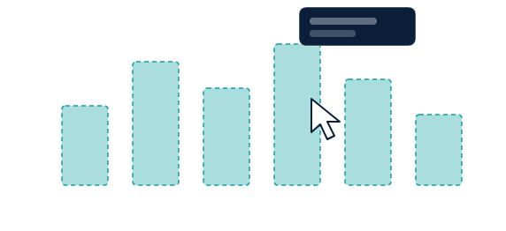
04 / 14 · HEALTHCARE USE CASE
ALPHA MONARCHS · NEURORHYTHM TWIN
Healthcare Use Case: Interactive Data Exploration
Explore sample health-related data and inspect model-generated outputs in an interactive environment.
1
Enter or select supported sample inputs
CONCEPTUAL MOCKUP
Sample health-related inputs the application supports.
SAMPLE INPUTS
1
4
MODEL OUTPUT
2
Process the inputs
Supported input
▾
OUTPUTAPPEARS HERE
Prepared for the model with pandas and NumPy.
Supported input
▾
5
3
Run the implemented model
INTERACTIVE VISUALIZATION · PLOTLY
Random Forest inference with scikit-learn.
Supported input
▾
4
Inspect the output and available visualizations
DATA PROCESSING
2
Model output and Plotly views in the Streamlit app.
Explore the information for educational purposes
Run model
3
5
For learning only. Not for diagnosis or treatment.
Placeholder shapes only. No real data is shown.
CONCEPTUAL MOCKUP
Illustration, not a screenshot. Depicts only interaction stages in the prototype.
NEURORHYTHM TWIN · TEAM ALPHA MONARCHS
EDUCATIONAL PROTOTYPE, NOT A MEDICAL DEVICE
04 / 14

Slide 5

05 / 14 · THE CONCEPT
NEURORHYTHM TWIN · TEAM ALPHA MONARCHS
Understanding the Digital Health Twin Concept
The idea in plain language — and where this prototype honestly sits.
1
THE CONCEPT
CONCEPTUAL RELATIONSHIP
CONCEPTUAL DIAGRAM
A digital health twin conceptually models health-related data in software.
1
2
3
Health-related data
Software model
Visualization interface
2
OUR PROTOTYPE
The information a twin represents.
Software that represents and reasons over that data.
Where people explore what the model shows.
NeuroRhythm Twin is an early prototype inspired by digital twin principles.
PROTOTYPE: SAMPLE INPUTS + SYNTHETIC HISTORY
PROTOTYPE: RANDOM FOREST
PROTOTYPE: PLOTLY IN STREAMLIT
WHAT IT IS NOT
BEYOND THIS PROTOTYPE — NOT CLAIMED
3
It is not a fully validated, continuously synchronized clinical digital twin.
DATA → MODEL → VISUAL INTERFACE
NOT IMPLEMENTED
NOT IMPLEMENTED
Continuous synchronization
Clinical validation
TAKEAWAY
An educational, early prototype inspired by digital twin principles — not a clinical tool.
EDUCATIONAL PROTOTYPE, NOT A MEDICAL DEVICE
05 / 14

Slide 6

06 / 14 · ARCHITECTURE
CONCEPTUAL SYSTEM ARCHITECTURE
Conceptual System Architecture
Data flows left to right: from inputs and historical data to the Streamlit interface.
DATA FLOW
CORE LOGIC
OUTPUT & INTERFACE
1Inputs · Dataset
2pandas · NumPy
3scikit-learn
4Plotly
5Streamlit
Data inputs & historical dataset
Data processing
Random Forest inference
Results & visualization layer
Streamlit user interface
Prepares inputs and history for the model.
Model generates an output from supported features.
Where users enter inputs and explore results.
Sample inputs plus the synthetic historical dataset.
Turns results into interactive charts.
DATA FLOW
CORE LOGIC
OUTPUT & INTERFACE
Inputs & historical dataset → data processing with pandas and NumPy.
Random Forest inference using scikit-learn.
Plotly for visualization, Streamlit for user interaction.
SCOPE
Only confirmed components are shown. Not depicted: cloud services, medical-device integrations, hospital databases, APIs, wearables.
NEURORHYTHM TWIN · TEAM ALPHA MONARCHS
EDUCATIONAL PROTOTYPE, NOT A MEDICAL DEVICE
06 / 14

Slide 7
07 / 14 · WHAT THE PROTOTYPE IS BUILT WITH
Technology Stack
The project's technologies and the role each one plays
5
INTERFACE
Streamlit
interactive application interface
CORE LANGUAGES & FRAMEWORKS
Python·Streamlit·scikit-learn
4
VISUAL-IZATION
Plotly
interactive visualizations
Language, application interface and ML framework.
MACHINELEARNING
scikit-learn
Random Forest
DATA HANDLING & VISUALIZATION
3
machine-learning framework
implemented model
pandas·NumPy·Plotly
pandas
NumPy
Data handling, numerical operations and interactive charts.
2
DATAHANDLING
data handling
numerical operations
1
LANGUAGE
Python
primary programming language
IMPLEMENTED MODEL & VERSION CONTROL
Random Forest·GitHub
The implemented model, and the repository that holds the source code.
GitHub
source-code repository
VERSION CONTROL · SPANS ALL LAYERS
NEURORHYTHM TWIN · TEAM ALPHA MONARCHS · EDUCATIONAL PROTOTYPE, NOT A MEDICAL DEVICE
IMPLEMENTED
07 / 14

Slide 8

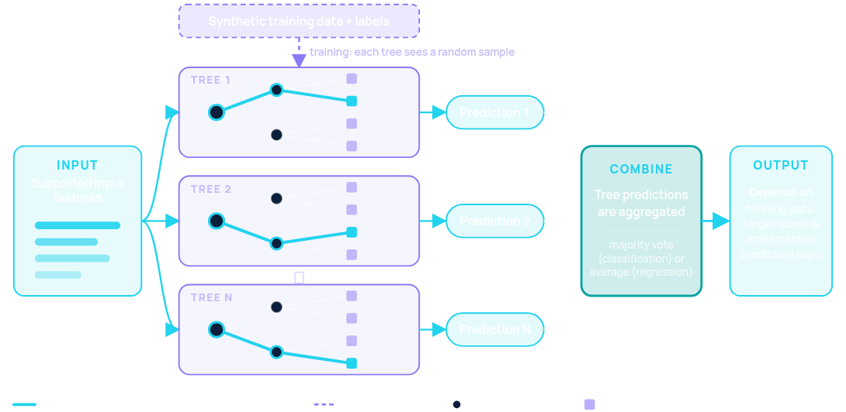
08 / 14 · AI/ML METHODOLOGY · HIGH-LEVEL VIEW
NEURORHYTHM TWIN · TEAM ALPHA MONARCHS
AI/ML Methodology: Random Forest Model
Many decision trees look at the same input features; their predictions are combined into one output.
HOW A RANDOM FOREST WORKS — SIMPLIFIED
1
MANY TREES, ONE ANSWER
CONCEPTUAL ILLUSTRATION
Combines predictions from multiple decision trees.
2
INPUT FEATURES
The model processes the supported input features.
3
WHAT SHAPES THE OUTPUT
Training data, target labels and the implemented prediction logic.
4
QUALITY NEEDS EVIDENCE
Quality must be assessed with appropriate, verified evaluation procedures.
SYNTHETIC DATA · SYNTHETIC LABELS
WHAT WE DO NOT CLAIM
No performance metrics are reported. No disease detection or clinical-outcome prediction is claimed.
The prototype trains and runs on synthetic data only.
EDUCATIONAL PROTOTYPE, NOT A MEDICAL DEVICE
NEURORHYTHM TWIN · 08 / 14

Slide 9

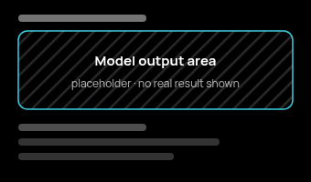
APPLICATION WORKFLOW · USER JOURNEY
Application Workflow and Interface
CONCEPTUAL MOCKUPS · NOT SCREENSHOTS
STREAMLIT APP · LIVE
Four stages of the user journey — described only as far as the current implementation supports.
1
STAGE 01
2
STAGE 02
3
STAGE 03
4
STAGE 04
Input
Processing
Output
Visualization
CONCEPTUAL MOCKUP
CONCEPTUAL MOCKUP
CONCEPTUAL MOCKUP
CONCEPTUAL MOCKUP
Inputs
pandas
NumPy
Random Forest
ILLUSTRATIVE FLOW
CHART PLACEHOLDER · NO DATA
IMPLEMENTED BASIS
IMPLEMENTED BASIS
IMPLEMENTED BASIS
IMPLEMENTED BASIS
Users enter or select supported sample health-related inputs in the Streamlit interface.
Inputs are processed with pandas and NumPy, then passed to the implemented Random Forest model (scikit-learn).
The model’s output is displayed in the interface. Its meaning depends on synthetic training data and labels.
Plotly visualizations let users interactively explore outputs for educational purposes.
Streamlit interface
pandas · NumPy · scikit-learn
Streamlit interface
Plotly
LIVE APPLICATION
READING THESE MOCKUPS
https://neurorhythmtwin-nwpkjzcxc8rktt5slbaplg.streamlit.app/
No screenshots supplied: panels are conceptual mockups. They show layout only — no real model outputs, values or results.
Deployed Streamlit prototype — open it to see the real interface.
NEURORHYTHM TWIN · TEAM ALPHA MONARCHS · EDUCATIONAL PROTOTYPE, NOT A MEDICAL DEVICE
09 / 14

Slide 10

PROTOTYPE STATUS · IMPLEMENTED VS. PLANNED
NEURORHYTHM TWIN · TEAM ALPHA MONARCHS
Current Prototype Status: Implemented Components
Seven components have been part of the project — shown solid; planned improvements are shown dashed.
#
GROUP
COMPONENT
ROLE IN PROTOTYPE
STATUS
PLANNED IMPROVEMENTS
PLANNED
1
IMPLEMENTED
Streamlit application
Interactive interface
IMPLEMENTED
Phase 1 · Prototype refinement — usability, documentation, workflow testing
2
IMPLEMENTED
Python-based project code
Primary language
IMPLEMENTED
Phase 2 · Data and model evaluation — ethically sourced data, valid labels, bias assessment
3
IMPLEMENTED
Random Forest model implementationAI/ML
Model inference
IMPLEMENTED
Phases 3 & 4 · Responsible health-data integration; further technical/clinical validation
4
DATA & PROCESSING
Synthetic historical dataset
Synthetic, not patient data
IMPLEMENTED
5
DATA & PROCESSING
pandas and NumPy data processing
Input & data handling
REPOSITORY
IMPLEMENTED
IMPLEMENTED
Project hosted on GitHub
6
DATA & PROCESSING
Plotly visualizations
Interactive output charts
IMPLEMENTED
https://github.com/HARSHA-1119/NeuroRhythmTwin
Source control for the Streamlit app, code and synthetic dataset.
7
SOURCE CONTROL
GitHub repository
Hosted source code
IMPLEMENTED
HONEST SCOPE
These components have been part of the project. Not every feature has been independently tested in the current version.
EDUCATIONAL PROTOTYPE, NOT A MEDICAL DEVICE.
ALPHA MONARCHS · NEURORHYTHM TWIN
10 / 14

Slide 11
11 / 14 · HONESTY FIRST · WHAT THIS PROTOTYPE IS NOT
NOT DEMONSTRATED
EDUCATIONAL ONLY
Limitations and Risks
#
LIMITATION / RISK
WHAT IT MEANS
EXPLICIT DISCLAIMER
01
Synthetic training data and labels
Outputs reflect synthetic examples, not real patients.
“
02
Lack of demonstrated clinical validation
No clinical evaluation is demonstrated; no accuracy or disease-detection claim is made.
NeuroRhythm Twin is an educational and research prototype. It is not a clinically validated medical tool and must not be used for diagnosis or treatment decisions.”
03
Potential bias and limited generalizability
Synthetic data may not represent diverse populations, so results may not generalize.
04
Risk of misleading outputs if the model is misunderstood
Outputs are illustrative; reading them as medical findings would mislead.
05
Privacy, security and responsible handling of real health information
Needed before any real health data is used; a prototype alone does not provide them.
06
Need for appropriate clinical expertise and evaluation
Required before any real-world healthcare use.
Not for diagnosis
Not for treatment decisions
07
No demonstrated integration with hospital systems or medical devices
None is claimed unless verified.
EDUCATIONAL PROTOTYPE, NOT A MEDICAL DEVICE.
NEURORHYTHM TWIN · TEAM ALPHA MONARCHS · 11 / 14

Slide 12


12 / 14 · FUTURE DEVELOPMENT
PLANNED WORK · FOUR PHASES
Future Development Roadmap
PLANNED · NOT CURRENT CAPABILITIES
Present future work as planned, not completed.
1
2
3
4
PHASE 1
PHASE 2
PHASE 3
PHASE 4
Prototype refinement
Data and model evaluation
Responsible health-data integration
Further validation
Test the existing workflow.
Investigate ethically sourced, appropriately licensed datasets.
Explore privacy-preserving data handling.
Conduct appropriate technical and clinical evaluation before any healthcare deployment.
Improve usability and documentation.
Investigate consent and security requirements.
Define valid target labels and evaluation procedures.
Verify model behavior and evaluation methodology.
Seek qualified healthcare and research collaborators.
Consider external data integrations only after feasibility, privacy, and safety assessments.
Assess generalization and bias.
PLANNED
Do not present future integrations or validation as already achieved.
EDUCATIONAL PROTOTYPE, NOT A MEDICAL DEVICE · NEURORHYTHM TWIN · TEAM ALPHA MONARCHS
12 / 14

Slide 13
EXPECTED IMPACT · EDUCATIONAL AND RESEARCH VALUE
NEURORHYTHM TWIN · ALPHA MONARCHS
Potential Impact: Educational and Research Value
Potential benefits, tied to what exists today — not measured outcomes.
AI / ML-RELATED VALUE
#
POTENTIAL VALUE
BUILT ON (TODAY)
DEPENDS ON / LIMITS
BASIS TODAY
Makes machine-learning concepts easier to explore through an interactive interface.
Streamlit interface; Random Forest model (scikit-learn); supported sample inputs
Educational use only; no measured learning outcomes
1
IMPLEMENTED
2
Demonstrates how data processing and visualization can work together.
pandas / NumPy processing feeding Plotly charts inside one Streamlit app
Shows workflow integration only; no performance claims
IMPLEMENTED
Provides a foundation for learning about AI-assisted health-data exploration.
Synthetic historical dataset; Random Forest inference
Synthetic data and labels; not clinically validated; no diagnostic claims
3
IMPLEMENTED
Could support further research if data quality, validity, privacy, and safety are addressed.
Roadmap phases 2–4: data and model evaluation, responsible integration, further validation
Data quality · validity · privacy · safety must be addressed first
4
PLANNED
POTENTIAL BENEFITS
≠
MEASURED REAL-WORLD OUTCOMES
Described qualitatively above as expected educational and research value.
None claimed. No clinical or real-world outcome evidence is presented.
EDUCATIONAL PROTOTYPE, NOT A MEDICAL DEVICE
13 / 14

Slide 14

CONCLUSION · SUMMARY OF THE PROTOTYPE
Building a Responsible Foundation forAI-Assisted Health Exploration
#
WHAT WE ARE SUMMARIZING
STATUS
HONEST BOUNDARY
Inspired by digital twin principles; not a clinical digital twin
TEAM
An interactive digital-health-inspired prototype
AlphaMonarchs
1
IMPLEMENTED
2
A Python and Streamlit implementation
IMPLEMENTED
Source code hosted on GitHub
A Random Forest model using synthetic data
Harsha Vardhan
3
IMPLEMENTED
No clinical accuracy claimed
Amrita Vishwa Vidyapeetham
Yashash Krishna
4
Visualizations supporting exploration of outputs
Plotly charts for educational exploration
Annamacharya Institute of Technology
IMPLEMENTED
A roadmap toward more rigorous evaluation and responsible development
AI / ML component
5
PLANNED
Future plans, not current capabilities
“
NeuroRhythm Twin — Exploring the possibilities of AI-assisted health-data insights, responsibly.”
TEAM ALPHA MONARCHS
Educational and research prototype · synthetic data
EDUCATIONAL PROTOTYPE, NOT A MEDICAL DEVICE
NEURORHYTHM TWIN · TEAM ALPHA MONARCHS
14 / 14

