Slide 1
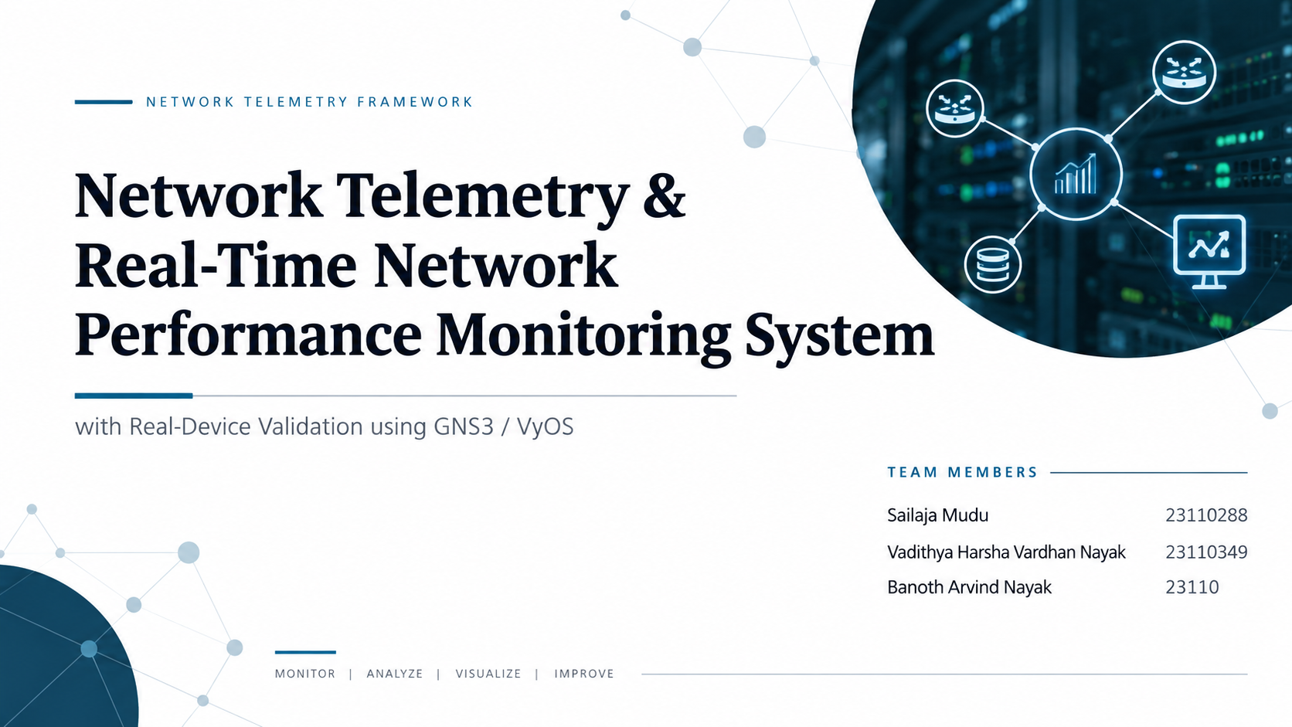

23110058

Slide 2
01 — PROBLEM & OBJECTIVES
Problem Statement & Objectives
OBJECTIVES
THE PROBLEM
1
Collect standardized telemetry — bandwidth, utilization, latency, packet loss, device availability
Administrators need continuous visibility into bandwidth, latency, packet loss, and device availability to catch degradation before it affects users.
Manually polling devices or reading raw counters does not scale, and commercial monitoring suites are heavyweight and closed-source — unsuitable for an academic setting where every layer must be understood.
This project builds a complete, end-to-end telemetry pipeline from first principles: raw SNMP counters in, calculated metrics and threshold-based alerts out, visualized in near real time.
2
Support two telemetry sources — simulated and real SNMPv2c devices.
3
Transport telemetry efficiently using gRPC and Protocol Buffers
4
Persist historical data in PostgreSQL with an indexed, query-efficient schema
5
Visualize live and historical metrics in Grafana with threshold-based alerting (deduplication + auto-recovery)
6
Validate the SNMP collector against a real, non-simulated device using GNS3/VyOS
Network Telemetry & Real-Time Network Performance Monitoring System
01

Slide 3
02 — ARCHITECTURE & MECHANISM
System Architecture & Data Flow
Custom Simulator
GNS3 / VyOS Router
router-01/02, switch-01/02
Real SNMP virtual device
SNMPv2c / ICMP — poll-based, not streaming
Python Telemetry Collector
gRPC +
Protobuf
FastAPI Backend
SQL
PostgreSQL
One common MetricSource interface — same pipeline for both sources
Router → Service → Repository
devices • telemetry_metrics • alerts
MECHANISM
1.
Devices/simulator produce raw counters, collected once per poll interval
Grafana Dashboards
2.
Collector differences two consecutive polls (actual elapsed time) → bandwidth/utilization
Reads PostgreSQL directly, 5–10s refresh
3.
gRPC batches one TelemetryBatch per device per poll; retries with backoff if backend is down
4.
Backend validates, ingests, evaluates thresholds; PostgreSQL persists with indexed schema
5.
Grafana queries PostgreSQL directly — no custom plugin, no streaming layer
Network Telemetry & Real-Time Network Performance Monitoring System
02

Slide 4
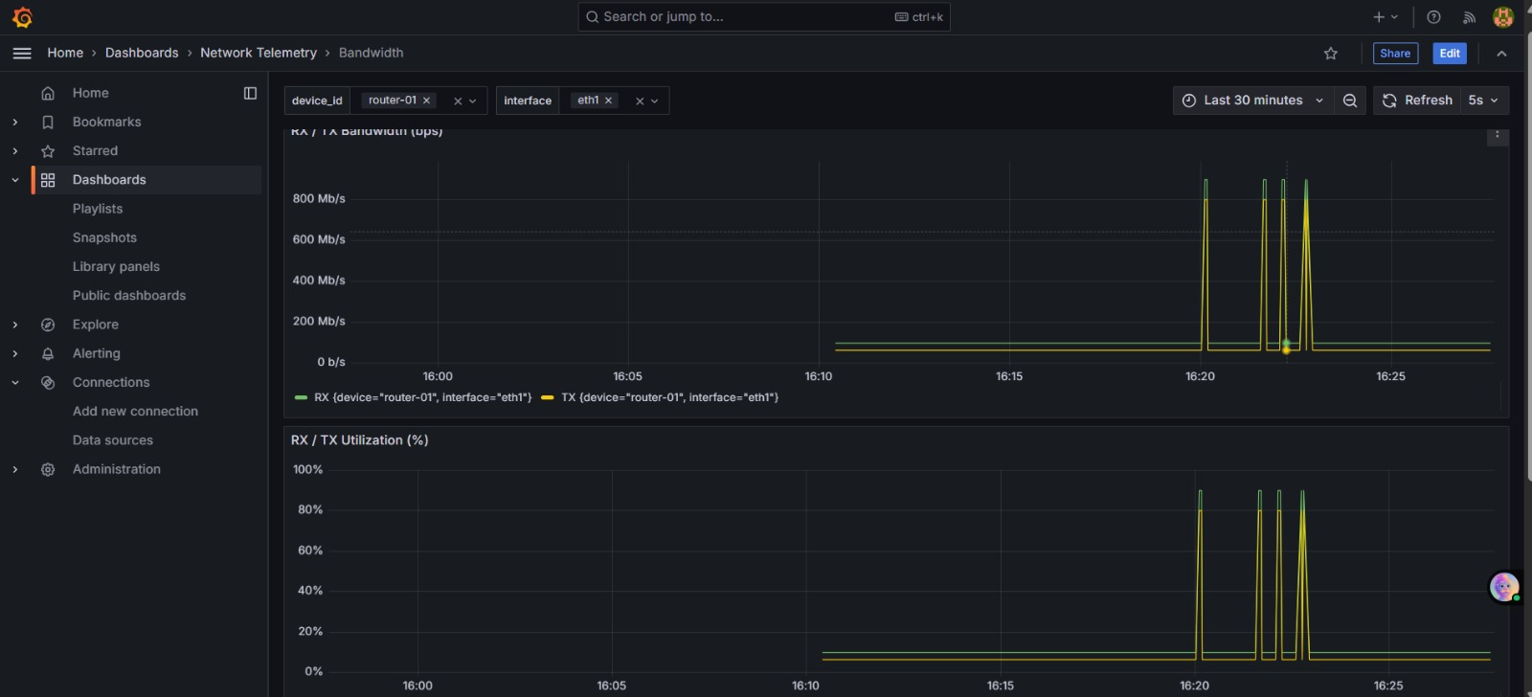
03 — WHAT WE BUILT
Extension, Issues Fixed & Evaluation
A. EXTENSION / IMPLEMENTATION
B. ISSUES FIXED
C. EVALUATION / RESULTS
• SNMPv2c collector (pysnmp) polling MIB-2/IF-MIB OIDs
Issue: Backend crash-looped: “password authentication failed”
Cause: Postgres password set only at first container startup; stale data volume
Fix: Cleared the data volume, reinitialized cleanly
112 / 112
• Custom simulator — 6 deterministic scenarios
automated tests passed — 0 failed, 0 skipped
(10 areas: SNMP, bandwidth engine, ICMP, simulator, gRPC, DB/ingestion, alert engine, REST API, integration)
• gRPC + Protobuf transport, retry/backoff
8 / 8
• FastAPI REST API: /devices, /metrics, /metrics/export (CSV), /alerts
Issue: snmpd failed to start (“unknown token”, “error opening endpoint”)
Cause: Repeated sed/heredoc edits corrupted snmpd.conf
Fix: Retyped a minimal, verified-clean config directly
live demonstration scenarios PASS (TC-02–TC-09): bandwidth/latency/packet-loss breach, alert recovery, device down (CRITICAL), device recovery, dedup, backend resilience
• PostgreSQL persistence, composite indexes
• Threshold alert engine — dedup + auto-recovery
• 4 Grafana dashboards (Overview, Bandwidth, Latency, Alerts)
More setup challees → Slide 5
• Real GNS3/VyOS SNMP validation — zero code change
Evidence — TC-02 bandwidth/utilization spike (Grafana)
Network Telemetry & Real-Time Network Performance Monitoring System
03

Slide 5
04 — IS THE SYSTEM DEPENDABLE?
Non-Functional Validation
Reliability
Fault Tolerance
Data Consistency
TESTED
TESTED
TESTED
Backend stopped mid-operation
(docker compose stop backend)
Simulated device unreachable
(DEVICE_DOWN scenario)
Alert lifecycle across 8 consecutive
breaching polls
RESULT
RESULT
RESULT
Retried with backoff, dropped batch cleanly, resumed on restart
PASS
CRITICAL alert raised; other devices unaffected
PASS
Exactly 1 ACTIVE row per interface; resolved_at correct
PASS
Modularity
Correctness
Performance
TESTED
TESTED
TESTED
Same unmodified code run vs.
simulator AND real GNS3/VyOS device
112-case automated suite
(unit / component / integration)
Throughput / load under stress
RESULT
RESULT
RESULT
Both sources, one pipeline, zero code change
PASS
112 passed, 0 failed, 0 skipped
PASS
Not quantitatively benchmarked — functional only
N/B
Network Telemetry & Real-Time Network Performance Monitoring System
04

Slide 6
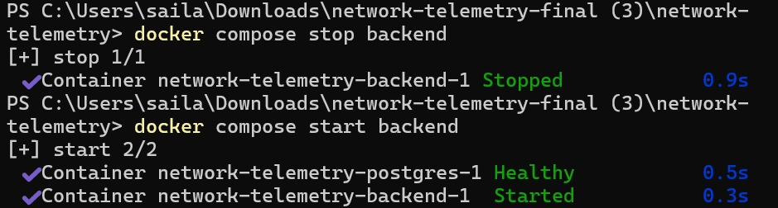
05 — REAL ENGINEERING, REAL DEBUGGING
Challenges Faced
GNS3 Networking — Isolated Virtual Networks
PROBLEM
INVESTIGATION
FIX
VERIFICATION
GNS3 VM management network and in-project router topology unconnected, despite sharing a subnet
Pinged from both directions — confirmed neither side had an actual L2 path to the other
Bridged a dedicated third NIC into the topology via a GNS3 Cloud node
Windows could reach the VyOS router; SNMP traffic flowed end-to-end
snmpd Configuration Corruption
PROBLEM
INVESTIGATION
FIX
VERIFICATION
snmpd repeatedly failed: “unknown token”, “error opening endpoint”
Traced to duplicated/garbled agentAddress lines from repeated sed/heredoc edits
Abandoned scripted edits; retyped a minimal, verified-clean config directly
snmpwalk returned a valid sysName — agent confirmed live
PostgreSQL / Docker — Password Mismatch
PROBLEM
INVESTIGATION
FIX
VERIFICATION
Backend container crash-looped: “password authentication failed”
Found Postgres sets its password only once, at first volume init — later .env changes don't apply
Cleared the stale data volume, let Postgres reinitialize with current credentials
docker compose ps showed backend healthy; telemetry resumed flowing
Network Telemetry & Real-Time Network Performance Monitoring System
05

