Slide 1

Securing the Perimeter
[T HARSHA VARDHAN]
[CBS-0202]

Slide 2
Project Scenario

Slide 3
Overview
XYZ is the premier cryptocurrency exchange. They transact over a billion trades everyday and are considered to be one of the most reliable and secure exchanges in the world. Due to their rapid growth, they've faced challenges in scaling their security posture.
The largest challenge they've faced is with their Perimeter Network Security being secure. The networking team was overburdened with the rapid growth and a majority of the network infrastructure was built insecurely.
Due to a lack of visibility and a lack of proper access control setup on the network, it was inevitable that a breach took place! XYZ was hit with a massive attack in which their network was breached and their internal servers were compromised resulting in over 500 Bitcoin being stolen!
Needing to get the bottom of this breach and resolving their current perimeter issues they've contracted you from SecureCorp, a world renowned cybersecurity consulting firm. Your job is to redesign their network architecture securely and set up a SIEM to monitor against future attacks.

Slide 4
Section 1:
Designing a secure Network Architecture

Slide 5
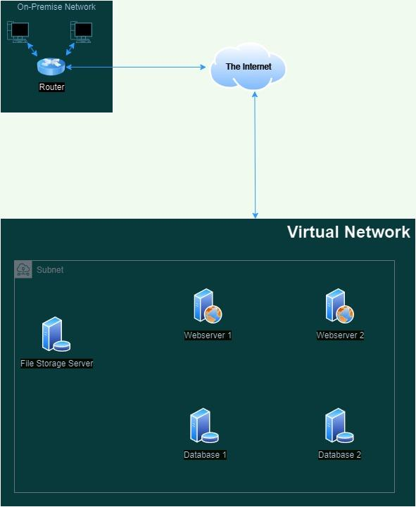
Network Description
Download the drawio.com file from here.
The on-premise network is connected to a virtual network through the internet.
All five servers are located within a single virtual network and in one subnet.
All servers have direct connections to the internet.
The two web servers are required to communicate with the two database servers to function correctly.
The file storage server only needs to be accessible from the on-premise network.

Slide 6
Identify Network Vulnerabilities
1. Un secured connection between on-premises and virtual network
On-premises network is directly connected with virtual network without any firewalls,encryption techniques and secure protocols through public internet that means hacker can intercept and modify the data during the transmission by attacks like man-in-the-middle attack,sniffing and spoofing.
2. All servers in the same subnet
IN virtual network all servers on same subnet that means all servers shares the same ip address range which results in if one server got hacked all servers in that subnet will get in risk . A hacker can easily move to database server after hacking webserver which results in databreach.
3. Unrestricted internet access for all servers
All servers have direct internet access, making them valuable to external threats and malware, hacker can exploit vulnerabilities in the servers. Those all servers Ditrectly connected to internet without firewalls like waf for webservers and etc. This increases the risk of ddos attacks, Xss and Sql injection.

Slide 7
Network Redesign
With the vulnerabilities identified, it’s time to rearchitect the network. A well-structured network with proper security controls is vital for defending the company's digital assets.
Use drawio.com to create the updated diagram. You can download the original diagram from here.
Update the network diagram to include:
Network segmentation separating public-facing services from internal services.
Placement of firewalls to control and filter traffic
A secure, encrypted connection method for the on-premise network to access the file storage server.
Ensure the updated diagram reflects these additions clearly.

Slide 8
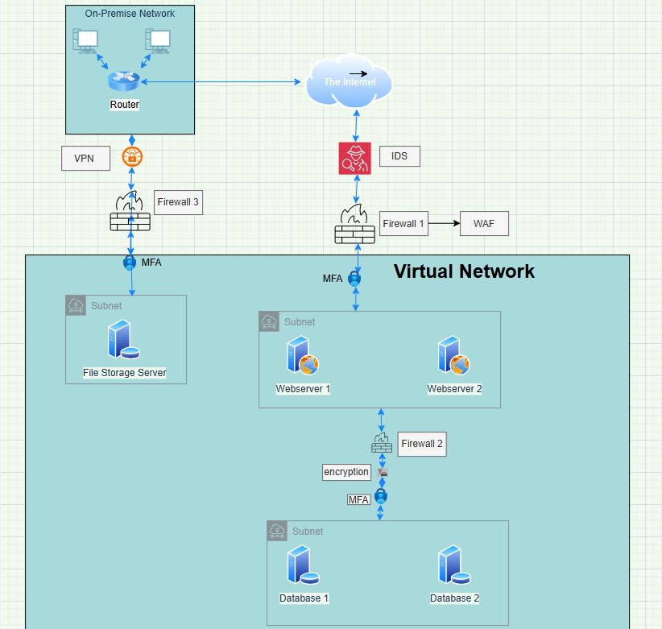
Network Redesign

Slide 9
Convince the Stakeholders
With a proposed network redesign, stakeholders will require a clear understanding of the benefits and necessity of these changes. Your next task is to prepare answers to the following potential questions they may have. In all your answers, make sure to emphasize the security aspects.
Why do we need to add firewalls to our network?
What is the benefit of having different areas in our network for web servers and database servers?
What does a VPN do for our connection to the file storage server?

Slide 10
Convince the Stakeholders
Why do we need to add firewalls to our network?
Firewalls acts as barriers between two networks. Firewalls stops Unauthorized users from accessing our networks. Firewalls filter traffic and allow only safe connections and only wanted data ,firewalls can inspect the packet and scan for malware and firewalls like proxy, packet filtering, application layer firewalls etc.
What is the benefit of having different areas in our network for web servers and database servers?
Keeping web and database servers in separate areas improves security. If a hacker brakes web server, they can’t directly reach the database results in protecting data and reduces the risk of data breaches. It also reduces traffic making the network faster and efficient.
What does a VPN do for our connection to the file storage server?
Virtual private network (vpn) it encrypts the traffic between on-premises network and file storage and it hides ip addresses and prevents unauthorized access By this hackers cannot spy on our network and authorized users can only connect to this file storage it creates a secure tunnel between those two networks.

Slide 11
Section 2:
Building a secure Network Architecture in VirtualBox

Slide 12
Network Setup
Following the favorable reception of your network diagram, management is keen to see this blueprint come to life in a test environment. They have chosen VirtualBox as the platform to host this venture into the cloud. Your next task is to build the test network, which is detailed below.
Construct two VirtualBox virtual networks (VNet):
Name the first VNet DMZ. Within it, create two subnets:
Public-DMZ for future web servers.
Private-DMZ for database servers.
Name the second VNet Internal and create one subnet within it called Internal-Subnet.
Take and submit a screenshot of the DMZ Virtual Network with the two subnets
Take and submit a screenshot of the Internal Virtual Network with the subnet

Slide 13
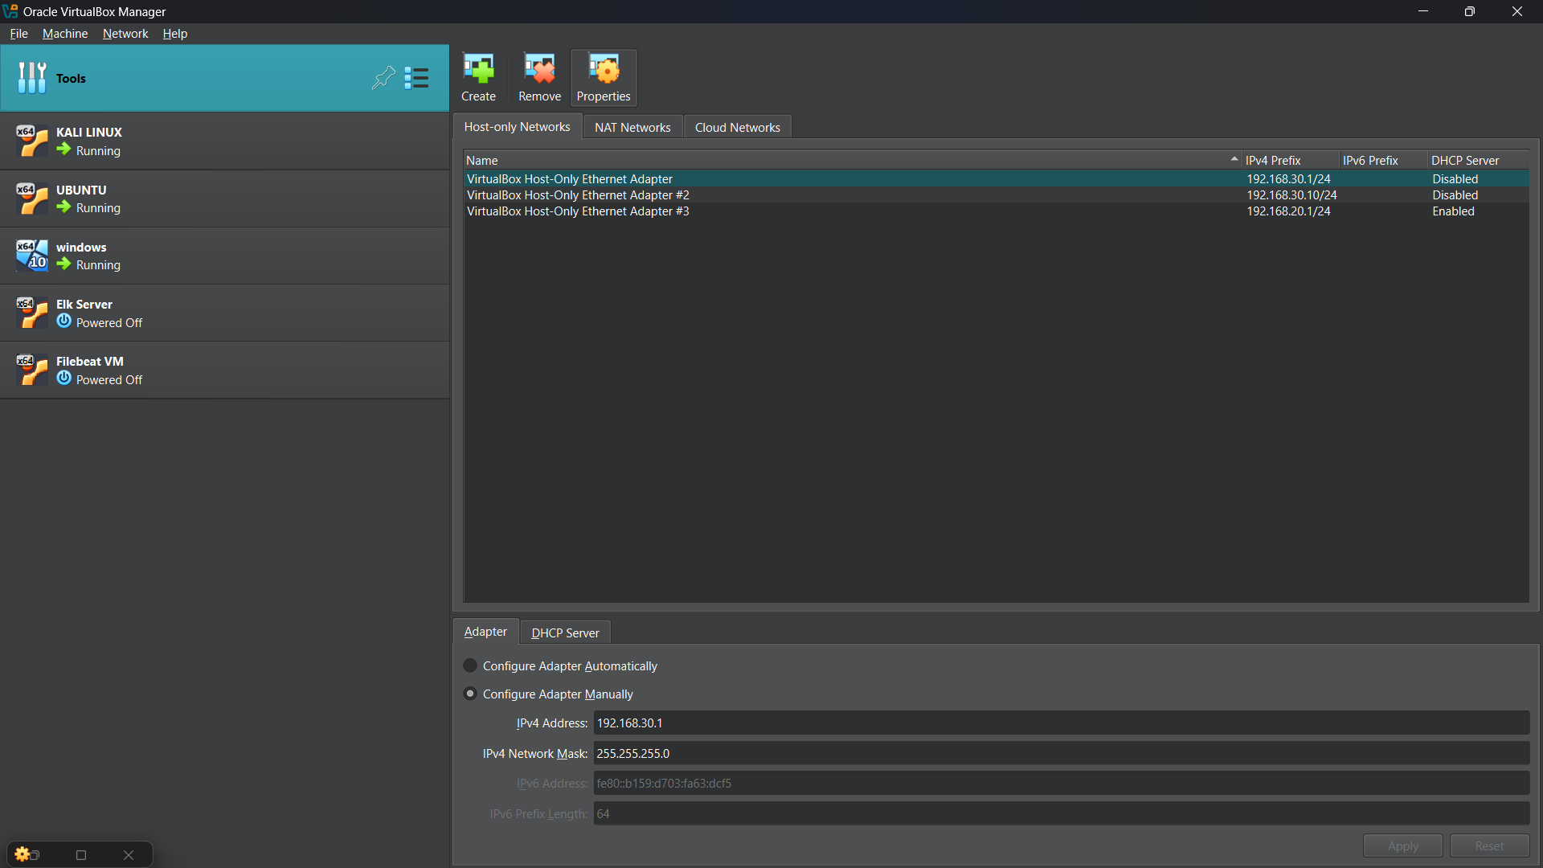
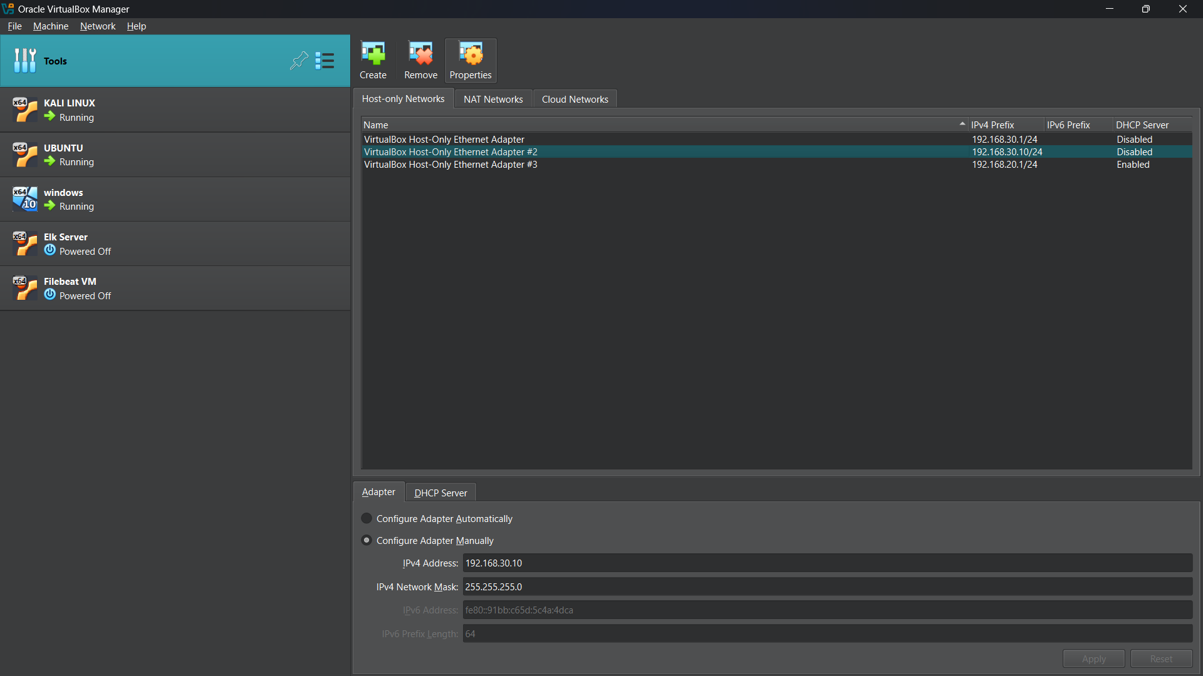

Network Setup
DMZ-PRIVATE : 192.168.10.0/24
DMZ –PUBLIC : 192.168.20.0/24
INTERNAL-SERVER : 192.168.30.0/24

Slide 14
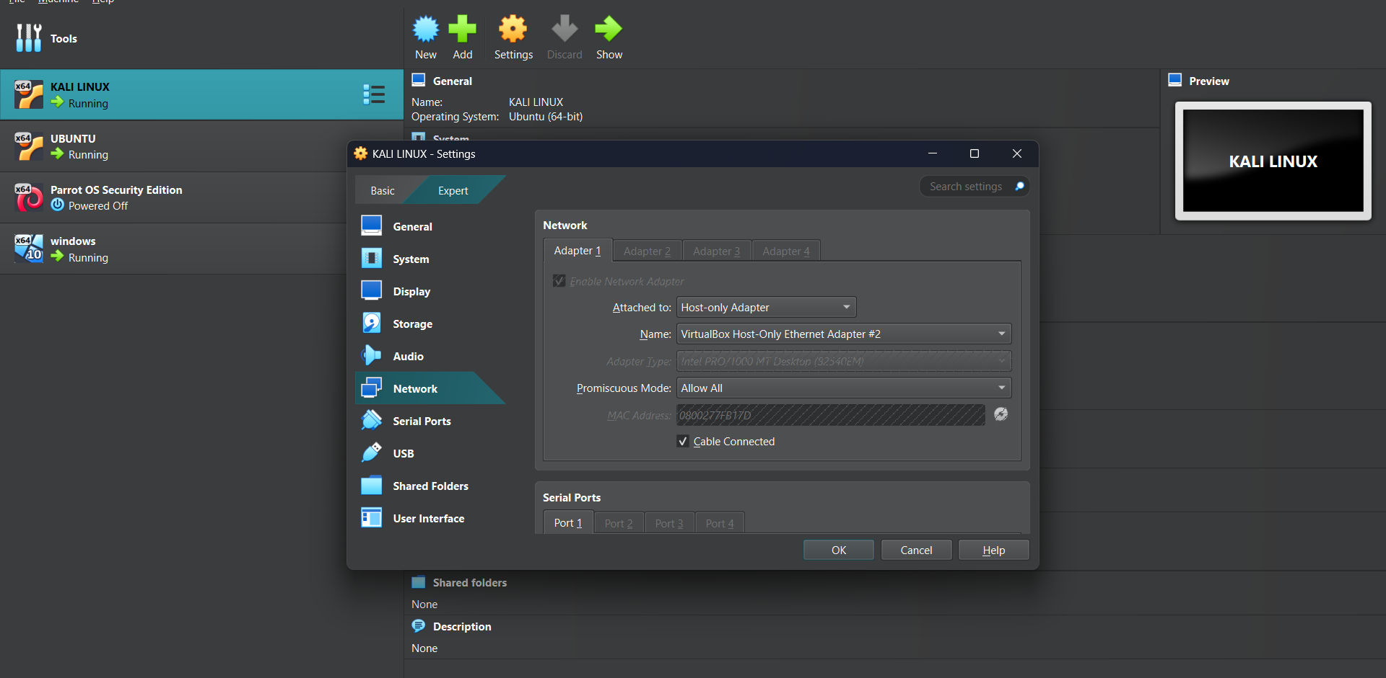
Network Setup – Private DMZ
Private-DMZ Virtual Network : 192.168.10.0/24
Note: host only Ethernet Adpater #2 means Private DMZ network
Kali Linux (192.168.10.10) is acting as the database Server in the Private-DMZ

Slide 15
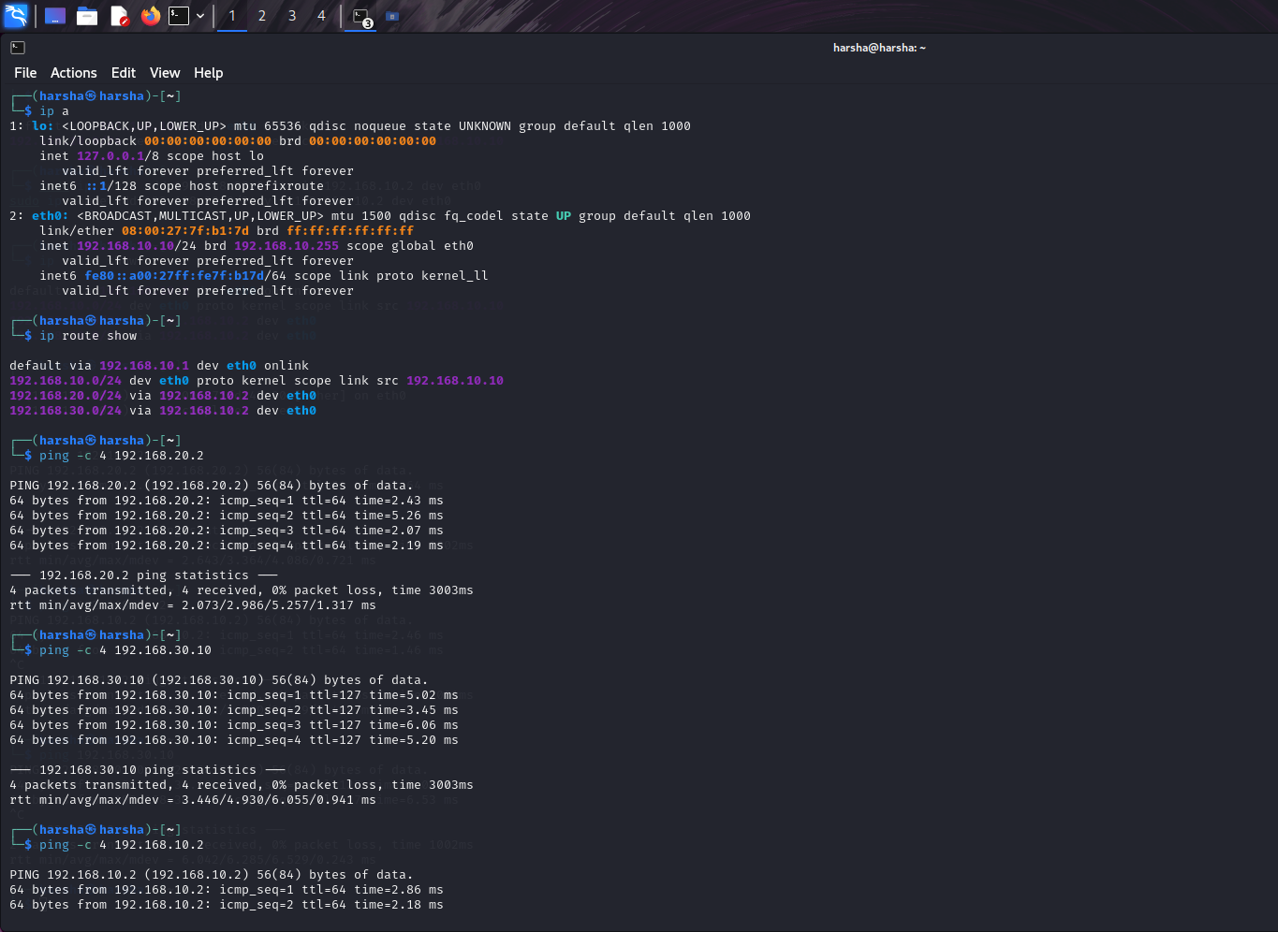
Network Setup – Private DMZ
Kali Linux terminal displaying the output of the ip a command, listing network interfaces and IP address 192.168.10.10.
Running the ping command to DMZ-public at 192.168.20.2 and 192.168.30.2.
Executig the ping command to Internal server at 192.168.30.10.
Output of the traceroute command to internal server (192.168.20.10) with hops passing through DMZ-public.

Slide 16
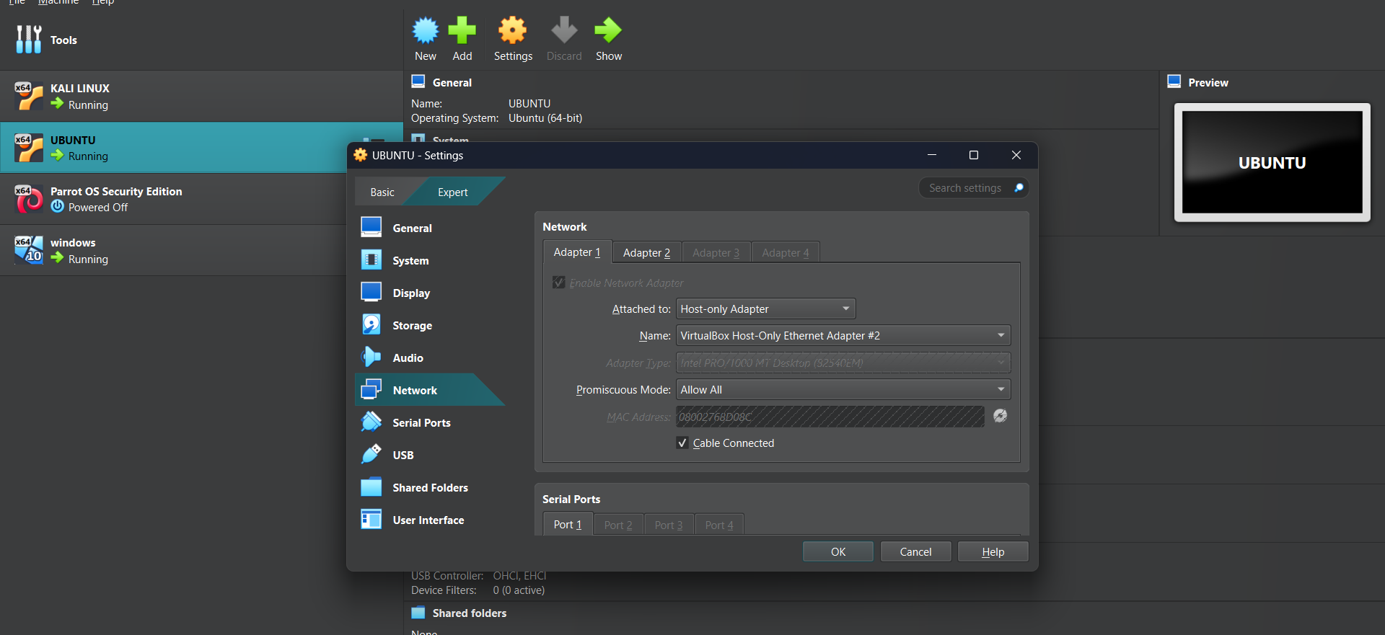

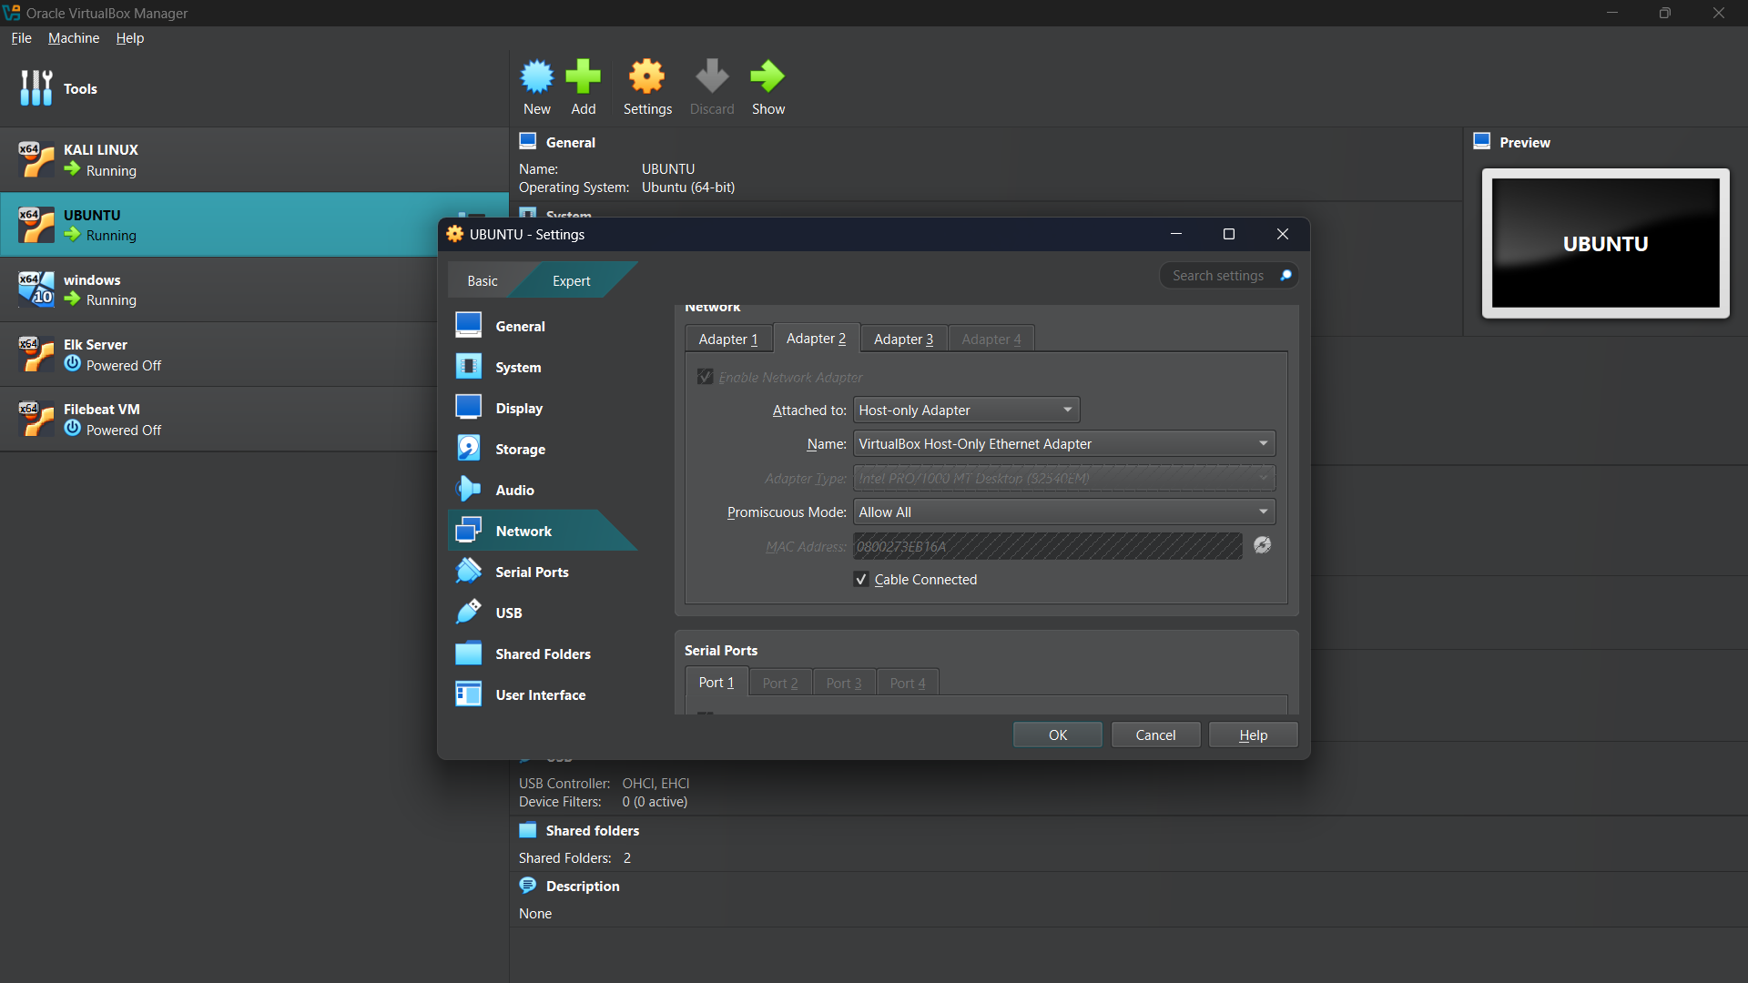
Network Setup – Public DMZ
PUBLIC-DMZ Virtual Network : 192.168.20.0/24
Note: host only Ethernet Adpater #3 means Private DMZ network

Slide 17
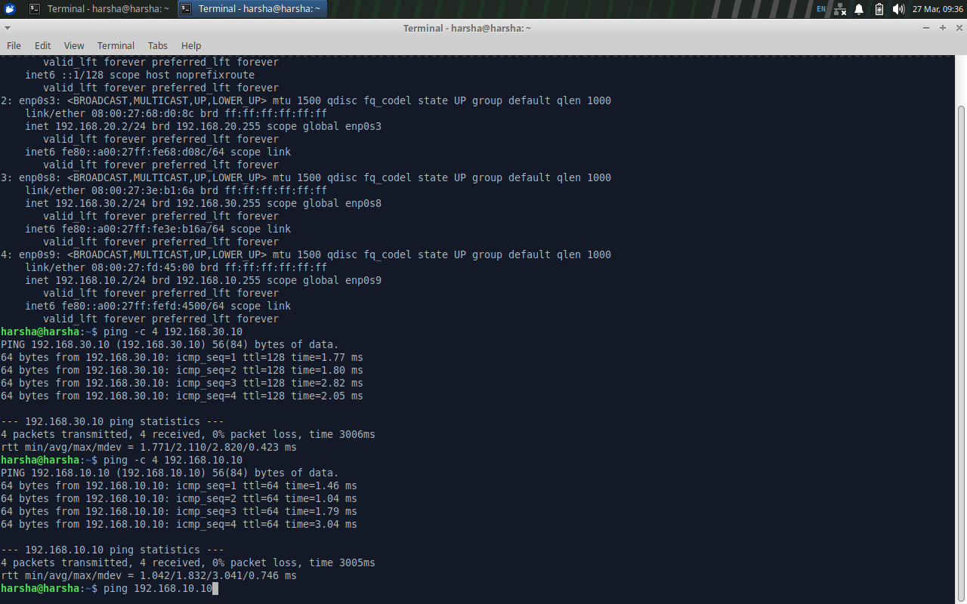
Network Setup – Public DMZ
Ubuntu (192.168.20.2) functions as a Public-DMZ server and a Router, forwarding traffic between the DMZ and Internal Network
ip a - command displays the enp0s3 (Private-DMZ: 192.168.10.20) and enp0s8 (Internal Network: 192.168.20.2) and enp0s9 (192.168.10.2).
Ping command from DMZ-public to DMZ-private (192.168.20.2)
Ping command from DMZ-public to Internal server (192.168.30.10).
It acts as router forwards packets between DMZ and Internal network.

Slide 18
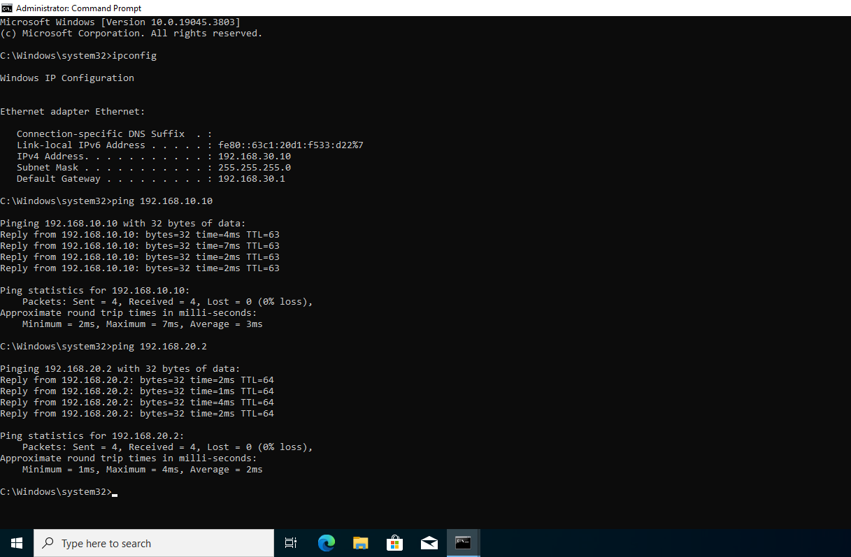
Network Setup – Internal Network
Windows (192.168.30.10) is acting as the internal virtual network and pinging to DMZ networks
Ping command from Internal server to DMZ-private (192.168.10.10)
Ping command fromInternal server to DMZ-public (192.168.20.2).
Note: host only Ethernet Adpater #1 means Internal network

Slide 19
Section 3:
Continuous Monitoring with a SIEM

Slide 20
Understanding SIEM Benefits
1. Early Threat Detection
SIEM quickly spots threats in advance before they attack in the network it detects unusual behaviour in the network based on know attacking methods and techniques and SIEM keeps track of logs and creates reports.
2. Centralized Security Monitoring
It means by using SIEM we can bring all systems data into one place for easy monitoring and detecting threats, instead of checking all devices in company it makes this process easy.
3. Better investigation and reduces cost regarding security
When a cyber attack happens SIEM saves all past security events all logs and records. And also by detecting all threats early SIEM reduces the cost of recovering from cyber attacks.

Slide 21
Deploy SIEM Components in VirtualBox
To give management a tangible understanding of how a Security Information and Event Management (SIEM) system operates, we're going to set up a demonstration in our VirtualBox test environment. This setup will involve deploying a virtual machine for the ELK server within the private subnet and a virtual machine for Filebeat within the public subnet. These components will work in tandem to illustrate the power of centralized logging and real-time analysis.
Deploy a virtual machine named Elk-Server in the Private-DMZ subnet of the DMZ VNet for the ELK stack.
Deploy a virtual machine named Filebeat-VM in the Public-DMZ subnet of the DMZ VNet for Filebeat.
Take and submit screenshots of the VM instances confirming their creation and network placement.

Slide 22
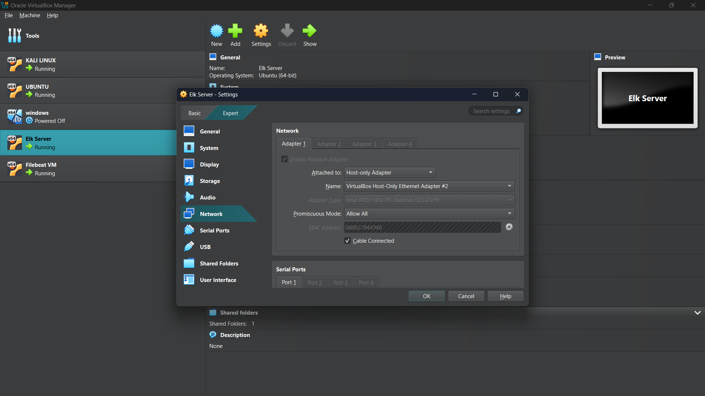
Deploy SIEM Components in VirtualBox – ELK Server
Assigning Public DMZ subnet for ELK server

Slide 23
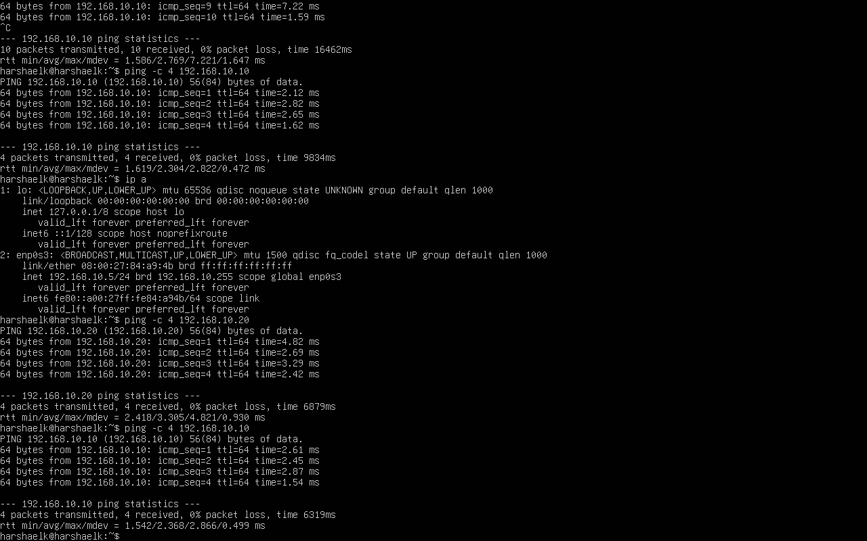
Deploy SIEM Components in VirtualBox –ELK Server
Deployed ELK-server in the private DMZ subnet of the DMZ vnet for ELK stack and pinged to 192.168.10.10 and 192.168.10.20

Slide 24
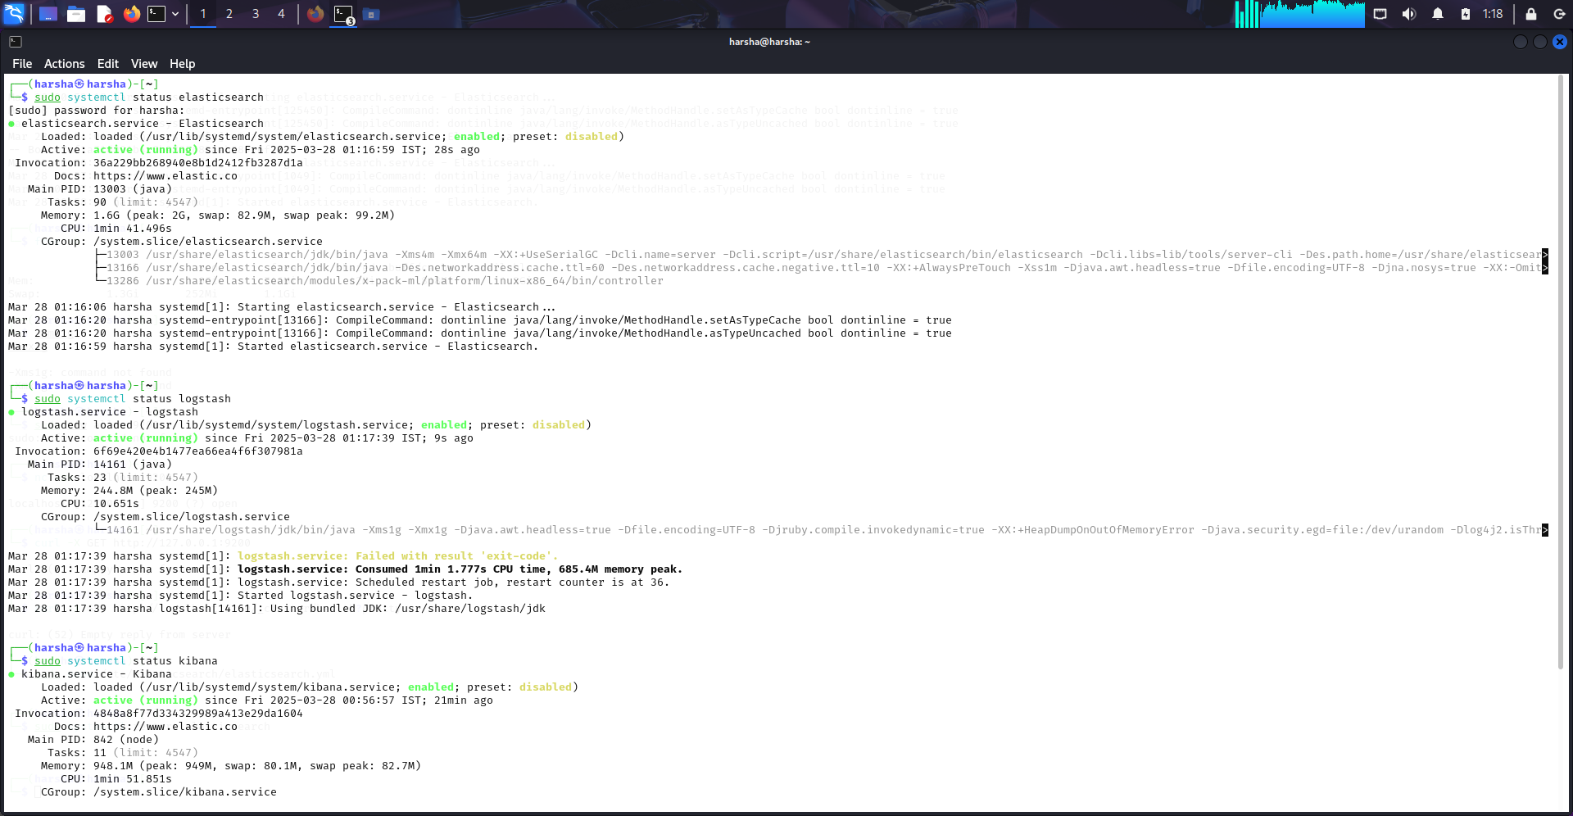
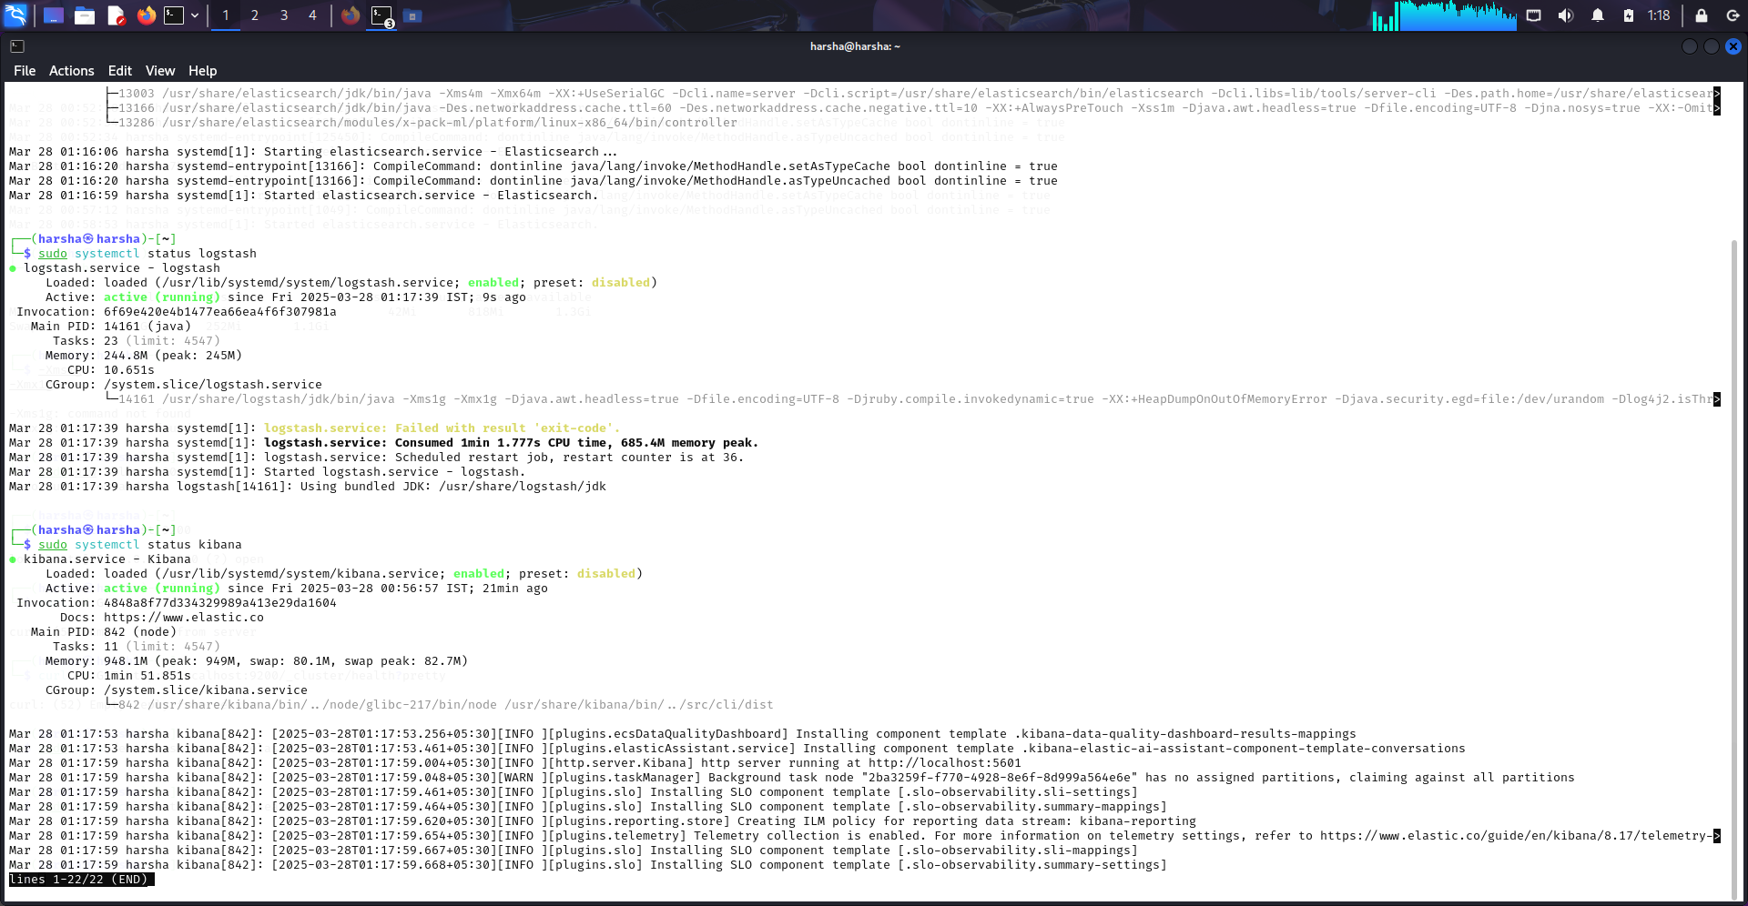
Deploy SIEM Components in VirtualBox –ELK Server

Slide 25
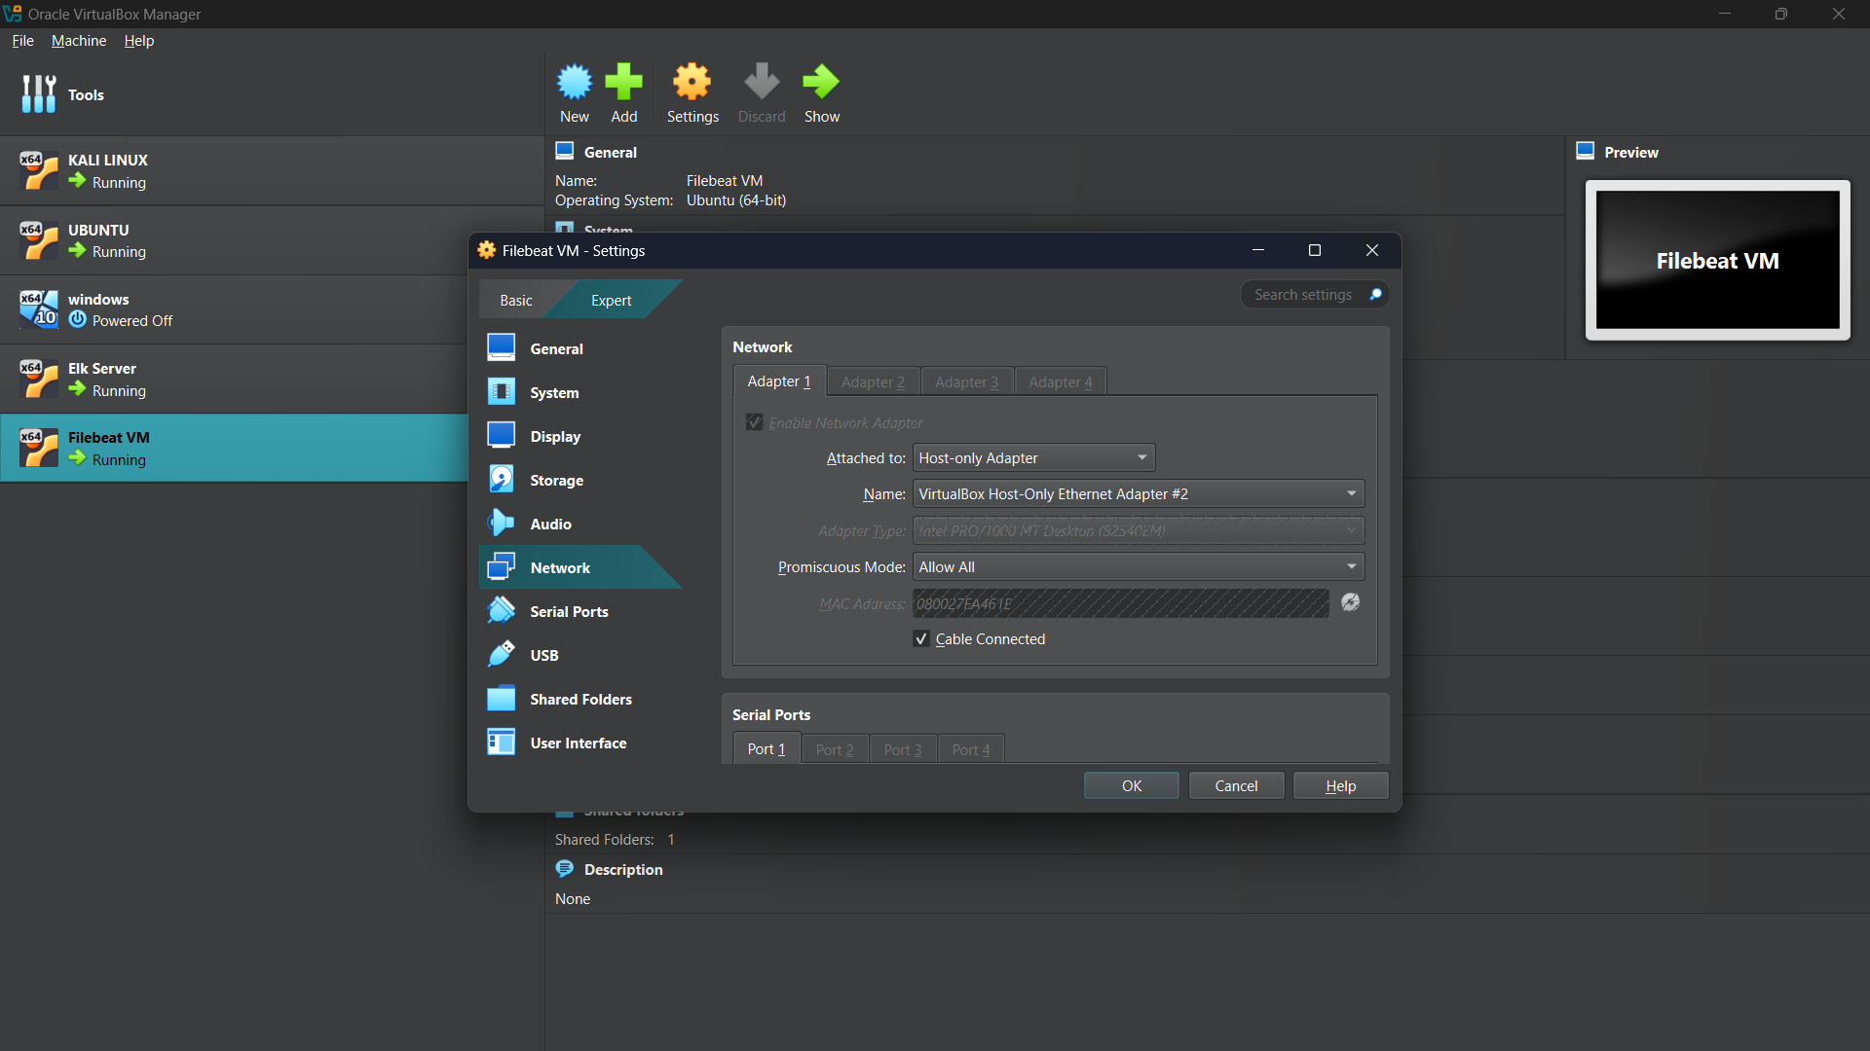
Deploy SIEM Components in VirtualBox – Filebeat
Assigning Public DMZ subnet for FileBeat

Slide 26
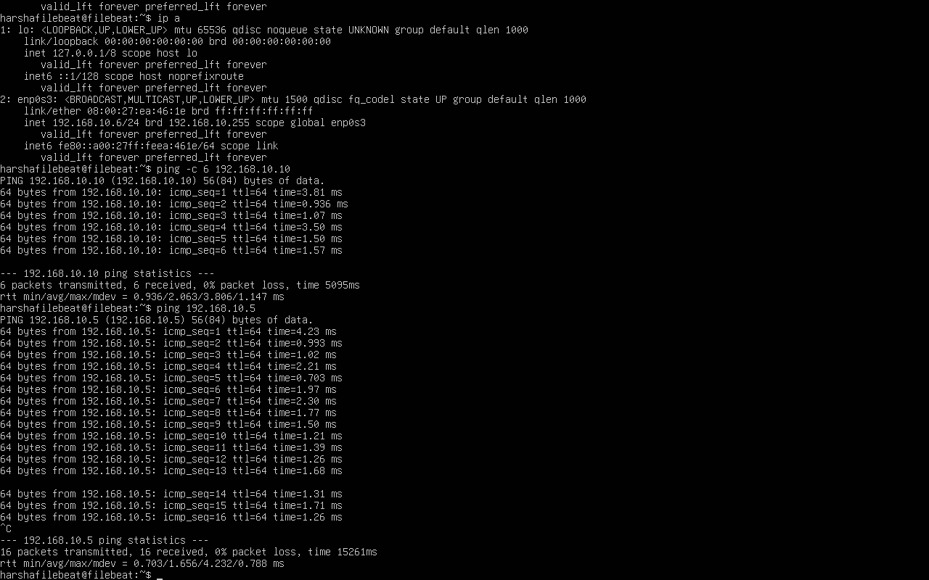
Deploy SIEM Components in VirtualBox – Filebeat
Deployed FileBeat in the public DMZ subnet of the DMZ vnet and pinged to 192.168.10.10, 192.168.10.20 and 192.168.10.5(ELK server).

Slide 27
Setup Monitoring
To fully showcase our SIEM's capabilities, we will set up the ELK (Elasticsearch, Logstash, Kibana) server, install Filebeat on our web server, and ensure that web server logs are correctly forwarded and displayed in Kibana. This comprehensive task is pivotal for demonstrating effective real-time monitoring and analysis of web server activity, which is essential for maintaining operational health and security within our infrastructure.
Install and configure the ELK server on a VM within the Private-DMZ subnet.
Install Filebeat on the web server in the Public-DMZ subnet.
Configure Filebeat to forward logs to the ELK server's Elasticsearch.
Generate traffic on the web server to create log data (i.e. access the server).
Verify logs are forwarded to Elasticsearch and visible in Kibana.
Create screenshots to confirm that the services are running:
Filebeat service running on the web server
Make it from the CLI, with the ‘systemctl status filebeat’
Kibana receives logs from the Filebeat host
From Kibana site SIEM/Hosts/Filebeat-VM

Slide 28
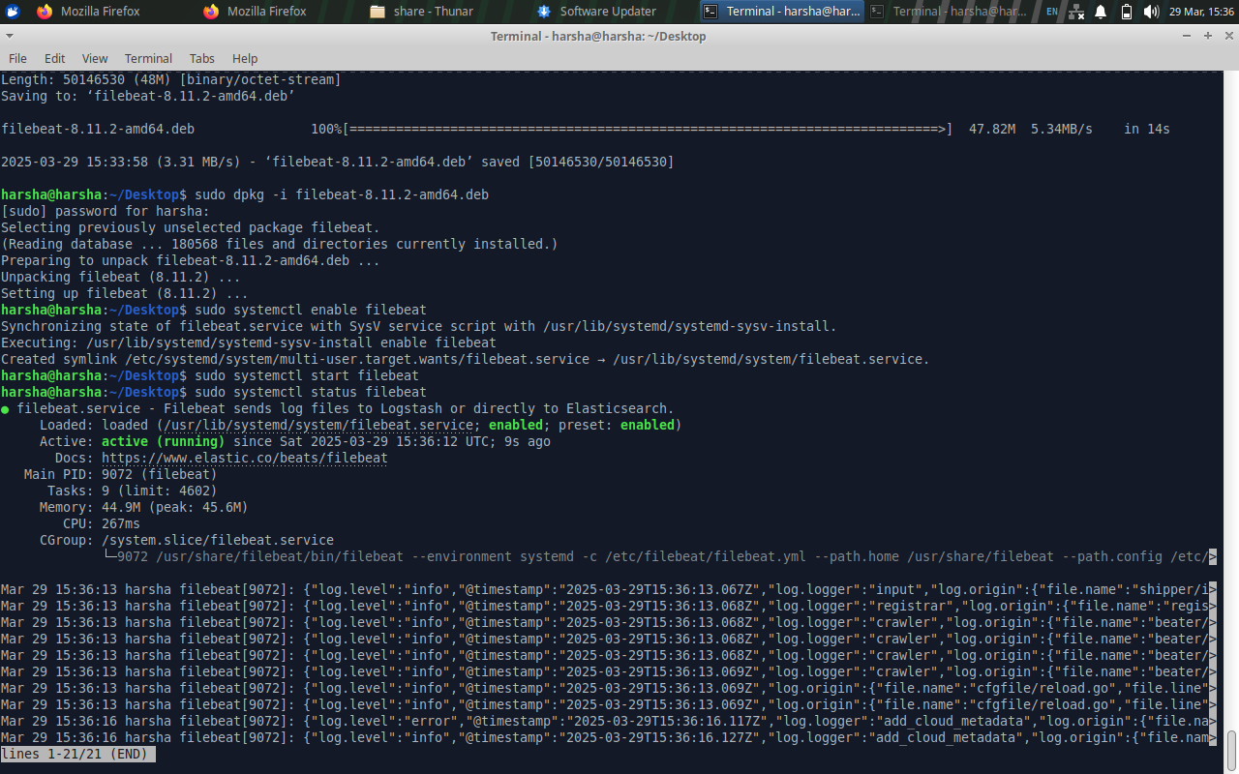
Setup Monitoring
The screenshot shows the status of the Filebeat service running on the web server. The command systemctl status filebeat verifies that Filebeat is active (running), meaning it is successfully installed and operational.

Slide 29
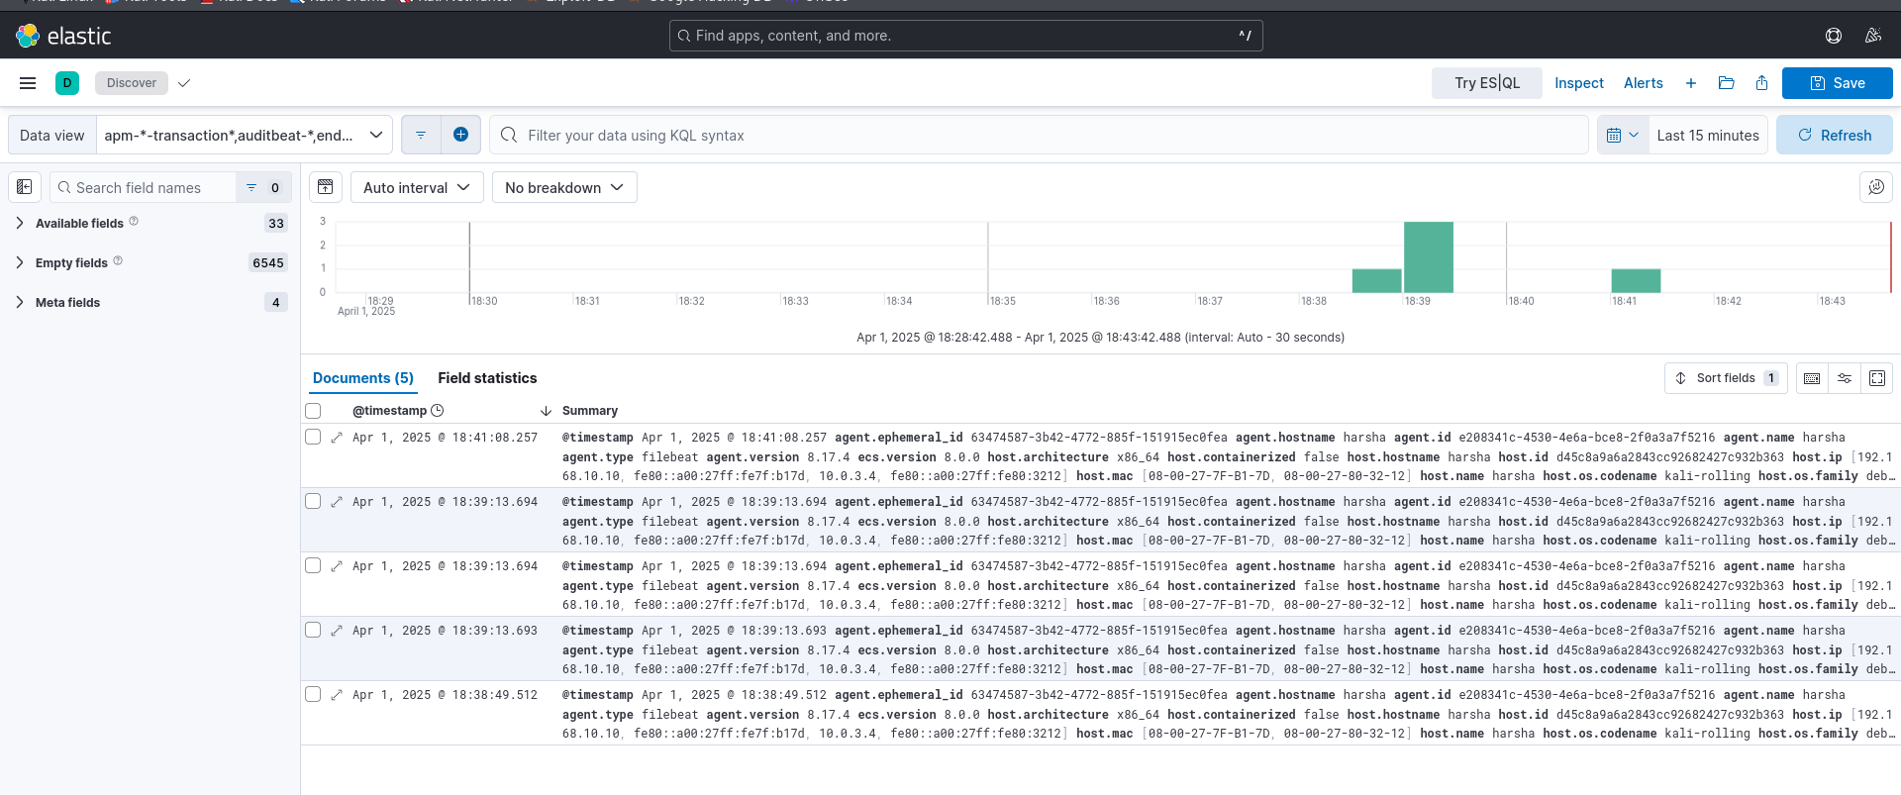
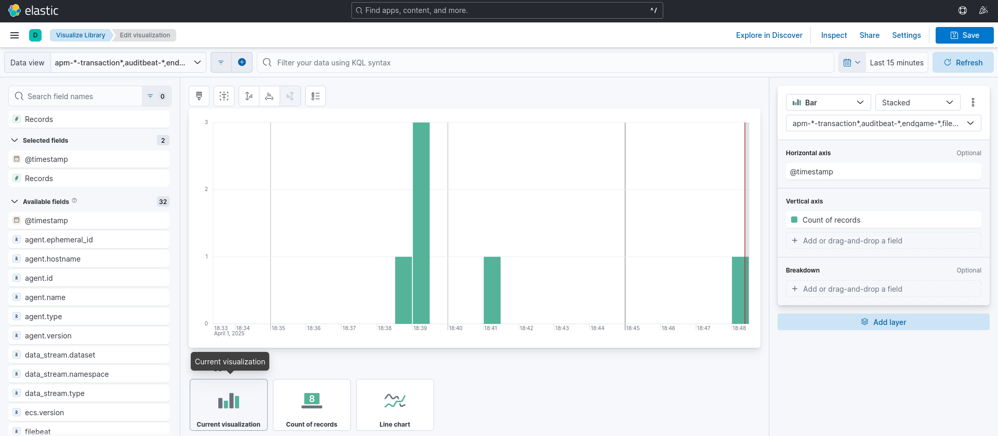
Setup Monitoring
This screenshot shows Kibana receiving logs from the Filebeat host.

Slide 30
Section 4:
Zero Trust

Slide 31
Zero Trust Comparison
Following a significant security breach at XYZ, the necessity to reassess and strengthen our network security architecture is paramount. A comparison between the emerging Zero Trust architecture and traditional network security models will highlight the potential enhancements Zero Trust can offer. Your task involves selecting three key principles from Zero Trust architecture, comparing them to traditional models, and evaluating the benefits of Zero Trust. This analysis is crucial for guiding XYZ towards a more resilient cybersecurity framework.
Select three principles of Zero Trust architecture (you can find them in the classroom and in the next page)
Compare each selected principle to its counterpart in traditional network security models, focusing on:
Differences in approach
Potential benefits of Zero Trust over traditional methods

Slide 32
Zero Trust Principles
Select three principles to use in the comparison:
Consideration of all resources: Every device, software, and system is a potential security vector.
Secured communication: Encrypt all data transfers, irrespective of location.
Per-session access: Grant access to resources only for the duration of a session.
Dynamic access policy: Access is based on real-time evaluations of multiple factors.
Continuous monitoring: Real-time assessment of asset integrity and security.
Dynamic authentication: Ongoing verification before allowing access.
Extensive data collection: Gather detailed information for security enhancement.

Slide 33
Zero Trust Comparison
1. Consideration of all Resources
Zero Trust Approach: It treats every device,software,system,as a risk because we don’t know in which vulnerabilities exist and No device or user is trusted automatically whether he is insider or outsider of our company . So that’s why we should check each device in our compant. | Traditional Approach: In traditional approach it focuses on protecting the network from outside like firewalls etc.
Benefits of Zero Trust: Reduces the risk of attacks by considering all devices in risk analysis. Stronger security because all devices must prove their identity before getting access. Increases the internal security.
2. Secured Communication
Zero Trust Approach: It encrypts all type of internal and external communications to and from of our company by using many encryption techniques like aes,des,rsa etc and also tls,ipsec etc | Traditional Approach: Communications are secure but not encrypted.hackers can intercept and steal our data through mitm and packet sniffing etc.
Benefits of Zero Trust: Protects Data it ensures all data is encrypted and making harder to for attackers to steal senstive data. Ensures secure communication between devices,application and users. Minimizes the risk of data breach by maintaining encryption.

Slide 34
Zero Trust Comparison
3. Continuous Monitoring
Zero Trust Approach: Continuously monitors all devices and users bheaviour , if a user or device starts acting suspiciously their access can be quickly revoked. | Traditional Approach: Security checks are often performed only during intial logging or authentication. Once user enters into our network he can do anything no survillance will be there so there is a risk of attacks or data breach.
Benefits of Zero Trust: Detects and responds to threats in real time. If something wrong in user bheaviour this system can quickly adjust security measures to prevent damage. Prevents attacks by detecting them before and saves data from cyber attacks.

Slide 35
The Zero Trust Model
Following your analysis of Zero Trust versus traditional security models, it’s clear that a Zero Trust framework is essential for enhancing XYZ's network security. The challenge now shifts to selecting the most appropriate Zero Trust model for XYZ from three distinct options: Device Agent & Gateway, Enclave Gateway, or Resource Portal. This selection is critical, as it must align with the unique challenges and goals of the company. Your task is to make an informed choice and articulate why this model stands out as the best fit for XYZ, considering their need for a robust response to recent security vulnerabilities.
Choose one Zero Trust model for XYZ from the following options:
Device Agent & Gateway
Enclave Gateway
Resource Portal
Justify why the selected model is the best fit for XYZ’s current network challenges and security objectives.

Slide 36
Zero Trust Model
Device Agent & Gateway
XYZ recently faced a security breach which highlights vulnerabilities in their network security. To prevent future attacks they need a suitable zero trust model that provides continuous monitoring ,strict access controls and secure communication across all devices.For all that Device Agent & Gateway is the best model because this model ensures that: Every device connected to XYZ is authenticated and continuously monitored. Even if an attacker gains access to the network, compromised devices wont bee untrusted unless verified. This model detects unusual behaviour in real time and can block access if a device compromised. This model ensures secure communication and strong authentication among all devices. Devices and users must verify their identity and security before accessing resources of company. This protects company data from cyber attacks and data breaches from inside and outside of the company.

