Slide 1


INTRODUCTION TO ARTIFICIAL INTELLIGENCE
TEAM MEMBERS:
Charitha Pally - 00726672
Harsha Gundu -00726685

Slide 2

PROJECT TITLE
IMPLEMENTATION OF MULTI ARM BANDIT USING REINFORCEMENT LEARNING

Slide 3
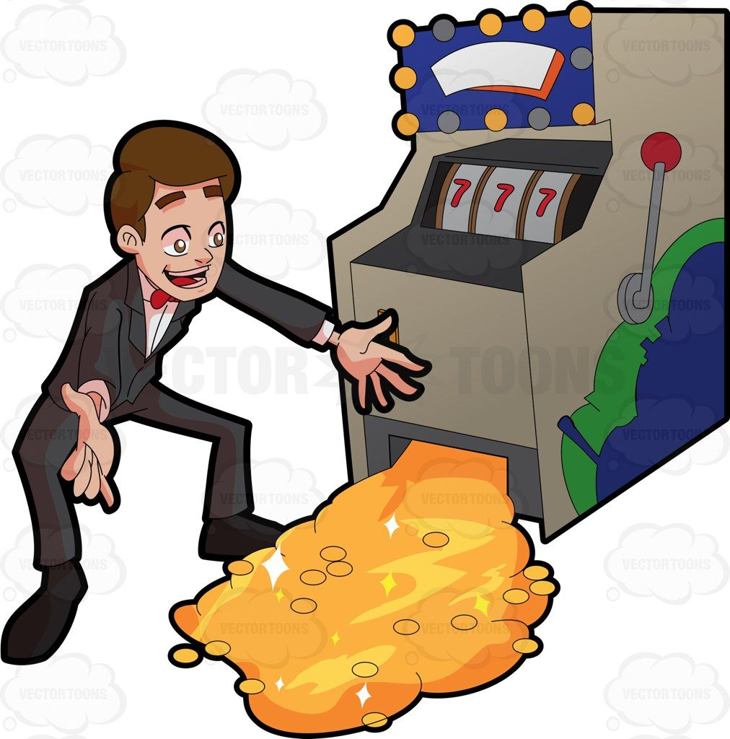
STATEMENT OF PROJECT OBJECTIVES
Bandit is slot machine with a lever . But we do not know which slot machine we should choose to get maximum reward.
The objective is to obtain the maximum rewards by a player from multi arm bandits(with different rewards) based on the series of trails .This problem statement is similar to the single-step Markov decision process. Each arm selected represents an activity that results in an immediate award .

Slide 4
APPROACH
TECHNIQUES:
  Epsilon(ϵ) greedy approach : With Epsilon probability , we will choose a random action (exploration) and choose an action with maximum qt(a) with probability 1-ϵ which helps to maintain good balance between exploration and exploitation.
  UCB (Upper Coincidence Bound) :We will be using UCB as this is based on the principle of optimism in the face of uncertainty .
TOOLS :
  Python
  Pycharm

Slide 5
DELIVERABLES
Theory explaining the implementation of RL in this project.
Techniques with mathematical expressions used.
Code(State, Action and Reward).
Results from the code executed.
Video demonstration of the project.

Slide 6

EVALUATION METHODOLOGY
Evaluation of this project can be done by checking the maximum rewards achieved after taking a better decision by choosing a bandit that gives a better reward in the result.

