Slide 1
AML PROJECT · CSAI STUDENT PROJECT 5 · SECTION AML
How many units
will sell next month?
Predicting 28-day retail inventory demand across intermittent SKU histories
using Kalman Filters and Global DeepAR models.
Dakarapu Hemamdhar Nath
2401010137
Data Cleaning & EDA
Palaparthi Harshakarthikeya
2401010313
Feature Eng. & Baselines
Sameer Alam Khan
2401020054
Kalman Filter per SKU
Akshay Y
2401020008
Global DeepAR Forecaster
Abhishek Tripathi
2401010022
Benchmark & Validation

Slide 2
01 · THE QUESTION
PRESENTER: HEMAMDHAR NATH
Can past sales predict demand when 90% of days are zeros?
THE TARGET
Daily Unit Demand (y_t)
Forecast daily unit sales for individual product-store SKUs across an untouched 28-day forward horizon.
THE CUTOFF
Strict 28-Day Horizon
Predictions originate at Day 1913. No actual sales from the 28-day validation period are ever consumed.
THE RULE
Zero-Leakage Rollout
Multi-step forecasts must be strictly causal (recursive or state-propagated). True sales cannot enter future lags.
CORE RESEARCH QUESTION
Does a localized state-space model (Kalman Filter per SKU) adapt faster than a global neural network (DeepAR) under severe retail intermittency, and which produces better uncertainty bounds for inventory safety stock?
Inventory Demand Forecasting · CSAI Project 5 · Team AML
02 / 11

Slide 3
02 · THE DATA
PRESENTER: HEMAMDHAR NATH
58.3 Million records, 1,941 daily timesteps
SOURCE MATRIX
30,490
SKUs across 10 stores (CA, TX, WI)
INTERMITTENCY
90.84%
Intermittent or lumpy sales regimes
EVALUATION HORIZON
1,400
Untouched points (50 SKUs × 28 days)
90.84% Intermittent & Lumpy (ADI ≥ 1.32 or CV² ≥ 0.49) 9.16% Smooth & Erratic
Zero-sales observations on active shelf days are preserved as legitimate zero-demand observations rather than treated as missing data or imputed. 12.38 million pre-launch zeros are isolated via first-sale date indexing to ensure clean, uncorrupted demand signals.
Inventory Demand Forecasting · CSAI Project 5 · Team AML
03 / 11

Slide 4
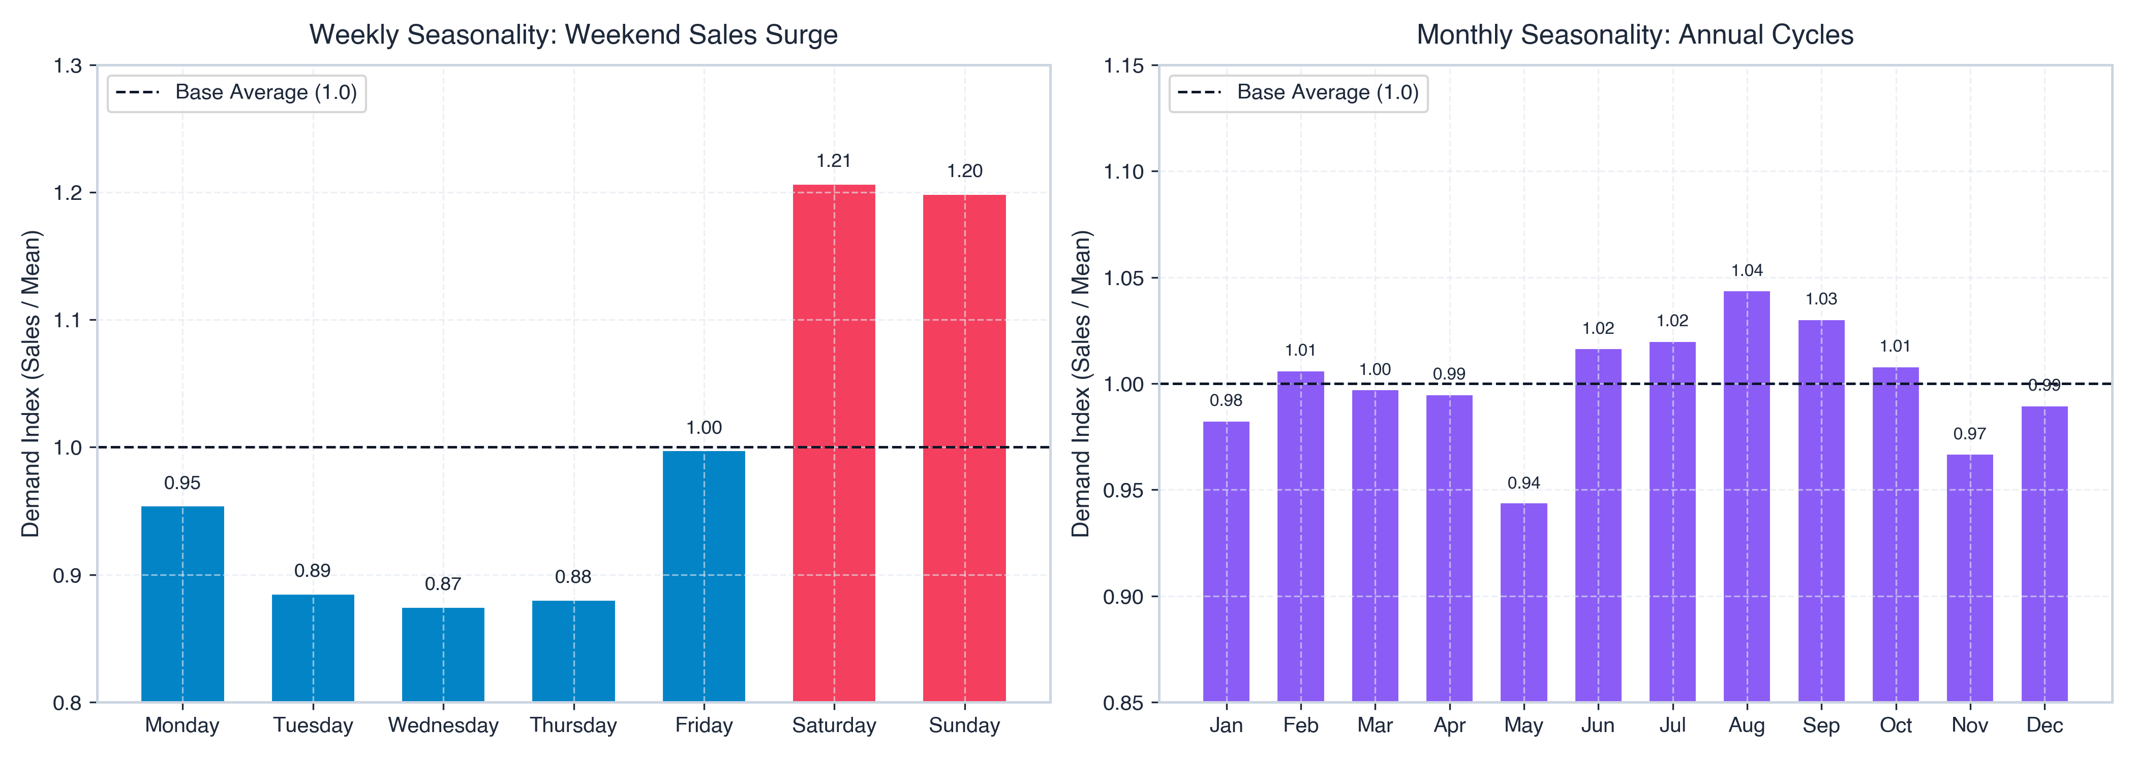
02 · THE DATA
PRESENTER: HEMAMDHAR NATH
Weekend surges, holiday shocks, and SNAP policy pulses
+20.7% Weekend Surge
Saturday & Sunday demand significantly outperforms weekday baseline across all categories. Autocorrelation confirms strong weekly harmonics at lags 7, 14, 21, and 28.
+21.31% SNAP Uplift
Government food stamp disbursement in Wisconsin creates sharp demand pulses (and +11.1% in Texas, +7.6% in California), concentrated heavily in the FOODS department.
Dec 25 Zero Sales
Total chain sales contract to 0 units every year on Christmas. Stationarity confirmed only after first-differencing (ADF test: t = -23.46, p < 1e-6).
Inventory Demand Forecasting · CSAI Project 5 · Team AML
04 / 11

Slide 5
03 · THE LEAKAGE TRAP
PRESENTER: HARSHAKARTHIKEYA
The biggest trap in forecasting is future data leakage
THE GOLDEN RULE
Shift(1)
Prior to Rolling
Computing rolling statistics using day t sales introduces direct target leakage. In naive setups this artificially inflates notebook scores by 40%+ while failing completely in production.
Every rolling metric in our pipeline enforces a strict shift(1) operation.
BANNED IN PRODUCTION
✕ Unshifted rolling means (using day t)
✕ Consuming actual validation sales in the 28-day rollout
✕ Random temporal cross-validation shuffling
✕ Imputing missing values with global future statistics
ALLOWED & ENFORCED
✓ Causal lags strictly from past: lag 1, 7, 28
✓ Shift(1) rolling mean & std for 7 and 28 days
✓ Known future calendar & SNAP indicators
✓ Pure recursive multi-step rollout using model's own predictions
Inventory Demand Forecasting · CSAI Project 5 · Team AML
05 / 11

Slide 6
04 · THE FEATURES
PRESENTER: HARSHAKARTHIKEYA
Causal lags, rolling statistics, and calendar signals
CATEGORICAL
Static Hierarchy
item_id, dept_id, cat_id, store_id, state_id preserved for multi-level hierarchical indexing and static entity embeddings.
NUMERIC & LAGS
Causal Autoregressive
lag_1, lag_7, lag_28, rolling_mean_7, rolling_mean_28, rolling_std_7, rolling_std_28 strictly computed via shift(1).
CYCLICAL & POLICY
Temporal & Policy
day_sin, day_cos, month_sin, month_cos, is_weekend, holiday markers, and dynamic state-specific snap_active indicators.
LEAK-FREE PREPROCESSING PIPELINE (FITTED ON TRAINING HISTORY ONLY)
1 · Tidy Reshaping
Melt wide sales to long panel
2 · Date Reindexing
Verify daily continuity
3 · Shift(1) Features
Causal lags & rolling stats
4 · Warmup Trimming
Drop uncomputable 28 days
Inventory Demand Forecasting · CSAI Project 5 · Team AML
06 / 11

Slide 7
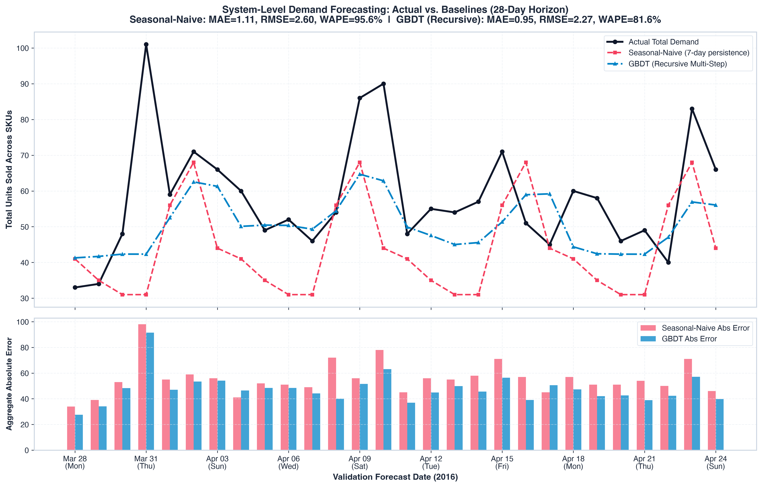
05 · AML BASELINES
PRESENTER: HARSHAKARTHIKEYA
Seasonal-Naive vs Recursive LightGBM Multi-Step Rollout
1 · SEASONAL-NAIVE (7-DAY PERSISTENCE)
Formula: ŷ_{T+h} = y_{T+h-7} (repeats same weekday last week)
Zero-parameter deterministic benchmark. Establishes baseline error floor:
MAE: 1.1143 | RMSE: 2.6030 | WAPE: 95.59%.
2 · GBDT (LIGHTGBM RECURSIVE ROLLOUT)
100 boosted trees with strictly recursive multi-step forecasting.
Top feature: rolling_mean_28 (12.82% importance), followed by rolling_mean_7.
Achieves 14.64% reduction in WAPE over Seasonal-Naive (81.60%).
Inventory Demand Forecasting · CSAI Project 5 · Team AML
07 / 11

Slide 8
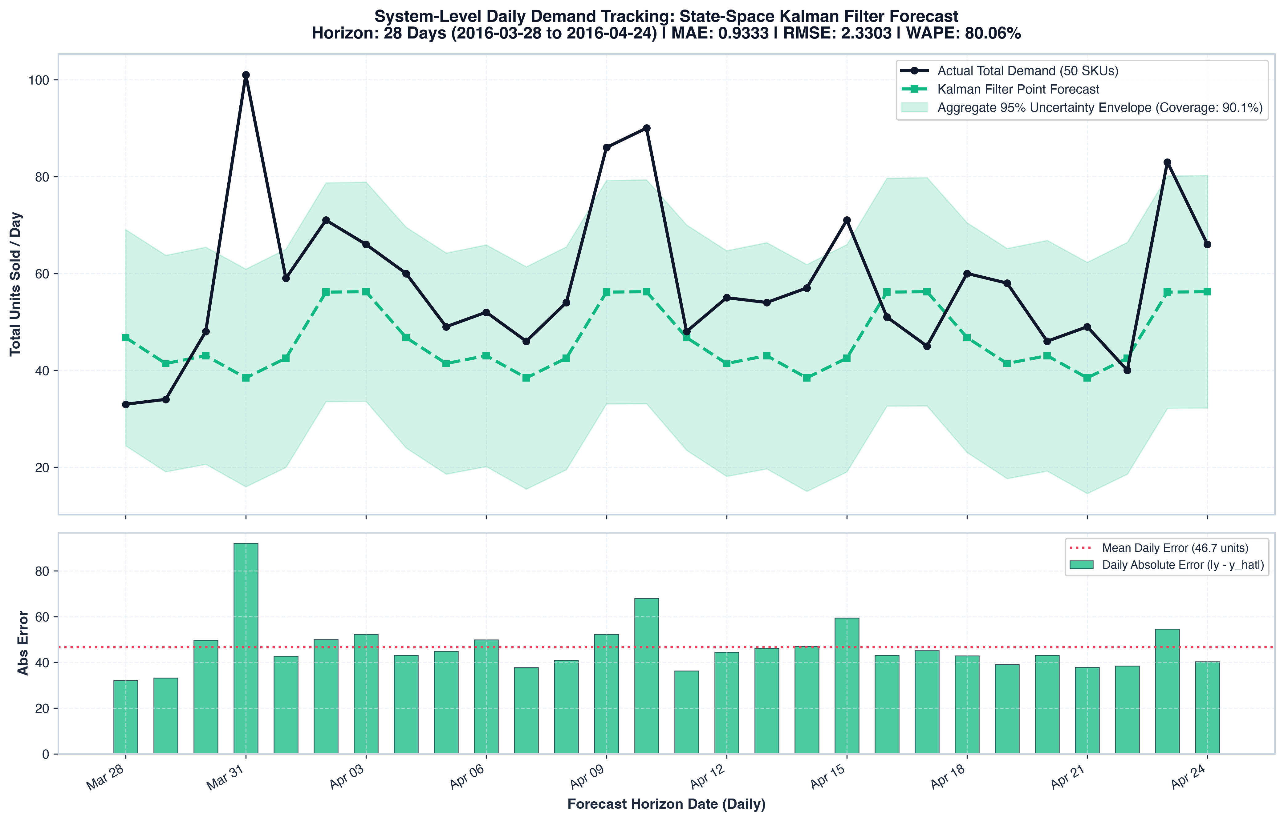
06 · STATE-SPACE MODELING
PRESENTER: SAMEER ALAM KHAN
Structural Kalman Filter per SKU (Local Level + Seasonality)
MATHEMATICAL FORMULATION
State Vector: x_t = [μ_t, s_{1,t}, ..., s_{6,t}]ᵀ ∈ ℝ⁷
Transition: x_t = F x_{t-1} + w_t, w_t ~ N(0, Q)
Observation: y_t = H x_t + v_t, v_t ~ N(0, R)
Tracks latent consumption level μ_t and 7-day cyclical harmonic in closed form.
BENCHMARK PERFORMANCE & ANALYTICAL UNCERTAINTY
🏆 Lowest MAE (0.9333) and lowest WAPE (80.06%) across all models.
Exact analytical covariance propagation P_t yields 80.93% coverage at 80% CI (width 2.30 units) and 90.07% at 95% CI.
Adapts to individual SKU step-changes without recursive compounding.
Inventory Demand Forecasting · CSAI Project 5 · Team AML
08 / 11

Slide 9
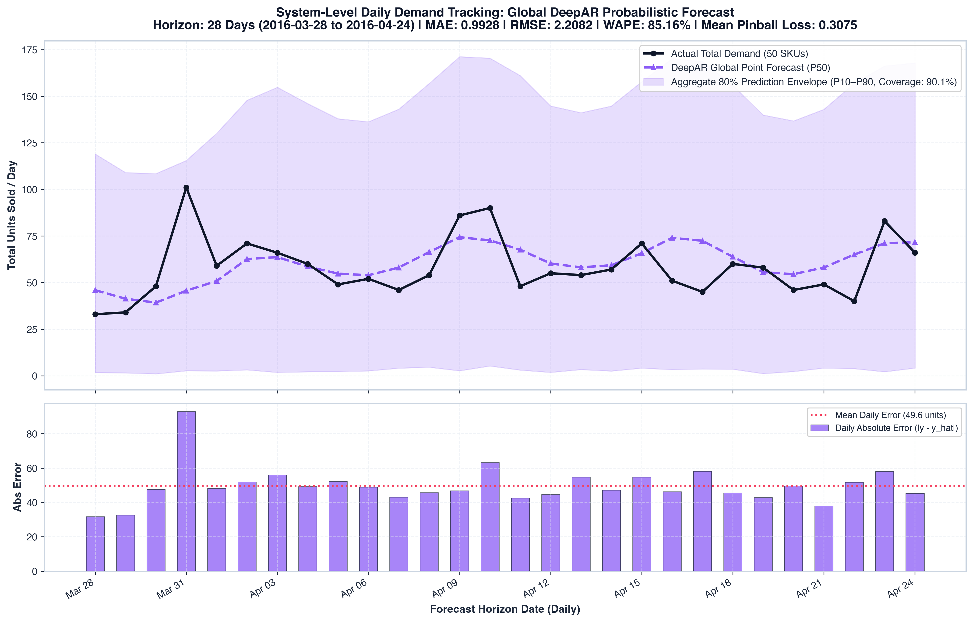
07 · PROBABILISTIC DEEP LEARNING
PRESENTER: AKSHAY Y
Global DeepAR Autoregressive LSTM Network
UNIFIED GLOBAL RECURRENT ARCHITECTURE
Single LSTM network trained across all 50 SKUs simultaneously.
Scale normalization: ν_i = 1 + (1/T) ∑ y_{i,t} ensures scale invariance.
Outputs parameters of Gaussian likelihood: y_{i,t} ~ N(μ_{i,t} ν_i, (σ_{i,t} ν_i)²).
Shares representations across sparse series via entity embeddings.
MONTE CARLO QUANTILE ROLLOUT & RMSE SUPREMACY
🏆 Lowest RMSE (2.2062) across all models (−15.24% vs baseline).
200 Monte Carlo sample paths drawn autoregressively for empirical quantiles.
80% Prediction Interval Coverage: 91.79% (width 3.20 units).
Mean Pinball Loss: 0.3075 (P10: 0.1116, P50: 0.5208, P90: 0.3258).
Inventory Demand Forecasting · CSAI Project 5 · Team AML
09 / 11

Slide 10
08 · THE FINAL EXAM
PRESENTER: ABHISHEK TRIPATHI
Four-Way Benchmark Scorecard & Error Trade-Offs
MEAN ABSOLUTE ERROR (MAE)
0.9333
🏆 Kalman Filter
GBDT: 0.9512 | DeepAR: 0.9748 | SNaive: 1.1143
16.25% lower error than baseline.
ROOT MEAN SQ ERROR (RMSE)
2.2062
🏆 Global DeepAR
GBDT: 2.2679 | Kalman: 2.3303 | SNaive: 2.6030
15.24% lower error than baseline.
WEIGHTED ABS % ERROR (WAPE)
80.06%
🏆 Kalman Filter
GBDT: 81.60% | DeepAR: 83.63% | SNaive: 95.59%
Lowest overall portfolio error.
80% INTERVAL COVERAGE
91.79%
🏆 Global DeepAR
Pinball loss: 0.3075 (width 3.20)
Kalman: 80.93% coverage (width 2.30).
WHY KALMAN FILTER WON MAE & WAPE (SAMEER'S MODEL)
Structural decomposition into local level and 7-day seasonality updates per SKU in closed form. It avoids recursive error compounding and adapts instantly to individual product step-changes without cross-series distortion.
WHY GLOBAL DEEPAR WON RMSE (AKSHAY'S MODEL)
DeepAR's shared recurrent representation across 50 SKUs pools statistical strength. This acts as a strong regularizer that severely penalizes extreme outlier forecasts, achieving the lowest quadratic loss.
Inventory Demand Forecasting · CSAI Project 5 · Team AML
10 / 11

Slide 11
09 · THE TAKEAWAY
PRESENTERS: ALL TEAM MEMBERS
No single model dominates: Align model with inventory goal
OPERATIONAL DECISION RULES
• Routine Daily Replenishment: Kalman Filter: Lowest absolute units off-target (0.9333 MAE) and lightweight per-SKU execution.
• Safety Stock & Risk Mitigation: Global DeepAR: Calibrated prediction intervals (91.8% at 80% CI) protect against expensive stockout spikes.
• Fast Tabular Operations: LightGBM: Fast training, handles tabular calendar features well, highly interpretable via feature importance.
LIMITATIONS & FUTURE HORIZONS
• Evaluation Scale: Tested on 50 representative series; next phase scales to all 30,490 SKUs.
• DeepAR Interval Sharpness: 80% CI coverage reached 91.79%, indicating conservative intervals that can be tightened with hyperparameter tuning.
• Hybrid Architecture: Future work: Feed Kalman Filter latent states (μ_t, s_t) directly as features into DeepAR to combine local tracking with global sequence learning.
FINAL VERDICT
Kalman Filter minimizes average units lost; Global DeepAR mitigates extreme inventory risk.
Inventory Demand Forecasting · CSAI Project 5 · Team AML
11 / 11

