Slide 1
Final Project Evaluation
Harshil Solanki – 23B1016
Sagnik Nandi – 23B0905
4 May 2025

Slide 2
Problem Statement
Enhancing Reasoning Power of LLMs using Self-consistency
Given QnA data and a pre-trained model our task was to compare the self-consistency method with other baseline methods (e.g., greedy decoding) to highlight its advantages
Input:
A Common Sense Question either as subjective or multiple choice question
Output:
Answer and Explanation / Correct Answer in case of MCQ
Example:
Input: What is the capital of France ? A.Paris B.London C.Berlin D.Madrid
Output: A. Paris

Slide 3
Motivation
The rise of LLMs like ChatGPT and their amazing capabilities interested us in exploring the research going on in this field
We were interested in understanding how LLMs ‘reason’ and what are the ways to improve its reasoning ability
Self-consistency significantly boosts the performance of Chain-of-Thought(CoT) reasoning in Common-sense Question Answering, thus making it more helpful and reliable for day-to-day applications

Slide 4
Literature Review
Background / Prior works / Key papers :
- First introduced in this paper : Chain-of-Thought Prompting Elicits Reasoning in Large Language Models (2022)
- Self consistency introduced in this paper : Self-Consistency Improves Chain Of Thought Reasoning In Language Models (2023)
- They showed that self-consistency boosts the performance of chain-of-thought prompting with a striking margin on a range of popular arithmetic and commonsense reasoning benchmarks

Slide 5
Dataset
Source :
The CommonsenseQA is a dataset for commonsense question answering task. The dataset consists of 12,247 questions with 5 choices each.
https://paperswithcode.com/dataset/commonsenseqa
Example Data Instance :
'id': '075e483d21c29a511267ef62bedc0461',
'question': 'The sanctions against the school were a punishing blow, and they seemed to ______ the efforts the school had made to change?',
'question_concept': 'punishing',
'choices': {'label': ['A', 'B', 'C', 'D', 'E'],
'text': ['ignore', 'enforce', 'authoritarian', 'yell at', 'avoid']},
'answerKey': 'A'

Slide 6
Method/Technique
Describe the model architecture or approach used
It first samples a diverse set of reasoning paths instead of only taking the greedy one, and then selects the most consistent answer by marginalizing out the sampled reasoning paths.
Explain the intuition: why this method? What does it capture?
Self-consistency leverages the intuition that a complex reasoning problem typically admits multiple different ways of thinking leading to its unique correct answer
Models used
Pre-trained models like Llama, Mistral from Together.ai

Slide 7
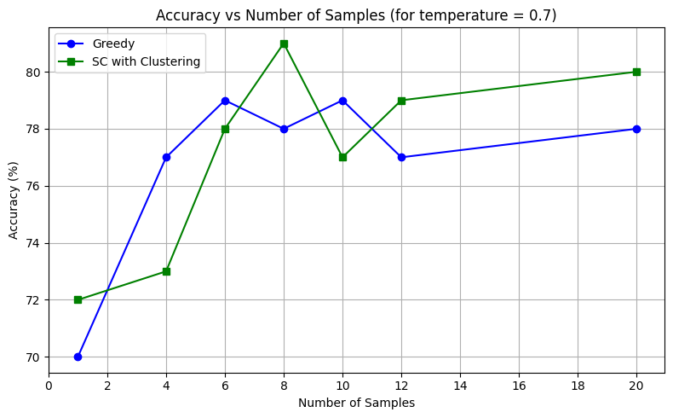
Results
Performance metrics and Comparison to benchmark or baseline
Accuracy (over 100 randomly sampled questions)
Number of diverse reasoning paths and Entropy

Slide 8
Analysis
Interesting insights, trends and patterns observed
For small n, greedy approach often performs better than self-consistent approach
Increasing number of samples increases diversity in reasoning paths and thus increases accuracy of self-consistency approach
Clustering based on similarity and most common answer performs equally well
Effect of sampling from various temperature range increases the accuracy of self-consistent approach

Slide 9
Error analysis
Possible reasons of error and inconsistencies
Some questions in the dataset have ambiguous options, in such cases often correct answers are generated by both approaches but it does not match with answer-key, thus affecting accuracy
Since the answers generated by LLMs are highly non-deterministic, we need big sample size (for example 500) and repeated experiments to confidently state the accuracy of these approaches

Slide 10
Improvements over the paper
Our contribution
Sample multiple reasoning paths by varying temperature
Cluster the sampled responses based on cosine similarity
Provide metrics like:
• Number of unique reasoning paths.
• Path similarity measures (e.g., cosine similarity).
• Diversity scores (e.g., Shannon entropy)

Slide 11
Learnings
Self-consistency significantly boosts accuracy in a range of arithmetic and commonsense reasoning tasks across various LLMs
It also aids in collecting rationales while solving complex problems, estimating uncertainty and improving output calibration
One limitation of self-consistency is that it incurs more computation cost
But using just 5–10 reasoning paths often captures most benefits due to quickly saturating performance

Slide 12

Demo
Interface

Slide 13
Summary and Conclusion
Key points
Self-consistent approach improves over greedy decoding in answering complex reasoning-based questions
Increasing number of paths increases accuracy of the system
Future work
Future work includes using self-consistency to generate supervised data for fine-tuning
Addressing issues with incorrect or nonsensical reasoning paths

