Slide 1

Open-Economy Macroeconomics:
Basic Concepts
31
Economics
P R I N C I P L E S O F
N. Gregory Mankiw
Premium PowerPoint Slides
by Ron Cronovich
Notes:
This chapter introduces students to such open-economy concepts as net exports, net capital outflows, and real & nominal exchange rates.
Most of the material in this chapter is not analytical. Students find most of the chapter to be straight-forward. However, some students have trouble understanding the identity NX = NCO.
NOTE: At the end of the Case Study on the U.S. Trade Deficit, I have included a slide with material that does not appear in the textbook, and therefore is not supported in the Study Guide or Test Bank. It concerns the U.S.’ net indebtedness to the rest of the world. Please feel free to skip it if you are at all uncomfortable with it. I’m confident, though, that many instructors and students will find it useful and interesting.
This PowerPoint chapter concludes with a couple of review questions.

Slide 2

In this chapter, look for the answers to these questions:
How are international flows of goods and assets related?
What’s the difference between the real and nominal exchange rate?
What is “purchasing-power parity,” and how does it explain nominal exchange rates?

Slide 3
Introduction
0
One of the Ten Principles of Economics
from Chapter 1:
Trade can make everyone better off.
This chapter introduces basic concepts of international macroeconomics:
  The trade balance (trade deficits, surpluses)
  International flows of assets
  Exchange rates
OPEN-ECONOMY MACROECONOMICS: BASIC CONCEPTS

Slide 4
Closed vs. Open Economies
0
A closed economy does not interact with other economies in the world.
An open economy interacts freely with other economies around the world.
OPEN-ECONOMY MACROECONOMICS: BASIC CONCEPTS

Slide 5
The Flow of Goods & Services
0
Exports:
domestically-produced g&s sold abroad
Imports:
foreign-produced g&s sold domestically
Net exports (NX), aka the trade balance
= value of exports – value of imports
OPEN-ECONOMY MACROECONOMICS: BASIC CONCEPTS
Notes:
As in previous PowerPoint chapters, “g&s” = goods & services.
You might point out to students that the clothes they are wearing were probably manufactured abroad and imported, as were the coffee they drank this morning and the iPod they listen to while jogging. We depend on people and companies around the world to produce many of the goods we use every day.
At the same time, millions of us work for companies that produce the goods and services that people in other countries use every day.

Slide 6
A C T I V E L E A R N I N G 1
Variables that affect NX
What do you think would happen to
Indian net exports if:
  A. U.S. experiences a recession
  (falling incomes, rising unemployment)
  B. Indian consumers decide to be patriotic and
  buy more products “Made in India”
  C. Prices of goods produced in France rise faster than prices of goods produced in India
Notes:
Before telling students the determinants of net exports, this exercise asks students to try to figure out how various events affect NX.
Even if many students do not figure out the correct answers to all three parts, the exercise still benefits them: learning occurs when misperceptions are brought out and corrected.

Slide 7
A C T I V E L E A R N I N G 1
Answers
A. U.S. experiences a recession
(falling incomes, rising unemployment)
  Indian net exports would fall
  due to a fall in American consumers’ purchases of Indian exports
B. Indian consumers decide to be patriotic and
buy more products “Made in India”
  India net exports would rise
  due to a fall in imports

Slide 8
A C T I V E L E A R N I N G 1
Answers
C. Prices of French goods rise faster than prices of Indian goods
  This makes Indian goods more attractive relative to France’s goods.
  Exports to France rise,
  imports from France fall,
  so Indian net exports rise.

Slide 9
Variables that Influence Net Exports
0
Consumers’ preferences for foreign and domestic goods
Prices of goods at home and abroad
Incomes of consumers at home and abroad
The exchange rates at which foreign currency trades for domestic currency
Transportation costs
Govt policies
OPEN-ECONOMY MACROECONOMICS: BASIC CONCEPTS

Slide 10
Trade Surpluses & Deficits
0
NX measures the imbalance in a country’s trade in goods and services.
  Trade deficit:
  an excess of imports over exports
  Trade surplus:
  an excess of exports over imports
  Balanced trade:
  when exports = imports
OPEN-ECONOMY MACROECONOMICS: BASIC CONCEPTS

Slide 11
The Flow of Capital
0
Net capital outflow (NCO):
domestic residents’ purchases of foreign assets
minus
foreigners’ purchases of domestic assets
NCO is also called net foreign investment.
OPEN-ECONOMY MACROECONOMICS: BASIC CONCEPTS

Slide 12
The Flow of Capital
0
The flow of capital abroad takes two forms:
  Foreign direct investment:
  Domestic residents actively manage the foreign investment, e.g., McDonalds opens a fast-food outlet in Moscow
  - Adapted for India- Café 92 opens an outlet in Kathmandu
  Foreign portfolio investment:
  Domestic residents purchase foreign stocks or bonds, supplying “loanable funds” to a foreign firm.
OPEN-ECONOMY MACROECONOMICS: BASIC CONCEPTS

Slide 13
The Flow of Capital
0
NCO measures the imbalance in a country’s trade in assets:
  When NCO > 0, “capital outflow”
  Domestic purchases of foreign assets exceed foreign purchases of domestic assets.
  When NCO < 0, “capital inflow”
  Foreign purchases of domestic assets exceed domestic purchases of foreign assets.
OPEN-ECONOMY MACROECONOMICS: BASIC CONCEPTS

Slide 14
Variables that Influence NCO
0
Real interest rates paid on foreign assets
Real interest rates paid on domestic assets
Perceived risks of holding foreign assets
Govt policies affecting foreign ownership of domestic assets
OPEN-ECONOMY MACROECONOMICS: BASIC CONCEPTS

Slide 15
The Equality of NX and NCO
0
An accounting identity: NCO = NX
  arises because every transaction that affects NX also affects NCO by the same amount
  (and vice versa)
When a foreigner purchases a good
from India,
  Indian exports and NX increase
  the foreigner pays with currency or assets,
  so India acquires some foreign assets,
  causing NCO to rise.
OPEN-ECONOMY MACROECONOMICS: BASIC CONCEPTS

Slide 16
The Equality of NX and NCO
0
An accounting identity: NCO = NX
  arises because every transaction that affects NX also affects NCO by the same amount
  (and vice versa)
When an Indian citizen buys foreign goods,
  Indian imports rise, NX falls
  the Indian buyer pays with Indian rupees or
  assets, so the other country acquires
  Indian assets, causing Indian NCO to fall.
OPEN-ECONOMY MACROECONOMICS: BASIC CONCEPTS
Notes:
The top half of this slide duplicates the previous one – intentionally. View both slides in “slide show” or presentation mode and you’ll see why.

Slide 17
Saving, Investment, and International Flows of Goods & Assets
0
Y = C + I + G + NX accounting identity
Y – C – G = I + NX rearranging terms
S = I + NX since S = Y – C – G
S = I + NCO since NX = NCO
When S > I, the excess loanable funds flow abroad in the form of positive net capital outflow.
When S < I, foreigners are financing some of the country’s investment, and NCO < 0.
OPEN-ECONOMY MACROECONOMICS: BASIC CONCEPTS

Slide 18
The Nominal Exchange Rate
0
Nominal exchange rate: the rate at which
one country’s currency trades for another
We express all exchange rates as foreign currency per unit of domestic currency.
Some exchange rates as of 16 July 2008,
all per US$
  Canadian dollar: 1.00
  Euro: 0.63
  Japanese yen: 104.77
  Mexican peso: 10.25
OPEN-ECONOMY MACROECONOMICS: BASIC CONCEPTS
Notes:
Just before you teach this, consider updating the data with the latest available. One convenient place for exchange rate data is
http://www.xe.net/ict/

Slide 19
Appreciation and Depreciation
0
Appreciation (or “strengthening”):
an increase in the value of a currency
as measured by the amount of foreign currency it can buy
Depreciation (or “weakening”):
a decrease in the value of a currency
as measured by the amount of foreign currency it can buy
Examples: During 2007, the U.S. dollar…
  depreciated 9.5% against the Euro
  appreciated 1.5% against the S. Korean Won
OPEN-ECONOMY MACROECONOMICS: BASIC CONCEPTS

Slide 20
The Real Exchange Rate
0
Real exchange rate: the rate at which the g&s of one country trade for the g&s of another
Real exchange rate =
where
  P = domestic price
  P* = foreign price (in foreign currency)
  e = nominal exchange rate, i.e., foreign currency per unit of domestic currency
e x P
P*
OPEN-ECONOMY MACROECONOMICS: BASIC CONCEPTS

Slide 21
Example With One Good
0
A Big Mac costs $2.50 in U.S., 400 yen in Japan
e = 120 yen per $
e x P = price in yen of a U.S. Big Mac
  = (120 yen per $) x ($2.50 per Big Mac)
  = 300 yen per U.S. Big Mac
Compute the real exchange rate:
e x P
300 yen per U.S. Big Mac
=
P*
400 yen per Japanese Big Mac
= 0.75 Japanese Big Macs per US Big Mac
OPEN-ECONOMY MACROECONOMICS: BASIC CONCEPTS
Notes:
This example shows that the real exchange rate is the price of domestic goods relative to the price of foreign goods.

Slide 22
Interpreting the Real Exchange Rate
0
“The real exchange rate =
0.75 Japanese Big Macs per U.S. Big Mac”
Correct interpretation:
To buy a Big Mac in the U.S.,
a Japanese citizen must sacrifice
an amount that could purchase
0.75 Big Macs in Japan.
OPEN-ECONOMY MACROECONOMICS: BASIC CONCEPTS
Notes:
Students sometimes interpret the real exchange rate literally – a Japanese citizen can exchange ¾ of a Japanese burger for an American one – which they (rightly) consider ridiculous.
This slide gives the correct interpretation.
If you wish, you can give students this information verbally rather than showing the slide.

Slide 23
A C T I V E L E A R N I N G 2
Compute a real exchange rate
e = 10 pesos per $
price of a tall Starbucks Latte
P = $3 in U.S., P* = 24 pesos in Mexico
A. What is the price of a US latte measured in pesos?
B. Calculate the real exchange rate,
measured as Mexican lattes per US latte.

Slide 24
A C T I V E L E A R N I N G 2
Answers
0
e = 10 pesos per $
price of a tall Starbucks Latte
P = $3 in U.S., P* = 24 pesos in Mexico
A. What is the price of a US latte in pesos?
e x P = (10 pesos per $) x (3 $ per US latte)
= 30 pesos per US latte
B. Calculate the real exchange rate.
e x P
30 pesos per U.S. latte
=
P*
24 pesos per Mexican latte
= 1.25 Mexican lattes per US latte

Slide 25
The Real Exchange Rate With Many Goods
0
P = U.S. price level, e.g., Consumer Price Index, measures the price of a basket of goods
P* = foreign price level
Real exchange rate
= (e x P)/P*
= price of a domestic basket of goods relative to
price of a foreign basket of goods
If U.S. real exchange rate appreciates,
U.S. goods become more expensive relative to foreign goods.
OPEN-ECONOMY MACROECONOMICS: BASIC CONCEPTS

Slide 26
The Law of One Price
0
Law of one price: the notion that a good should sell for the same price in all markets
  Suppose coffee sells for $4/pound in Seattle and $5/pound in Boston,
  and can be costlessly transported.
  There is an opportunity for arbitrage,
  making a quick profit by buying coffee in Seattle and selling it in Boston.
  Such arbitrage drives up the price in Seattle and drives down the price in Boston, until the two prices are equal.
OPEN-ECONOMY MACROECONOMICS: BASIC CONCEPTS

Slide 27
Purchasing-Power Parity (PPP)
0
Purchasing-power parity:
a theory of exchange rates whereby a unit of any currency should be able to buy the same quantity of goods in all countries
based on the law of one price
implies that nominal exchange rates adjust
to equalize the price of a basket of goods across countries
OPEN-ECONOMY MACROECONOMICS: BASIC CONCEPTS

Slide 28
Purchasing-Power Parity (PPP)
0
Example: The “basket” contains a Big Mac.
  P = price of US Big Mac (in dollars)
  P* = price of Japanese Big Mac (in yen)
  e = exchange rate, yen per dollar
According to PPP,
e x P = P*
price of US
Big Mac, in yen
price of Japanese Big Mac, in yen
P*
Solve for e:
e =
P
OPEN-ECONOMY MACROECONOMICS: BASIC CONCEPTS

Slide 29
PPP and Its Implications
0
PPP implies that the nominal
exchange rate between two countries
should equal the ratio of price levels.
If the two countries have different inflation rates, then e will change over time:
  If inflation is higher in Mexico than in the U.S., then P* rises faster than P, so e rises –
  the dollar appreciates against the peso.
  If inflation is higher in the U.S. than in Japan, then P rises faster than P*, so e falls –
  the dollar depreciates against the yen.
P*
e =
P
OPEN-ECONOMY MACROECONOMICS: BASIC CONCEPTS

Slide 30
Limitations of PPP Theory
0
Two reasons why exchange rates do not always adjust to equalize prices across countries:
Many goods cannot easily be traded
  Examples: haircuts, going to the movies
  Price differences on such goods cannot be arbitraged away
Foreign, domestic goods not perfect substitutes
  E.g., some U.S. consumers prefer Toyotas over Chevys, or vice versa
  Price differences reflect taste differences
OPEN-ECONOMY MACROECONOMICS: BASIC CONCEPTS

Slide 31
Limitations of PPP Theory
0
Nonetheless, PPP works well in many cases, especially as an explanation of long-run trends.
For example, PPP implies:
the greater a country’s inflation rate,
the faster its currency should depreciate
(relative to a low-inflation country like the US).
The data support this prediction…
OPEN-ECONOMY MACROECONOMICS: BASIC CONCEPTS
Notes:
At this point in the textbook, there appears a graph (Figure 3) which shows Germany’s exchange rate during its interwar hyperinflation. The graph makes the point very clearly that, in this particular case, high inflation is accompanied by a similarly high depreciation.
For the sake of variety, and to show students that this relationship holds more generally, I show on the next slide a scatterplot of data on exchange rate depreciation and inflation rates for a cross-section of countries. The message is the same: the higher a country’s inflation rate, the greater will be the rate at which the country’s exchange rate depreciates.

Slide 32
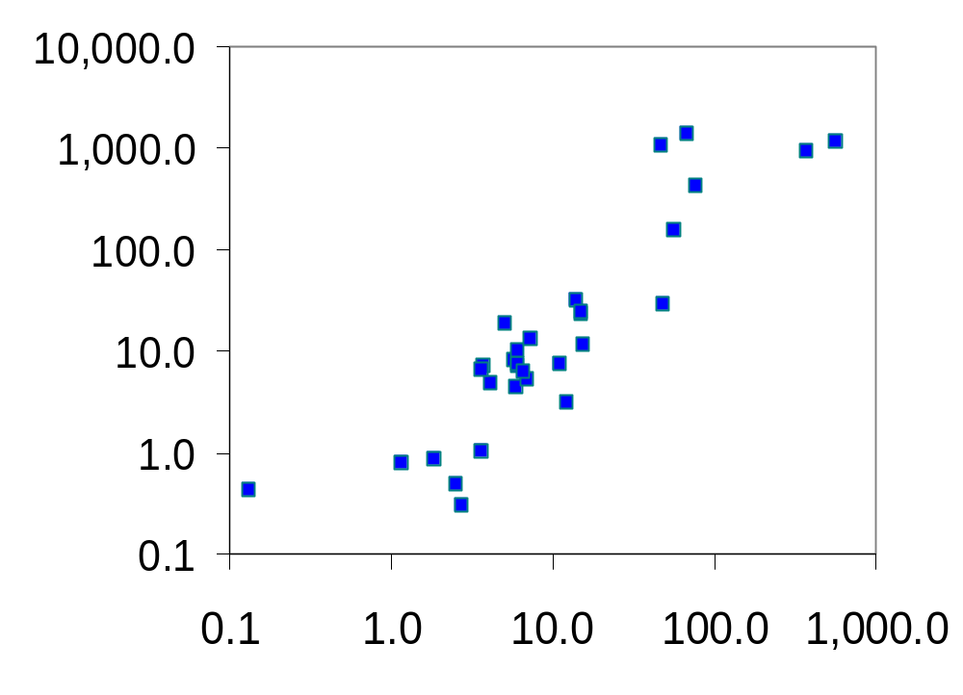
Inflation & Depreciation in a Cross-Section of 31 Countries
0
Ukraine
Avg annual
depreciation
relative to
US dollar
1993-2003
(log scale)
Romania
Brazil
Argentina
Mexico
Canada
Kenya
Japan
Avg annual CPI inflation
1993-2003 (log scale)
Notes:
Due to the vast variation across countries, the relationship is easier to see using a log scale on both axes. As it turns out, the U.S. dollar appreciated against most currencies during 1993-2003, so I didn’t have to worry about logs of negative numbers.
Source: World Development Indicators (WDI online database), World Bank
The website is: http://devdata.worldbank.org/dataonline/
However, you either need to pay for a subscription to use this database, or to purchase the database on CD-ROM from the World Bank.
The included countries are: Argentina, Australia, Bolivia, Brazil, Canada, Chile, China, Colombia, Egypt, Ethiopia, India, Indonesia, Israel, Japan, Kenya, S. Korea, Mexico, Mongolia, Morocco, Peru, Philippines, Poland, Portugal, Romania, Singapore, South Africa, Sudan, Thailand, Turkey, Ukraine, and Zimbabwe.
My selection of countries for this chart was not purely random – I just looked down the list of countries with available data, and picked a handful, aiming for diversity. Please be assured: I did not include or exclude any countries based on whether they support PPP or not. Really!
But I did use 10-year averages because PPP doesn’t work as well over short time horizons.

Slide 33
A C T I V E L E A R N I N G 3
Chapter review questions
1. Which of the following statements about a country with a trade deficit is not true?
  A. Exports < imports
  B. Net capital outflow < 0
  C. Investment < saving
  D. Y < C + I + G
2. A Ford Escape SUV sells for $24,000 in the U.S. and 720,000 rubles in Russia.
If purchasing-power parity holds, what is the nominal exchange rate (rubles per dollar)?
Notes:
These review questions are not hard, but will give students – and you – a quick check of their understanding.
If you wish, you can change the slide title from “Chapter review questions” to “Practice exam questions” or “Old exam questions.” Anything with the word “exam” always gets students’ attention!

Slide 34
A C T I V E L E A R N I N G 3
Answers
1. Which of the following statements about a country with a trade deficit is not true?
  A. Exports < imports
  B. Net capital outflow < 0
  C. Investment < saving
  D. Y < C + I + G
not true!
  A trade deficit means NX < 0.
  Since NX = S – I,
  a trade deficit implies I > S.

Slide 35
A C T I V E L E A R N I N G 3
Answers
2. A Ford Escape SUV sells for $24,000 in the U.S. and 720,000 rubles in Russia.
If purchasing-power parity holds, what is the nominal exchange rate (rubles per dollar)?
P* = 720,000 rubles
P = $24,000
e = P*/P = 720000/24000 = 30 rubles per dollar

Slide 36
CHAPTER SUMMARY
Net exports equal exports minus imports.
Net capital outflow equals domestic residents’ purchases of foreign assets minus foreigners’ purchases of domestic assets.
Every international transaction involves the exchange of an asset for a good or service,
so net exports equal net capital outflow.

Slide 37
CHAPTER SUMMARY
Saving can be used to finance domestic investment or to buy assets abroad. Thus, saving equals domestic investment plus net capital outflow.
The nominal exchange rate is the relative price of the currency of two countries.
The real exchange rate is the relative price of the goods and services of the two countries.

Slide 38
CHAPTER SUMMARY
According to the theory of purchasing-power parity, a unit of any country’s currency should be able to buy the same quantity of goods in all countries.
This theory implies that the nominal exchange rate between two countries should equal the ratio of the price levels in the two countries.
It also implies that countries with high inflation should have depreciating currencies.

