Slide 1

Acadexa
Your one stop solution
Capstone Project (2025-26)
Harshil Vadher
92200133036
Marwadi University

Slide 2
Problem Statement
Students face challenges in managing academic tasks.
Lack of a unified platform for course updates, notifications, and resources.
Existing solutions are fragmented and not student-centric.

Slide 3
Project Vision & Objectives
Our mission is to create a comprehensive student-centered mobile application that seamlessly integrates with the existing Acadexa web platform, transforming how students interact with their academic environment.
Real-Time Academic Access
Digital Assignment Management
Enhanced Peer Communication
Provide instant access to batch details, attendance records, and fee updates directly on mobile devices
Enable seamless assignment submissions and online examinations within the mobile application
Implement batch-specific chat functionality to foster collaboration and academic discussion
Accessible Learning Resources
Personalized Student Dashboard
Make study materials and faculty information available anytime, anywhere for continuous learning
Build an intuitive profile interface for comprehensive academic information management

Slide 4
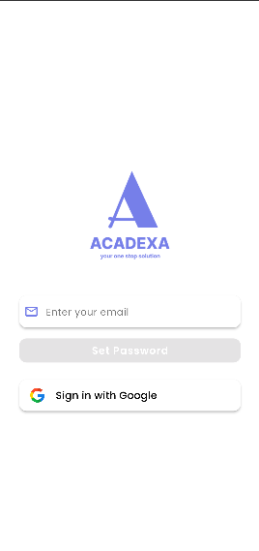
Objective
Develop a mobile app using Flutter for cross-platform support.
Backend integration with PHP & MySQL.
Provide secure login and personalized dashboards.
Ensure smooth deployment and scalability.

Slide 5
Technical Architecture & Innovation
The application leverages cutting-edge technologies to deliver a robust, cross-platform solution that meets modern educational demands while maintaining cost-effectiveness and reliability.
Frontend Development
Backend Infrastructure
Built with Flutter, our cross-platform framework ensures consistent user experience across Android and iOS devices. This approach reduces development time while maximizing reach to all students regardless of their device preference.
The server-side architecture utilizes PHP for robust backend processing and MySQL for structured data management, ensuring secure and efficient handling of student information.
Rapid development cycles

Slide 6
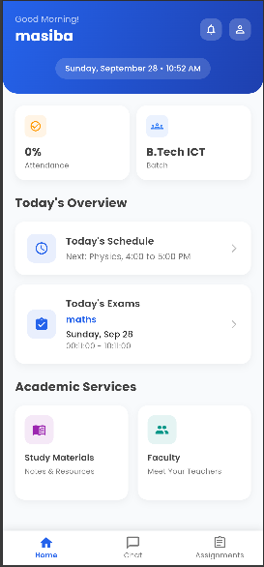
System Architecture
Frontend: Flutter (Android/iOS)
Backend: PHP APIs
Database: MySQL
Hosting: Web server for APIs & DB

Slide 7
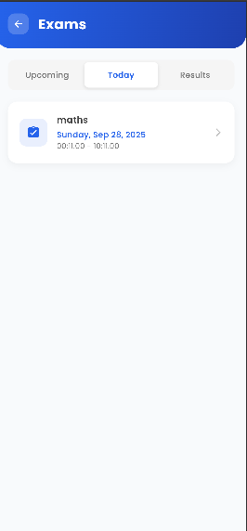
Key Features
Student login & authentication
Course & subject management
Notifications & announcements
Assignment tracking
User-friendly dashboard

Slide 8
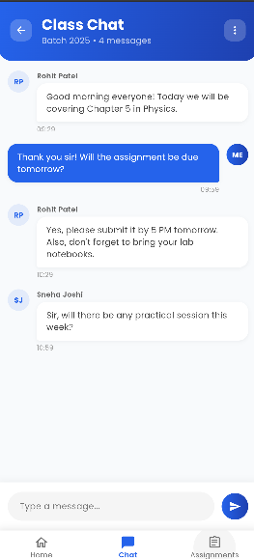
Additional Features
AI-powered performance tracking with predictive analytics
Gamification elements for student motivation
Integration with Google Calendar and Microsoft Teams
Offline mode for accessing downloaded resources
Push notifications for deadlines and updates

Slide 9
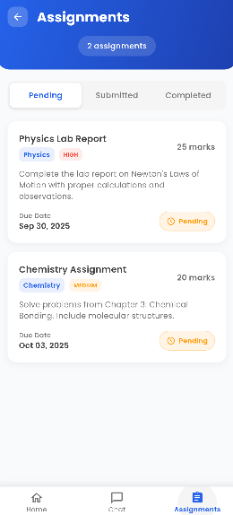
Future Enhancements
Integration with Learning Management Systems (LMS) like Moodle
AR/VR-based virtual classroom experience
Voice assistant support for accessibility
Data analytics dashboard for faculty and administrators
AI chatbot for instant query resolution

Slide 10
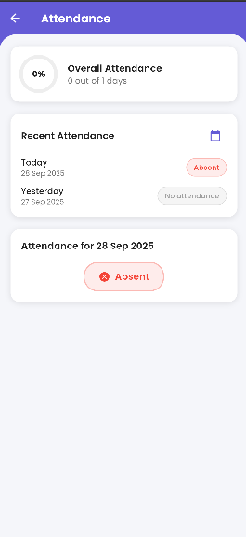
Project Impact
Improves student engagement and productivity
Reduces administrative workload through automation
Provides a unified digital ecosystem for academia
Encourages collaborative and peer-to-peer learning
Supports scalability for multi-institution adoption

Slide 11
