Slide 1

GLA University Mathura
Department of computer engineering and applications
MINI PROJECT-2
Presented By:-
Hemant Kumar (191500448)
Harshit Bhardwaj (191500322)
Gaurav Yadav(191500296)
Harsh Gupta (191500317)
Tushar Jain (191500860)
Supervised By:-
Mr. Neeraj Khanna

Slide 2
Overview of the presentation
About the Project
Objective
Requirements
Snapshots from the app

Slide 3
About the Project
Our Mini project-2 “Chatify” is an online chat application which allows the user to send and receive messages.
It consists of various pages like-
Login Page
Signup Page
Users list Page
Message Page
For Signup and Login Section authentication is provided using Firebase.

Slide 4
Objective
The primary goal of this mini project-2 “Chatify” website is to Send and Receive messages.
It maintains all the past messages.
It is a user friendly app where user can access messages in a more efficient way.

Slide 5
Here are Sub Section where there are lots of category where user can visit and select what the organizations needs
Login Page
Signup Page
Users list Page
Sender’s messaging screen
Receiver’s message screen

Slide 6
Requirements
Software Specification
Technology Implemented : App development
Language Used : Kotlin
Development Environment : Android Studio Chipmunk
Web Browser : Chrome / Firefox
Hardware Requirements
Smart phone with android v5.0 (lollipop) or above

Slide 7
THIS IS HOW OUR
APP LOOKS ➔
Hope you w like it :)

Slide 8
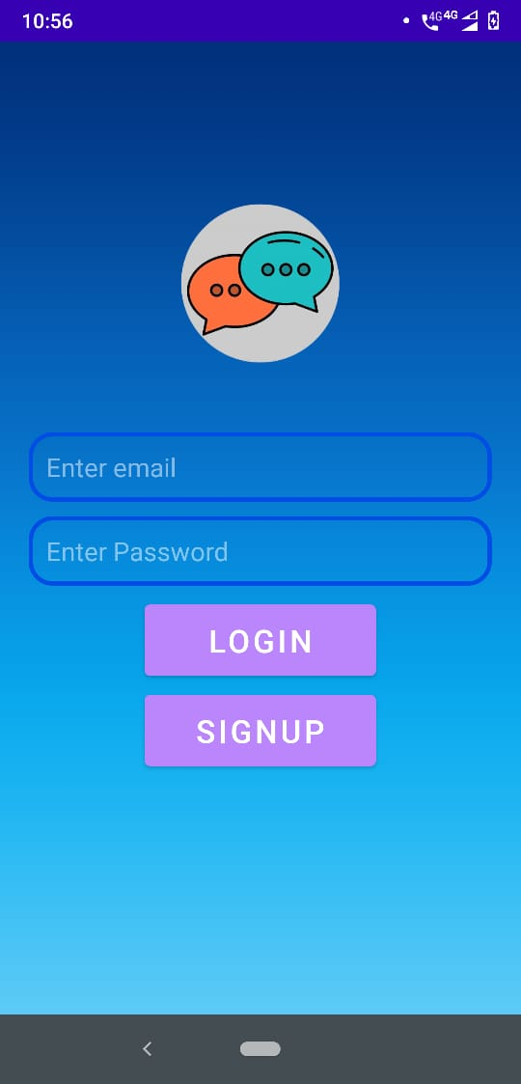
Login Page

Slide 9
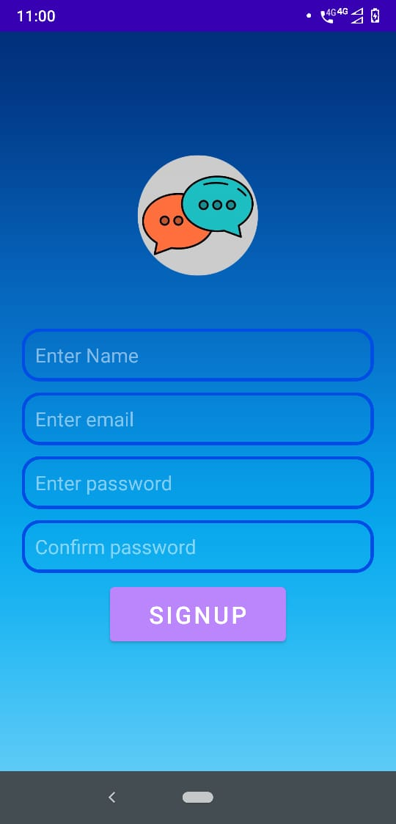
Sign Up Page

Slide 10
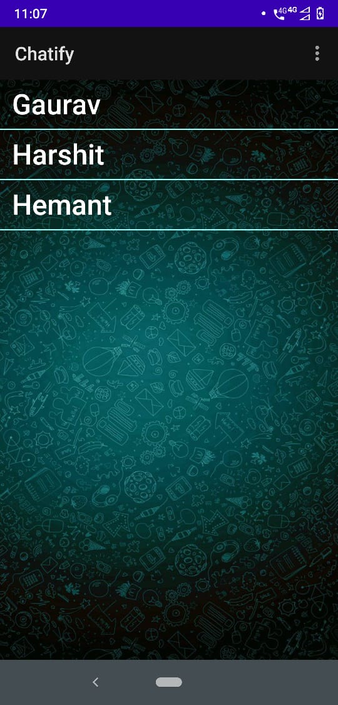
Users to chat with

Slide 11
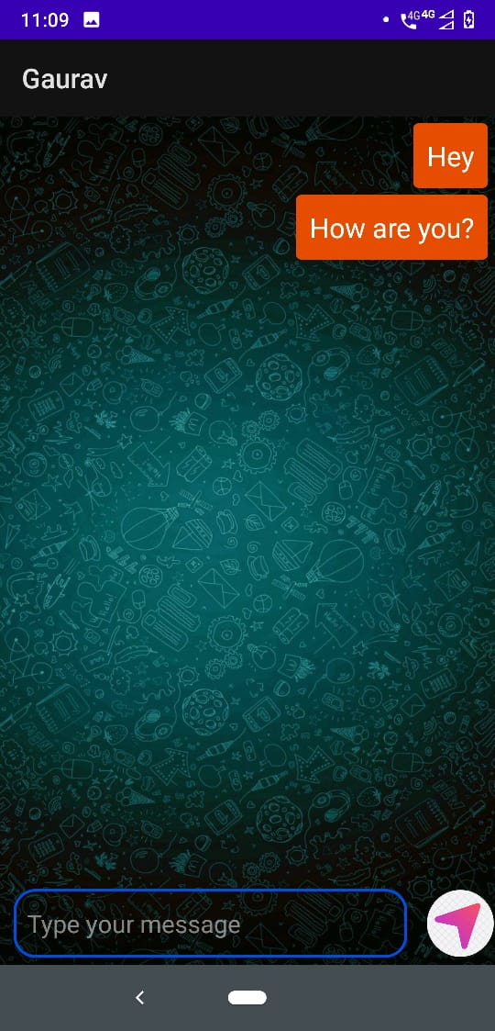
Message Section (Sender’s screen)

Slide 12
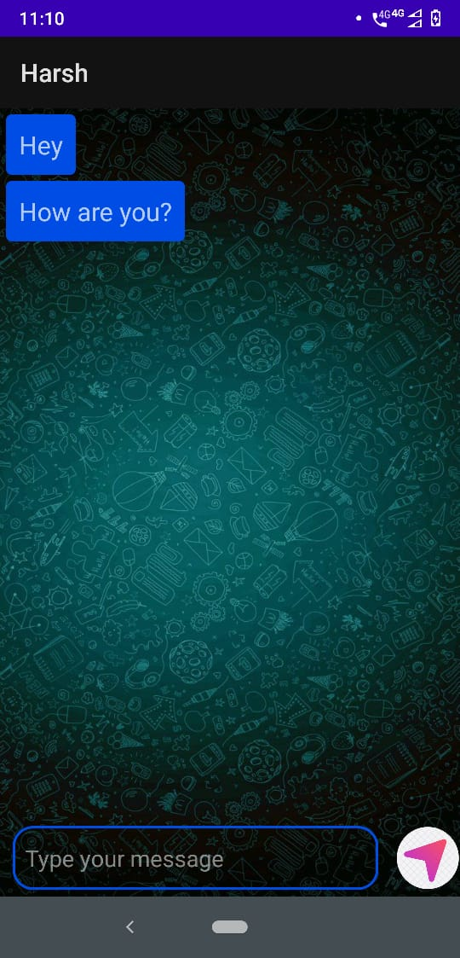
Message Page (Receiver’s screen)

Slide 13
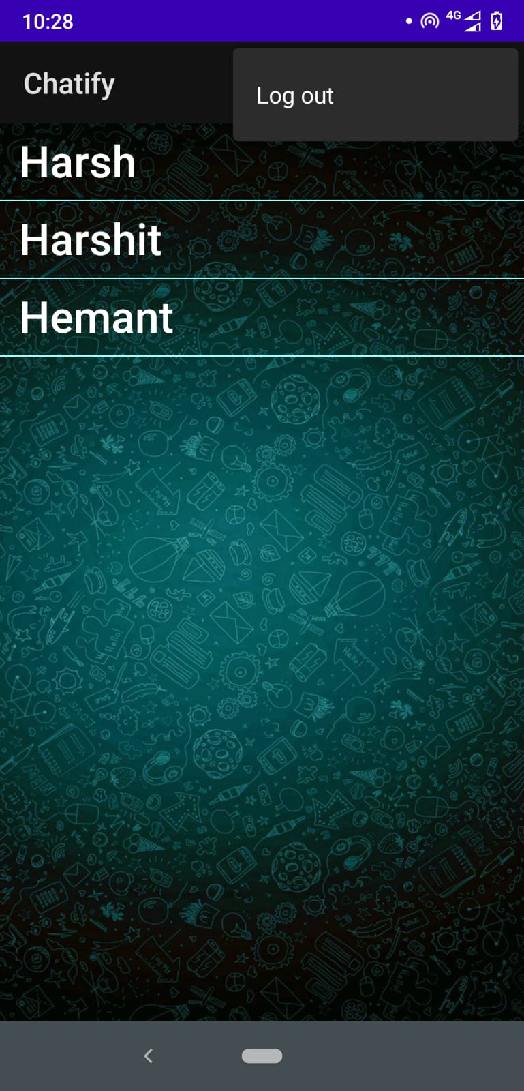
Log out

Slide 14
Thank You

