Slide 1
Drivers Dowsiness Alert System

Slide 2
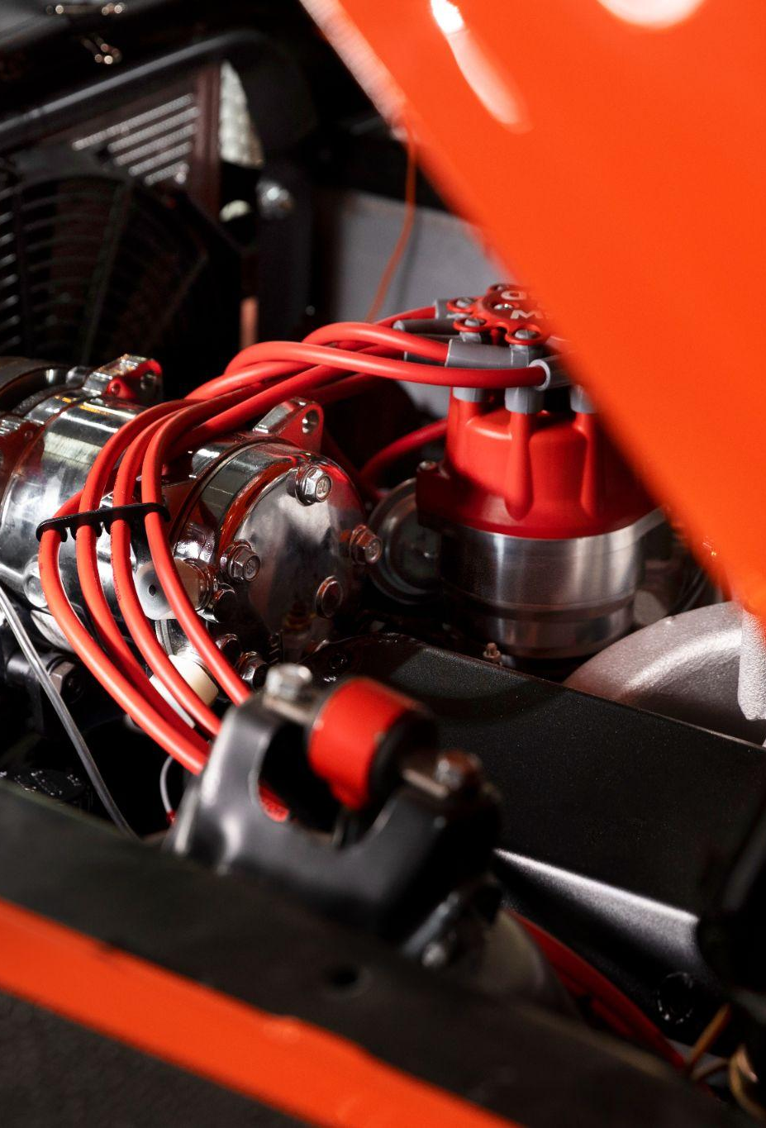
Abstract
This project introduces a high-tech drowsiness detection system for safer roads. It uses OpenCV, Face Recognition, DLib, and Hog libraries along with an infrared camera to monitor the driver's eyes. If signs of drowsiness are detected, it triggers an alarm prompting the driver to take control. Rigorous testing proves its reliability under different lighting conditions. OpenCV enables quick image processing, Face Recognition ensures accurate eye tracking, making it practical and cost-effective. After three alerts, it switches to autopilot mode for enhanced safety. Implemented on a user-friendly IoT device using Raspberry Pi, it's a significant leap in road safety tech.

Slide 3
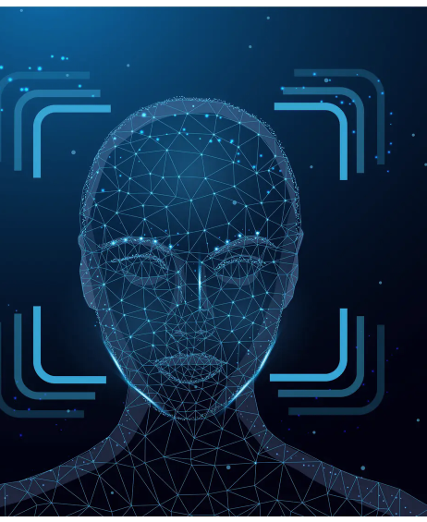
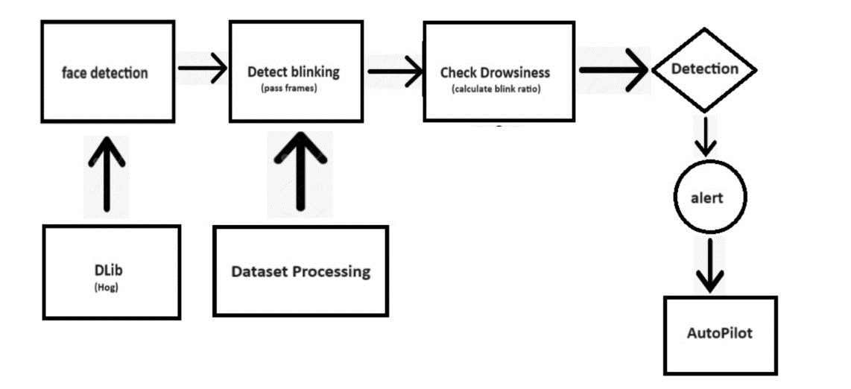
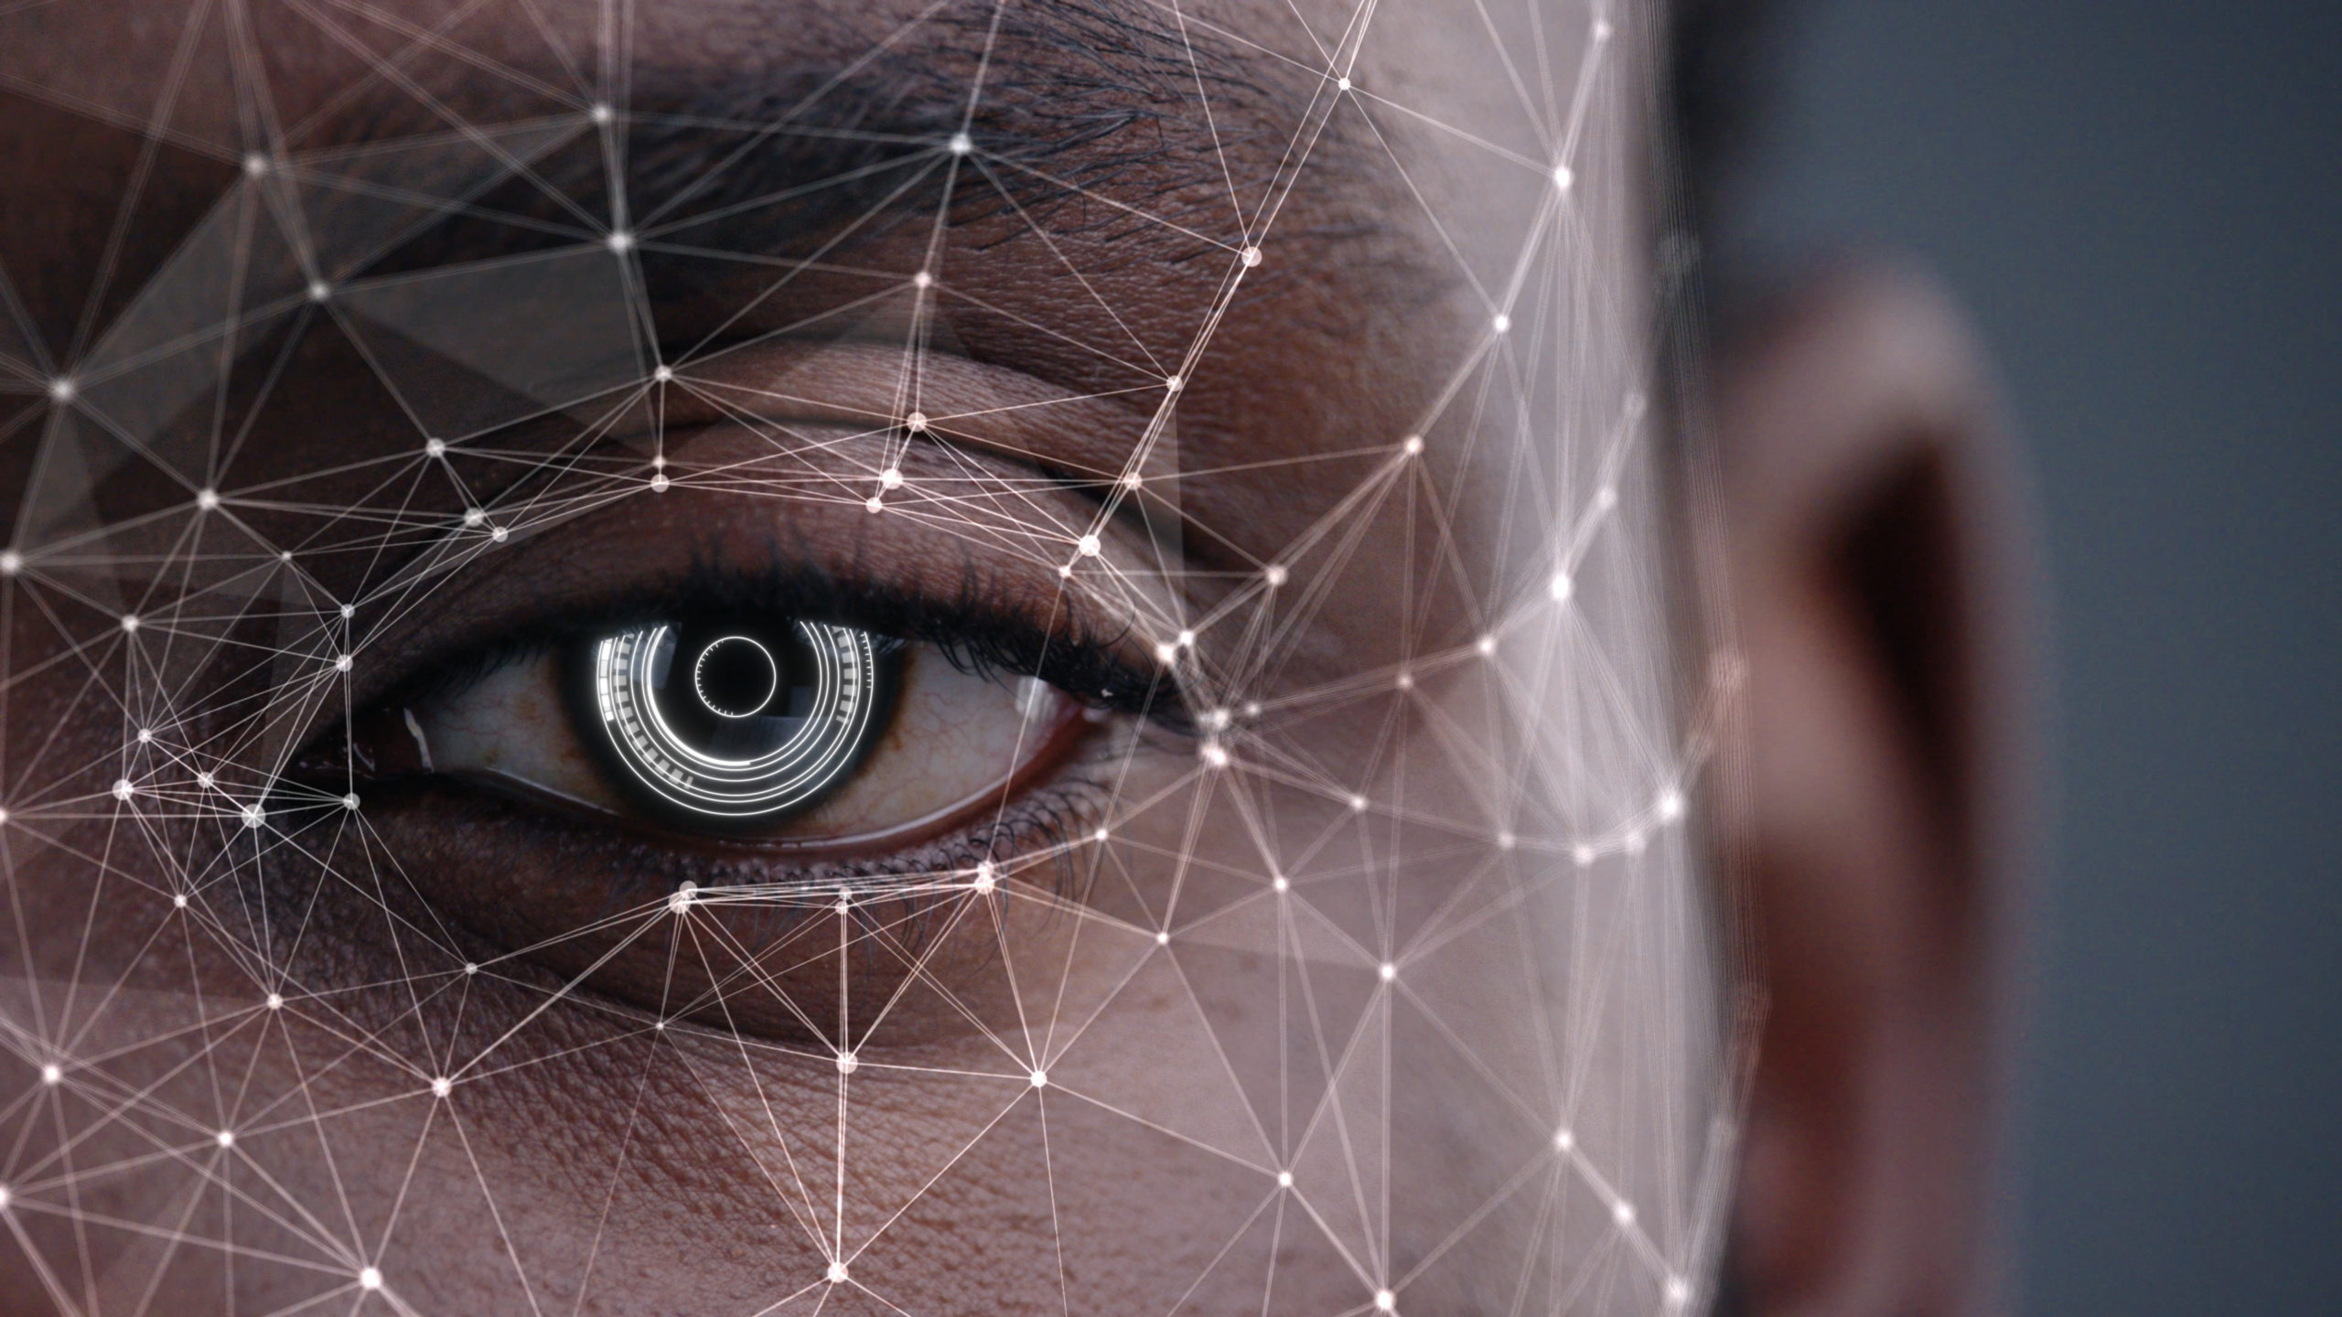
Block Diagram of the project

Slide 4
Algorithm
Initialization: System startup. Open camera module. Frame Processing: Convert frame into grayscale for efficient processing. Face Detection: Use Histogram of Oriented Gradients (HOG) to detect faces in the grayscale frame. Eye Detection: Apply shape_landmark dataset to detect eyes within the detected face regions. Blink Ratio Calculation: Calculate the blink ratio based on the eye landmarks detected. Alarm Triggering: If the eyes are detected as closed based on the blink ratio, trigger an alarm. Alarm Count Tracking: Keep track of the number of alarms triggered. Autopilot Activation: If three consecutive alarms are triggered: Activate autopilot mode in the vehicle. Autopilot Mode: Vehicle runs in autopilot mode. Continuously monitors the user's condition. Activates alarm and safety measures if needed. User Alertness Check: Once the user wakes up and interacts with the system: Switch from autopilot mode to manual mode.

Slide 5
Dataset
Shape_predictor_68_face_landmarks.dat
Purpose: It's a file used with the dlib library to predict 68 specific points on a face.
Facial Landmarks: These points represent key parts of the face, like eyes, nose, mouth, and face contours.
Detection: By recognizing these landmarks, applications understand facial structure.
Applications: Used for tasks like face alignment, expression analysis, and gaze estimation.
Eye Detection: Specifically used in your algorithm to find eye locations for calculating blink ratio.
Pre-Trained Model: It's a model that's been trained on a vast dataset to accurately predict these facial landmarks.

Slide 6
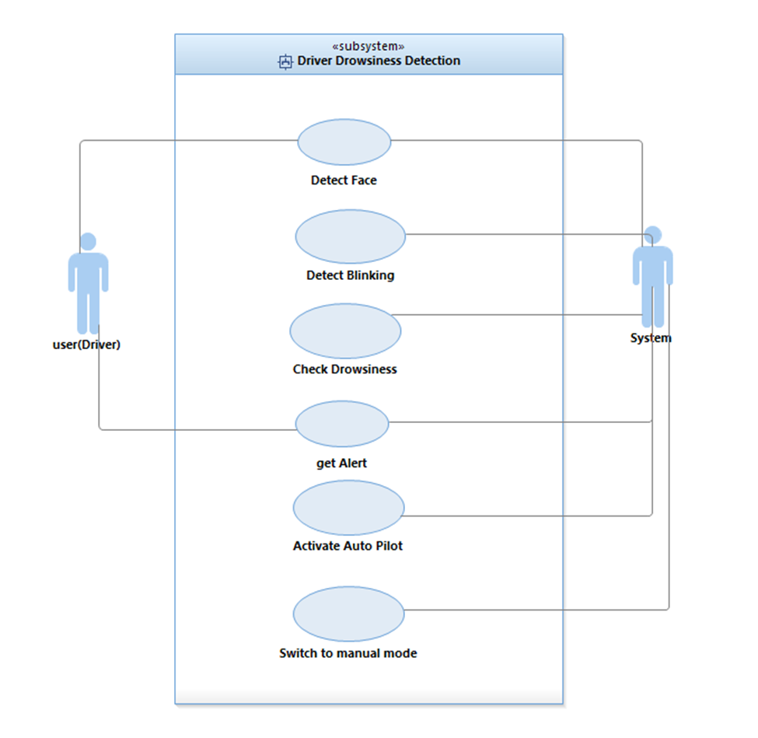
UML Diagrams use case:

Slide 7
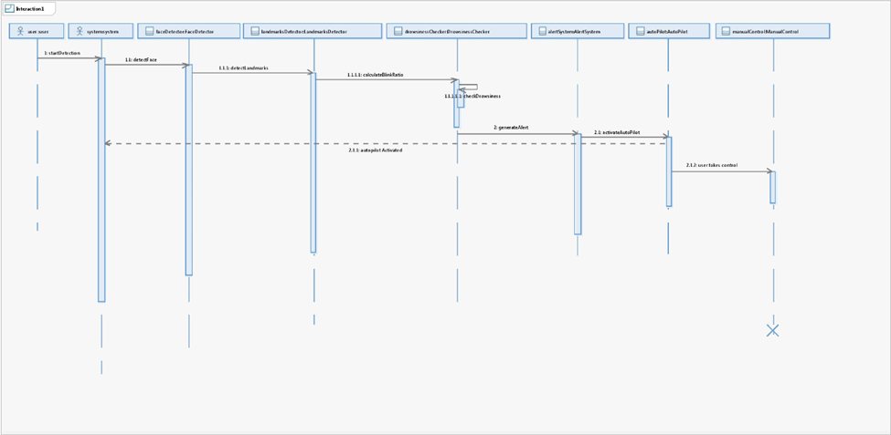
UML Diagrams Sequence:

Slide 8
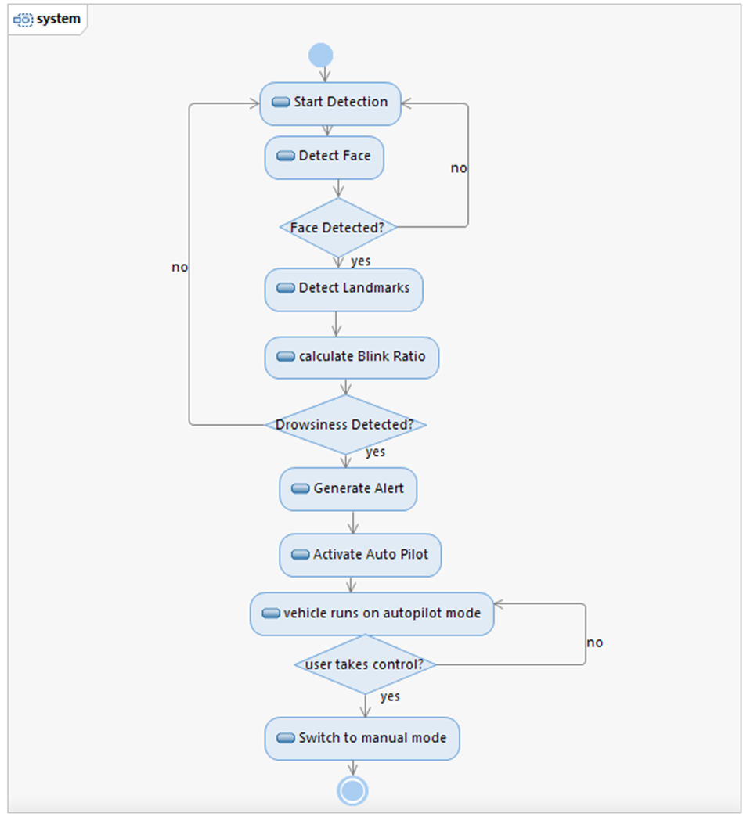
UML Diagrams Activity:

Slide 9
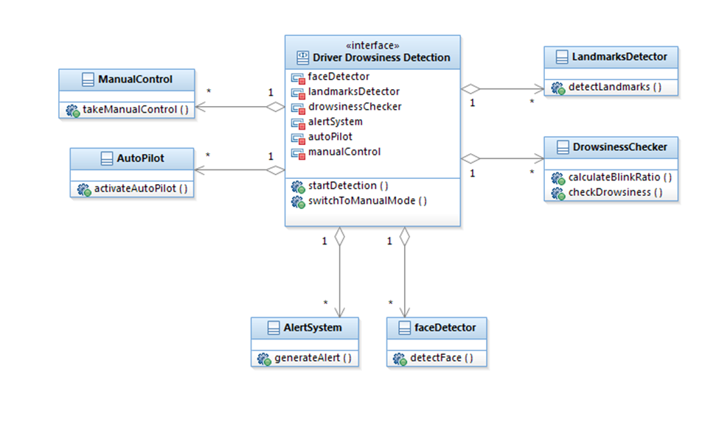
UML Diagrams Class :

Slide 10
Thank You

