Slide 1
The Influence of Genetic Algorithms on Learning Possibilities of Artificial Neural Networks
Harshit Kumar More
Kunal Sati
Submitted as part of Soft Computing Project (MCS Sem I)

Slide 2
Introduction
Demonstrating learning ability of a Neural Network using a Genetic Algorithm
Studying how GAs can optimize the learning process of ANNs
How changes in GA parameter affect speed and performance
Network topology of ANN affects generalization and performance of Neural Networks
Using A computer game: Classical Snake (piloted by an ANN trained via a GA)

Slide 3
Classic Snake Game
A simple grid-based arcade game
The player controls a snake that moves continuously inside the grid
The Goal of the game is make the snake grow larger without getting eliminated
The snake is eliminated when its head hits the boundary of the grid (walls) or it bites itself (the head of the snake hits its own body)
The snake grows by one unit when it consumed food, which randomly appears on the grid
Player can make 4 moves to steer the snake: Up Down Left Right
Note: The Snake cannot move backwards onto itself
Experiment is called – “SnakeAI”

Slide 4
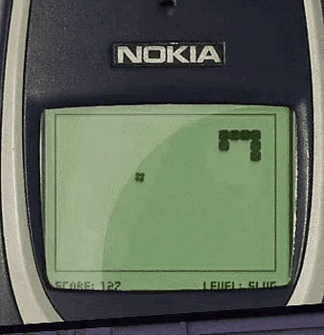
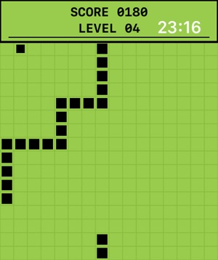
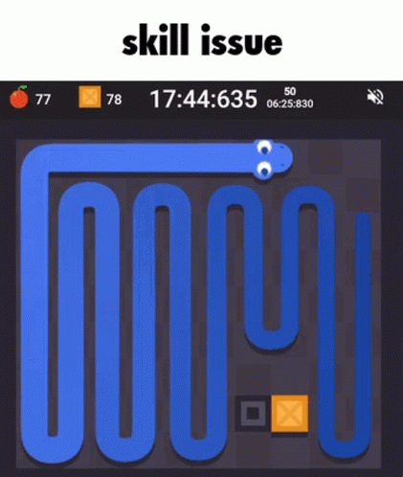
Classic Snake

Slide 5
Experimental Setup – ANN Topology
24 Neuron Inputs (Distances to 3 important Objects)
3 Objects include Food, Wall & Body of Snake (Measured in 8 directions
4 Neuron Output (4 directions for snake to turn to)
Hidden Layers varied from 1-4 Layers with 4-48 Neurons

Slide 6
Genetic Algorithm Parameters
Population sizes: 500, 2000, 4000 individuals per generation
Mutation rates: 5 10 15 20 25 50 (%)
Generations: 50 per run, each test repeated 60 times for statistical accuracy
Fitness function: +1 surviving each step, +100 for food eaten
4800 training evolutions (java based local and virtual Linux servers)

Slide 7
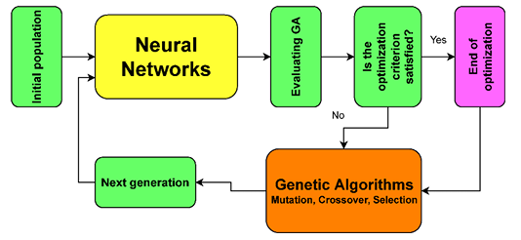
Experiment Flow

Slide 8
Why Use GAs with ANNs?
Minimum Data Demands – GAs have zero demand on computation resources in form of data
Optimization of Hard of Define Functions – When expected solution cannot be properly defined, GAs can allow for a good approximation towards the solution
Cost and Time Efficient – Training a Deep Neural Network would have excessive demand on computation resources, GAs have practically comparatively none
A hybrid approach allows for direction towards solving the problem (using fitness function to approximate success) and neural network for modelling complexities in the solution

Slide 9
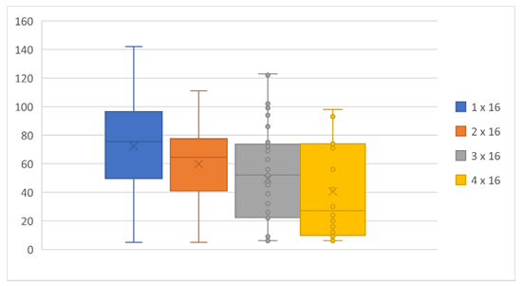
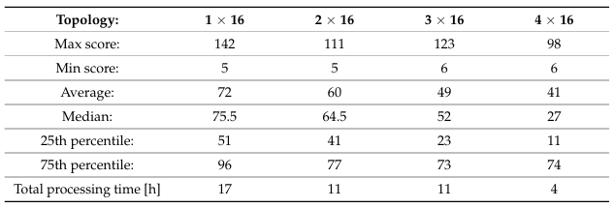
Results – Network Topology
Best results obtained from 1 Hidden Layer with 16 Neurons
Increasing Layers to 3-4 caused overfitting
Increasing Neurons per layer improved performance noticeably 16-24 Neurons, diminishing returns after that

Slide 10
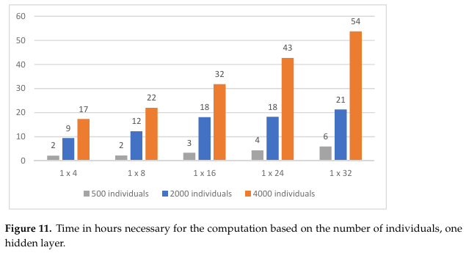
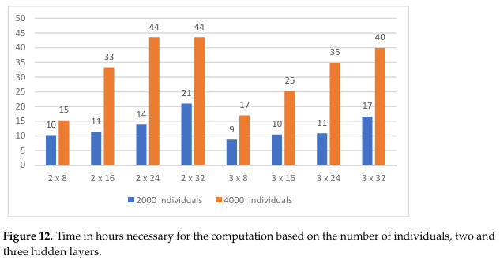
Results – GAs Parameters
Increasing Population size improved results
Time Increased Linearly with population growth
Gains plateaued at population size of about 2000

Slide 11
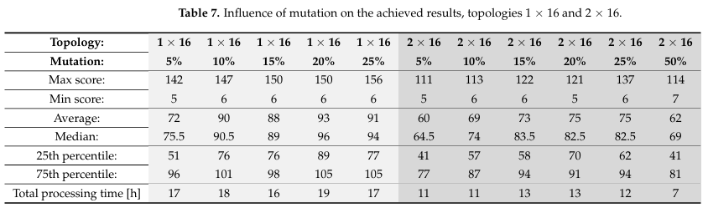
Results – GAs Parameters
Too High (50%) and Too Low (5%) Mutation Rate performed poorly
Higher mutation helped avoid local optima but it converged much slowly
Best Results at 15-25% Mutation Rate (Balance b/w Exploring & Convergence)

Slide 12
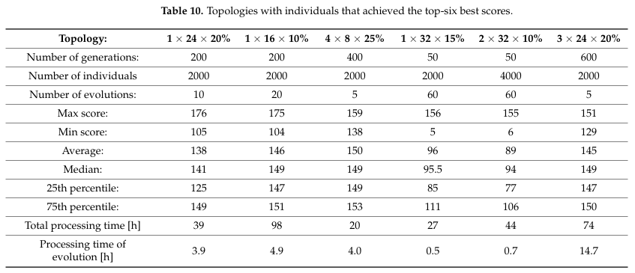
Best Results – Score

Slide 13
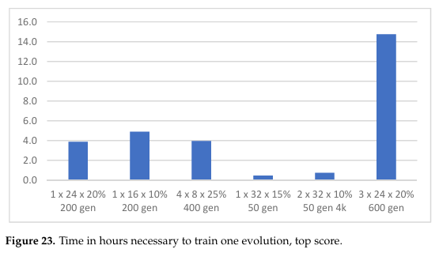
Best Results – Time

Slide 14
Conclusions
1. Topology of network is Significant: A simpler ANN can outperform deeper ANNs for smaller problems
2. GA Parameter tuning is important: Properly tuned parameters can have a huge effect on performance
3. GAs are helpful in training ANNs: Especially when target variable is not known and in gradient-based learning

Slide 15
References
Padhy, N.; Singh, R.P.; Satapathy, S.C. Cost-effective and fault-resilient reusability prediction model by using adaptive genetic algorithm based neural network for web-of-service applications. Clust. Comput. 2019, 22, 14559–14581. [CrossRef]
Viau, G. Train a Neural Network to Play Snake Using a Genetic Algorithm. Available online: https://github.com/greerviau/ SnakeAI (accessed on 1 April 2022).
Haldurai, L.; Madhubala, T.; Rajalakshmi, R. A study on genetic algorithm and its applications. Int. J. Comput. Sci. Eng. 2016, 4, 139.
Nicholson, C. Artificial Intelligence (AI) vs. Machine Learning vs. Deep Learning. Available online: https://wiki.pathmind.com/ ai-vs-machine-learning-vs-deep-learning

