Slide 1
Project Presentation
Fake News Detection and Generation
Harshita
72212988
B.Tech CSE IBM

Slide 2
Fake News Generator & Detector
- GPT-2 Generator + DistilBERT Classifier
- FastAPI Backend + Streamlit Frontend
- Deployment on Render & Streamlit Cloud

Slide 3
Introduction
Fake news has become one of the most widespread and harmful challenges in the digital era.
With the explosive growth of social media platforms, misinformation can reach millions of people within seconds.
Manual fact-checking is slow, expensive, and cannot keep up with the massive volume of online content.
Because of this, automated fake news generation and detection systems have become essential tools in media research, journalism, public safety, and AI ethics.
This project uses state-of-the-art Natural Language Processing (NLP) models to:
Generate synthetic fake news for research and testing
Detect whether a news headline is real or fake
Build an end-to-end MLOps pipeline with model serving and deployment
The goal is to demonstrate how modern NLP systems can be trained, evaluated, deployed, and integrated into real-world applications.

Slide 4
Problem Statement
• Detect whether a news headline is REAL or FAKE
• Generate fake news for research/testing
• Build full ML pipeline with deployment

Slide 5
Project Overview
• GPT-2 model generates fake headlines
• DistilBERT model classifies fake vs real
• FastAPI backend serves models
• Streamlit frontend for UI

Slide 6
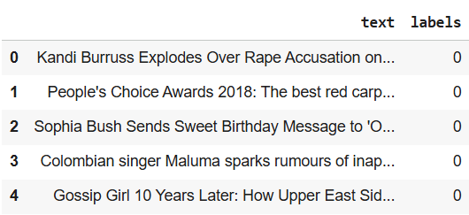
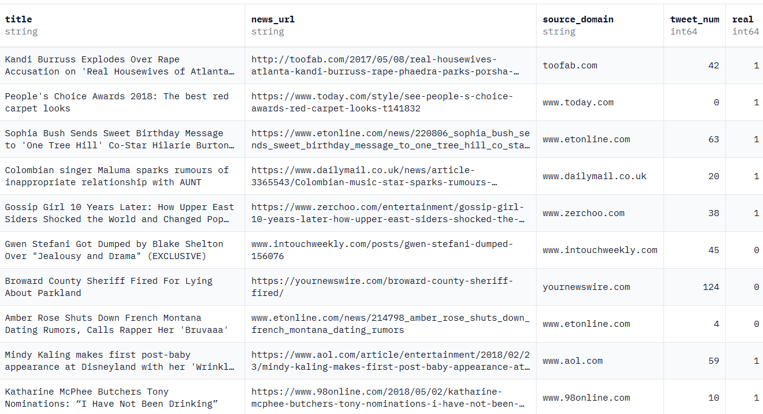
Dataset Summary
FakeNewsNet Dataset from HuggingFace
Binary labels: 0 = REAL, 1 = FAKE
Kept only relevant columns after preprocessing (text, labels)
Split into train, test and validation

Slide 7
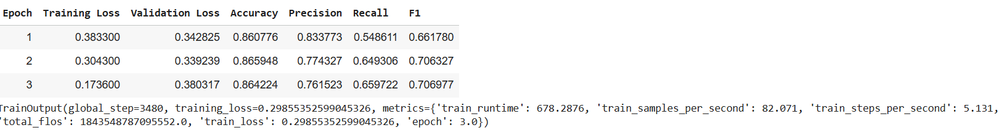
Model Architecture: DistilBERT
• Lightweight transformer for classification
• Fine-tuned on fake news dataset
• Outputs prediction + confidence
TrainOutput(global_step=3480, training_loss=0.29855352599045326, metrics={'train_runtime': 678.2876, 'train_samples_per_second': 82.071, 'train_steps_per_second': 5.131, 'total_flos': 1843548787095552.0, 'train_loss': 0.29855352599045326, 'epoch': 3.0})

Slide 8
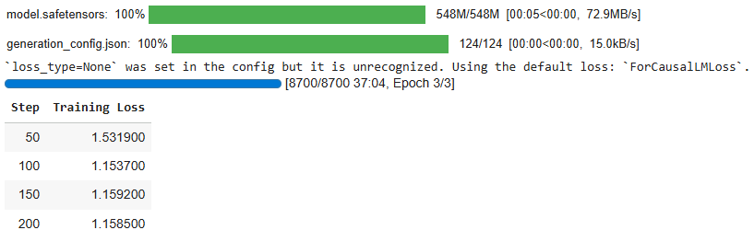
Model Architecture: GPT-2
• Generative LM trained to mimic news style
• Produces human-like fake headlines
• Tuned for short headline generation
TrainOutput(global_step=8700, training_loss=0.8854884829466371, metrics={'train_runtime': 2225.1908, 'train_samples_per_second': 31.273, 'train_steps_per_second': 3.91, 'total_flos': 2272848740352000.0, 'train_loss': 0.8854884829466371, 'epoch': 3.0})

Slide 9
Training Pipeline
Loading Dataset
Tokenize
Training
"rickstello/FakeNewsNet“ – downloaded from HuggingFace
Tokenization using Hugging Face AutoTokenizer
Trained Model and fine tune on google colab
Evaluate Model
Creating Pipeline
Deployment
Classification: Accuracy, F1 Score, Precison, Recall
Generation: Bleu Score
To generate fake news and detect whether the news is fake or not
Deployed the backend on Render using FastAPI and the frontend on Streamlit Cloud

Slide 10

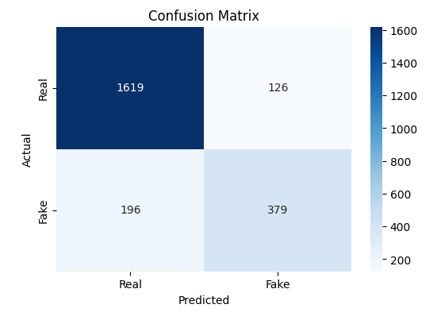
Evaluation Results
Detection

Slide 11
Evaluation Results
Generation
Metrics | Score | Interpretation
Distinct-1 | 0.4528 | 45% of words are unique → moderate word-level diversity
Distinct-2 | 0.8027 | 80% of word pairs are unique → high phrase-level diversity
Self-BLEU | 0.1567 | Low score → generated texts are diverse, not repetitive
Style Match | 0.4371 | Moderate similarity to real texts → partially mimics style
Perplexity | 172.29 | Measures fluency → lower values = more predictable / fluent text; higher = more uncertainty

Slide 12
Fast-Api - Backend
https://fake-news-detector-and-generator.onrender.com
• Endpoints: /generate, /detect, /pipeline
• JSON-based structured responses
• Ready for cloud deployment

Slide 13
Streamlit - Frontend
https://fake-news-detector-and-generator.streamlit.app/
• User-friendly interface
• News generation UI
• Detection UI
• Full pipeline interface

Slide 14
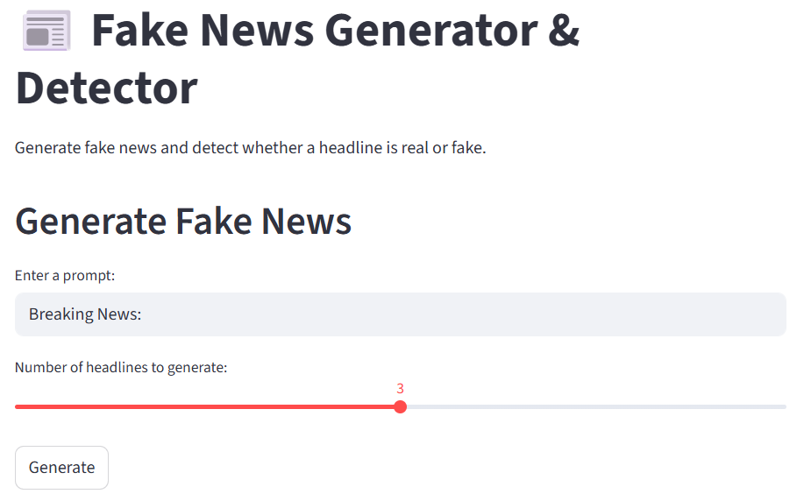
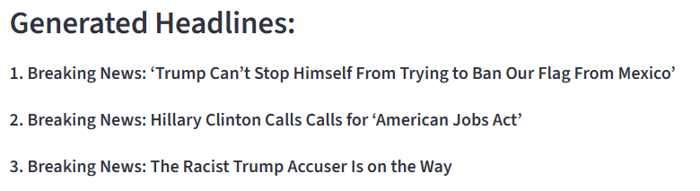
Fake News Generation Examples

Slide 15
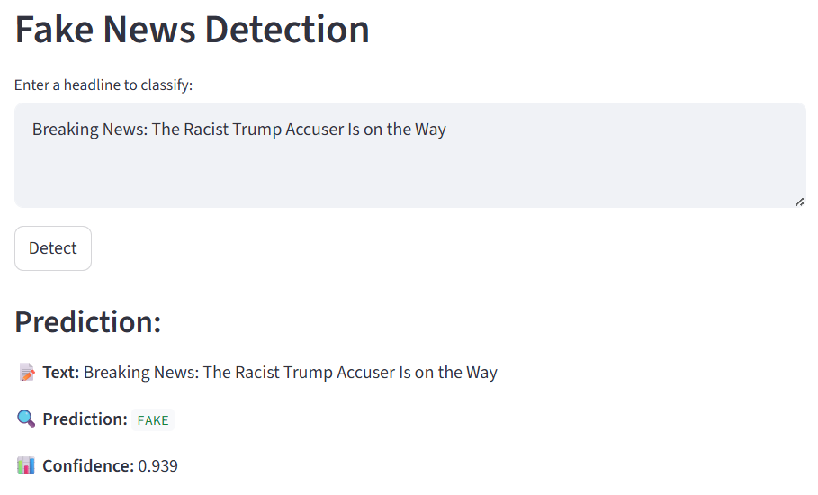
Fake News Generation Examples

Slide 16
Future Work
Extend detection to multi-class categories
- Satire, Clickbait, Propaganda, Biased Reporting, Partially True Content, Manipulated Headlines
2. Collect larger, multilingual, and more varied datasets to improve accuracy, reduce model bias and increase generalization
3. Integrate external fact-checking APIs for hybrid verification like Google Fact Check API, NewsTrust Databases
4. Extend the dataset and classifier to include region-specific misinformation: Political (US, EU, India, etc.) and varied topics like Economic, Health, Climate, Technology, Celebrity News
This makes the system effective for global fake news detection.
5. Upgrade to More Robust, Advanced Models

Slide 17


