Slide 1

N Queen Visualizer
Harshita Rajoria
Reg.No.:12224044
Roll No.:48
Section: 9SK02

Slide 2
Acknowledgement
I would like to express my sincere gratitude to Rahul Sir, our trainer, for providing us with the opportunity to participate in the Summer Term Training and Project. His guidance, support, and expertise have been invaluable throughout our journey.
I would also like to extend my appreciation to the university for organizing this training program and for giving us the chance to work on a real-world project like the N-Queen Visualiser. This experience has been immensely beneficial in enhancing our skills and knowledge in computer science and web development.
The training sessions conducted by Rahul Sir have been informative, engaging, and have provided us with a solid foundation in various technologies and best practices. His patience, dedication, and willingness to share his knowledge have been truly commendable.
Through this project, we have gained hands-on experience in building a web application from scratch, utilizing modern tools and frameworks. The step-by-step visualization of the N-Queen problem and the ability to control the speed of the algorithm have been particularly interesting aspects of the project.
We are grateful for the opportunity to work on this project and to learn from Rahul and the university. This experience has been a valuable addition to our academic and professional growth, and we look forward to applying the skills and knowledge gained here in our future endeavors.

Slide 3
Table of Contents
Content:
Introduction
Purpose
Scope
Overview
General Description
Perspectives
Functions
Characteristics
Assumptions and Dependencies
Specific Requirements
Design Constraints
Screenshots

Slide 4
Introduction
Purpose: The purpose of this application is to provide an interactive and educational tool for understanding and exploring the classic N-Queen problem.
Scope: The scope of this project is to develop a web application that allows users to visualize the solutions to the N-Queen problem.
Overview: The N-Queen Visualiser is a web application that helps users visualize the placement of queens on an N x N chessboard such that no two queens threaten each other. This visualization aids in understanding the algorithm used to solve this problem, a fundamental concept in computer science.

Slide 5
General Description
Perspectives: The N-Queen Visualiser is a standalone web application accessible through a web browser. It offers a user-friendly interface for interacting with the N-Queen problem and visualizing its solutions.
Functions:
Visualizing the chessboard and the placement of queens.
Providing step-by-step visualization of the algorithm as it searches for solutions.
Allowing users to control the speed of the visualization.
Displaying the number of possible solutions for a given N.
Validating user input and providing feedback on invalid values.

Slide 6
Application Characteristics
Responsive Design: The application adapts to different screen sizes and devices, ensuring usability on desktops, tablets, and smartphones.
Interactive Controls: Users can adjust the speed of the visualization to match their learning pace.
Multiple Solutions: The application can display multiple solutions for the N-Queen problem, providing a comprehensive understanding of the algorithm.
User Interface: A clear and intuitive interface ensures a seamless user experience, making the application accessible to users of all levels.

Slide 7
Specific Requirements
The key requirements for the N-Queen Visualizer include:
Ability to accept user input for the value of N.
Validation of user input to ensure valid values.
Visualization of the chessboard and the placement of queens.
Step-by-step animation of the algorithm's progress.
User controls for adjusting the visualization speed.
Display of the number of possible solutions for a given N.
Responsive design to accommodate different screen sizes.

Slide 8
Design Constraints
User Experience: Ensure a clear and intuitive user interface that is easy to navigate.
Performance: Optimize the application for smooth performance, especially during the visualization of multiple solutions.
Accessibility: Ensure the application is accessible on various devices and screen sizes.
Scalability: Allow the application to handle large values of N without significant performance degradation.

Slide 9
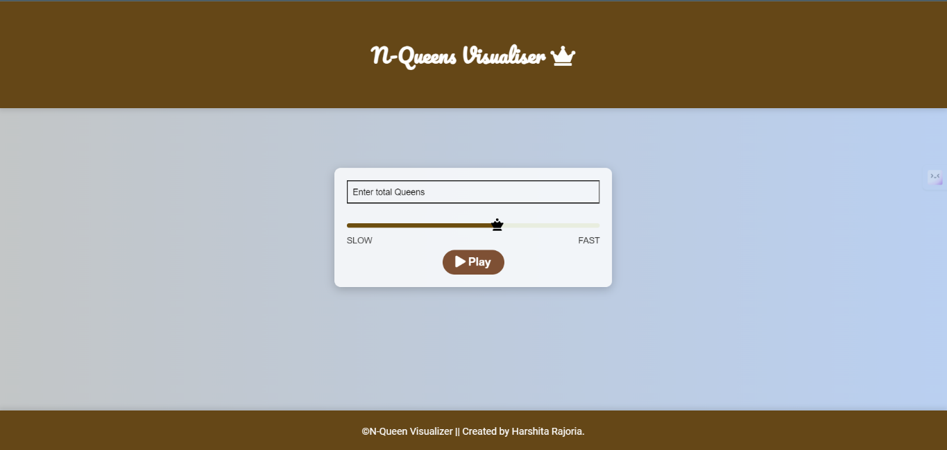
Screenshots
Inteface:

Slide 10
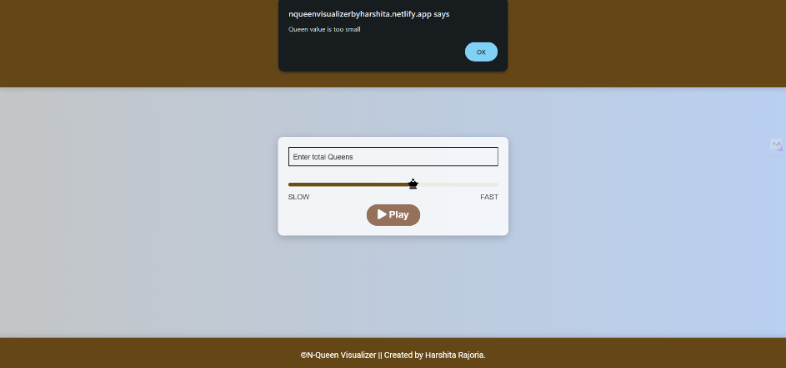

Showing Constraints:

Slide 11
Conclusion
In conclusion, the N-Queen Visualiser project has provided us with invaluable experience in web development and algorithm visualization. We have learned to build a responsive and interactive web application from scratch, applying modern tools and frameworks.
We extend our heartfelt gratitude to Rahul Sir for his guidance and to the university for this opportunity. The skills and knowledge gained from this project will significantly contribute to our academic and professional growth.

Slide 12
Thank you for your attention.

