Slide 1

Student Details
Name : Tadikamalla Harshith
SKILLS BUILD E-MAIL ID : tadikamallaharshith15@gmail.com
BRANCH : CSE-IoT & CS IIncl BCT
ROLL NO : 21KT1A4754
COLLEGE : POTTI SRIRAMULU CHALAVADI MALLIKARJUNA RAO COLLEGE OF ENGINEERING AND TECHNOLOGY

Slide 2

hiding a text inside an image using steganography
In today’s digital age, In organizations and companies, the transmission of sensitive information is crucial yet fraught with risks. Traditional methods of data encryption are often easily detectable, which can attract malicious entities and potential cyber-attacks.
There is a pressing need for a more secure and covert means of communication that ensures confidential data remains protected during transmission.

Slide 3
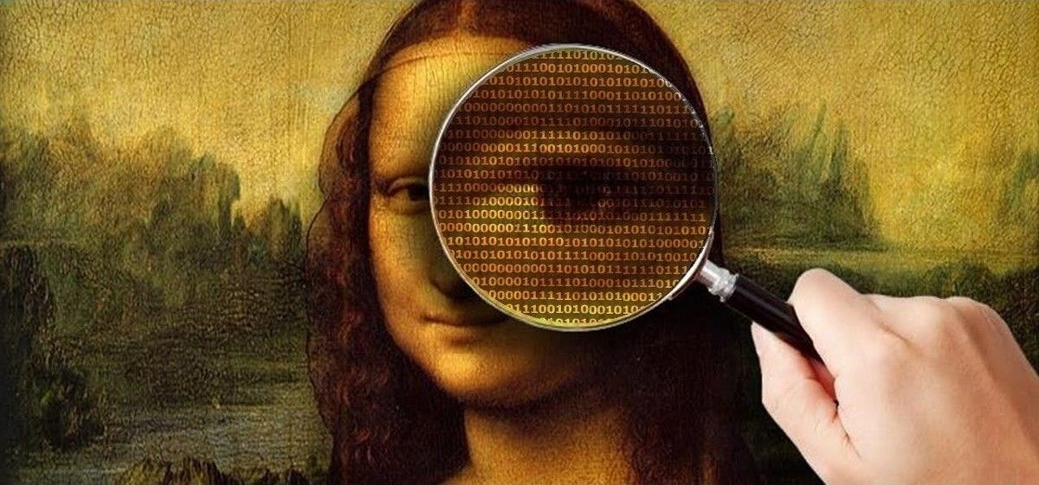
AGENDA
The agenda of this project to send a secret text to higher officials using the steganography concept and RGB technique, ensuring that criminals or others cannot identify the image or its hidden content. Thos project will involve encoding the secret text into the least significant bits of the image’s pixels, making the alterations imperceptible to the human eye.
Additionally, a secure key-based XOR operation will be used to enhance the security of the hidden message. Finally, the project will include a robust mechanism for decoding and retrieving the hidden message, ensuring that only authorized personnel with the correct key can access the concealed information

Slide 4
PROJECT OVERVIEW
Image Steganography offers a unique approach to secure data transmission by embedding hidden text within digital images. Unlike traditional encryption, which alters the data directly, steganography hides information in plain sight, making it less susceptible to detection. The embedded text remains invisible to the naked eye and requires a specific decryption key to be extracted.
Steganographic Encoding: We utilize advanced techniques to embed textual information discreetly within image files without altering their visual appearance.
Encryption: The hidden text undergoes encryption before being embedded, ensuring that even if the steganographic content is discovered, it remains unreadable without the decryption key.
User Interface: Our application features an intuitive user interface that facilitates easy embedding and extraction of hidden text from images. Users can seamlessly select images, enter text, manage secret keys, and save steganographic images for transmission.
Security: By combining encryption and steganography, our project provides a dual-layered security approach, enhancing the confidentiality and integrity of sensitive information during transmission.

Slide 5
WHO ARE THE END USERS of this project?
Organizational Staff: Employees across departments who need to securely transmit sensitive data such as financial reports, intellectual property, or proprietary information.
IT Security Teams: Security professionals responsible for implementing and managing data protection measures within the organization, ensuring compliance with security protocols.
Researchers and Academia: Researchers and scholars requiring secure communication channels for sharing research findings, academic papers, and confidential data.
Government Agencies: Officials and agencies involved in national security, law enforcement, and diplomatic communications requiring covert transmission of sensitive information.
Healthcare Providers: Healthcare professionals needing to securely exchange patient information, medical records, and confidential healthcare data while adhering to strict privacy regulations.

Slide 6
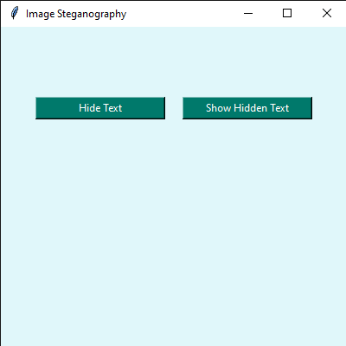
YOUR SOLUTION AND ITS VALUE PROPOSITION
Our solution leverages image steganography to enhance secure communication by embedding hidden text within digital images.
Enhanced Security: By combining encryption and steganography, our solution offers a robust method for concealing sensitive information.
Ease of Use: Our user-friendly interface simplifies the process of embedding and extracting hidden text within images.
Data Integrity: The use of steganography ensures that the visual integrity of the image is preserved, maintaining the covertness of the embedded information.
Versatility: Our solution caters to various sectors such as government agencies, healthcare providers, academic institutions, and corporate entities.
Compliance and Confidentiality: Organizations benefit from compliance with regulatory requirements concerning data privacy and confidentiality.

Slide 7
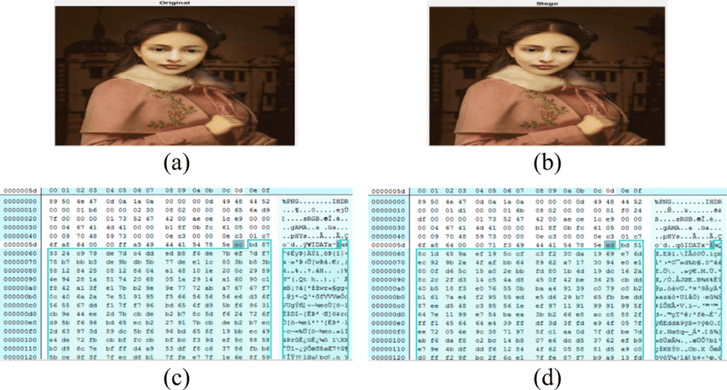
How did you customize the project and make it your own
By using problem statement this project is created to hide a text inside an image using RGB, LSB method is used for imperceptible to the human eye. And here XOR operation is used for hide and unhide the image.
This project is customized only to hide a text inside an image using above conditions and can only unhide the image who has secret key others are not able to unhide the image.

Slide 8
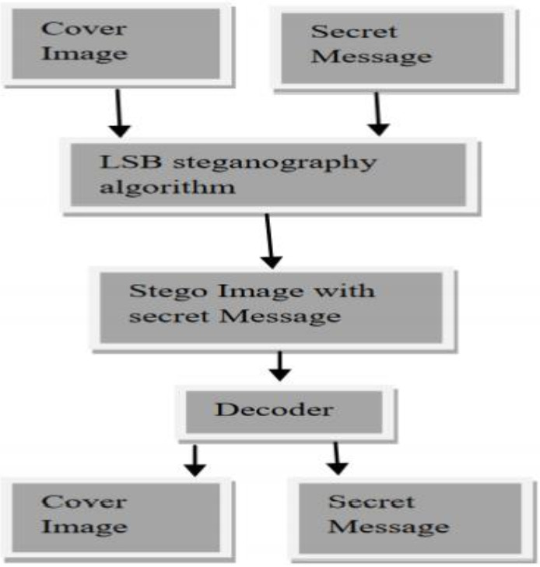
MODELLING
Steganography Algorithm Selection: Chose image steganography as the method for embedding hidden text within digital images. &
Implemented algorithms to convert text to binary and embed it into RGB color channels of the image without visibly altering its appearance.
Encryption Integration: Integrated encryption using Fernet from cryptography library to secure the hidden text before embedding. &
Implemented decryption to retrieve and decode hidden text from steganographic images using the same encryption key.
User Interface Development: Developed a graphical user interface (GUI) using tkinter library for seamless interaction with the steganography tool.
Error Handling and Validation: Implemented checks for image and key validity to ensure smooth operation and prevent errors during text embedding and extraction.
Testing and Validation: Conducted rigorous testing to validate the functionality of text hiding and extraction under various scenarios.
Deployment and Usage: Deployed the steganography tool as a standalone application for practical use in secure communication scenarios.

Slide 9
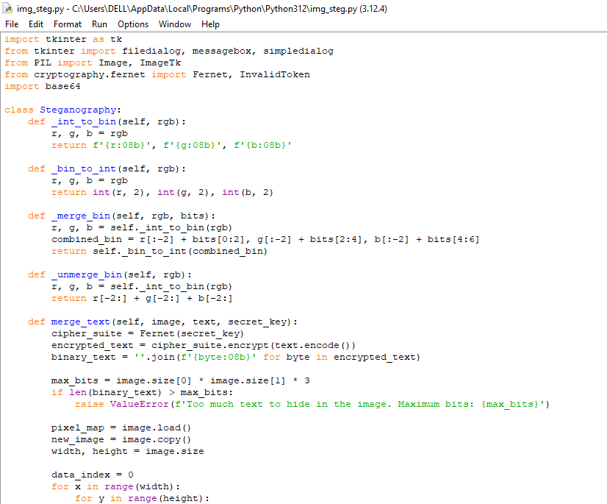
Results

Slide 10


Original & steganography images
Before Hiding
the Text
After Hiding
the Text
Original image
Stego image

Slide 11
links
Project Link : https://github.com/HARSHITH-TADIKAMALLA/Hiding-a-text-inside-an-image-using-Steganography/upload/main

