Slide 1

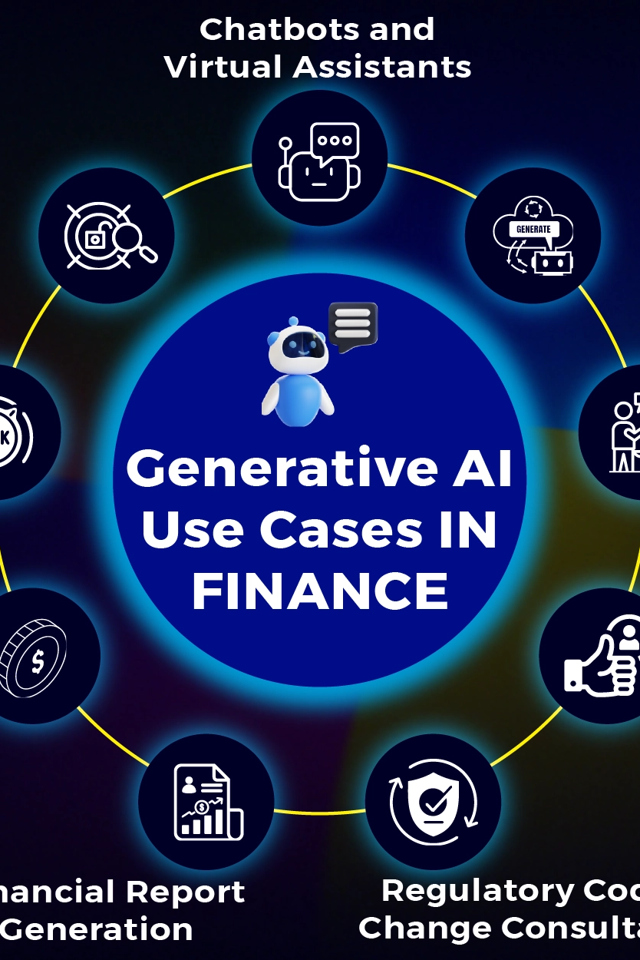
AI-Powered Investment Strategy Advisor
In today's complex financial landscape, navigating the world of investments can be overwhelming. Individuals often lack the time, expertise, or resources to make informed investment decisions. This is where an AI-powered investment strategy advisor steps in, offering personalized guidance and actionable insights to help investors achieve their financial goals.

Slide 2

Stakeholders
1
Individual Investors
2
Financial Advisors
3
Financial Institutions
4
Tech Companies

Slide 3

Statistics
More costly for professional advisor to reduce the cost effectiveness to the individual investors
A survey reveals that more than 80% of retail investors feel the need for more personalized investment advice to better align with their financial goals and risk tolerance.

Slide 4
Existing Solutions
Traditional Investment Advice
Robo-Advisors
DIY Investment Platforms
Traditional financial advisors provide personalized advice based on their experience and knowledge of the market. However, this can be expensive and time-consuming for individuals.
Robo-advisors offer automated investment solutions based on pre-defined algorithms. These solutions are often less expensive than traditional advisors but lack the personalized touch.
Many platforms allow individuals to invest independently, providing access to market data and tools for managing their investments. However, this requires a significant level of financial literacy and understanding of market dynamics.

Slide 5





Solution Approach
User Data Collection
The system gathers user information, including financial goals, risk tolerance, investment preferences, and income and expenditure data.
Market Analysis
AI algorithms analyze real-time market data, including financial news, economic indicators, and company performance, to identify investment opportunities and risks.
Portfolio Recommendation
The system generates personalized investment recommendations based on the user's data and market analysis, suggesting asset allocation, specific investment choices, and diversification strategies.
Real-time Alerts
The system monitors the market and provides timely alerts to users about significant market events, portfolio performance updates, and potential investment opportunities.

Slide 6
Thank You

