Slide 1
Intro to Deep Neural Networks: Multi-layer Perceptrons
CS771: Introduction to Machine Learning
Piyush Rai

Slide 2



Limitation of Linear Models
2
Linear models: Output produced by taking a linear combination of input features
A basic unit of the form $y=f(w^{⊤}x)$ is known as the “Perceptron” (not to be confused with the Perceptron “algorithm”, which learns a linear classification model)
This can’t however learn nonlinear functions or nonlinear decision boundaries
Linear regression, logistic regression, SVM, etc
$f$ is some linear/nonlinear function
(e.g., identity, sign, or sigmoid)
Although can kernelize to make them nonlinear

Slide 3
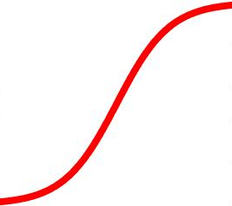

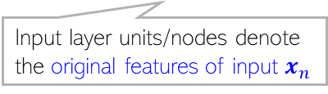
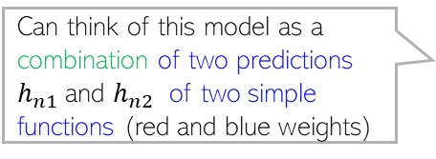
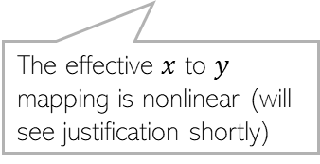
Neural Networks: Multi-layer Perceptron (MLP)
3
An MLP is a network containing several Perceptron units across many layers
An MLP consists of an input layer, an output layer, and one or more hidden layers
Output Layer
(with a scalar-valued output)
$${\hat{y}}_{n}$$
Hidden layer units/nodes (a.k.a. “neurons”) act as new features
Learnable weights
One hidden Layer
(with K=2 hidden units)
Can think of this model as a combination of two predictions $h_{n1}$and $h_{n2}$ of two simple functions (red and blue weights)
Input Layer
(with D=3 visible units)
The effective $x$ to $y$ mapping is nonlinear (will see justification shortly)
Input layer units/nodes denote the original features of input $x_{n}$
MLP is also called feedforward fully-connected network

Slide 4

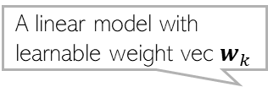


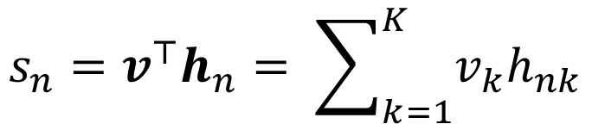
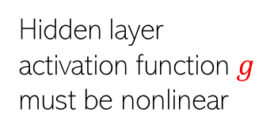




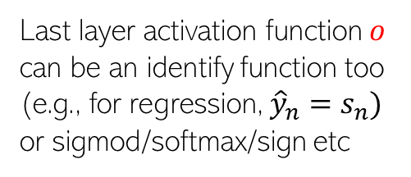
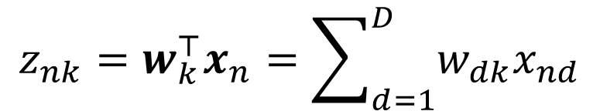





Illustration: Neural Net with Single Hidden Layer
4
$${\hat{y}}_{n}$$
Compute $K$ pre-activations for each input $x_{n}$
Apply nonlinear activation on each pre-act
Apply a linear model with $h_{n}$ acting as features
Finally, output is produced as
Loss: $ℒ\left(W,v\right)= \sum_{n=1}^{N}{ℓ(y_{n},}{\hat{y}}_{n})$
A linear model with learnable weight vec $w_{k}$
Last layer activation function $o$ can be an identify function too (e.g., for regression, ${\hat{y}}_{n}=s_{n})$ or sigmod/softmax/sign etc
$$z_{nk}=w_{k}^{⊤}x_{n}=\sum_{d=1}^{D}{w_{dk}x_{nd}}$$
$$(k=1,2,…, K)$$
$$s_{n}$$
$$h_{n1}$$
$$h_{n2}$$
Called a hidden unit
$$h_{nk}=g(z_{nk})$$
$$(k=1,2,…, K)$$
Hidden layer activation function $g$ must be nonlinear
A linear model with learnable weight vec $v$
$$s_{n}=v^{⊤}h_{n}= \sum_{k=1}^{K}{v_{k}h_{nk}}$$
$$z_{n1}$$
$$z_{n2}$$
Score of the input
Score converted to the actual prediction
$${\hat{y}}_{n}=o(s_{n})$$

Slide 5
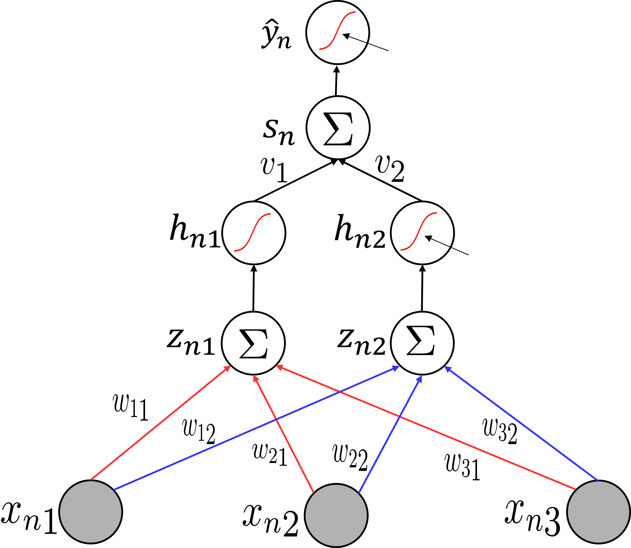
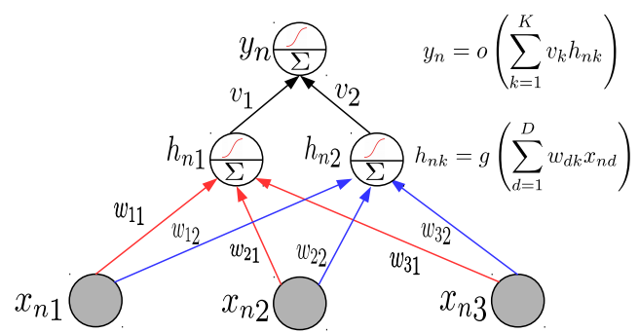

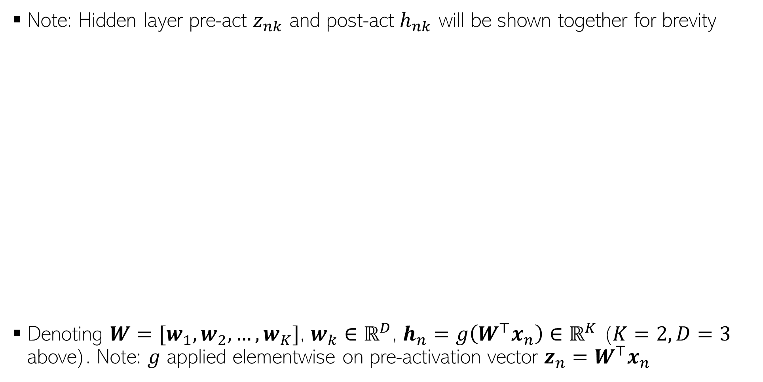
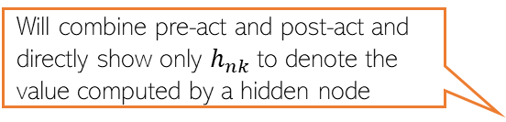
Neural Nets: A Compact Illustration
Will denote a linear combination of inputs followed by a nonlinear operation on the result
5
Note: Hidden layer pre-act $z_{nk}$ and post-act $h_{nk}$ will be shown together for brevity
Denoting $W=[w_{1},w_{2},…, w_{K}]$, $w_{k}∈ℝ^{D}$, $h_{n}=g\left(W^{⊤}x_{n}\right)∈ℝ^{K}$ ($K=2,D=3$ above). Note: $g$ applied elementwise on pre-activation vector $z_{n}=W^{⊤}x_{n}$
Will directly show the final output
Will combine pre-act and post-act and directly show only $h_{nk}$to denote the value computed by a hidden node
Single
Hidden
Layer
More succinctly..
$$h_{nk}=g(w_{k}^{⊤}x_{n})$$

Slide 6
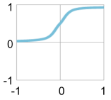
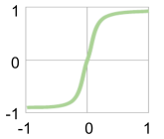

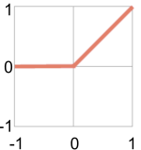
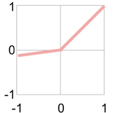

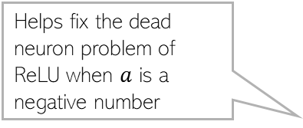
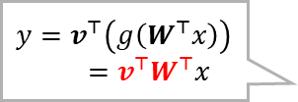
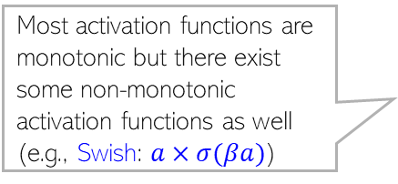
Activation Functions: Some Common Choices
6
sigmoid
tanh
For sigmoid as well as tanh, gradients saturate (become close to zero as the function tends to its extreme values)
Preferred more than sigmoid. Helps keep the mean of the next layer’s inputs close to zero (with sigmoid, it is close to 0.5)
h
h
a
a
ReLU
ReLU and Leaky ReLU are among the most popular ones (also efficient to compute)
Leaky ReLU
$$y=v^{⊤}\left(g\left(W^{⊤}x\right)\right)$$
$=v^{⊤}W^{⊤}x$
Imp: Without nonlinear activation, a deep neural network is equivalent to a linear model no matter how many layers we use
h
Still linear
Helps fix the dead neuron problem of ReLU when $a$ is a negative number
Most activation functions are monotonic but there exist some non-monotonic activation functions as well (e.g., Swish: $a×σ(βa)$)
a

Slide 7
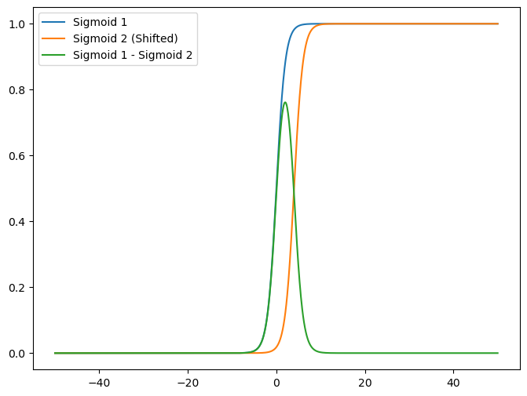
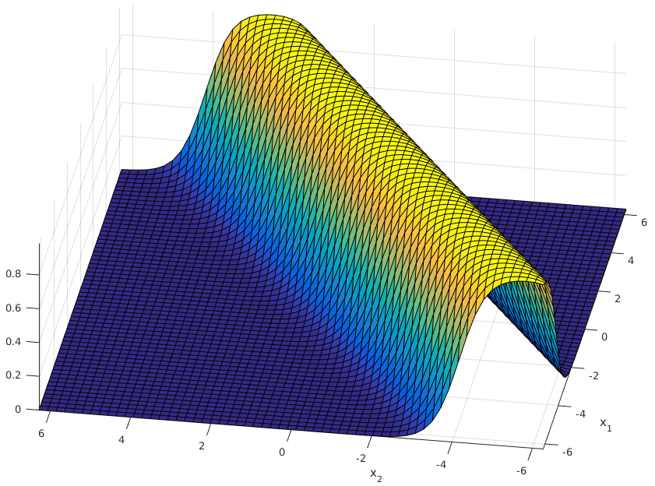
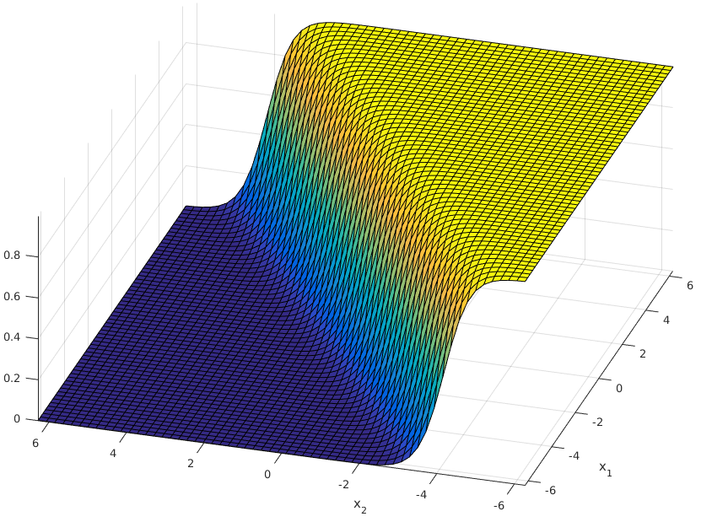
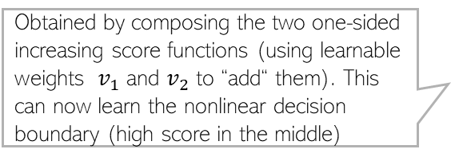

MLP Can Learn Any Nonlinear Function
7
An MLP can be seen as a composition of multiple linear models combined nonlinearly
High-score in the middle and low-score on either of the two sides of it. Exactly what we want for the given classification problem
Obtained by composing the two one-sided increasing score functions (using learnable weights $v_{1}$ and $v_{2}$ to “add“ them). This can now learn the nonlinear decision boundary (high score in the middle)
score
Score monotonically increases. One-sided increase (not ideal for learning nonlinear decision boundaries). Just a linear model
$${\hat{y}}_{n}$$
score
score
score
A nonlinear classification problem
Standard Single “Perceptron” Classifier (no hidden units)
A single hidden layer MLP with sufficiently large number of hidden units can approximate any function (Hornik, 1991)
A Multi-layer Perceptron Classifier
(one hidden layer with 2 units)
Capable of learning nonlinear boundaries

Slide 8


Superposition of two linear models = Nonlinear model
8
Two sigmoids (blue and orange) can be combined via a shift and a subtraction operation to result in a nonlinear separation boundary
Likewise, more than two sigmoids can be combined to learn even more sophisticated separation boundaries
$$p(y=red|x)$$
Nonlinear separation boundary
$$x$$

Slide 9
Examples of some basic NN/MLP architectures
9

Slide 10


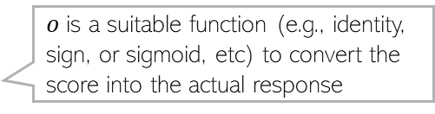
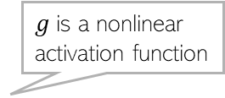
Single Hidden Layer and Single Output
10
One hidden layer with $K$ nodes and a single output (e.g., scalar-valued regression or binary classification)
$o$is a suitable function (e.g., identity, sign, or sigmoid, etc) to convert the score into the actual response
$${\hat{y}}_{n}=o(v^{⊤}h_{n})$$
$g$is a nonlinear activation function

Slide 11



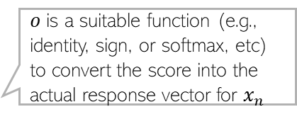



Single Hidden Layer and Multiple Outputs
11
One hidden layer with $K$ nodes and a vector of $C$ outputs (e.g., vector-valued regression or multi-class classification or multi-label classification)
$o$is a suitable function (e.g., identity, sign, or softmax, etc) to convert the score into the actual response vector for $x_{n}$
$${\hat{y}}_{n1}$$
$${\hat{y}}_{n2}$$
$${\hat{y}}_{nC}$$
$${\hat{y}}_{n}=o(V^{⊤}h_{n})$$
$g$is a nonlinear activation function

Slide 12
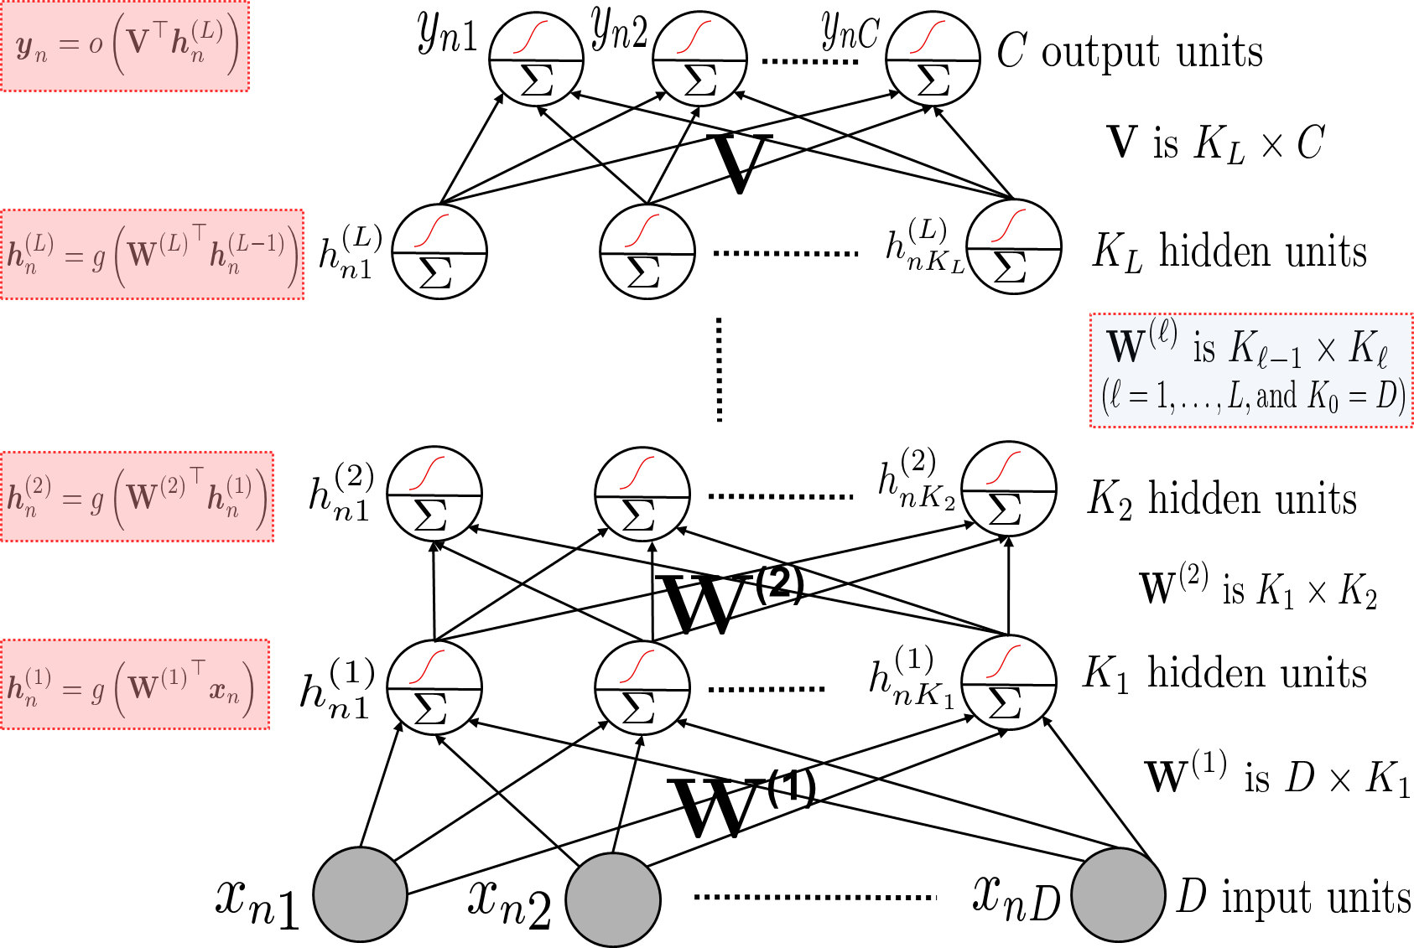
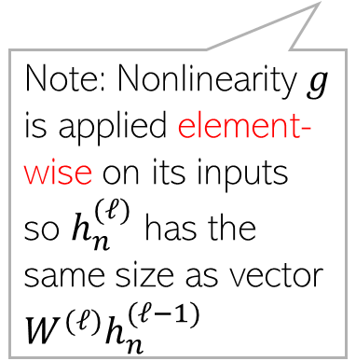
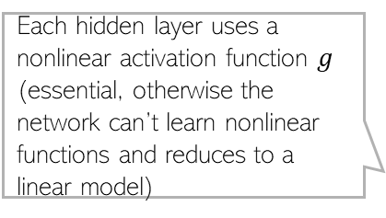
Multiple Hidden Layers (One/Multiple Outputs)
12
Most general case: Multiple hidden layers with (with same or different number of hidden nodes in each) and a scalar or vector-valued output
Each hidden layer uses a nonlinear activation function $g$ (essential, otherwise the network can’t learn nonlinear functions and reduces to a linear model)
Note: Nonlinearity $g$ is applied element-wise on its inputs so $h_{n}^{(ℓ)}$ has the same size as vector $W^{(ℓ)}h_{n}^{(ℓ−1)}$

Slide 13

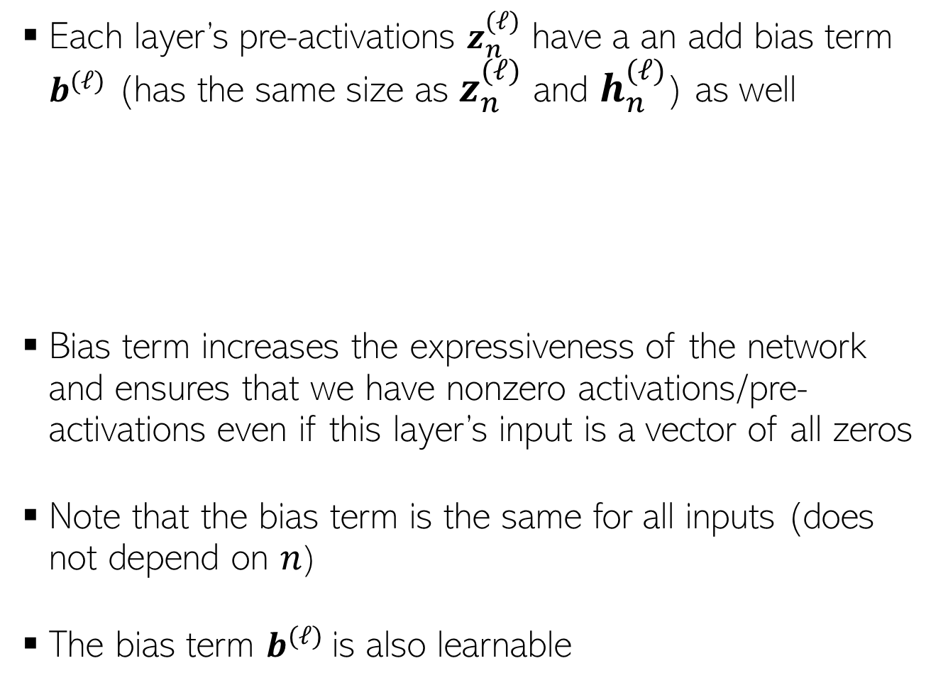








The Bias Term
13
Each layer’s pre-activations $z_{n}^{(ℓ)}$ have a an add bias term $b^{(ℓ)}$ (has the same size as $z_{n}^{(ℓ)}$ and $h_{n}^{(ℓ)}$) as well
Bias term increases the expressiveness of the network and ensures that we have nonzero activations/pre-activations even if this layer’s input is a vector of all zeros
Note that the bias term is the same for all inputs (does not depend on $n$)
The bias term $b^{(ℓ)}$is also learnable
$${\hat{y}}_{n}$$
$$z_{n}^{(ℓ)}=W^{{\left(ℓ\right)}^{⊤}}h_{n}^{(ℓ−1)}+b^{(ℓ)}$$
$$v$$
$$h_{n}^{(2)}$$
$$h_{n}^{(ℓ)}=g(z_{n}^{\left(ℓ\right)})$$
$$W^{(2)}$$
$$h_{n}^{(1)}$$
$$W^{(1)}$$
$$x_{n}$$

Slide 14
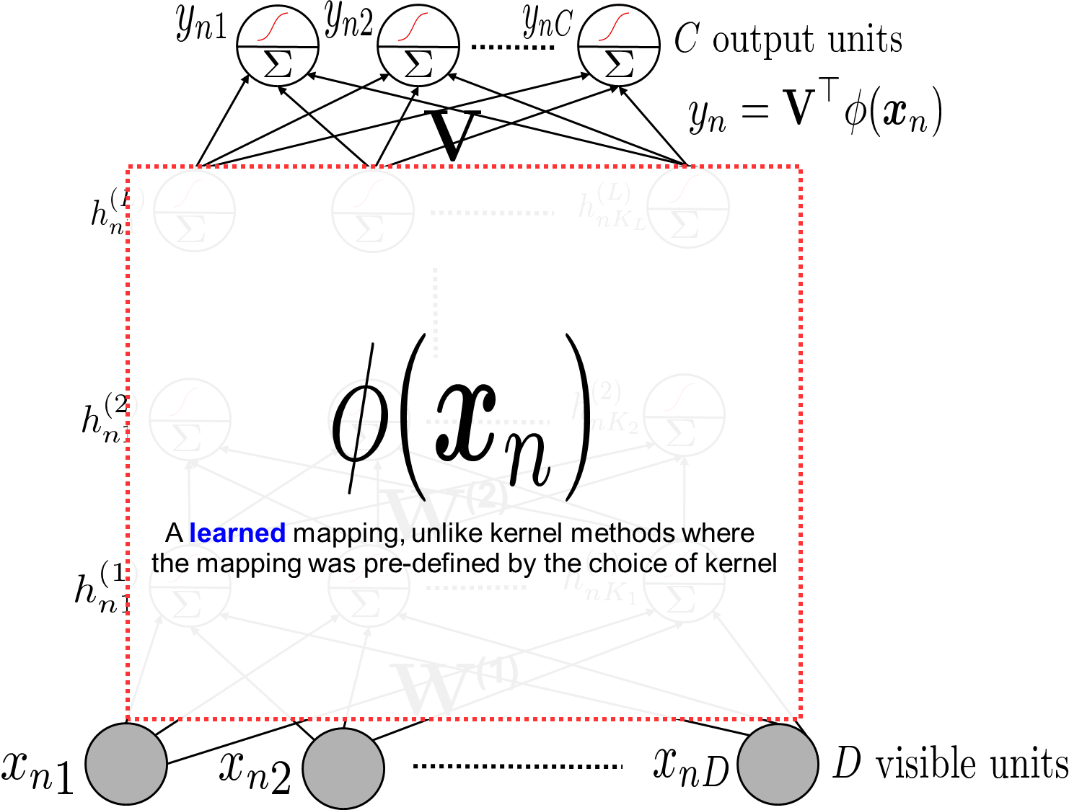

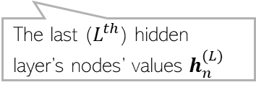
Neural Nets are Feature Learners
14
Hidden layers can be seen as learning a feature rep. $φ\left(x_{n}\right)$ for each input $x_{n}$
The last ($L^{th}$) hidden layer’s nodes’ values $h_{n}^{(L)}$

Slide 15
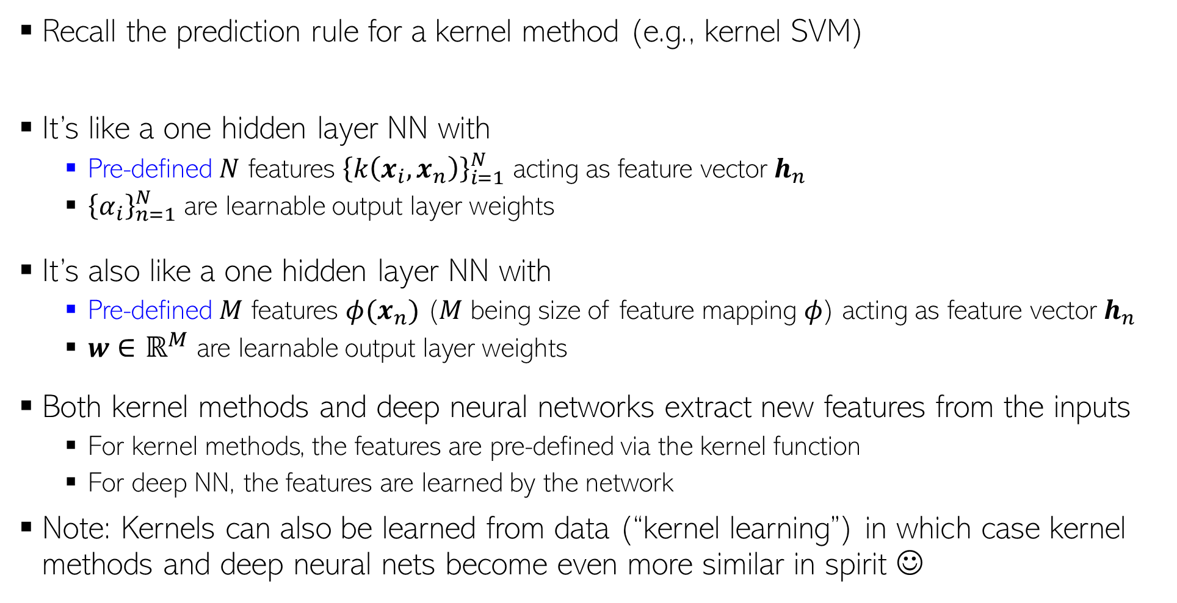

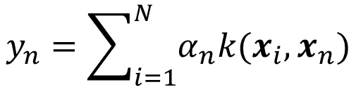
Kernel Methods vs Neural Nets
Also note that neural nets are faster than kernel methods at test time since kernel methods need to store the training examples at test time whereas neural nets do not
15
Recall the prediction rule for a kernel method (e.g., kernel SVM)
It’s like a one hidden layer NN with
Pre-defined $N$ features ${\left\{k\left(x_{i}, x_{n}\right)\right\}}_{i=1}^{N}$ acting as feature vector $h_{n}$
${\left\{α_{i}\right\}}_{n=1}^{N}$ are learnable output layer weights
It’s also like a one hidden layer NN with
Pre-defined $M$ features $φ(x_{n})$ ($M$ being size of feature mapping $φ$) acting as feature vector $h_{n}$
$w∈ℝ^{M}$ are learnable output layer weights
Both kernel methods and deep neural networks extract new features from the inputs
For kernel methods, the features are pre-defined via the kernel function
For deep NN, the features are learned by the network
Note: Kernels can also be learned from data (“kernel learning”) in which case kernel methods and deep neural nets become even more similar in spirit ☺
$$y_{n}=\sum_{i=1}^{N}{α_{n}k(x_{i},x_{n})}$$
$$y_{n}=w^{⊤} φ(x_{n})$$
OR

Slide 16
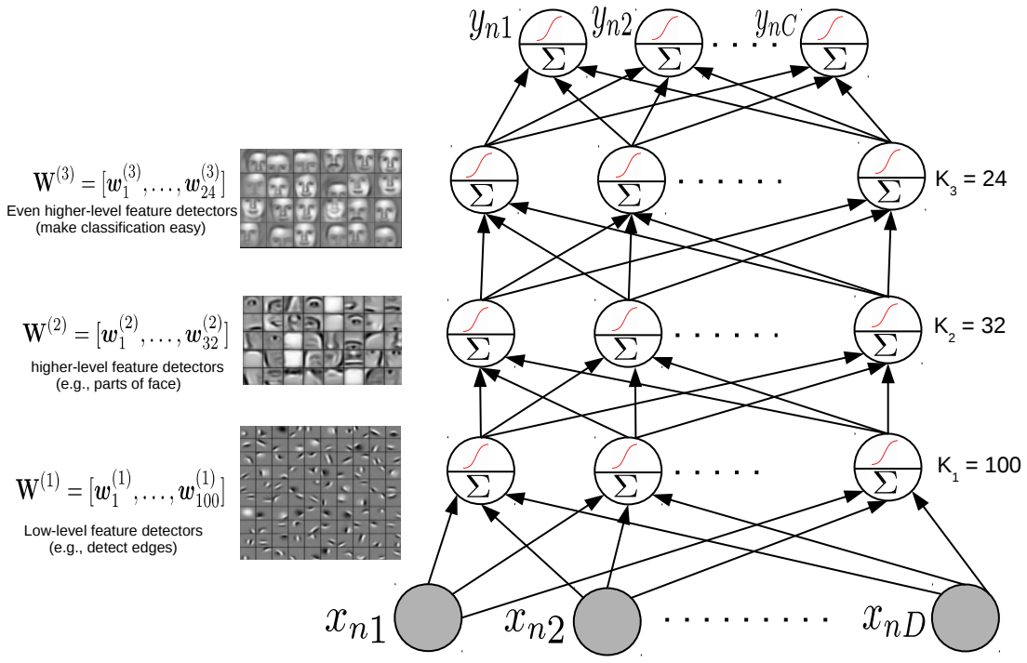
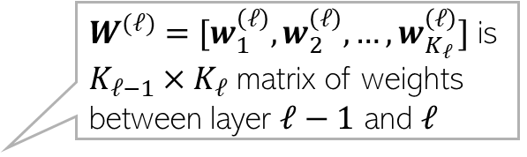







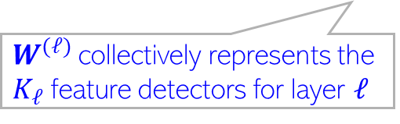
Features Learned by a Neural Network
16
$W^{(ℓ)}=[w_{1}^{\left(ℓ\right)}, w_{2}^{\left(ℓ\right)}, …,w_{K_{ℓ}}^{\left(ℓ\right)}]$ is ${K_{ℓ−1}×K}_{ℓ}$ matrix of weights between layer $ℓ−1$ and $ℓ$
$w_{k}^{(ℓ)}∈ℝ^{K_{ℓ−1}}$ denotes “feature detector” for feature $k$ of layer $ℓ$ For
For input $x_{n}$, $h_{nk}^{(ℓ)}=g({w_{k}^{\left(ℓ\right)}}^{⊤}h_{n}^{(ℓ−1)})$ is the value of feature $k$ in layer $ℓ$
$W^{(ℓ)}$collectively represents the $K_{ℓ}$ feature detectors for layer $ℓ$
All the incoming weights (a vector) to a hidden node can be seen as representing a pattern/feature-detector of previous layer’s inputs
$$h_{n}^{(3)}$$
E.g., $w_{32}^{(2)}$ denotes a feature detector
$$h_{n}^{(2)}$$
All the incoming weights (a vector) to a hidden node can be seen as representing a pattern/feature-detector of previous layer’s inputs
E.g., $w_{100}^{(1)}$ denotes a feature detector
$$h_{n}^{(1)}$$
$$K_{0}=D$$

Slide 17

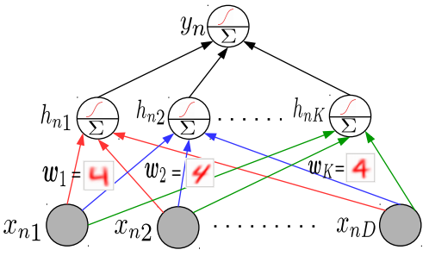
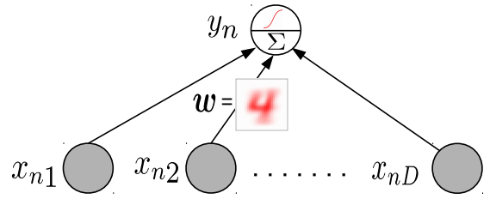
Why Neural Networks Work Better: Another View
17
Linear models tend to only learn the “average” pattern
E.g., Weight vector of a linear classification model represent average pattern of a class
Deep models can learn multiple patterns (each hidden node can learn one pattern)
Thus deep models can learn to capture more subtle variations that a simpler linear model

Slide 18
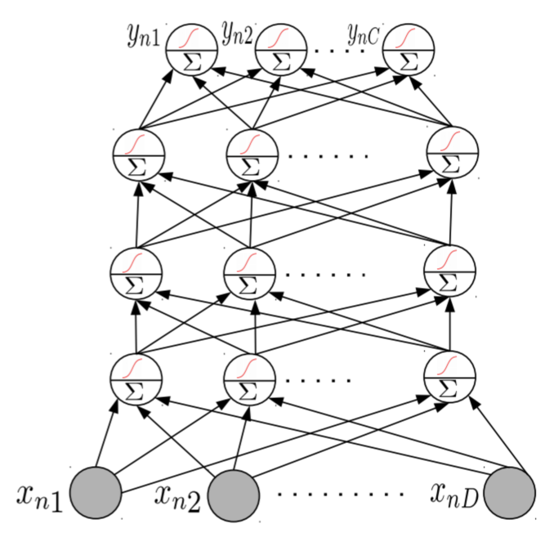
Neural Nets: Some Aspects
18
Much of the magic lies in the hidden layers
Hidden layers learn and detect good features
Need to consider a few aspects
Number of hidden layers, number of units in each hidden layer
Why bother about many hidden layers and not use a single very wide hidden layer (recall Hornik’s universal function approximator theorem)?
Complex networks (several, very wide hidden layers) or simpler networks (few, moderately wide hidden layers)?
Aren’t deep neural network prone to overfitting (since they contain a huge number of parameters)?
Choosing the right NN architecture is important and a research area in itself. Neural Architecture Search (NAS) is an automated technique to do this

Slide 19
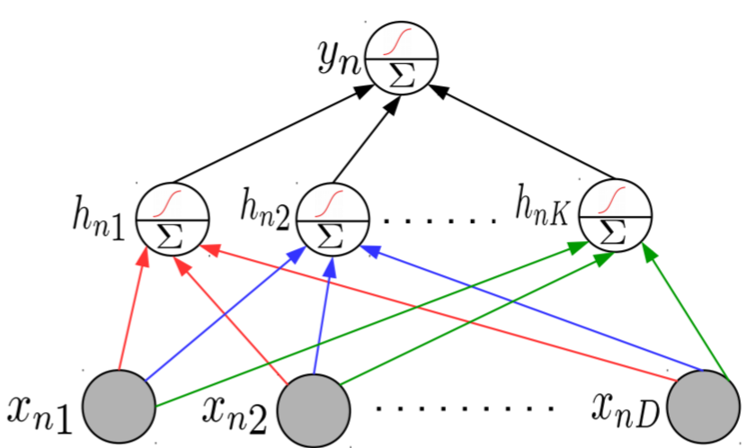
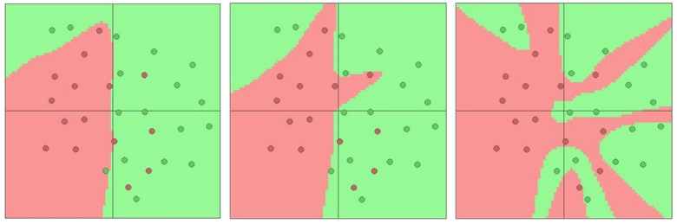
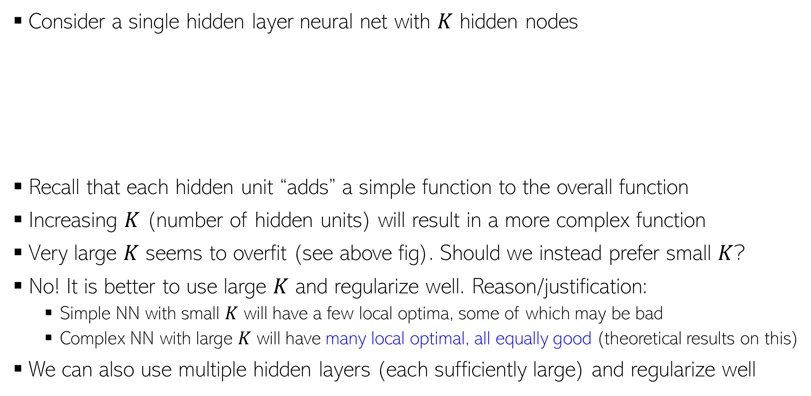
Representational Power of Neural Nets
19
Consider a single hidden layer neural net with $K$ hidden nodes
Recall that each hidden unit “adds” a simple function to the overall function
Increasing $K$ (number of hidden units) will result in a more complex function
Very large $K$ seems to overfit (see above fig). Should we instead prefer small $K$?
No! It is better to use large $K$ and regularize well. Reason/justification:
Simple NN with small $K$ will have a few local optima, some of which may be bad
Complex NN with large $K$ will have many local optimal, all equally good (theoretical results on this)
We can also use multiple hidden layers (each sufficiently large) and regularize well
K = 3
K = 6
K = 20

Slide 20

Wide or Deep?
20
While very wide single hidden layer can approx. any function, often we prefer many, less wide, hidden layers
Higher layers help learn more directly useful/interpretable features (also useful for compressing data using a small number of features)

