Slide 1
A Labs Technical Test
Name : Harsh Kumar
Email : kabiryadav55555@gmail.com

Slide 2
Objective
The objective is to provide various aspects, including data collection, integration, analysis, reporting, and suggestions for improving conversion rates and retaining mobile app users.

Slide 3
End-to-End Analytics Framework:
1. Data Collection and Integration:
Utilize a combination of tracking tools, obtained from Kaggle. Gather data from various touchpoints, including the website, mobile app, and other relevant sources.
2. Data Capturing:
Implement event tracking and tagging mechanisms that align with the data you've acquired. Capture user interactions, behaviors, and events across the product lifecycle as outlined in the provided data

Slide 4
web-based dashboard that will track the relevant metrics across the lifecycle of the product.
data collection from data sources, data capturing, data integration of various sources, downstream analytics including reports, insights-driven dashboards

Slide 5
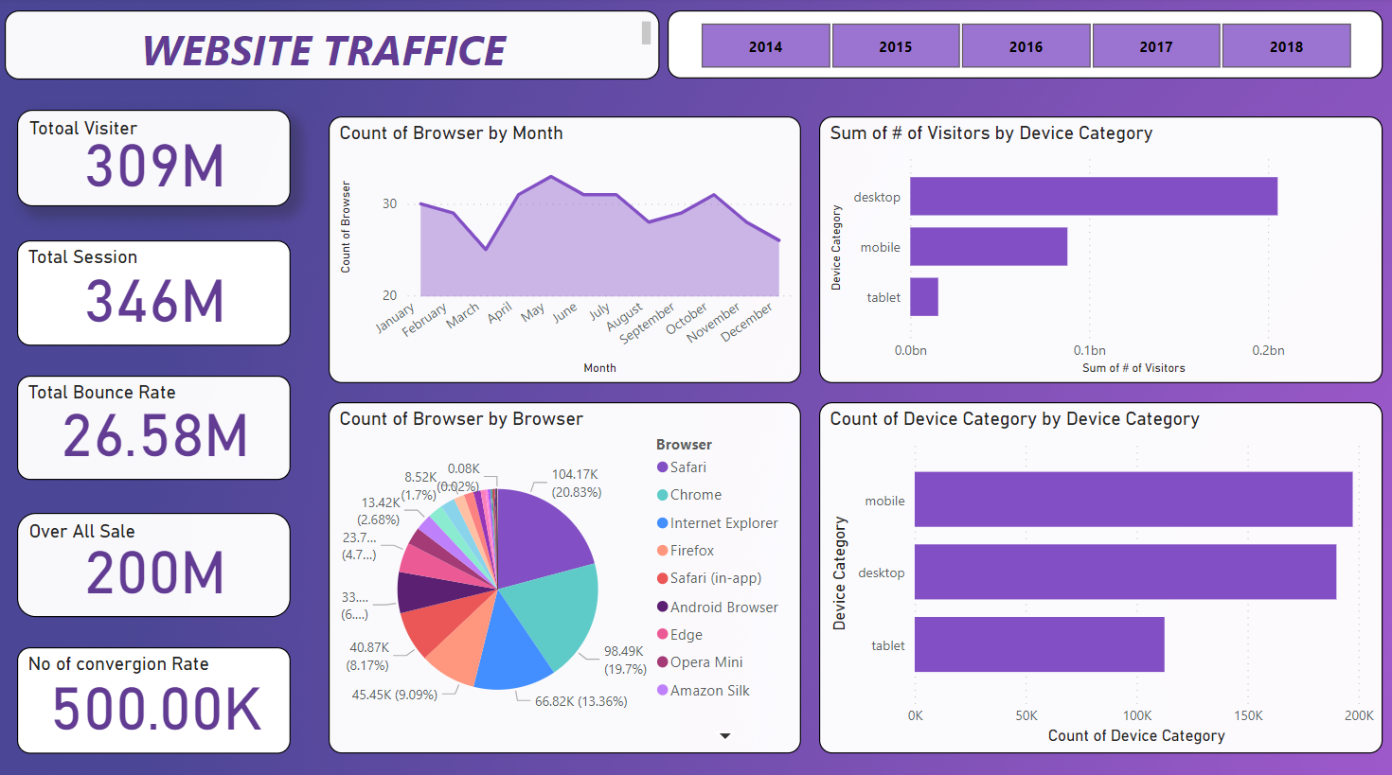

Slide 6
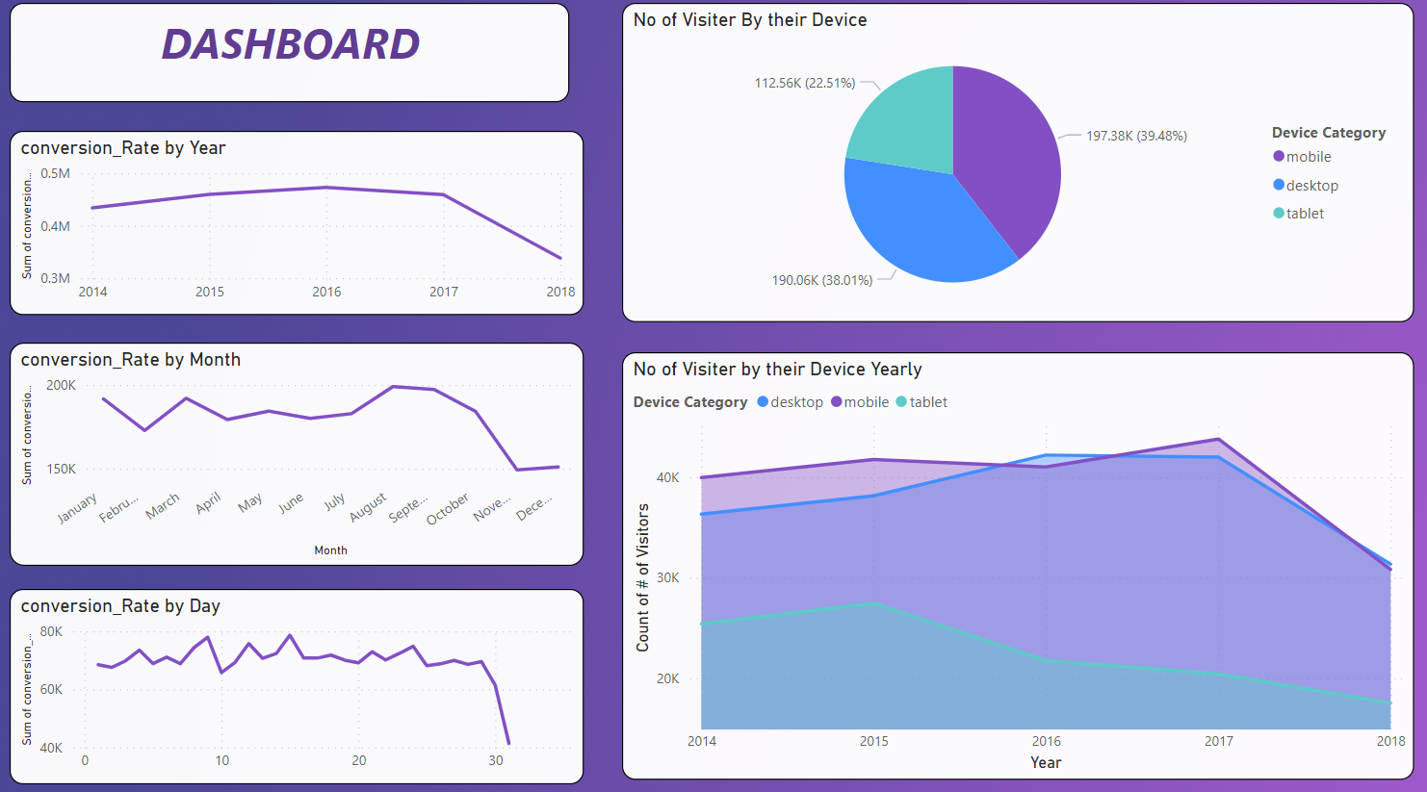

Slide 7
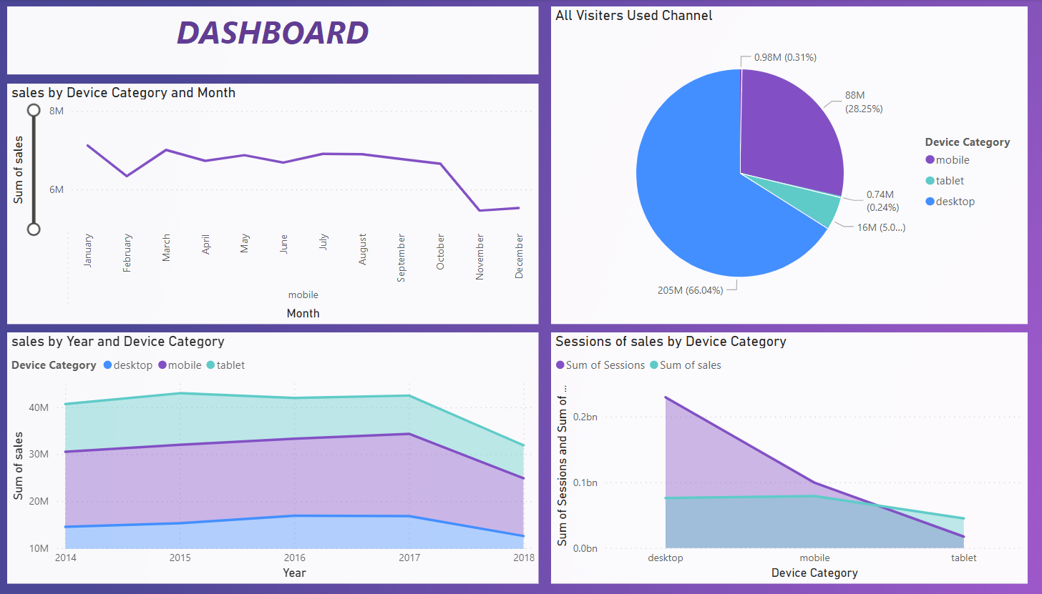

Slide 8
One more observation is of losing mobile app users app performance, and potential pain
User Experience Issues: Mobile apps with poor user interfaces, slow load times, or frequent crashes can lead to user frustration and abandonment.
Lack of Value: If users don't perceive significant value or benefits from the app, they may uninstall or stop using it.
Competitor Apps: Users might switch to competitors' apps that offer better features or experiences.
Ineffective Onboarding: If the onboarding process is confusing or lengthy, users may abandon the app before understanding its value.
Push Notifications: Overwhelming or irrelevant push notifications can lead to app uninstalls.
Technical Glitches: Frequent technical issues, such as login problems or payment failures, can deter users.

Slide 9
Possible Suggestions for User Retention:
Personalization: Customize content, recommendations, and offers based on user preferences.
Engaging Content: Provide high-quality, relevant content that meets users' needs.
Easy Onboarding: Simplify sign-up and initial use, guiding users through your platform's features.
Gamification: Integrate gamified elements to enhance engagement and make interactions fun.
Email Campaigns: Send personalized, timely emails with value-driven content and offers.
Community Building: Foster user communities or forums for discussions and sharing.

Slide 10
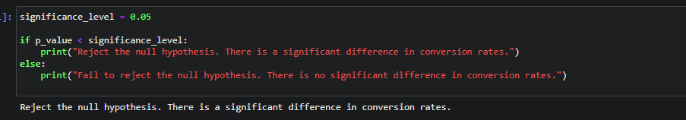
why users are dropping off?
Hypotheses to test in order to understand why users are dropping off
Changes in User Interface (UI) design are causing user drop-offs.
The recent changes in UI might have affected user experience and made it less intuitive, resulting in increased drop-offs.
Longer loading times are contributing to user drop-offs
Lack of personalized content is resulting in user disengagement.

Slide 11
To improve conversion rates:
Streamline user journey, improve UI/UX.
A/B test changes, prioritize high-impact ones.
Personalize content and address objections.
Build trust with social proof and clear value proposition.
Engage with users for feedback and insights.
Continuously refine strategies for sustained improvement.

Slide 12
Tools & Frameworks we can use for the same
Google Analytics: Offers in-depth insights into user behavior, funnel analysis, and conversion tracking.
Hotjar: Provides heatmaps, session recordings, and user surveys to understand how users interact with site.
Optimizely: Enables A/B testing and experimentation to test different variations of site.
Unbounce: Allows easy creation and testing of landing pages to improve conversion rates.
Crazy Egg: Provides heatmaps, A/B testing, and user session recordings for UX analysis.

Slide 13
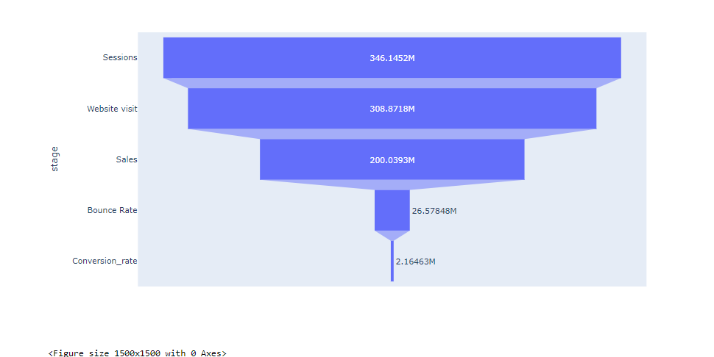
Blue Print Funnel

Slide 14
Thank You

