Slide 1
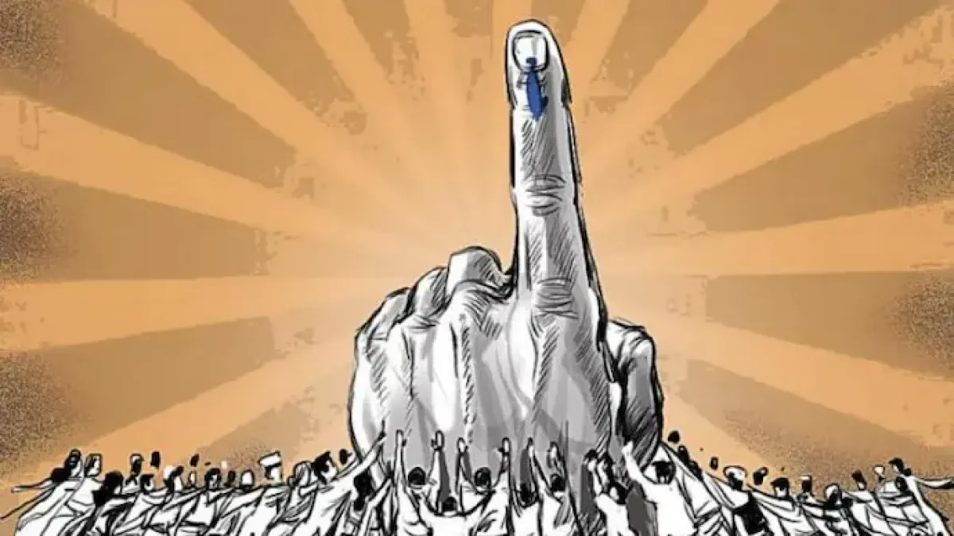
PROJECT ON:
ONLINE VOTING SYSTEM
This Photo by Unknown Author is licensed under CC BY-SA-NC

Slide 2
HI TO ALL
I, HARSH MOHAN
BTECH 1ST YEAR CSE STUDENT
RIT ROORKEE.
TODAY I AM GOING TO SHOWCASE MY PROJECT

Slide 3

OVERALL PROGRAMMING
This Photo by Unknown Author is licensed under CC BY-SA

Slide 4

VOTERS SLIP
This Photo by Unknown Author is licensed under CC BY

Slide 5
THANK YOU
GitHub: https://github.com/HARSHMOHAN01/ONLINE-VOTING-SYSTEM
LinkedIn: https://www.linkedin.com/in/harshmohan01/

