Slide 1

Data challenge - python
Joseph Gerig BoKyeung Kim,
Gloria Majchrzak Harsh Pundir
BUDT758 X _01
Notes:
Joe 1-6 slides
Gloria 7-11 slides
Joy 12-15 slides
Harsh 16-20 slides
ALL slide 21 Q&A

Slide 2
Agenda
Introduction
Methods
Findings and Results
Recommendations
Future Work

Slide 3
Client Background – Current State
Extensive Classification System
Alumni Database
History of Events
Notes:
Current State: strong foundation about database, 3part-code system, and the coding has allowed the association to evaluate the return on investment for individual events
Now, we will help you analyze aggregate data to draw conclusions and inform future strategies
Transititon intot next slide

Slide 4
Our Objectives
Extensive Classification system
Alumni Database
History of Events
Insights to Planning Future events
Increase Attendance in Key Groups
Provide Long-Term Data Structure
Notes:
From the presentation today, you will see that we will show you want key variables drive attendance for major gift prospects and first time attendees
We will also leave you with future use of the database as more events occur into future months
We will help you in understanding what types of events attract the largest number of first time attendees and major gift prospects so that we can use this information in planning future events.

Slide 5
Data Cleaning
Created Separate Data Frames with Unique Cleaned Code
Activity
Group
Location
Used Left Join to do “Vlookup” in Python
Checked for Correct Values in Calculated Field
Combine 7 Sheets into 1
622 Data Points in 7 Unique Sheets

Slide 6
Statement of Facts
342 Unique Activities
622 Data Points
Data
Cleaning
50 Unique Groups
46 Unique Locations

Slide 7
Data Visualization Methods
Preliminary Analysis
Detailed Review
Pivot Table
Box and Whisker Plot
Scattered Plot
Bar Plot
Histogram
Correlations
Tree Map
Heat Map
Time Series Trend
Clustering
Notes:
BENEFITS:
High level: we were able to see outliers, and clear indicators of what locations and activities were popular
Detailed Level View: we were able to drill down and see how variables influence ___________
Correlations: showed us direction on what variables influence one another and able to provide direction for MP and FT
You will see all of these charts shown throughout the rest of the presentation

Slide 8
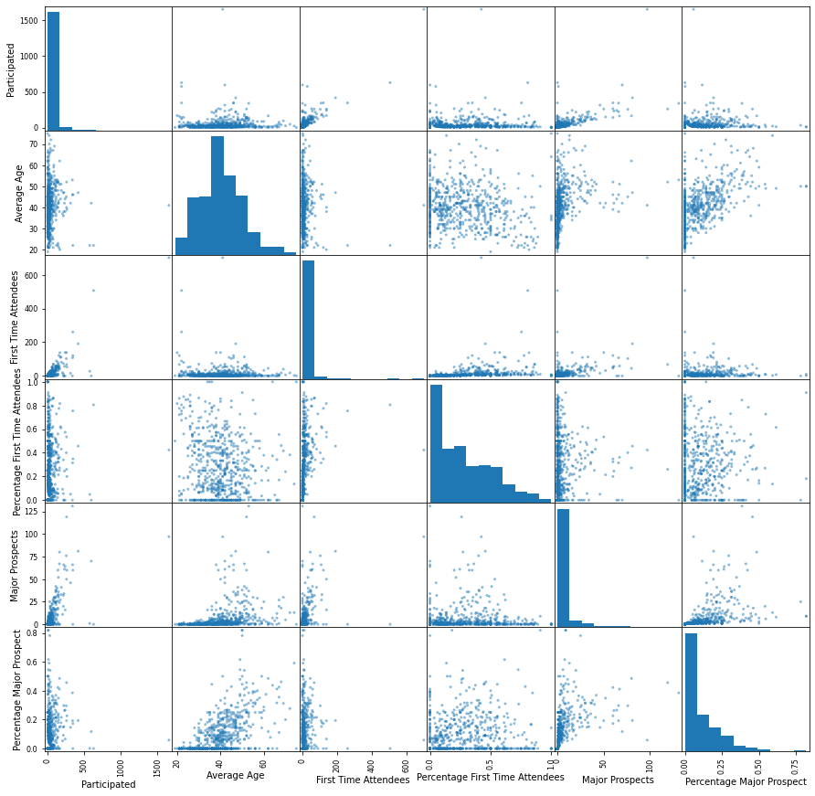
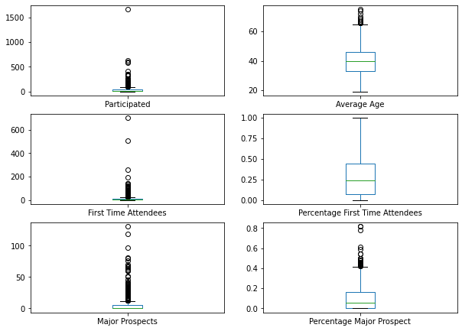
Preliminary Analysis View
Notes:
We found that this is a good analysis for a bird’s eye view and guides us to seeing outliers and startt tto see a shift of relattionships. We used this as a guide

Slide 9

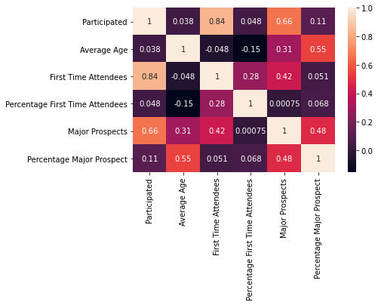
Correlations
Correlation Pairs:
# Participants & 1st Time Attendees (0.84)
# Participants & Major Prospects (0.66)
Average Age and % Major Prospect (0.55)
# Major Prospects & First Time attendees (0.42)

Slide 10
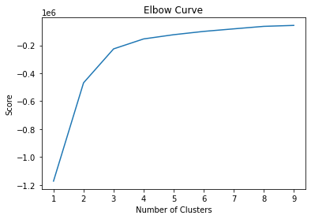
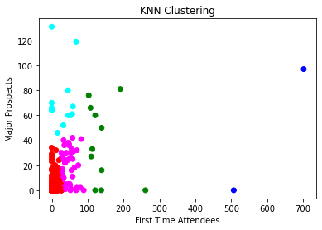
K-Means Clustering
Notes:
Elbow tells us the optimal value of clustering bins that we should create. To have the disttance from the center to be in the minimum from each cluster. We should cluster 3 to 4 max.
4 colors on KNN are showing less than .2. Shows the different groups.
Bullet points around the clusters. Mentioning clustering around numeric data
As FT increase, y axis increases. Very compact 0-100. The y-axis grows farther apart as MP.

Slide 11
Findings and Results – Detailed Level
Location
Group
Activity
Notes:
MP will be green back ground FT light blue background

Slide 12
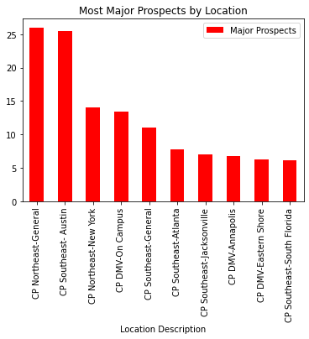
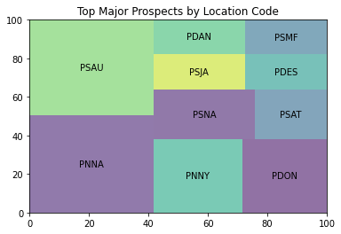
Findings & Results
Location
MP
Notes:
*Compare with tree map
Least around with what areas of the locations have not been successful with MP. More rural areas are not worth investing
From these top 10 locations, 55% attended these locations are from the total of the Major Prospects.

Slide 13
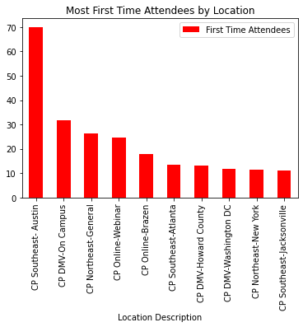
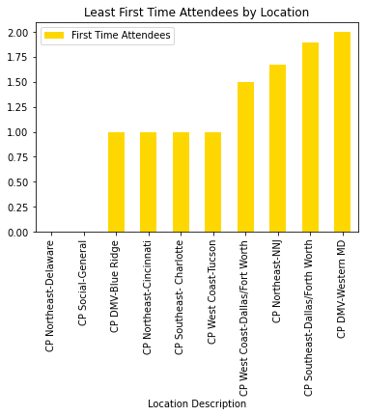
Findings & Results FT - Location
Location
FT
Notes:
Insight to share: _______
On campus themed events are a positive. If respect to costs, on campus will save fees and earn revenue for the University. FT enjoy coming. This is a proven successful area.
In future….why Austin? What was successful there? (It is an open carry city so maybe that’s why.)
It is a happy hour meet and greet. Austin had other event following event with only 4 people. Austin has potential but be careful what type of activity. Location isn’t sole factor.
Looking up same activity in different locations: happy hour in other US area
From these top 10 locations, 51% attended these locations are from the total of the First Time Attendees.

Slide 14
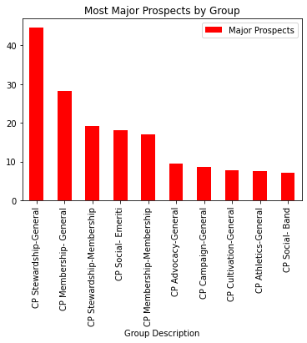
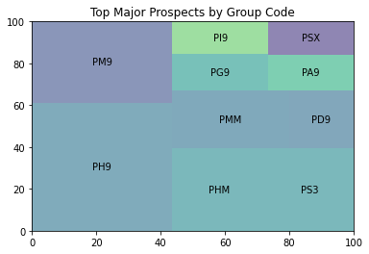
Findings & Results – Group
Group
MP
Notes:
Top 10 gives you 50% of total participants on average. (45% are the Major Prospects attending through these Top 10 Groups)
For example, if we had 100 groups, the top 20 groups in order by Major Prospects, gives me 50% of the overall Major Prospects participating within all our groups.

Slide 15
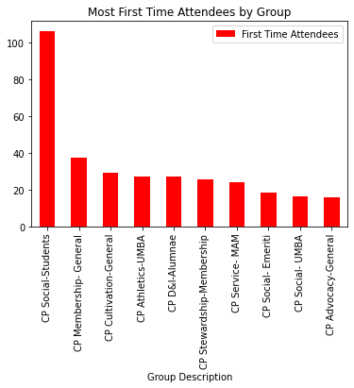
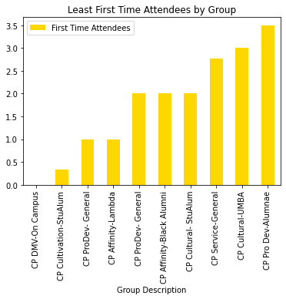
Findings & Results – Group
Group
FT
Notes:
Aware social setttings will attract first time attendees.
Out of all participated within groups, on average, 33 First Time Atttendees attend the top 10 events
For example, if we had 100 groups, the top 20 groups in order by First Time Attendees, gives me 33% of the overall first-time attendees participated within our groups

Slide 16
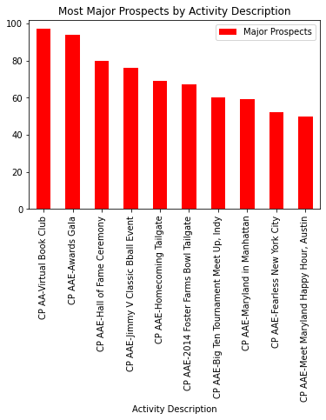
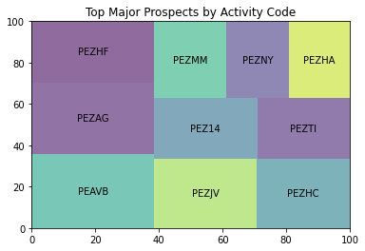
Findings & Results – Activity
Activity
MP
Notes:
27.2% of total participants attend the top 10 acrtivities are Major Prospects.
For example, if we had 1000 activities, the top 3 activities in order by Major Prospects, gives me 27.2% of the overall MP participating in all our activities.

Slide 17
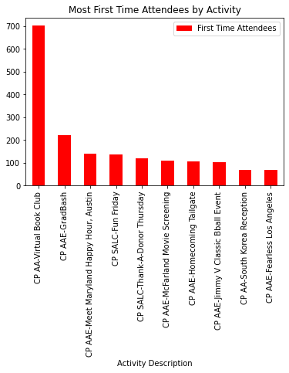
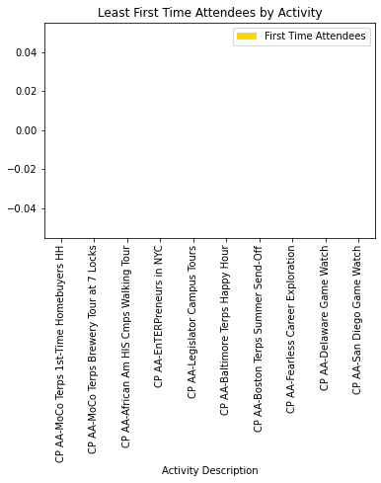
Findings & Results – Activity
Activity
FT
Notes:
FT. Supporting the evidence around on-campus types of activities for best to attract FT-ers
.3%. Top 10 activities of 342 unique activities.
33% of the first time attendees attending the top 10 activities.
Out of all the first time attendees that we achieve through all the activities, the top .3% of the overall activities contributes towards 33% of the overall First Time Attendees
For example, if we had 1000 activities, the top 3 activities in order by First Time Attendees, gives me 33% of the overall first-time attendees participated in all our activities.

Slide 18
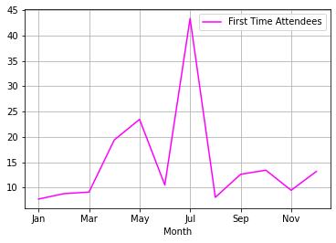
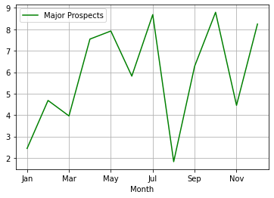
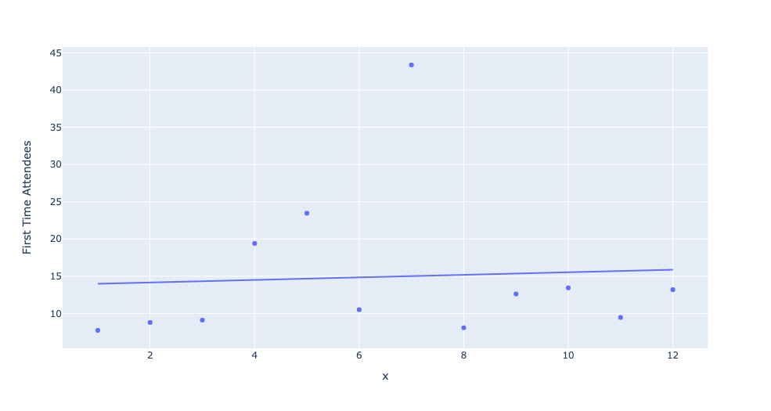
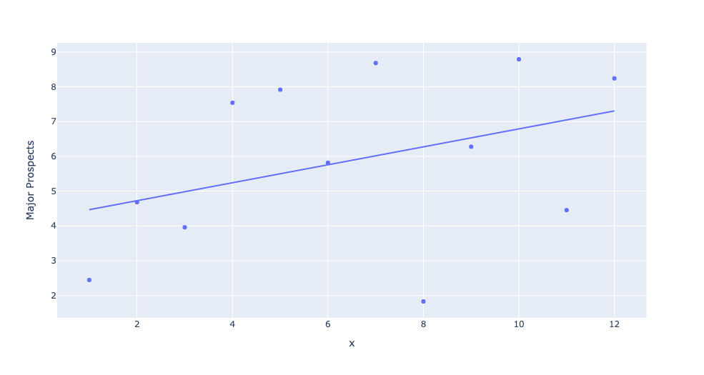
Time Series Trends
Average over 7 years
Notes:
Time series first time attendees
From here, you can see that alumni enjoy June and July. There is a high correlation for FTA and MP. Best time for both is July
Drip in August for both.
MP spikes again in October…...MP position around events; July, Oct.
However, the reason why we observe such spikes in certain months might be bc there are more funds invested to host events - more data is needed to evaluate the optimal seasonal patterns.

Slide 19
Recommendation
An increase in participation will generate more major prospects AND first-time attendees
Annual events around UMD traditions will increase first time AND major prospects attendees
Focus on stewardship as a driving factor for major prospects on campus.
Focus on social events for driving first time attendees location on campus
Notes:
RECOMMENDATION:
We found that treating the MP and FT as two different groups and hosting events separate will increase overall attendance for each group.
Correlation is .42 high correlation. How many common top groups are there from Treemap.
Clustering we can see the overlaps and where the MP and FTT begin to distance. Irrelevant to outliers.
Stewardship PH9 being Alumni awards gala, basketball suite, awards gala, hall of fame ceremony
Analyzing data thru activities has more scope in cutting down costs and formulating a strategy around FT and MP attendance.
Only .3% of activities encompass the major chunk of the desired parameter of FT and MP

Slide 20
Future Work
Extensive Classification system
Alumni Database
History of Events
Insights to Planning Future events
Increase Attendance in Key Groups
Provide Long-Term Data Structure
Use Centralized Database Instead of Excel
Gather More Details
Develop School-Specific events within UMD
Perform Regression Analysis for better strategy formation.
Notes:
From the presentation today, you will see that we will show you want key variables drive attendance for major gift prospects and first time attendees
We will also leave you with future use of the database as more events occur into future months
We will help you in understanding what types of events attract the largest number of first time attendees and major gift prospects so that we can use this information in planning future events.
1. Code create is reusable
Continue to update your Excel Sheet
Utilize Python to prevent redundant data cleaning
2. Gather More Details:
Record times of events for further tracking
Collect alumni’s geographical distribution
Collect data on participants’ jobs
3. Develop School-Specific events within UMD
On-Campus is a success
Build relationships with school related departments

Slide 21
We will now take questions.
Q&A Session
Thank you for your time!

Slide 22
Appendix Slides
Slide 25-33 will be used as reference material for further support if questions were to be asked. They will not be referenced unless needed

Slide 23
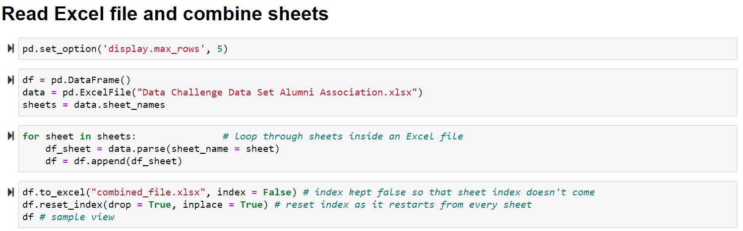
Import Data Code

Slide 24
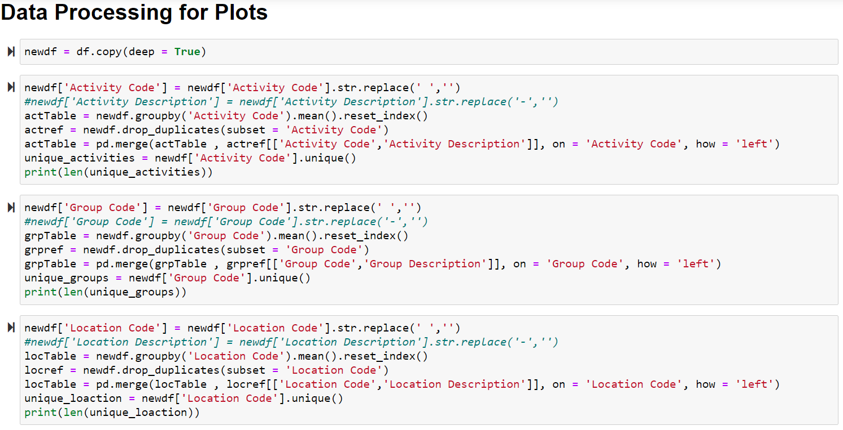
Data Cleaning

Slide 25
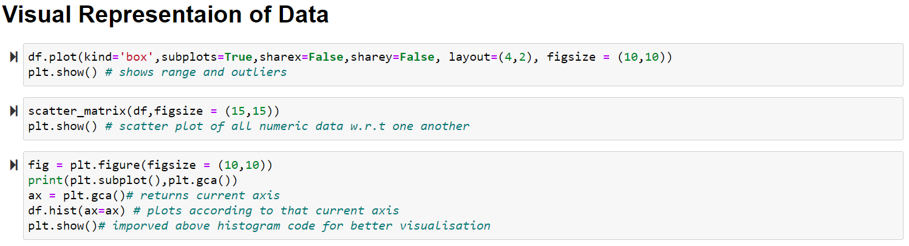
Histogram and Boxplot Code

Slide 26
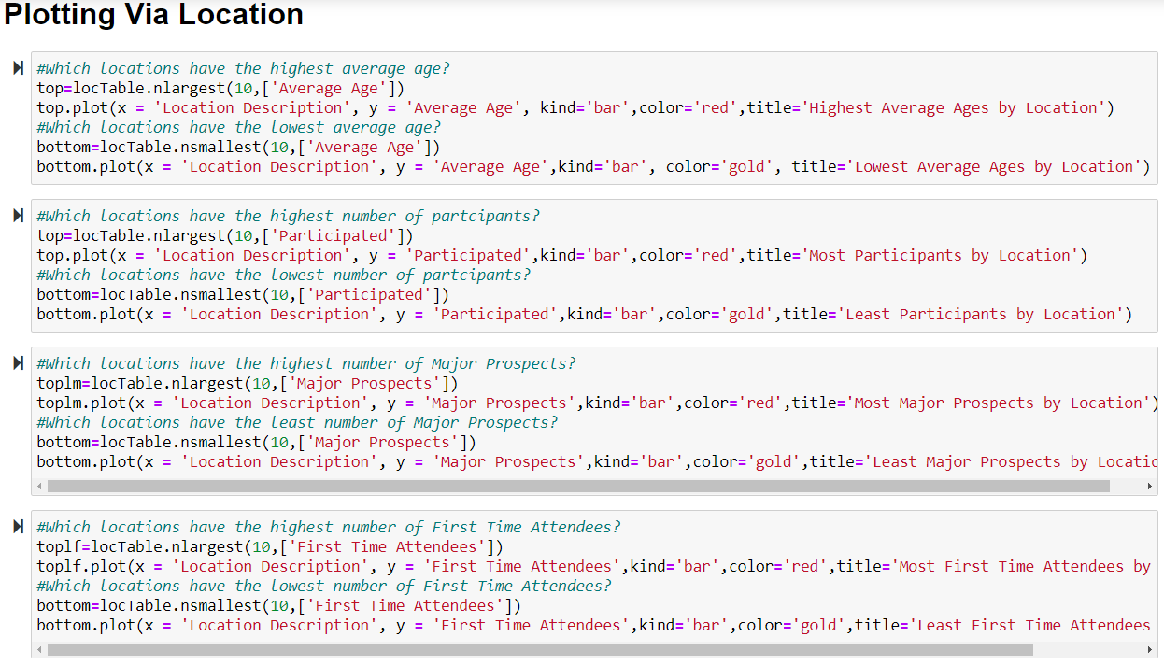
Location Plotting Sample

Slide 27
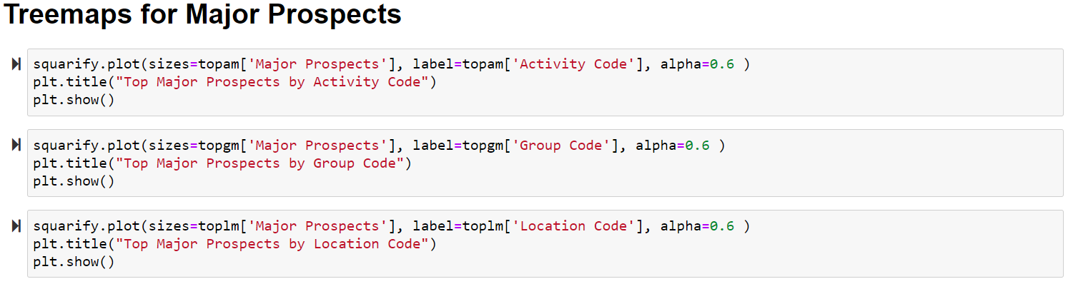
Tree Map Code

Slide 28
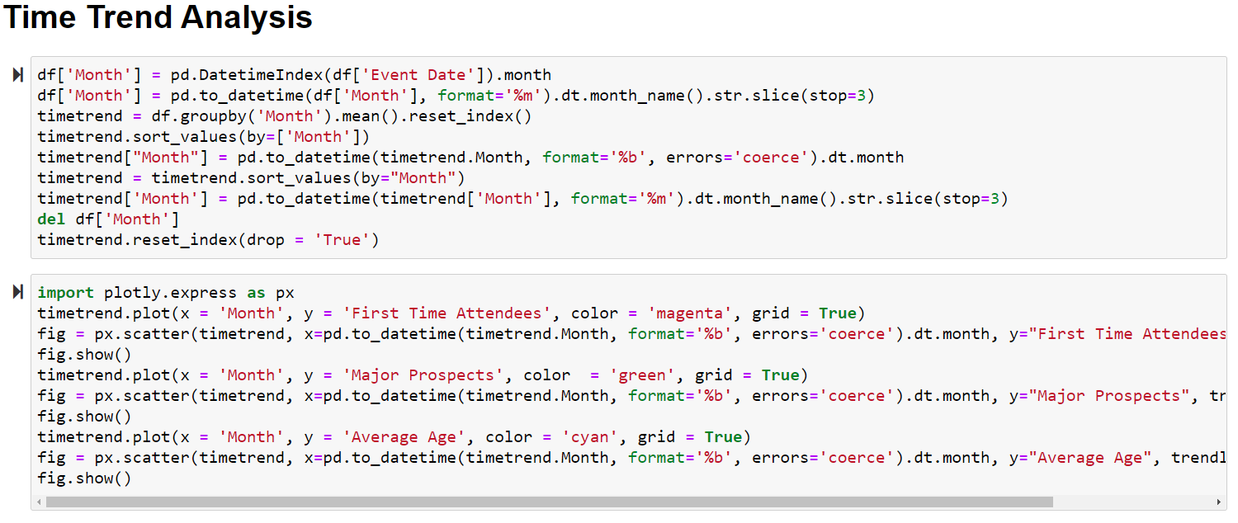
Time Trend Code

Slide 29
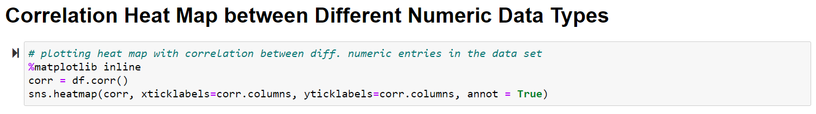
Correlation Heat Map Code

Slide 30
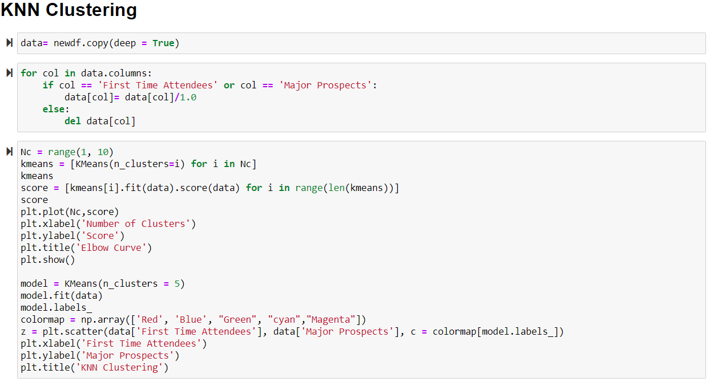
KNN Code

Slide 31
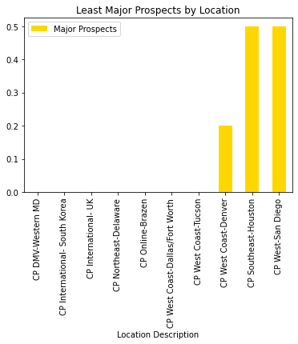
Findings & Results – Location
Notes:
*Compare with tree map
* Least around with what areas of the locations have not been successful with MP. If we were to solely set our objectives to getting the maximum amount of MP, international locations might not be the best option.
This doesn’t mean it’s a financial loss for us to host events in these locations, it is certainly worth investing for a long-term acquisition of MPs, and keeping connections with Terps living abroad or in more rural areas.

Slide 32
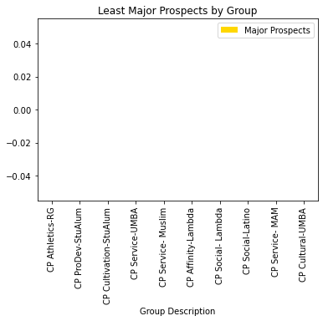
Findings & Results – Group

Slide 33
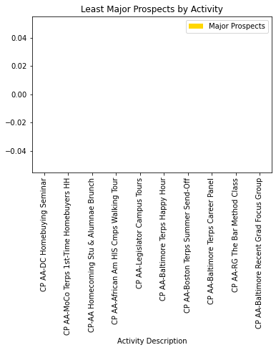
Findings & Results – Activity
Notes:
Continued to share insight around supporting campus events for MP and Stewardships. Awards and Hall of Fame top with MP. UMD themed wins with MP.
The online virtual book club attracted the highest number of gift prospects - total particiaptns 1657 ppl with 98 major prospects
Awards Gala - total participants ~300 with Major gift prospects ~96
Hall of Fame Ceremony

