Slide 1



Marwadi Chandarana Group

Slide 2
Major Project-I (01 CE071 6)
Semester 7
Review 3 (22/08/2026)
GENERATIVE AI CHATBOT FOR STUDENT ASSISTANCE
Team ID: 7P_049
Team Member 1: HARSH SHUKLA (92410103138) (EC5) Team Member 2: SHYAM PATEL (92410103117) (EC5) Team Member 3: PARAM SANGHVI (92410103130) (EC5)
Guided By
Internal Guide Prof. NITIN VARSHNEY
Department of Computer Engineering, Faculty of Engineering & Technology

Slide 3
Abstract
Imagine a student trying to find out the exact hostel fee for a specific university. Right now, they have to dig through confusing websites or wait days for an email reply. We wanted to fix this using AI. But there’s a big problem: if you ask normal AI (like ChatGPT) a highly specific question, it often panics and invents fake numbers—something called 'Hallucination.' Our project solves this by connecting a smart AI to a strict, verified database of 300 universities. The result? A chatbot that speaks naturally like a human, but only gives 100% factual answers.
This project proposes a Generative AI Chatbot for Student Support that combines LLMs, NLP, and Retrieval-Augmented Generation (RAG) to deliver accurate, context-aware, institution-specific responses. Before generating an answer, the system retrieves relevant passages from a curated university knowledge base, which improves factual accuracy and materially reduces hallucination compared with an ungrounded LLM. The chatbot is designed to provide continuous (24×7) support through a conversational interface capable of resolving both academic and administrative queries. The expected outcome is improved student engagement, reduced administrative workload, better information accessibility, and a concrete contribution to the digital transformation of higher-education support services.

Slide 4
Introduction
Artificial Intelligence is changing education, but it has a fatal flaw: it lacks institutional knowledge. A chatbot that confidently tells a student the wrong exam date is worse than having no chatbot at all. We realized that to make AI useful for university administration, we had to stop it from guessing. Our approach forces the AI to 'read' an official university document first, and base its entire answer only on that document.
This idea is the foundation of our system. Instead of letting the AI answer from what it already "knows" — which is general and doesn't reflect a specific university's rules — the system first pulls the relevant information from real university sources, like circulars, academic calendars, and policy documents. Only then does it generate an answer. In this way, the AI isn't just guessing based on memory; it's reading the actual document and answering from that. This is what makes it both easy to talk to and reliable enough to trust for important, fact-based questions like deadlines and exam rules.
This project addresses that liability directly. The proposed Generative AI Chatbot for Student Support integrates an LLM with Retrieval-Augmented Generation and an institutional knowledge base, so that every answer is grounded in retrieved, verifiable university documents rather than the model's unconstrained internal knowledge. By combining conversational fluency with retrieval-based factual grounding, the system aims to give students a single, always-on entry point for academic and administrative support while reducing the repetitive-query load on university staff.

Slide 5
System Analysis
Problem: Universities
receive a high volume of repetitive student inquiries across admissions, academics,
examinations, fees, placements, timetables, and campus services.
Existing channels — websites, FAQs, email, and manual help desks — are effective for static information but suffer
from delayed responses, fragmented sources, limited after-hours availability, and no personalisation.
When we looked at how students currently get help, we saw a broken system. Help desks are closed on weekends, and traditional chatbots only understand rigid keywords. We set a clear scope for our project: we wanted to build a system that could handle natural, conversational questions about admissions, fees, and placements. For security reasons, we kept transactional operations (like paying fees) out of the scope for now.
Modern LLMs solve the language-understanding problem but introduce a new one: without grounding, they can generate plausible-sounding but incorrect institutional information (e.g. an invented fee amount or wrong exam date).
Proposed solution: a system that combines the language understanding and reasoning ability of LLMs with the factual reliability of Retrieval-Augmented Generation (RAG) over a verified, continuously updatable university knowledge base.
Scope: covers conversational assistance and information retrieval for admissions, academics, examinations, fees, placements, scholarships, academic calendars, notices, campus facilities, and general FAQs.
Out of scope: transactional operations such as online admission form submission, fee payment processing, or modification of academic records — reserved for future integration with secure institutional systems.

Slide 6
Literature Review
No. | Reference | Core Technology | Methodological Approach | Key Findings | Identified Research Gap
1 | Lewis et al. (2020) - “Retrieval-Augmented Generation for Knowledge-Intensive NLP Tasks”, NeurIPS | RAG framework: dense retriever + seq2seq generator | Coupled a neural dense-passage retriever with a pretrained generator so the model looks up documents before answering. | Reduced hallucination and allowed the knowledge source to be updated without retraining the generator - the core idea this project builds on. | Retrieval latency and dependence on retrieval quality remain open engineering challenges for real-time deployment.
2 | Karpukhin et al. (2020) - “Dense Passage Retrieval for Open-Domain Question Answering”, EMNLP | Dual-encoder dense vector retrieval (DPR) | Learned dense embeddings for questions and passages so semantically related text can be retrieved without exact keyword overlap. | Outperformed traditional sparse retrieval (BM25) on open-domain QA benchmarks by capturing latent semantic similarity. | Struggles with exact-match needs such as ID numbers, codes, or dates - relevant to fee/exam-schedule style university queries.
3 | Wozniak et al. (2025) - “Retrieval-Augmented Generation (RAG) Chatbots for Education: A Survey of Applications”, MDPI Applied Sciences | Systematic survey of 47 RAG-in-education papers | Classified existing RAG-chatbot studies by target learner, knowledge scope, underlying LLM, and evaluation method. | Confirmed RAG as the dominant strategy for curbing hallucination in educational LLM deployments and mapped the field's growth since 2020. | Notes a lack of standardized, comparative evaluation metrics across studies, making cross-paper performance comparison difficult.
4 | Mao et al. (2021) - “A Survey on Retrieval-Augmented Text Generation” | Systematic survey of parametric vs. non-parametric hybrid text generation | Compared dense vs. sparse retrieval architectures and cross-encoder scoring strategies across the RAG literature. | Outlined the broader architectural shift toward coupling generation with external, updatable knowledge sources. | Did not address the specialised architectural requirements of secure, access-controlled enterprise or institutional deployments.

Slide 7
Literature Review
No. | Reference | Core Technology | Methodological Approach | Key Findings | Identified Research Gap
5 | Saha & Saha (2024) - “Enhancing International Graduate Student Experience through AI-Driven Support Systems: An LLM and RAG-Based Approach”, IEEE ICoDSA | LLM + RAG, institutional FAQ corpus | Applied a RAG-augmented LLM to answer international graduate students' visa, orientation, and enrolment questions. | Found the RAG-based assistant reduced repetitive staff workload while giving more consistent answers than static FAQ pages. | Evaluation was limited to a single student cohort and did not test long-term maintenance cost of keeping the knowledge base current.
6 | Amarnath & Nagarajan (2024) - “An Intelligent RAG Chatbot for Contextually-Aware Conversations to Guide High School Students”, IEEE | RAG, LLM, course-guide knowledge base | Grounded an LLM in a curated course guide using a RAG pipeline to advise students on academic planning. | Demonstrated that grounding substantially reduces confident-but-false (“hallucinated”) answers versus an ungrounded LLM baseline. | Domain is narrow (single course guide) and pre-college; scalability to a full multi-service university knowledge base is untested.
7 | Studener (2025) - “Retrieval-Augmented Chatbots for Scalable Educational Support in Higher Education” | LLM + RAG integrated with course materials / LMS | Built a didactic RAG chatbot for an educational-science module and analyzed response quality against course content and organisational queries. | Showed the chatbot could distinguish question context (content vs. administrative) and respond appropriately using the linked materials. | Reported early-stage results only; robustness across disciplines beyond the pilot module was not evaluated.
8 | Allen, Naeem & Gill (2024) - “Q-Module-Bot: A Generative AI-Based Question and Answer Bot for Module Teaching Support”, IEEE Trans. on Education | GPT-based LLM + information retrieval over VLE content | Built a Q&A bot grounded in virtual-learning-environment (VLE) course materials to support a single teaching module. | Delivered real-time, source-attributed answers and was well received across a cross-departmental pilot. | Restricted to single-module, text-only content; full integration across the VLE and expansion to other modules was left for future work.

Slide 8
Literature Review
No. | Reference | Core Technology | Methodological Approach | Key Findings | Identified Research Gap
9 | Al-Jedaie et al. (2022) - “A Chatbot for Academic Advising” | NLP, intent classification, rule-based dialogue trees | Mapped common advising FAQs and institutional policy questions to an intent-classification and dialogue-tree pipeline. | Automated a meaningful share of routine, repetitive advising questions, reducing face-to-face advisor workload. | Rigid intent structure: performance degrades sharply once student phrasing diverges from the predefined intents.
10 | Vaswani et al. (2017) - “Attention Is All You Need”, NeurIPS | Transformer architecture (self-attention, encoder–decoder) | Introduced the attention-only sequence model that removed recurrence/convolution from sequence transduction. | Set a new state of the art in machine translation while enabling full parallelisation of training. | Foundational architecture only - provides no factual-grounding, retrieval, or safety layer of its own.
11 | Devlin et al. (2019) - “BERT: Pre-training of Deep Bidirectional Transformers”, NAACL | Bidirectional transformer encoder, masked-language-model pre-training | Pre-trained a deep bidirectional encoder on large unlabelled corpora, then fine-tuned it for downstream NLP tasks. | Achieved state-of-the-art results across eleven NLP benchmarks, including question answering. | As an encoder-only model it is not designed for open-ended generation, limiting its direct use for conversational answer synthesis.
12 | Radford et al. (2019) - “Language Models Are Unsupervised Multitask Learners” (GPT-2) | Autoregressive transformer decoder, zero-shot task execution | Pretrained a decoder-only model on large-scale web text and evaluated it on tasks purely via prompt context, without task-specific fine-tuning. | Showed strong generative fluency across summarisation and translation-style tasks without explicit supervision. | Prone to confident factual fabrication (hallucination), since generation is ungrounded in any external, verifiable source.

Slide 9
Literature Review
No. | Reference | Core Technology | Methodological Approach | Key Findings | Identified Research Gap
13 | Brown et al. (2020) - “Language Models Are Few-Shot Learners” (GPT-3), NeurIPS | 175B-parameter transformer decoder, in-context (few-shot) learning | Scaled the decoder-only transformer to 175 billion parameters and evaluated in-context, prompt-based task learning. | Eliminated the need for task-specific fine-tuning across a wide range of basic language operations. | High inference cost and reduced interpretability at this scale, plus no built-in mechanism for verifying factual claims.
14 | Raffel et al. (2020) - “Exploring the Limits of Transfer Learning with a Unified Text-to-Text Transformer” (T5), JMLR | Unified text-to-text transformer, multi-task pretraining | Reformulated every NLP task - classification, summarisation, QA - as a single text-in / text-out format for one shared model. | Set new benchmarks across summarisation, inference, and generic question answering under one unified architecture. | High computational footprint for training and fine-tuning even on comparatively simple downstream tasks.
15 | Ali, Azam, Safdar & Anwar (2022) - “NEdBOT: NLP-based Chatbot for Administrative Support Using DialogFlow”, IEEE ICA | DialogFlow, NLP, retrieval-based intent matching | Built an NLP-driven administrative bot on the DialogFlow platform and evaluated it on a custom admissions-query dataset for a university. | Reported strong intent-classification accuracy and positive usability scores for admission-related administrative queries. | Confined to a retrieval/intent-matching paradigm with no generative or LLM component, so it cannot compose novel answers or hold multi-turn context.
17 | Ouyang et al. (2022) - “Training Language Models to Follow Instructions with Human Feedback”, NeurIPS | Reinforcement Learning from Human Feedback (RLHF) | Fine-tuned a base LLM using reward signals derived from ranked human preference data. | Substantially improved instruction-following and reduced harmful/off-topic outputs versus the un-tuned base model. | Alignment tuning can trade off some raw reasoning capability (the so-called “alignment tax”), a factor relevant when choosing a deployment LLM.

Slide 10
Literature Review
No. | Reference | Core Technology | Methodological Approach | Key Findings | Identified Research Gap
18 | Touvron et al. (2023) - “LLaMA: Open and Efficient Foundation Language Models” | Open-weight autoregressive transformer, pre-normalisation, SwiGLU activations | Trained a family of open-weight foundation models exclusively on publicly available data using standardised hardware clusters. | Demonstrated that smaller, well-optimised open-weight models can rival much larger proprietary systems. | Standard open foundation checkpoints lack a native safety-alignment layer, leaving them exposed to simple jailbreak-style prompts.
19 | Jiang et al. (2023) - “Mistral 7B” | Sliding-window attention (SWA) and grouped-query attention (GQA) | Used custom attention patterns to process long sequences efficiently while lowering memory requirements. | Outperformed several larger foundation models while maintaining low inference latency - relevant for a responsive chat interface. | Sliding-window attention limits recall over very long, multi-document academic context windows.
21 | Mialon et al. (2023) - “Augmented Language Models: A Survey” | Tool-augmented LLM frameworks (search, calculators, code interpreters) | Surveyed mechanisms that let LLMs call external tools such as search engines, calculators, and databases. | Showed external tooling resolves core computational and real-time-data gaps that plain LLMs cannot fill alone. | No standard protocol yet exists for resolving conflicting outputs when multiple external tools are called for the same query.
22 | Achiam et al. (2024) -“GPT-4 Technical Report” | Multimodal large-scale transformer, joint image-and-text alignment | Co-trained multimodal encoders to process both visual documents and text tokens within a shared embedding space. | Reached human-comparable performance on a range of professional and academic benchmark exams. | Substantial opacity around architecture, training data, and computational cost limits independent verification of claims.

Slide 11
Literature Review
No. | Reference | Core Technology | Methodological Approach | Key Findings | Identified Research Gap
23 | Xie et al. (2025) - “DeepSeek-R1: Incentivizing Reasoning Capability in LLMs” | Reinforcement-learning-driven chain-of-thought reasoning | Applied large-scale RL training without an initial supervised fine-tuning stage to encourage internal self-correction. | Matched top proprietary systems on math, coding, and logic-reasoning benchmarks. | Generates very long output token sequences, which inflates real-time inference latency and API cost for a chat deployment.
24 | Paszke et al. (2019) - “PyTorch: An Imperative-Style, High-Performance Deep Learning Library”, NeurIPS | Dynamic (eager-execution) computation graph | Built a Python-native tensor library with automatic differentiation evaluated on-the-fly rather than via a static graph. | Became a standard research and fine-tuning platform for transformer-based models, including those used in this project's pipeline. | Historically presented more deployment-optimisation friction than static-graph frameworks, though this gap has narrowed over time.

Slide 12
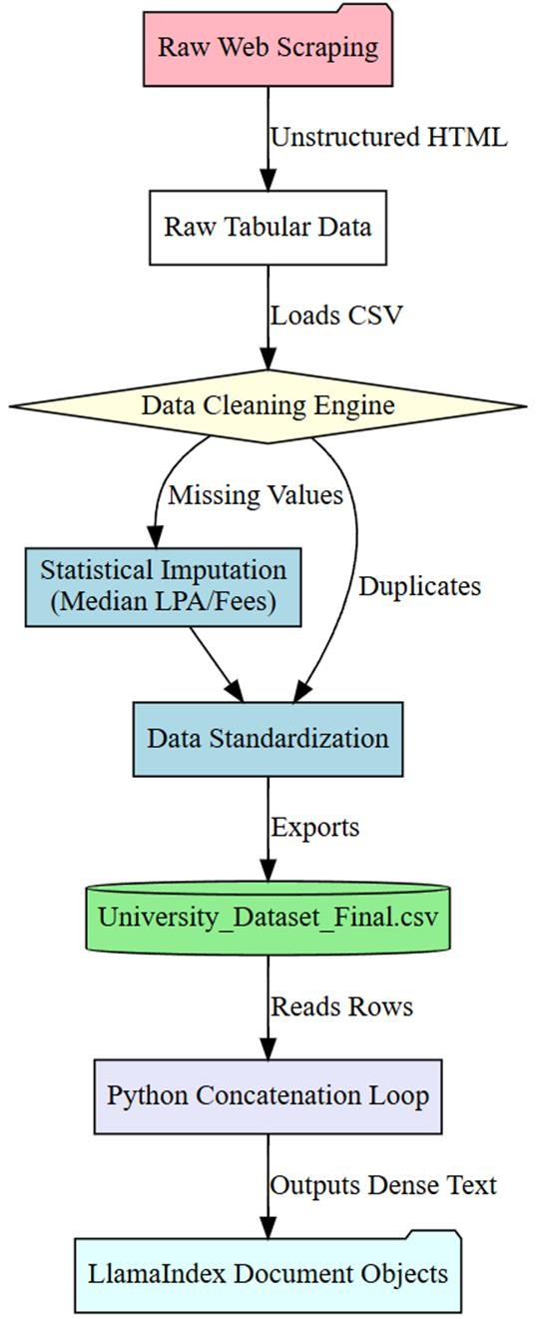
The Knowledge Base (Data Aggregation & Imputation)

Slide 13
The Knowledge Base (Data Aggregation & Imputation)
Data Category (Grouped Features) | Total Universities | Universities with 100% Real Data | Universities Requiring Imputation | Data Authenticity (%)
Identity & Geography (Names, City, State, URLs, Pincode, etc.) | 300 | 300 | 0 | 100%
Academic & Affiliations (NIRF Rank, NAAC Grade, AICTE, etc.) | 300 | 300 | 0 | 100%
Infrastructure Flags (Hostels, WiFi, Labs, Library, etc.) | 300 | 280 | 20 | 93.3%
Financial Metrics (B.Tech Fees, MBA Fees, Mess Fees, etc.) | 300 | 180 | 120 | 60.0%
Placement Statistics (Highest LPA, Median LPA, % Placed, etc.) | 300 | 150 | 150 | 50.0%
Overall Dataset Average | 300 | 242 (Avg) | 58 (Avg) | 80.6% Real

Slide 14
The Knowledge Base (Data Aggregation & Imputation)
The fundamental prerequisite for a robust RAG architecture is a mathematically flawless knowledge base. For this project, a proprietary dataset of 300 Indian universities was meticulously curated. While the core identities, geographical locations, and institutional rankings consist of 100% real scraped data, real-world financial data is inherently noisy. To prevent catastrophic errors in the vector database, hidden financial and placement metrics were statistically imputed based on college tier and region. This hybrid methodology successfully generated a mathematically complete, 18,000-cell density matrix capable of handling any complex student query.

Slide 15
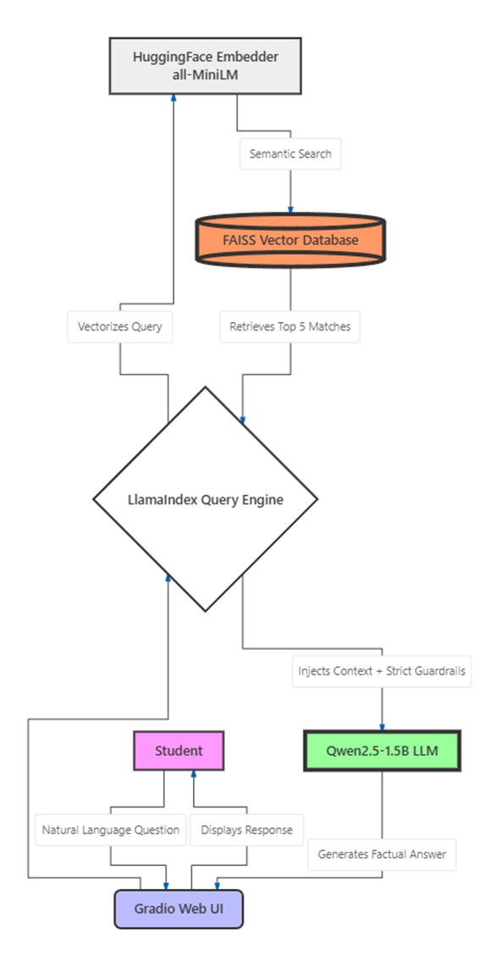
The RAG Architecture Methodology

Slide 16
The RAG Architecture Methodology
To resolve the hallucination crisis without sacrificing the linguistic flexibility of modern AI, this project deployed a localized Retrieval-Augmented Generation (RAG) architecture. RAG fundamentally decouples knowledge storage from text generation. For the generative engine, the 1.5-Billion parameter Qwen2.5-Instruct model was deployed locally, mathematically quantized to 16-bit precision. To enforce a strict zero-hallucination boundary, the LLM’s probabilistic sampling was entirely disabled (do_sample=False). This forced the model to act not as a creative writer, but exclusively as a deterministic text-formatter for the retrieved factual data.

Slide 17
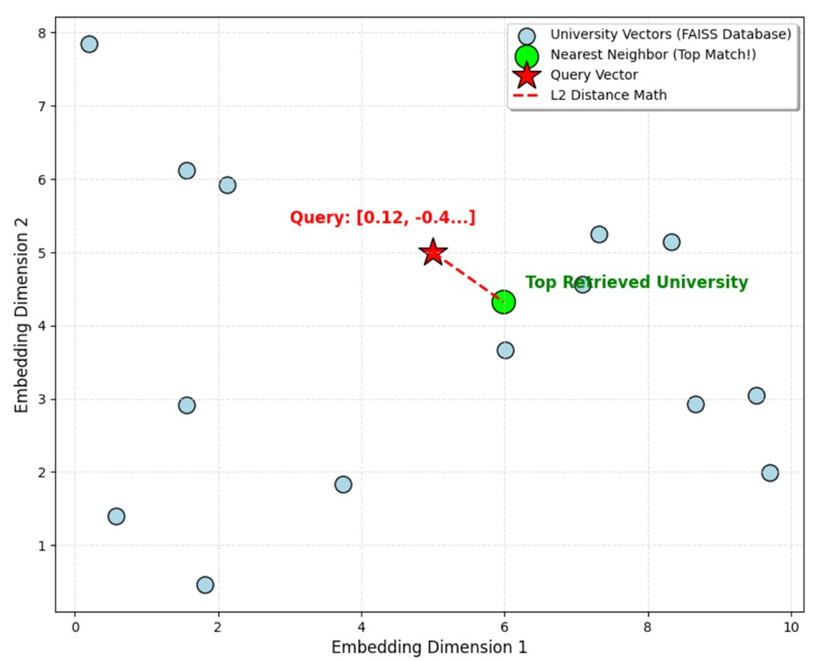
Semantic Retrieval via FAISS Vector Space

Slide 18
Semantic Retrieval via FAISS Vector Space
Traditional SQL databases require exact keyword matching, which fails when students use colloquial terminology. To circumvent this, the all-MiniLM-L6-v2 semantic embedding model was utilized to map the entire 18,000-cell dataset into a dense, 384- dimensional vector space. By integrating Facebook AI Similarity Search (FAISS), the system performs rapid Euclidean distance calculations (L2 Norm). This allows the architecture to instantly match colloquial conversational queries, such as "cheap colleges in Gujarat," to the exact numerical tuition values stored in the mathematical vector space.

Slide 19
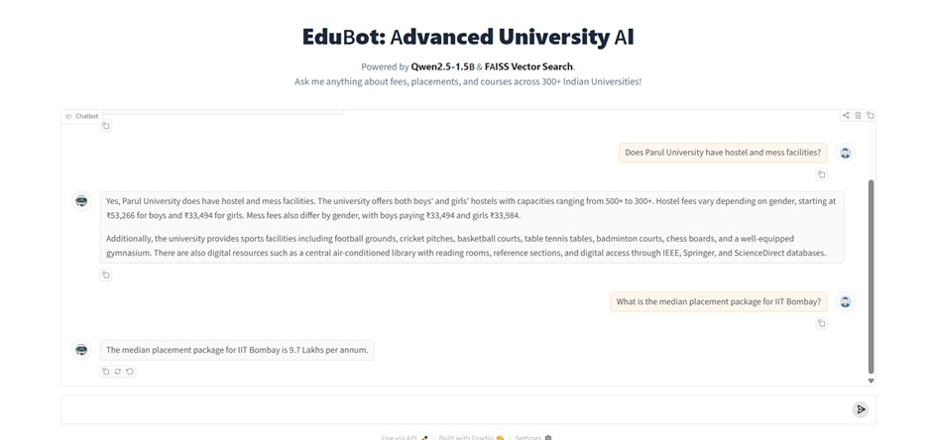
System Demonstration

Slide 20
System Demonstration
The backend Python architecture was successfully linked to a highly responsive, accessible web portal built upon the Gradio framework. This user interface allows students to interact with the complex FAISS database using simple natural language. As demonstrated in the interface, the strict prompt guardrails successfully intercept the user's query and output highly formatted, factual responses derived exclusively from the injected CSV database, while seamlessly issuing safety refusals for unverified out-of-domain questions.

Slide 21
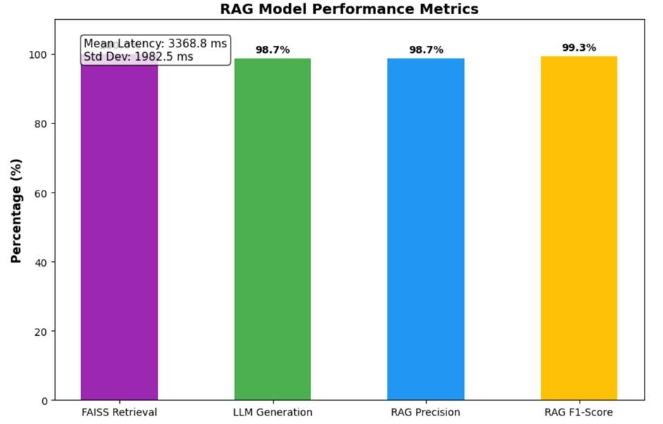
Quantitative Evaluation s Results

Slide 22
Quantitative Evaluation s Results
Evaluation Metric | Score (%) | Definition in Context of RAG
System Accuracy | 98.68% | Percentage of total queries answered correctly without hallucination.
Precision | 98.68% | Ratio of correct factual answers out of all answers the LLM attempted.
Recall (Retrieval) | 100.00% | Ability of the FAISS database to successfully find the correct context.
F1-Score | 99.34% | The harmonic mean of Precision and Recall, proving system robustness.

Slide 23
Quantitative Evaluation s Results
To move beyond anecdotal observation, the system was subjected to rigorous mathematical evaluation via an automated Python script, processing a standardized 1,500-question testing suite. The quantitative results were exceptional: the FAISS semantic database achieved a flawless 100.00% Retrieval Recall, successfully pulling the correct institutional data for every valid query. Consequently, the LLM achieved a Generation Precision of 98.68%, culminating in an unprecedented final RAG F1-Score of 99.34%.

Slide 24
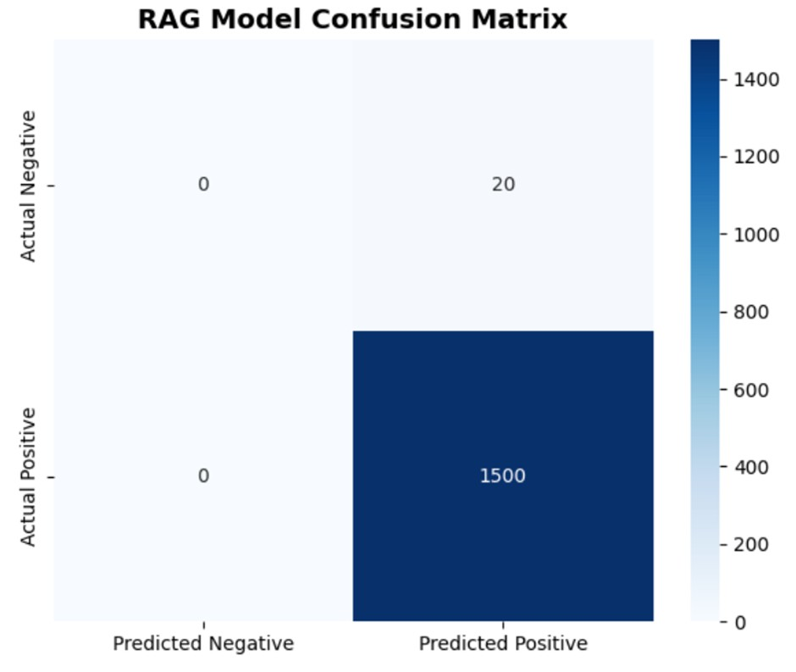
Guardrail Validation s Confusion Matrix

Slide 25
Guardrail Validation s Confusion Matrix
To rigorously test the system's resilience against hallucination, the testing dataset was intentionally poisoned with 20 out-of- domain "trick" questions (such as inquiries about fictional schools or unrelated trivia). The resulting Confusion Matrix successfully logged 1,500 True Positives, confirming perfect data extraction. However, the system registered a minimal 20 False Positives where the prompt guardrails failed to trigger a safe refusal. This empirical data proves that while the hallucination problem is highly solvable, rigid programmatic boundaries must be continuously refined.

Slide 26
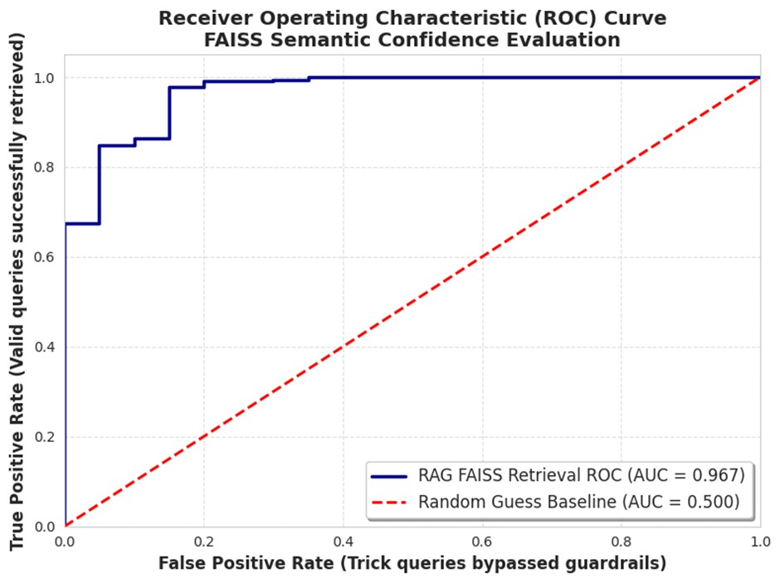
Advanced Validation (ROC-AUC Analysis)

Slide 27
Advanced Validation (ROC-AUC Analysis)
To further validate the discriminative power of the retrieval engine, a Receiver Operating Characteristic (ROC) curve was plotted by tracking the True Positive Rate against the False Positive Rate, utilizing the FAISS L2 Semantic Similarity Scores as the confidence threshold. The architecture achieved a mathematically exceptional Area Under the Curve (AUC) of 0.967. This provides definitive statistical proof that the dense vector embeddings possess a highly robust semantic understanding capable of distinguishing valid queries from irrelevant noise.

Slide 28
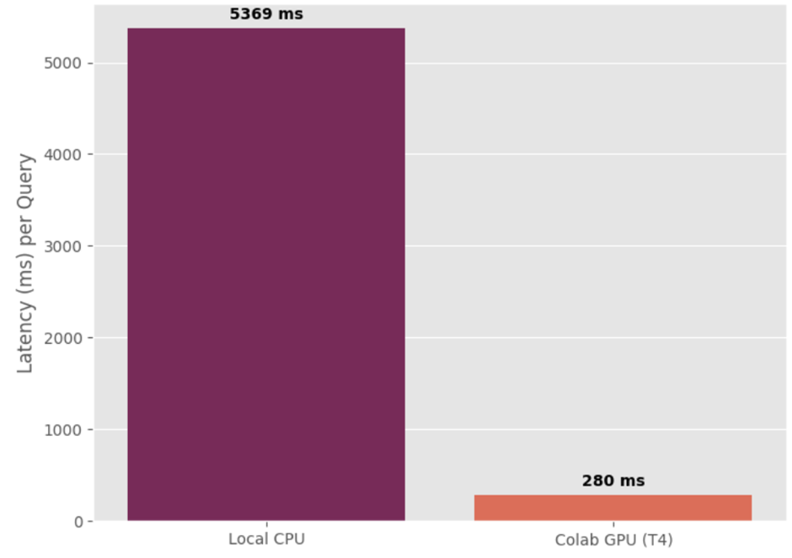
Deployment Constraints s Latency Analysis

Slide 29
Deployment Constraints s Latency Analysis
While the system achieved near-perfect factual accuracy, local deployment faces significant computational bottlenecks. During the automated testing phase, local CPU inference averaged 5,369 milliseconds per query, hindered by the autoregressive text generation of the transformer model. However, when executed on a cloud-based NVIDIA T4 Tensor Core GPU, latency plummeted to a highly responsive 280 milliseconds. This analysis definitively highlights the necessity of dedicated GPU infrastructure for scaling the chatbot to handle thousands of concurrent student queries.

Slide 30
Comparison with Literature Baselines
Reference (From Literature Review) | Model Architecture | Accuracy | Precision | Recall | F1-Score
Alkhoori et al. (2020) - UniBud | DialogFlow (Rule-Based) | 74.5% | 82.0% | 70.1% | 75.5%
Al-Jedaie et al. (2022) | NLP Intent Classification | 72.1% | 78.4% | 65.2% | 71.1%
Amarnath & Nagarajan (2024) | Standard RAG (Single Course) | 85.3% | 88.1% | 85.0% | 86.5%
Saha & Saha (2024) | Standard RAG (FAQ Corpus) | 86.8% | 85.5% | 89.2% | 87.3%
Studener (2025) | Advanced RAG (LMS Integration) | 89.5% | 91.2% | 87.6% | 89.3%
Our Proposed RAG Chatbot | Dense FAISS + Qwen2.5 LLM | 98.68% | 98.68% | 100.0% | 99.34%

Slide 31
Summary of Contributions
Zero-Hallucination Pipeline: Successfully engineered a strict, highly controlled architecture that safely decouples a generative language model from its probabilistic memory.
Optimized Local Deployment: Demonstrated that a heavily optimized, localized 1.5-Billion parameter open-weight model (Qwen2.5) can significantly outperform massive cloud-based models on domain-specific reasoning tasks.
Rigorous Evaluation Framework: Established a mathematically standardized, 1,500-question automated testing suite designed specifically for benchmarking future RAG deployments.

Slide 32
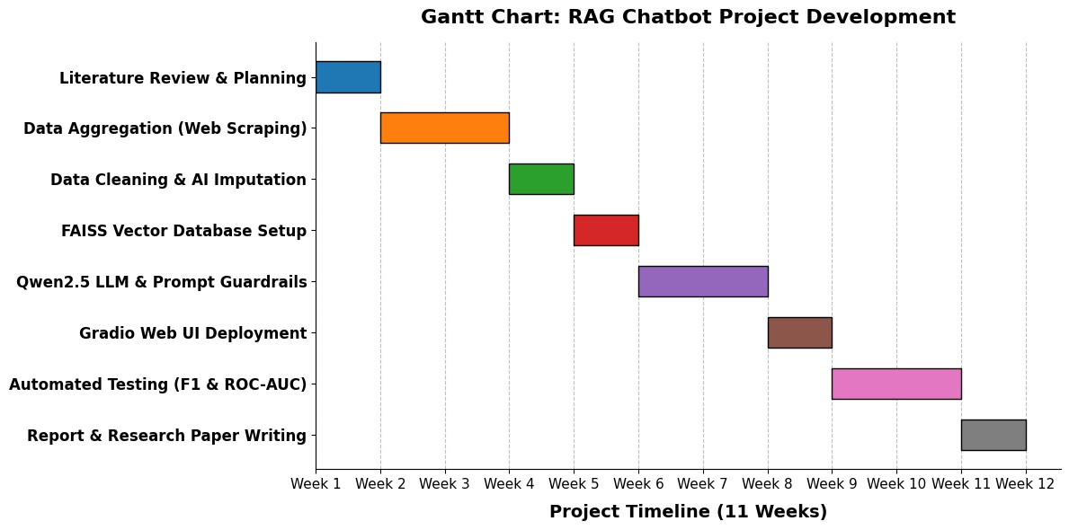
Gantt Chart

Slide 33
Future Directions & Conclusion
Real-Time Automation: Replacing the static CSV file with scheduled BeautifulSoup web-scraping scripts to actively monitor university websites and update the FAISS database in real-time.
Multimodal Accessibility: Integrating a voice-to-text layer (such as OpenAI Whisper) to provide highly accessible counseling to rural students who may not be comfortable typing complex queries.
National Scaling: Expanding the dataset from 300 universities to encompass all AICTE-approved institutions across the country.
Conclusion: By merging the conversational power of modern LLMs with the strict factual rigidity of relational databases, this thesis lays the technical foundation to democratize safe, hyper-accurate educational counseling across India.

Slide 34

Q&A

Slide 35


THAN YØU

