Slide 1
AIDEX
Cyber-crime cases
Digital evidence
AI-assisted review
AI Digital Evidence Intelligence & Investigation System
Minor Project / Academic Project
Diploma Computer Engineering
Institute: Neotech Faculty of Diploma Engineering
Academic Year: 2026-2027
Notes:
Source: README.md and aidex/settings.py identify AIDEX and the project purpose.

Slide 2
Team Members
AIDEX
02
Saksham Patel
Enroll:
249590307047
Harsh Parmar
Enroll: 249590307035
Shrushti Suthar
Enroll: 249590307061
Amisha Agarwal
Enroll: 249590307001
Viral Mali
Enroll:
249590307029
Notes:
Team names came from README.md. No enrollment numbers were found.

Slide 3
Introduction
AIDEX
03
AIDEX supports cyber-crime investigation work by linking cases, uploaded digital evidence, AI-assisted analysis and investigation reports in one role-aware Django application.
Administrators
Investigators
Cyber Officers
• Manage cyber-crime cases and assignments
• Upload and verify digital evidence
• Run explicit AI analysis
• Create reviewed investigation reports
Notes:
Verified from README.md, dashboard/views.py, cases/views.py, evidence/views.py, ai_engine/models.py, reports/models.py.

Slide 4
Problem Statement
AIDEX
04
Manual or scattered investigation records make it difficult to preserve evidence integrity, role accountability and report traceability during cyber-crime case handling.
• Evidence files need reliable metadata and SHA-256 fingerprints
• Sensitive evidence must stay protected during preview, download and AI preparation
• Case status changes need controlled transitions
• Reports need review, approval, publication and audit history
Notes:
Supported by evidence/models.py, evidence/encrypted_storage.py, cases/forms.py, reports/services.py and README.md.

Slide 5
Objectives
AIDEX
05
• Provide role-based access
• Track case assignment and closure
• Store encrypted evidence with SHA-256 checks
• Support explicit AI-assisted analysis
• Control report review and publication
• Show searchable role dashboards
Notes:
Objectives reflect implemented modules in accounts, dashboard, cases, evidence, ai_engine and reports.

Slide 6
Existing vs Proposed System
AIDEX
06
Aspect | Existing / Manual Approach | AIDEX Proposed System
Case tracking | Separate notes or files | Central case records with status workflow
Evidence integrity | Manual filename and storage checks | SHA-256 fingerprints, validation and encrypted storage
Access control | Hard to separate responsibilities | Administrator, Investigator and Cyber Officer roles
Analysis | Manual review without reuse | Explicit AI analysis records with cache and review
Reports | Document drafts without system history | Report lifecycle with audit events
Notes:
Comparison is derived from implemented workflows and README.md.

Slide 7
Technology Stack
AIDEX
07
Layer | Technologies detected
Backend | Django 6, Python 3.12+, Gunicorn
Frontend | HTML templates, CSS, JavaScript, Bootstrap Icons, Chart.js
Database | SQLite for development, MySQL option via settings
AI and extraction | google-genai, OpenRouter-compatible provider, Pillow, pytesseract, OpenCV, pypdf, python-docx, openpyxl, python-pptx
Security utilities | cryptography for AES-256-GCM evidence storage, SHA-256 hashing
Notes:
Sources: requirements.txt, README.md, aidex/settings.py, ai_engine/providers.py, ai_engine/ocr.py, evidence/encrypted_storage.py.

Slide 8
System Architecture
AIDEX
08
Application Modules
Accounts, Cases, Evidence, AI, Reports, Dashboard
Browser
HTML, CSS, JS
Django URLs
Views and Forms
SQLite / MySQL
Django Models
Protected Media
Encrypted evidence files
External AI Provider
Gemini or OpenRouter
Notes:
Architecture from aidex/urls.py, settings.py, module views/forms/models and protected media routing.

Slide 9
Modules
AIDEX
09
Module | Actual responsibility
Accounts | Custom user model, registration, login, password reset, profile
Dashboard | Role dashboards with chart-ready case, evidence and report data
Cases | Case creation, assignment, status update, archive and restore
Evidence | Upload, validation, encrypted storage, verification and download
AI Engine | Evidence analysis, OCR/extraction, provider execution, review and logs
Reports | Draft, review, approve, reject, publish, archive, restore and revise reports
Notes:
Sources: app directories, urls.py files, models.py, forms.py and views.py.

Slide 10
Key Features
AIDEX
10
• Role-aware access for three user types
• Case assignment with controlled status changes
• Evidence validation before storage
• AES-256-GCM storage with SHA-256 checks
• AI analysis with review and retries
• Report approval and publication flow
Notes:
Feature status: implemented or partially implemented only. QR functionality was not found and is not included.

Slide 11
Database / ER Diagram
AIDEX
11
User
accounts_user
Case
aidex_cases
Evidence
aidex_evidence
AIAnalysis
aidex_ai_analysis
AIAnalysisLog
aidex_ai_analysis_logs
Report
aidex_investigation_reports
ReportAuditLog
aidex_report_audit_logs
• User creates and is assigned to cases
• Case owns evidence and reports
• Evidence owns AI analyses
• Reports reference evidence and reviewed AI analyses
Notes:
Model relationships verified from accounts/models.py, cases/models.py, evidence/models.py, ai_engine/models.py and reports/models.py.

Slide 12
Database Design
AIDEX
12
Entity | Key attributes
accounts_user | id, username, email, badge_id, role, account_status
aidex_cases | case_number, case_title, crime_category, priority, status
aidex_evidence | title, type, file metadata, sha256_hash, verification_status
aidex_ai_analysis | analysis_number, provider, model_name, status, threat_level
aidex_investigation_reports | report_number, version, status, file_sha256
audit logs | event type, actor, status changes and metadata
Legend: id fields act as primary keys. SHA-256 values support evidence and report integrity checks.
Notes:
Detailed ER summary cross-checked against Django models and migrations. Important many-to-many links: Report.included_evidence and Report.included_analyses.

Slide 13
Database Relationships
AIDEX
13
Relationship | Meaning in AIDEX
User to Case | Users create cases and investigators receive assignments
Case to Evidence | One case contains multiple evidence records
Evidence to AIAnalysis | One evidence record can have multiple analysis runs
Case to Report | One case can have multiple investigation report versions
Report to Evidence | Reports link selected evidence through a many-to-many table
Report to AIAnalysis | Reports link reviewed AI findings through a many-to-many table
Audit-log tables preserve workflow history for AI analysis and report actions.
Notes:
Relationships verified from accounts/models.py, cases/models.py, evidence/models.py, ai_engine/models.py and reports/models.py.

Slide 14
User Workflow
AIDEX
14
1. Login
Account status and role checked
2. Dashboard
Role-specific overview and actions
3. Case
Create, assign and update status
4. Evidence
Upload, validate, hash and verify
5. AI Analysis
Run explicit analysis and review output
6. Report
Draft, review, approve and publish
The workflow follows the actual application routes: account login, role dashboard, case management, evidence management, AI analysis and report lifecycle.
Notes:
Workflow verified from accounts/urls.py, dashboard/urls.py, cases/urls.py, evidence/urls.py, ai_engine/urls.py and reports/urls.py.

Slide 15
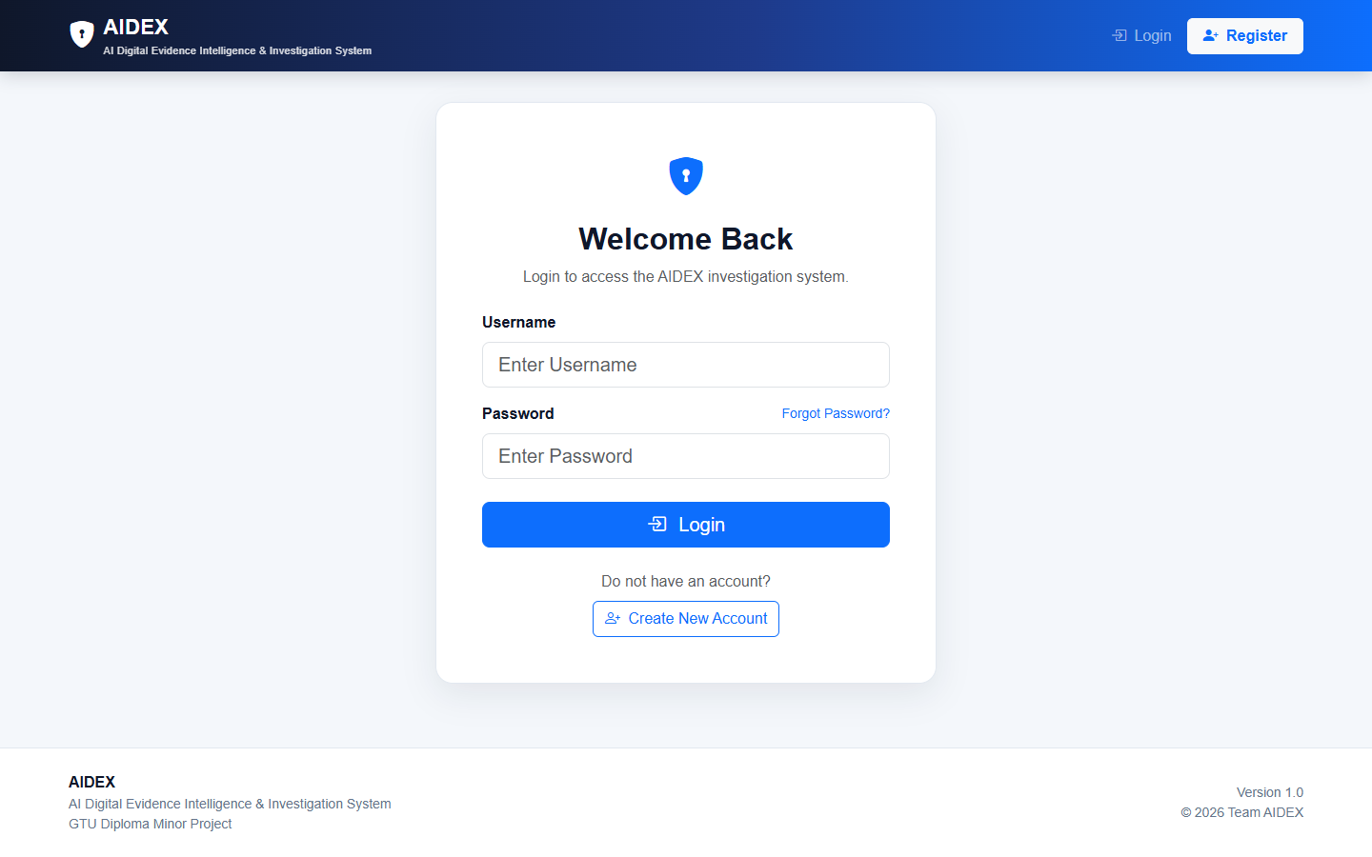
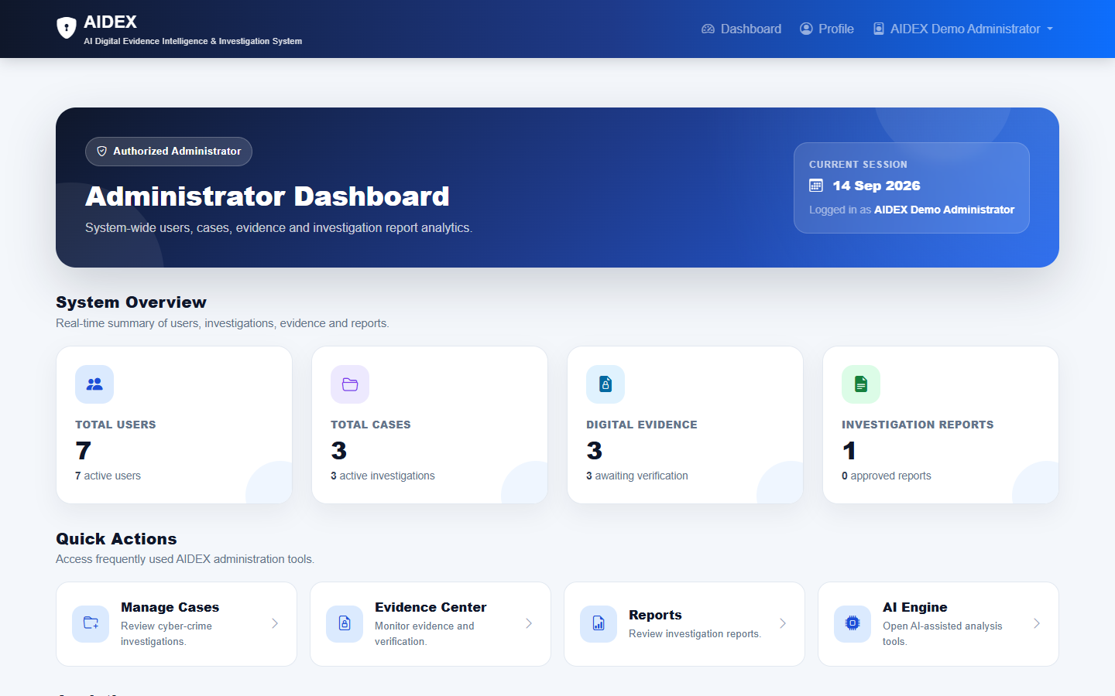
Application Screenshots Part 1
AIDEX
15
Login
Admin Dashboard
• Login is the authentication entry point
• Administrator dashboard shows module shortcuts
Notes:
Screenshots captured from /accounts/login/ and /dashboard/admin/.

Slide 16
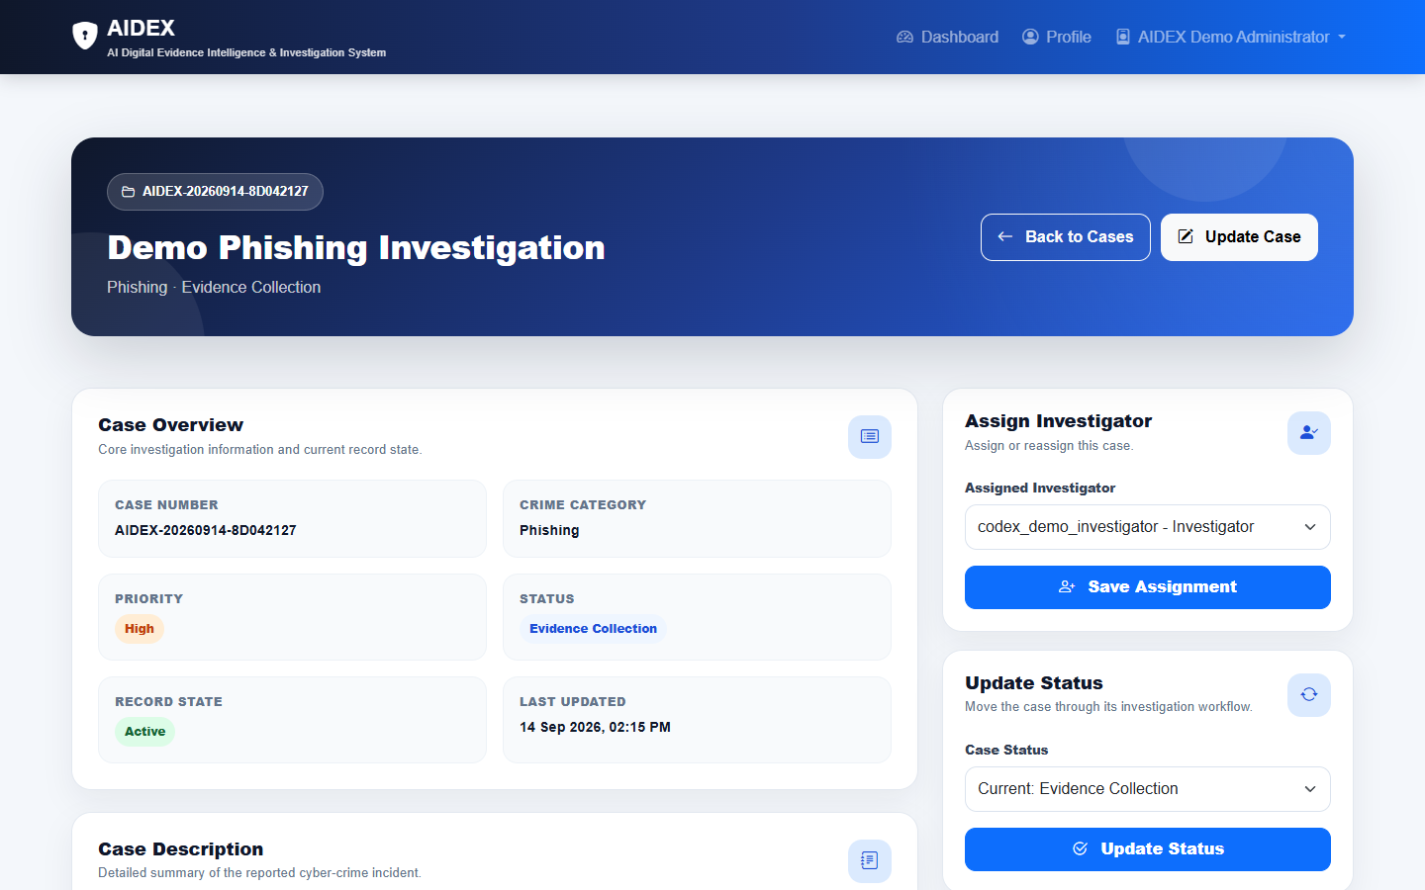
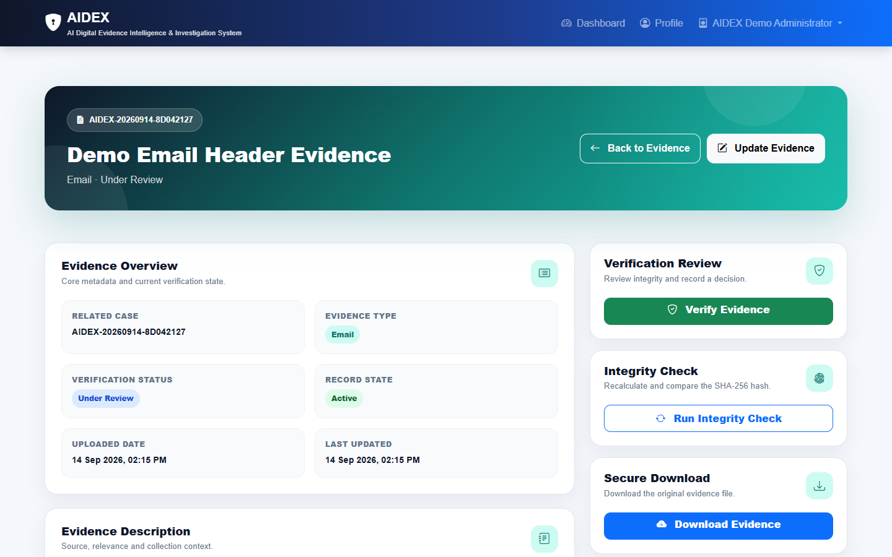
Application Screenshots Part 2
AIDEX
16
Case Detail
Evidence Detail
• Case detail shows assignment and status workflow
• Evidence detail shows integrity metadata
Notes:
Screenshots captured from case and evidence module pages.

Slide 17
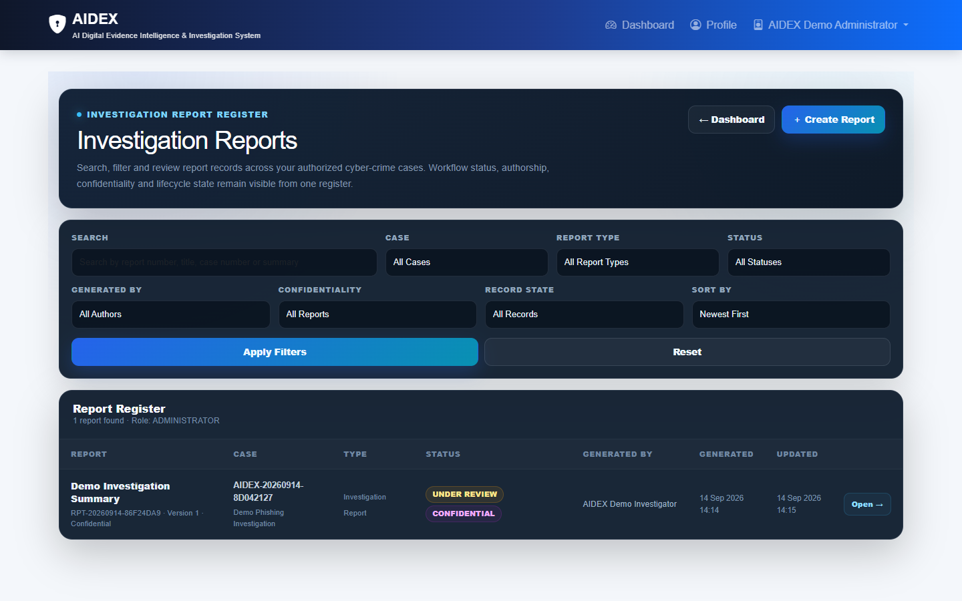
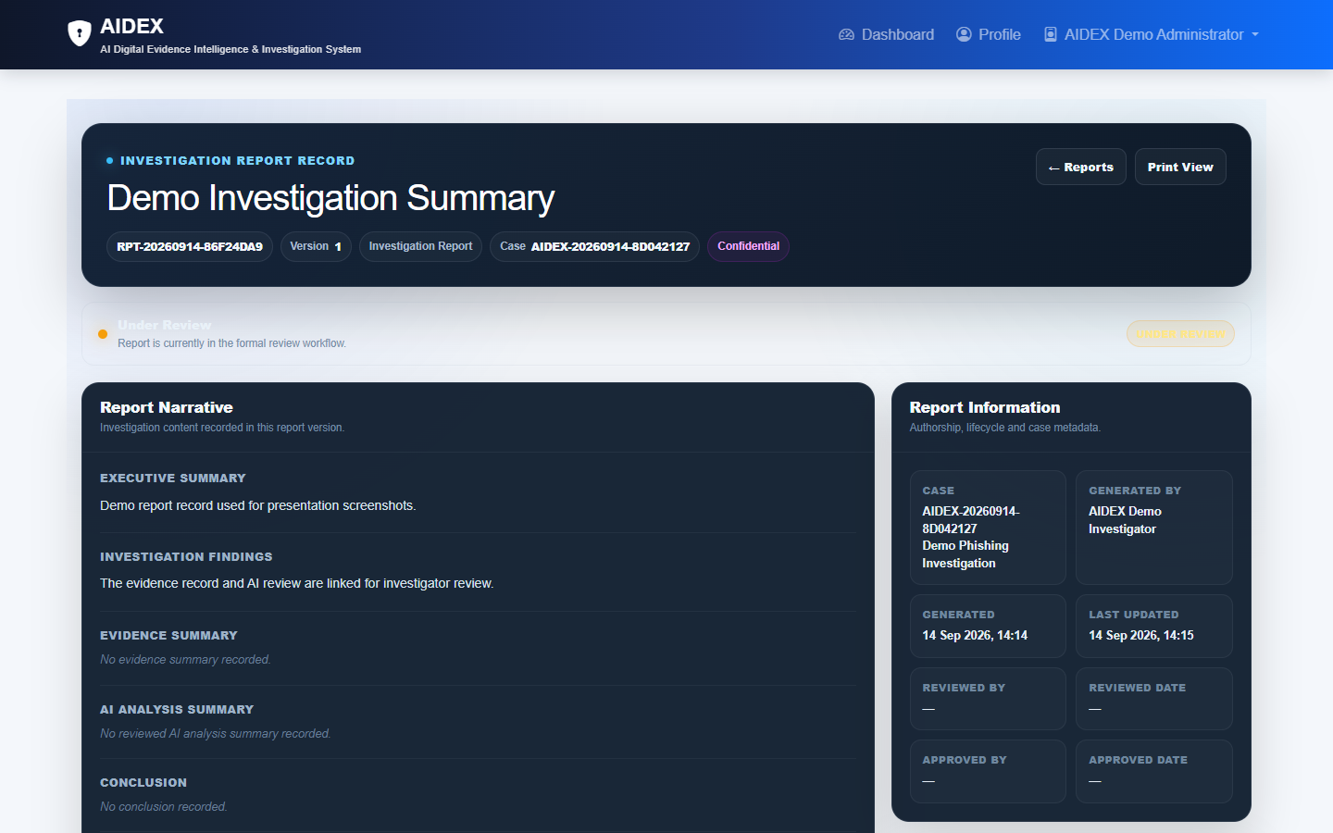
Application Screenshots Part 3
AIDEX
17
Report Register
Report Detail
• Report register shows searchable records
• Report detail shows status and metadata
Notes:
Screenshots captured from reports/list and report detail pages.

Slide 18
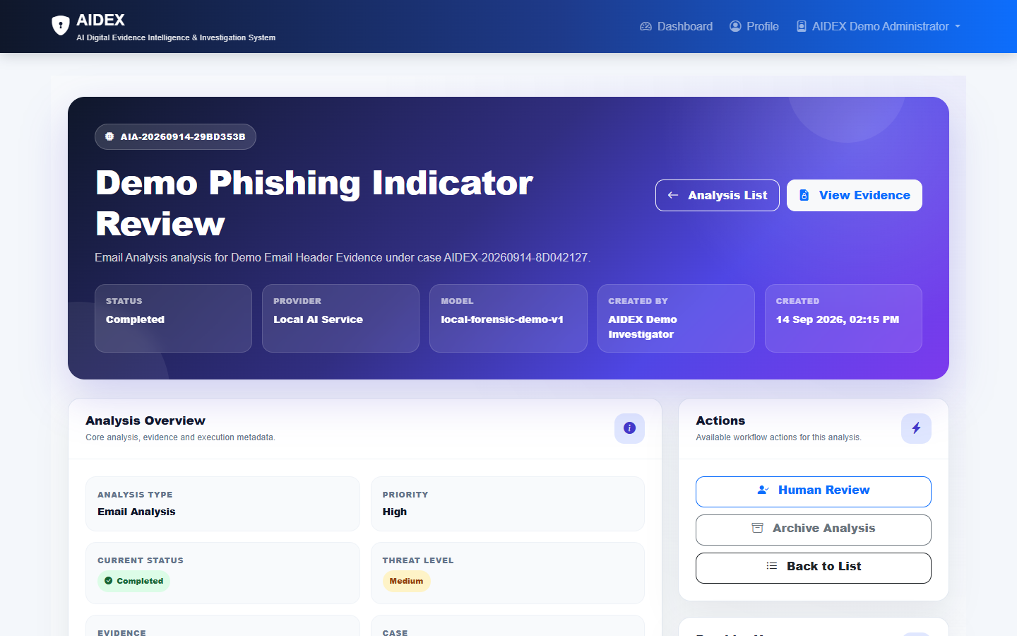
AI / Intelligent Analysis
AIDEX
18
AI analysis works on uploaded evidence records. Users create a request, choose a provider and review the result before reporting.
• Providers: Gemini, OpenRouter-compatible and Local
• Stores status, threat level and review fields
• Supports retry, cancel, archive and restore
• Extracts text from common document formats
Notes:
AI functionality verified from ai_engine/models.py, forms.py, services.py, providers.py, ocr.py, urls.py and tests.py. Screenshot captured from AI analysis detail page.

Slide 19
Testing & Results
AIDEX
19
The automated Django test suite passed 79 tests. Django system checks reported no issues.
Area | Important verified scenarios
Accounts | Login lockout, counter reset, expired lock release
Cases | Assignment, role visibility, status transitions, archive and restore
Evidence | AES-GCM storage, SHA-256 metadata, file-signature checks, secure download
AI Engine | Provider selection, cache keys, retry, cancel, human review and safe errors
Reports | Review, approval, PDF publication gate, audit log and revisions
Dashboard | Role-based redirect and dashboard access protection
Notes:
Actual command executed: python manage.py test. Result: Ran 79 tests in 83.575s, OK.

Slide 20
Security Implementation
AIDEX
20
AIDEX separates application roles from Django admin privileges and protects evidence files outside public media access.
Control | Implementation evidence
Role authorization | Administrator, Investigator and Cyber Officer checks in dashboards and module views
Login protection | Failed-login counter, temporary lock, password reset eligibility checks
Evidence protection | AES-256-GCM encrypted storage and protected media download route
Integrity and AI safety | SHA-256 fingerprints, explicit analysis runs and redacted provider errors
Notes:
Security evidence from accounts/models.py, accounts/views.py, evidence/encrypted_storage.py, evidence/views.py, reports/models.py and ai_engine/views.py.

Slide 21
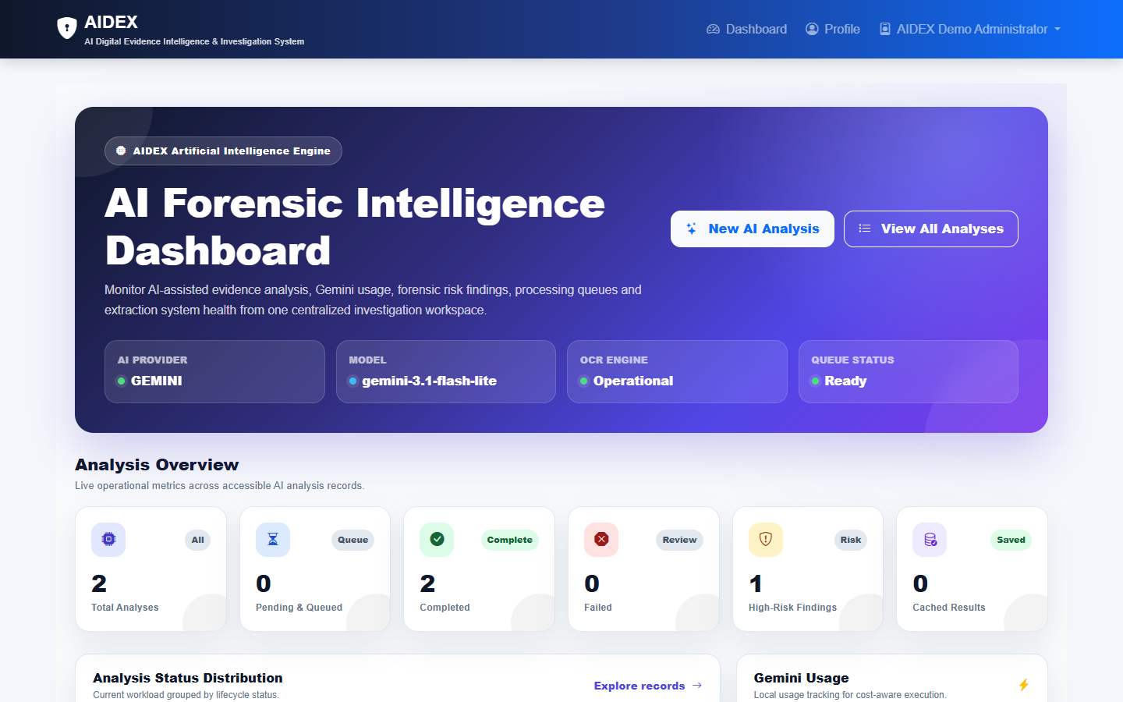
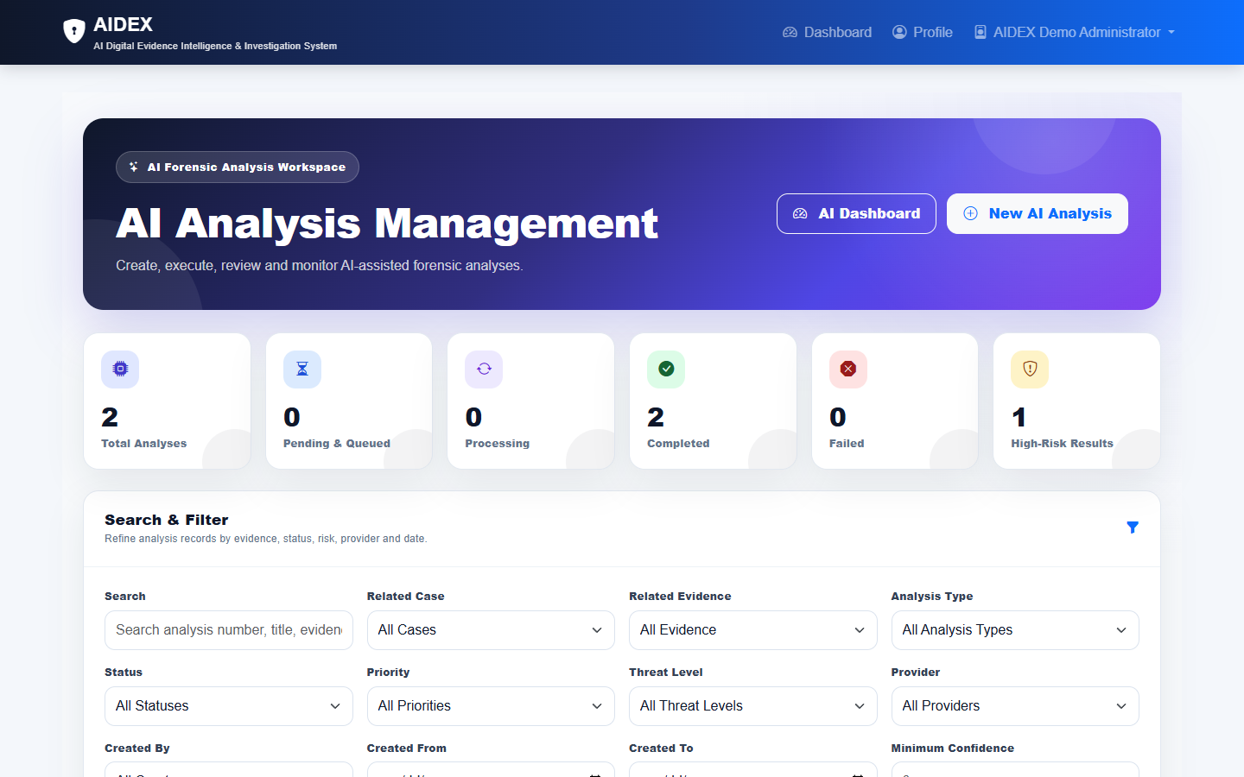
AI Workflow Screens
AIDEX
21
AI Dashboard
Analysis Register
The AI workflow moves from dashboard overview to the analysis register. The detailed reviewed record appears on the previous slide.
• Screens use local demo data
• No API key exposure is shown
Notes:
AI screenshots captured from /ai/, /ai/analysis/ and AI analysis detail route.

Slide 22
Deployment & Run Process
AIDEX
22
The repository supports local Django development and includes Gunicorn-based deployment configuration.
Area | Actual project configuration
Local run | python manage.py runserver
Django entry points | aidex/wsgi.py and aidex/asgi.py
Environment | .env loaded through python-dotenv with .env.example as reference
Database | SQLite by default, MySQL selected with DB_ENGINE=mysql
Static files | WhiteNoise and collectstatic support for production
Hosting | render.yaml uses Gunicorn with aidex.wsgi:application
Notes:
Deployment/run details verified from README.md, aidex/settings.py, aidex/wsgi.py, aidex/asgi.py and render.yaml.

Slide 23
Advantages & Limitations
AIDEX
23
Advantages
Current Limitations
• Central cyber-crime case workflow
• Encrypted evidence with integrity checks
• Role-based dashboards
• Review history for AI and reports
• Audio transcription is a placeholder
• Heavy OCR runs synchronously
• Production needs secrets and HTTPS
• Screenshots use demo data
Notes:
Limitations are based on README production notes and explicit placeholder implementation in ai_engine/ocr.py.

Slide 24
Future Scope & Conclusion
AIDEX
24
Future Scope
Conclusion
• Add background workers for OCR and video
• Configure speech-to-text for audio evidence
• Extend report export automation
• Add monitoring and audit dashboards
AIDEX delivers a working Django system for cyber-crime investigation, secure evidence handling, AI-assisted analysis and controlled reporting.
Future items are improvements only, not implemented features.
Notes:
Future scope is separated from implemented functionality. Conclusion summarizes current implementation.

Slide 25
Thank You
AIDEX
25
AIDEX
AI Digital Evidence Intelligence & Investigation System
Questions & Answers
Team: Saksham Patel, Harsh, Shrushti, Amisha, Viral
Notes:
Closing slide with project and team details.

