Slide 1
AIDEX
Cyber-crime cases
Digital evidence
AI-assisted review
AI Digital Evidence Intelligence & Investigation System
Minor Project / Academic Project
Diploma Computer Engineering
Institute: Neotech Faculty of Diploma Engineering
Academic Year: 2026-2027
Notes:
Source: README.md and aidex/settings.py identify AIDEX and the project purpose.

Slide 2
Team Members
AIDEX
02
Saksham Patel
Harsh Parmar
Shrushti Suthar
Amisha Agarwal
Viral Mali
Notes:
Team names came from README.md. No enrollment numbers were found.

Slide 3
Introduction
AIDEX
03
AIDEX supports cyber-crime investigation work by linking cases, uploaded digital evidence, AI-assisted analysis and investigation reports in one role-aware Django application.
Administrators
Investigators
Cyber Officers
• Manage cyber-crime cases and assignments
• Upload and verify digital evidence records
• Run explicit AI analysis and review generated findings
• Create investigation reports with approval and publication flow
Notes:
Verified from README.md, dashboard/views.py, cases/views.py, evidence/views.py, ai_engine/models.py, reports/models.py.

Slide 4
Problem Statement
AIDEX
04
Manual or scattered investigation records make it difficult to preserve evidence integrity, role accountability and report traceability during cyber-crime case handling.
• Evidence files need reliable metadata and SHA-256 fingerprints
• Sensitive evidence must stay protected during preview, download and AI preparation
• Case status changes need controlled transitions
• Reports need review, approval, publication and audit history
Notes:
Supported by evidence/models.py, evidence/encrypted_storage.py, cases/forms.py, reports/services.py and README.md.

Slide 5
Objectives
AIDEX
05
• Provide role-based access for administrators, investigators and cyber officers
• Track cases from creation through assignment, investigation and closure
• Store evidence with validation, encryption and SHA-256 integrity checks
• Support explicit AI-assisted analysis with caching, retries and audit logs
• Generate investigation reports with review, approval and publication controls
• Show role-specific dashboards and searchable registers
Notes:
Objectives reflect implemented modules in accounts, dashboard, cases, evidence, ai_engine and reports.

Slide 6
Existing vs Proposed System
AIDEX
06
Aspect | Existing / Manual Approach | AIDEX Proposed System
Case tracking | Separate notes or files | Central case records with status workflow
Evidence integrity | Manual filename and storage checks | SHA-256 fingerprints, validation and encrypted storage
Access control | Hard to separate responsibilities | Administrator, Investigator and Cyber Officer roles
Analysis | Manual review without reuse | Explicit AI analysis records with cache and review
Reports | Document drafts without system history | Report lifecycle with audit events
Notes:
Comparison is derived from implemented workflows and README.md.

Slide 7
Technology Stack
AIDEX
07
Layer | Technologies detected
Backend | Django 6, Python 3.12+, Gunicorn
Frontend | HTML templates, CSS, JavaScript, Bootstrap Icons, Chart.js
Database | SQLite for development, MySQL option via settings
AI and extraction | google-genai, OpenRouter-compatible provider, Pillow, pytesseract, OpenCV, pypdf, python-docx, openpyxl, python-pptx
Security utilities | cryptography for AES-256-GCM evidence storage, SHA-256 hashing
Notes:
Sources: requirements.txt, README.md, aidex/settings.py, ai_engine/providers.py, ai_engine/ocr.py, evidence/encrypted_storage.py.

Slide 8
System Architecture
AIDEX
08
Application Modules
Accounts, Cases, Evidence, AI, Reports, Dashboard
Browser
HTML, CSS, JS
Django URLs
Views and Forms
SQLite / MySQL
Django Models
Protected Media
Encrypted evidence files
External AI Provider
Gemini or OpenRouter
Notes:
Architecture from aidex/urls.py, settings.py, module views/forms/models and protected media routing.

Slide 9
Modules
AIDEX
09
Module | Actual responsibility
Accounts | Custom user model, registration, login, password reset, profile
Dashboard | Role dashboards with chart-ready case, evidence and report data
Cases | Case creation, assignment, status update, archive and restore
Evidence | Upload, validation, encrypted storage, verification and download
AI Engine | Evidence analysis, OCR/extraction, provider execution, review and logs
Reports | Draft, review, approve, reject, publish, archive, restore and revise reports
Notes:
Sources: app directories, urls.py files, models.py, forms.py and views.py.

Slide 10
Key Features
AIDEX
10
• Role-aware access for Administrator, Investigator and Cyber Officer
• Case assignment and controlled status transitions
• Evidence upload with extension, size and content-signature validation
• AES-256-GCM encrypted evidence storage and SHA-256 tamper checks
• AI analysis with provider selection, retry handling, caching and human review
• Report lifecycle with audit log, integrity hash, PDF publication gate and revisions
• Search, filter and pagination for cases, evidence, AI analysis and reports
Notes:
Feature status: implemented or partially implemented only. QR functionality was not found and is not included.

Slide 11
Database / ER Diagram
AIDEX
11
User
accounts_user
Case
aidex_cases
Evidence
aidex_evidence
AIAnalysis
aidex_ai_analysis
AIAnalysisLog
aidex_ai_analysis_logs
Report
aidex_investigation_reports
ReportAuditLog
aidex_report_audit_logs
• User creates and is assigned to cases
• Case owns evidence and reports
• Evidence owns AI analyses
• Reports reference evidence and reviewed AI analyses
Notes:
Model relationships verified from accounts/models.py, cases/models.py, evidence/models.py, ai_engine/models.py and reports/models.py.

Slide 12
Database Design
AIDEX
12
Entity | Key attributes | Relationships
accounts_user | PK id, username, email, badge_id, role, account_status | Creates cases, uploads evidence, generates or reviews reports
aidex_cases | PK id, case_number, case_title, crime_category, priority, status | One case contains many evidence records and many reports
aidex_evidence | PK id, title, type, file metadata, sha256_hash, verification_status | Each evidence record belongs to one case and can have many AI analyses
aidex_ai_analysis | PK id, analysis_number, provider, model_name, status, threat_level | Each analysis belongs to one evidence record and has audit logs
aidex_investigation_reports | PK id, report_number, version, status, file_sha256 | Belongs to one case; links selected evidence and AI analyses
audit logs | Event type, actor, status changes, metadata | AIAnalysisLog and ReportAuditLog preserve workflow history
Legend: PK means primary key. FK means foreign key. Report to Evidence and Report to AIAnalysis are many-to-many links through Django-managed junction tables.
Notes:
Detailed ER summary cross-checked against Django models and migrations. Important many-to-many links: Report.included_evidence and Report.included_analyses.

Slide 13
User Workflow
AIDEX
13
1. Login
Account status and role checked
2. Dashboard
Role-specific overview and actions
3. Case
Create, assign and update status
4. Evidence
Upload, validate, hash and verify
5. AI Analysis
Run explicit analysis and review output
6. Report
Draft, review, approve and publish
The workflow follows the actual application routes: account login, role dashboard, case management, evidence management, AI analysis and report lifecycle.
Notes:
Workflow verified from accounts/urls.py, dashboard/urls.py, cases/urls.py, evidence/urls.py, ai_engine/urls.py and reports/urls.py.

Slide 14
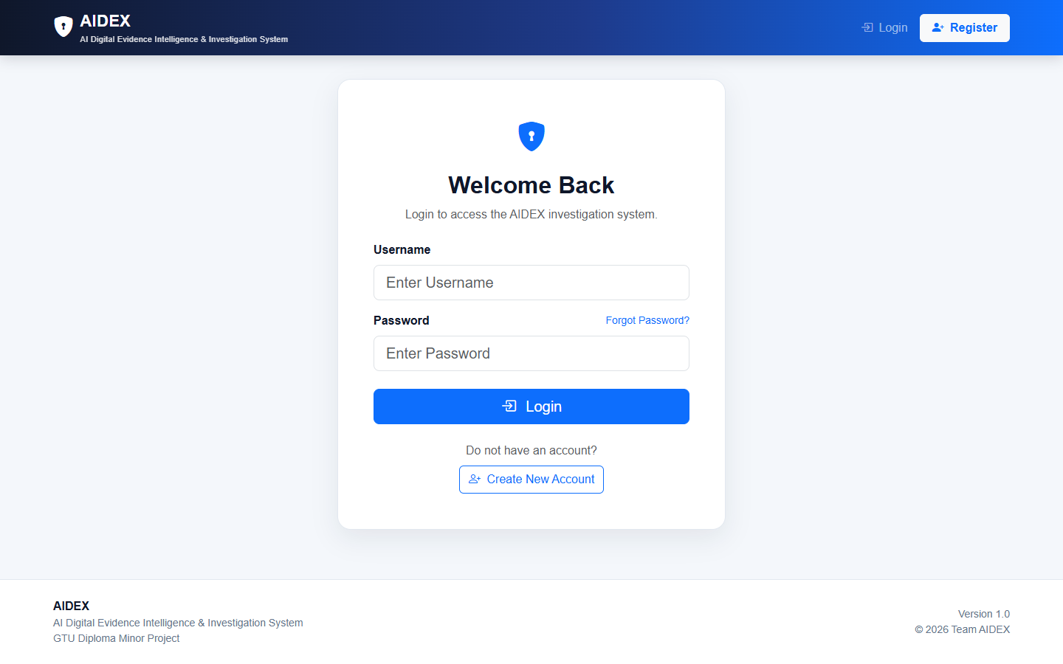
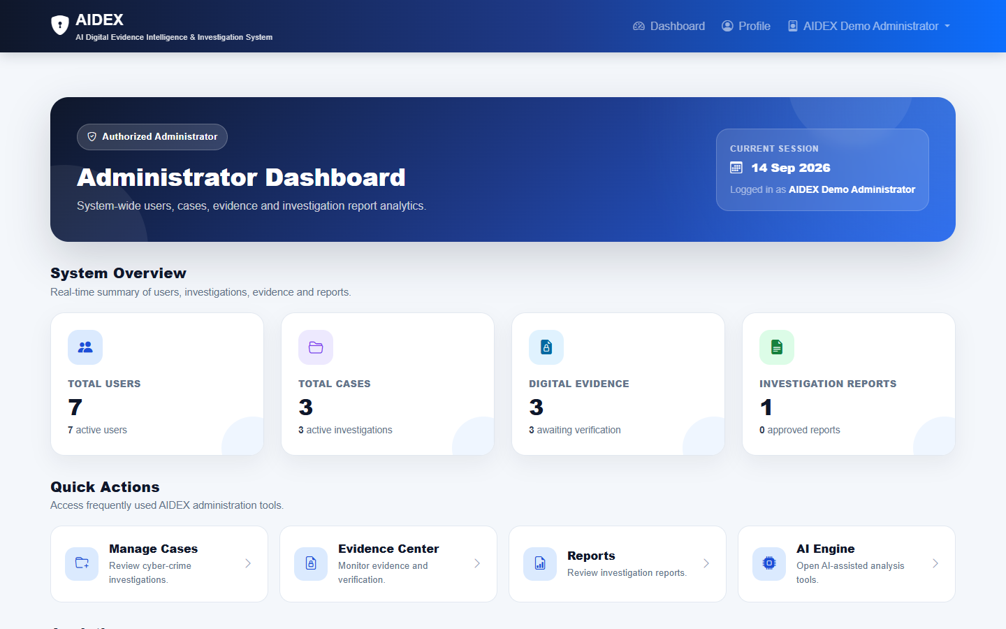
Application Screenshots Part 1
AIDEX
14
Login
Admin Dashboard
• Login screen shows the authentication entry point
• Administrator dashboard shows real summary cards and module shortcuts
Notes:
Screenshots captured from /accounts/login/ and /dashboard/admin/.

Slide 15
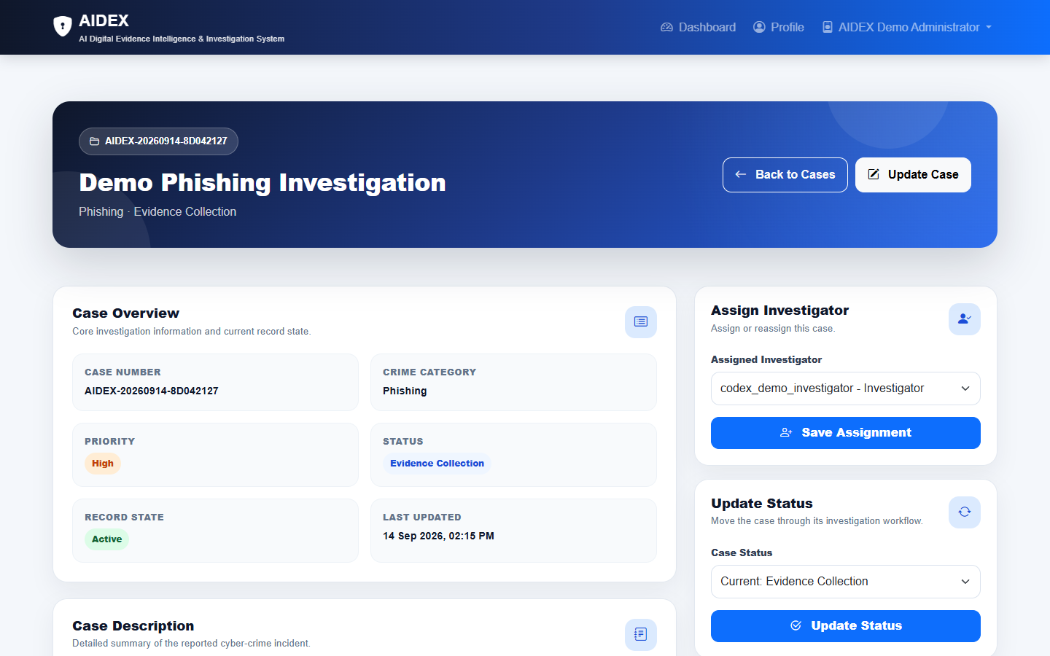
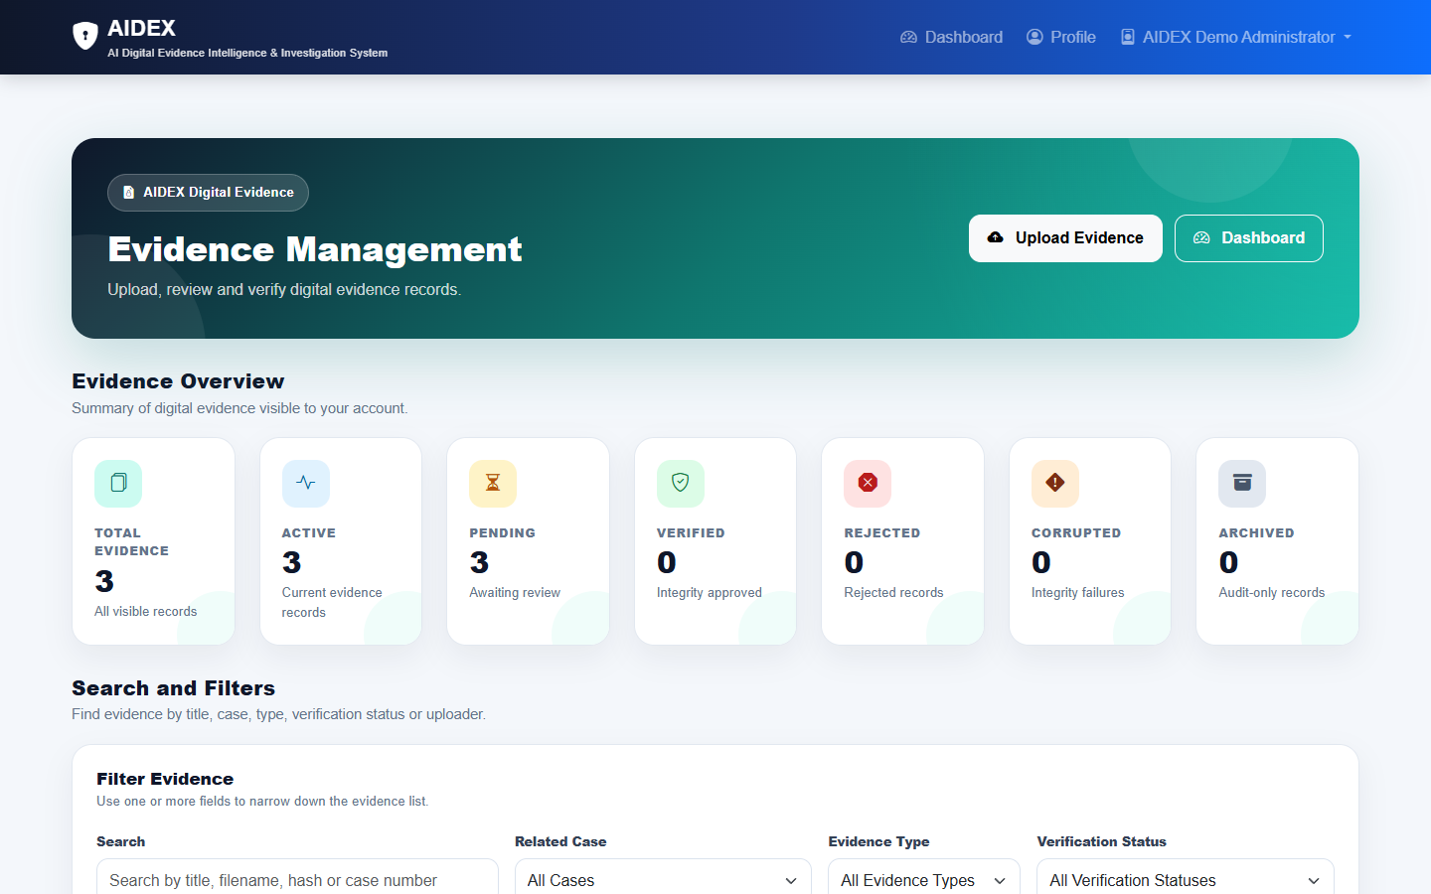
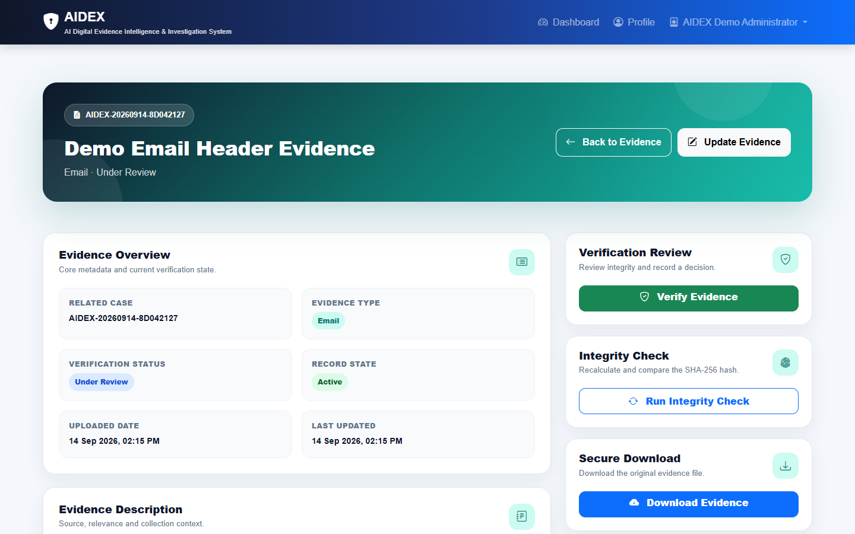
Application Screenshots Part 2
AIDEX
15
Case Detail
Evidence Register
Evidence Detail
• Case detail shows assignment and status workflow
• Evidence register shows search, filters and verification counts
• Evidence detail keeps file metadata and integrity context visible
Notes:
Screenshots captured from case and evidence module pages.

Slide 16
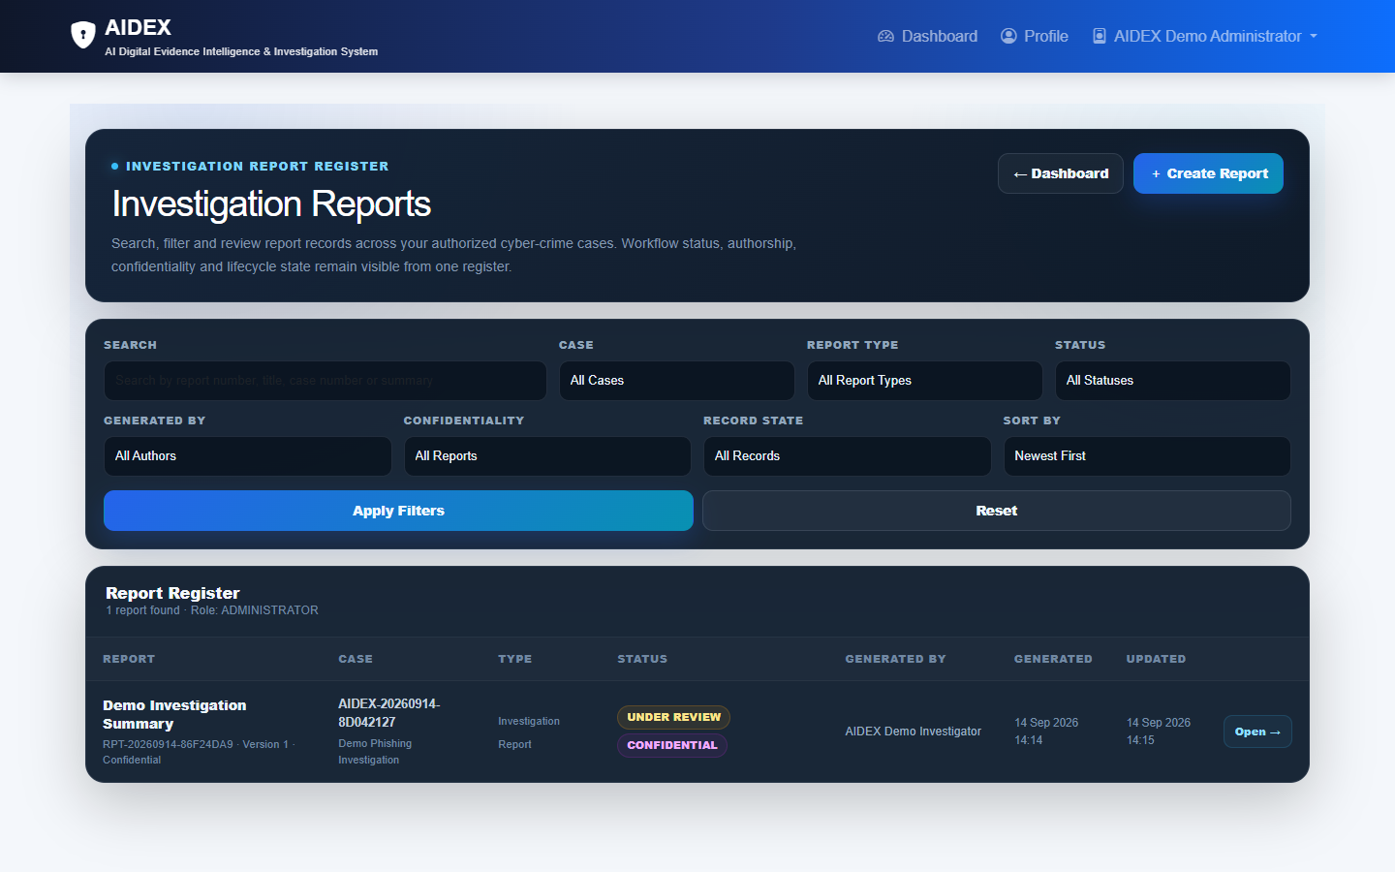
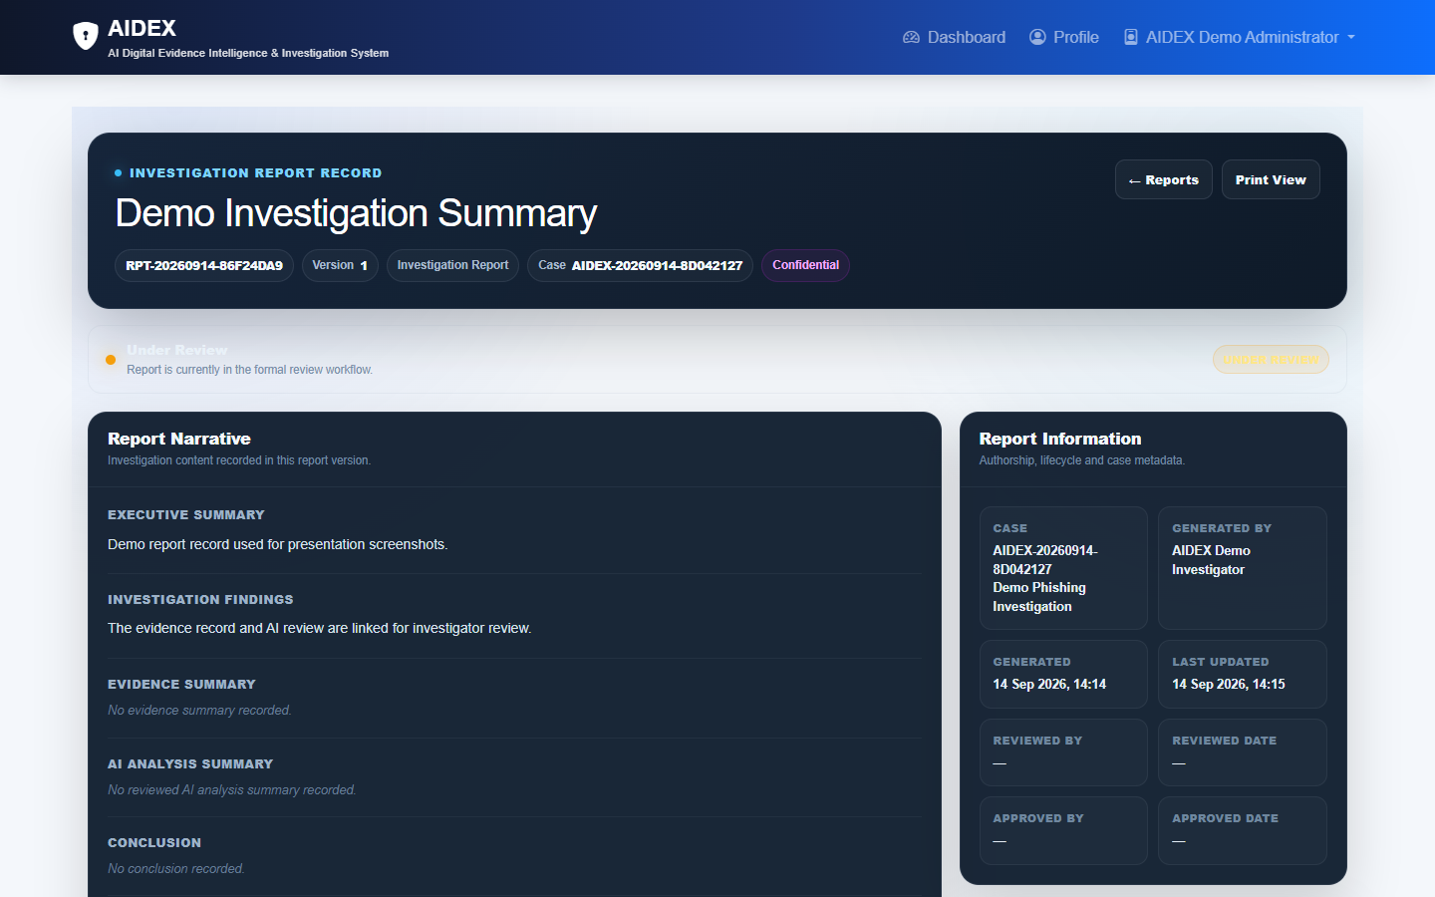
Application Screenshots Part 3
AIDEX
16
Report Register
Report Detail
• Report register shows searchable investigation report records
• Report detail shows narrative sections, lifecycle status and metadata
Notes:
Screenshots captured from reports/list and report detail pages.

Slide 17
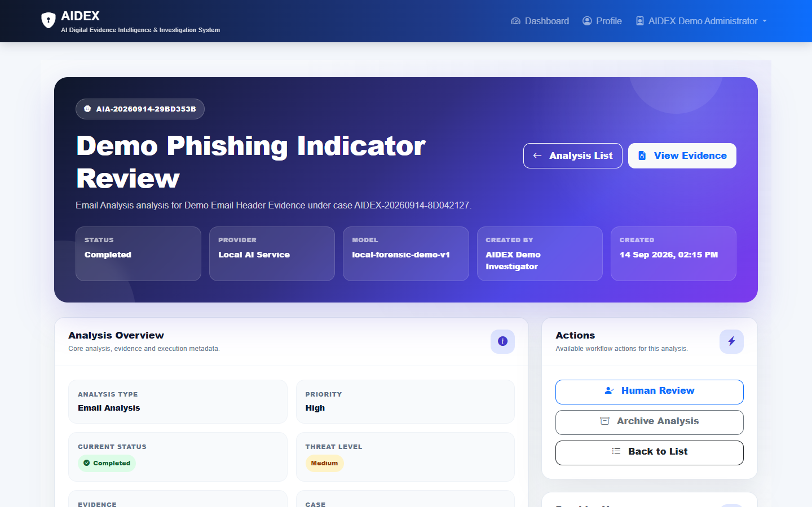
AI / Intelligent Analysis
AIDEX
17
AI analysis works on uploaded evidence records. Users create an analysis request, choose the provider/model, run the analysis explicitly, then review the result before it can support reporting.
• Implemented providers: Gemini, OpenRouter-compatible and Local
• Stores status, threat level, risk/confidence fields, token counts and provider errors
• Includes retry, cancel, archive, restore and human review workflows
• OCR/extraction supports text, PDF, images, DOCX, XLSX, PPTX, ZIP and sampled video frames
Notes:
AI functionality verified from ai_engine/models.py, forms.py, services.py, providers.py, ocr.py, urls.py and tests.py. Screenshot captured from AI analysis detail page.

Slide 18
Testing & Results
AIDEX
18
The automated Django test suite was run after screenshot capture. Result: 79 tests passed in 83.575 seconds, with system checks reporting no issues.
Area | Important verified scenarios
Accounts | Login lockout, counter reset, expired lock release
Cases | Assignment, role visibility, status transitions, archive and restore
Evidence | AES-GCM storage, SHA-256 metadata, file-signature checks, secure download
AI Engine | Provider selection, cache keys, retry, cancel, human review and safe errors
Reports | Review, approval, PDF publication gate, audit log and revisions
Dashboard | Role-based redirect and dashboard access protection
Notes:
Actual command executed: python manage.py test. Result: Ran 79 tests in 83.575s, OK.

Slide 19
Advantages & Limitations
AIDEX
19
Advantages
Current Limitations
• Central workflow for cyber-crime cases
• Encrypted evidence storage with integrity checks
• Role-based dashboards and access rules
• AI and report actions preserve review/audit context
• Audio transcription is an explicit placeholder
• Heavy OCR/video work still runs synchronously in this build
• Production deployment needs configured secrets, HTTPS and host settings
• Screenshots use temporary demo data, not live investigation data
Future scope: background workers for heavy analysis, configured speech-to-text, richer export automation and deployment monitoring.
Notes:
Limitations are based on README production notes and explicit placeholder implementation in ai_engine/ocr.py.

Slide 20
Thank You
AIDEX
20
AIDEX
AI Digital Evidence Intelligence & Investigation System
Questions & Answers
Team: Saksham Patel, Harsh, Shrushti, Amisha, Viral
Notes:
Closing slide with project and team details.

