Slide 1
RUST PROGRAMMING LANGUAGE
MA019
HARSORA RUSHITKUMAR R.

Slide 2
AGENDA
01. Introduction
02. About RUST
Open Source and Open Governance
Top-tier performance
Like C/C++ or better
Features Of Rust
03.Environment Setup
Installation on Windows
04.Reason To Learn Rust
Rust improved memory safety
Dependable code
Rust is fast and flexible

Slide 3
INTRODUCTION
The Rust programming language helps you write faster, more reliable software.
High-level ergonomics and low-level control are often at odds in programming language design; Rust challenges that conflict.
Through balancing powerful technical capacity and a great developer experience.
Rust gives you the option to control low-level details (such as memory usage) without all the hassle traditionally associated with such control.

Slide 4
Features of Rust
Zero cost abstraction
Error messages
Move semantics
Threads without data races
Pattern matching
Guaranteed memory safety
Efficient C bindings
Safe memory space allocation
Minimal time

Slide 5
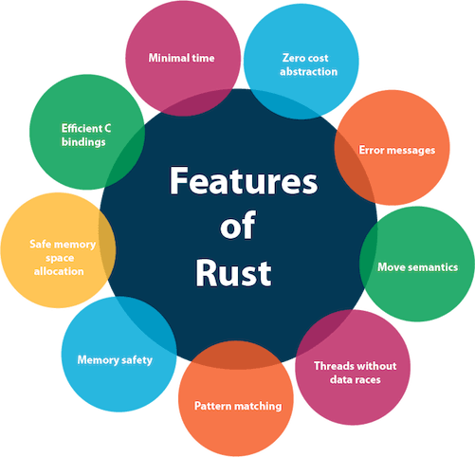

Slide 6
Zero cost abstraction
In Rust, we can add abstractions without affecting the runtime performance of the code. It improves the code quality and readability of the code without any runtime performance cost.
Error messages
Error messages are displayed with (formatting, colors) and also suggest misspellings in our program.
Movesemantics
Rust provides this feature that allows a copy operation to be replaced by the move operation when a source object is a temporary object.

Slide 7
Zero cost abstraction
In C++ programming, there is an excellent improvement in error messages as compared to GCC. Rust goes one step further in case of clarity. Error messages are displayed with (formatting, colors) and also suggest misspellings in our program.

Slide 8
What is Rust?
Rust is a systems programming language that runs
blazingly fast, prevents nearly all segfaults, and
guarantees thread safety.
Rust is a systems programming language focused on three goals: safety, speed, and concurrency.

Slide 9
A brief history
Rust began as a side project of Graydon Hoare, an employee at Mozilla. In short order, Mozilla saw the potential of the new language and began sponsoring it, before revealing it to the world in 2010.
One possible source of the name, according to Hoare, is the rust fungus.
This has caused Rust programmers to adopt “Rustaceans” as their moniker of choice.

Slide 10








Who are using Rust?

Slide 11

THE RUST PROGRAMMIG LANGUAGE
MA019
HARSORA RUSHIT

Slide 12

Today's Agenda
Features Of Rust
Why Use Rust
Basic Syntax Of Rust

Slide 13
FEATURES OF RUST
1.Zero cost abstraction
2.Error messages
3.Move semantics
4.Threads without data races
5.Pattern matching
6.Guaranteed memory safety
7.Efficient C bindings
8.Safe memory space allocation
9.Minimal time

Slide 15
Message Error
let x = 5;
println!("{}", x);

Slide 16
Efficient C Bindings (Call C Function)
extern "C" {
fn abs(input: i32) -> i32;
}
fn main() {
unsafe {
let x = -42;
let y = abs(x);
println!("The value of {} is {}", x, y);
}
}

Slide 17
Pattern Matching
fn main() {
let x = 5;
match x {
1 => println!("one"),
2 => println!("two"),
3 => println!("three"),
4 => println!("four"),
5 => println!("five"),
_ => println!("something else"),
}
}

Slide 18


As A Proramming Language
More Than That......
C/C++
Haskell/Python
More Control,
Less Safety
Less Control,
More Safety
Rust
More Control,
More Safety

Slide 19

WHY USE
RUST?
1.High performance while ensuring memory safety
2.Support for concurrent programming
3.The growing number of Rust packages at crates.io repository
4.A vibrant community driving the development of the language
5.Backwards compatibility and stability ensured

Slide 20
BASIC SYNTAX Of RUST
fn main() {
println!("Hello,world!");
}

Slide 21

THE RUST PROGRAMMING LANGUAGE
HARSORA RUSHIT
MA019

Slide 22
TODAY'S AGENDA
Control And Safety
In The Real World
Comments
Basic Rust Program

Slide 23
Types of comments in rust
// - Line Comment
/*...*/ - Block Comment

Slide 24
What is control ?
The Ability To Run Some Code Depending On Whether A Condition Is True And To Run Some Code Repeatedly While A Condition Is True are Basic Building Blocks In Most Programming Languages.
The Most Common Constructs That Let You Control The Flow Of Execution Of Rust Code Are If Expressions And Loops.

Slide 25
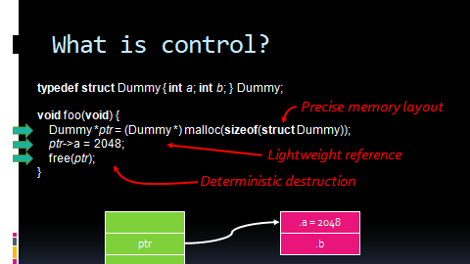

Slide 26
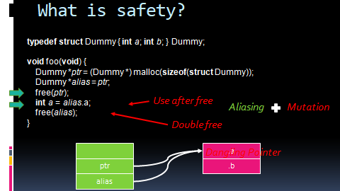

Slide 27
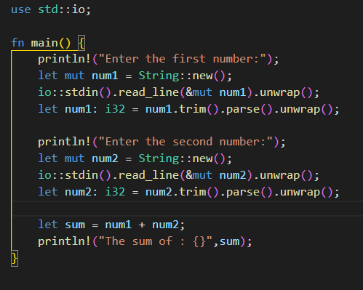

Slide 28

The Rust Programming Language
HARSORA RUSHIT
MA019

Slide 29
Today's agenda
1)DataTypesInRust
Integer
Floating-Point
Boolean
Character

Slide 30
Integer Type
Signed Integer
fn main() {
// Signed integer type
let x: i32 = -200;
let y: i32 = 200;
println!("x = {}", x);
println!("y = {}", y);
}
Output:
x = -200 y = 200
It Declares A Function Called Main With No Parameters And No Return Value.
The let keyword is used to introduce a new variable binding.
i - specifies signed integer type (can store both positive or negative value)
32 - size of the data type (takes 32 bits of space in memory)
The {} is a placeholder for the value of the variables passed as arguments after the string. In this case, the variables x and y are printed using {} with their respective values.

Slide 31
Unsigned Integer
fn main() {
// Unsigned integer type
let x: u32 = 300;
println!("x = {}", x);
}
Output:
x = 300
We Can Also Create Variables That Can Only Store Positive Integer Values
U32 specifies That The x variable Can Only Store Positive Values. U specifies Unsigned Integer Type.
If We Try To Store Negative Numbers To u32 type Variables, We Will Get An Error

Slide 32
Floating Point Type
fn main() {
// f32 floating point type
let x: f32 = 3.1;
// f64 floating point type
let y: f64 = 45.0000031;
println!("x = {}", x);
println!("y = {}", y);
}
Output:
x = 3.1 y = 45.0000031
Rust Also Has two Primitive Types for Floating-point Numbers.
Rust's Floating-point Types Are F32 And F64 , Which Are 32 Bits And 64 Bits In Size, Respectively.
F32 is A Type Declaration For The Floating Point Value. In This Case, x is Assigned To A Floating Point Value Of 3.1.

Slide 33
Rust Boolean Type
fn main() {
// boolean type
let flag1: bool = true;
let flag2: bool = false;
println!("flag1 = {}", flag1);
println!("flag2 = {}", flag2);
}
Output:
flag1 = true flag2 = false
In Rust, A Boolean Data Type Can Have Two Possible Values: true or false
We Have Used The bool keyword To Represent The Boolean Type In Rust.
Note: booleans Are Frequently Used In Conditional Statements Like If/Else Expressions.

Slide 34
Rust Character Type
The character data type in Rust is used to store a character.
char represents the character type variable and we use single quotes to represent a character.
We can also store special characters like $, @, &, etc. using the character type.
We can also store numbers as characters using single quotes
fn main() {
// char type
let character: char = 'z';
println!("character = {}", character);
}
Output:
character = z

Slide 35

The Rust Programming Language
MA019
HARSORA RUSHIT

Slide 36
Today's Agenda
Type of Methods
Type of Concurrency
Types of packages

Slide 37
Type Of Interface
Trait Interface: Traits are used to define a set of methods that can be implemented by different types. Traits are similar to interfaces in other programming languages.
Struct Interface: Structs are used to define complex data structures that can be used as a data interface between different parts of the program.
Function Interface: Functions in Rust can be used as an interface to perform a specific task or operation.
Macro Interface: Macros are used to define code that can be reused in different parts of the program. They are similar to functions but operate on the AST (Abstract Syntax Tree) level.

Slide 38
Trait Interface
Defined Within A Trait And Can Be Implemented By Any Type That Implements The Trait. They Are Similar To Instance Methods But Are Not Defined On A Specific Struct Or Enum.
The Greet Method Takes A Reference To Self As An Argument And Returns Nothing.
Person Struct With A Single Field Name Of Type String
The Person Struct. It Provides A Method Implementation For The Greet Method That Simply Prints A Greeting Message Using The Name Field Of The Person Struct.
Person Instance With The Name Field Set To "Alice", And Then Calls The Greet Method On That Instance, Which Prints The Greeting Message To The Console.
trait Greeting {
fn greet(&self); }
struct Person {
name: String, }
impl Greeting for Person {
fn greet(&self) {
println!("Hello, my name is {}!",self.name); } }
fn main() {
let person = Person { name: String::from("Harsora") };
person.greet(); }

Slide 39
Concurrency
Rust aims to handle concurrent and parallel programming efficiently and safely. With the increasing use of multiple processors, concurrent and parallel programming have become essential.
However, historically they have been difficult and error-prone. Rust hopes to change this by providing a safe and efficient way to handle these types of programming.

Slide 40
Type of concurrency
Threads: Rust provides native support for threads, which allow you to execute multiple tasks concurrently. Threads can communicate with each other using channels, which provide a safe and efficient way to pass messages between threads.
Futures: Rust's async/await syntax allows you to write asynchronous code in a familiar synchronous style. Futures provide a way to represent an operation that may not complete immediately, allowing other code to execute in the meantime.
Actors: Rust also provides support for the actor model of concurrency, which is a popular model for building concurrent systems. Actors are isolated units of computation that communicate with each other by sending messages.
Atomic operations: Rust provides atomic operations, which allow you to modify shared data safely without needing to use locks or other synchronization primitives.

Slide 41
Example of Threads
Output:-
Thread 1: 1
Thread 2: 1
Thread 1: 2
Thread 2: 2
Thread 1: 3
Thread 2: 3
Thread 1: 4
Thread 2: 4
Thread 1: 5
Thread 2: 5
use std::thread;
fn main() {
let t1 = thread::spawn(|| {
for i in 1..=5 {
println!("Thread 1: {}", i);} } );
let t2 = thread::spawn(|| {
for i in 1..=5 {
println!("Thread 2: {}", i); } } );
t1.join().unwrap();
t2.join().unwrap();
}

Slide 42
Type of packages
Binary Crates: These are the executable crates that are produced after compiling Rust code. They can be executed directly from the command line.
Library Crates: These crates contain reusable code that can be used by other crates or projects. They do not produce executable files but can be imported as dependencies in other projects.

Slide 43
How to create package
Creating a Binary Package in Rust
To create a binary package, we can use the cargo command in the terminal.
$ cargo new hello_world –bin
Output
Created binary (application) `hello_world` package
We create a binary package hello_world using cargo and the --bin option. It is the default cargo behavior.
Let's look at the contents of the hello_world package.
hello_world is the package directory
Cargo.toml is a file that contains metadata about the crate, such as its name, version, and dependencies
src/main.rs is the crate root and contains the source code of the binary package
hello_world ├── Cargo.toml └── src └── main.rs

Slide 44
How to create package
Creating a Library Package in Rust
Similarly, we can create a library package in Rust using cargo.
$ cargo new hello_world_lib --lib
Output
Created library `hello_world_lib` package
We create a library package hello_world_lib using cargo and the --lib option.
Let's look at the contents of the hello_world_lib package.
Here,
hello_world_lib is the package directory
Cargo.toml is a file that contains metadata about the crate, such as its name, version, and dependencies
src/lib.rs is the crate root and contains the source code of the library package
hello_world_lib ├── Cargo.toml └── src └── lib.rs

Slide 45
fn main() {
println!("Thank you");
}

