Slide 1
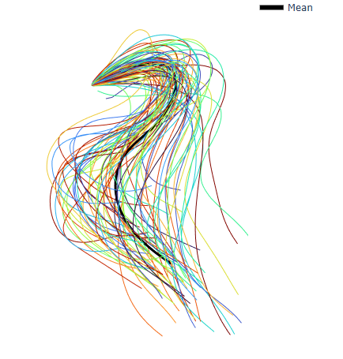
Distal Alignment
B1
Distal
B2
Proximal

Slide 2
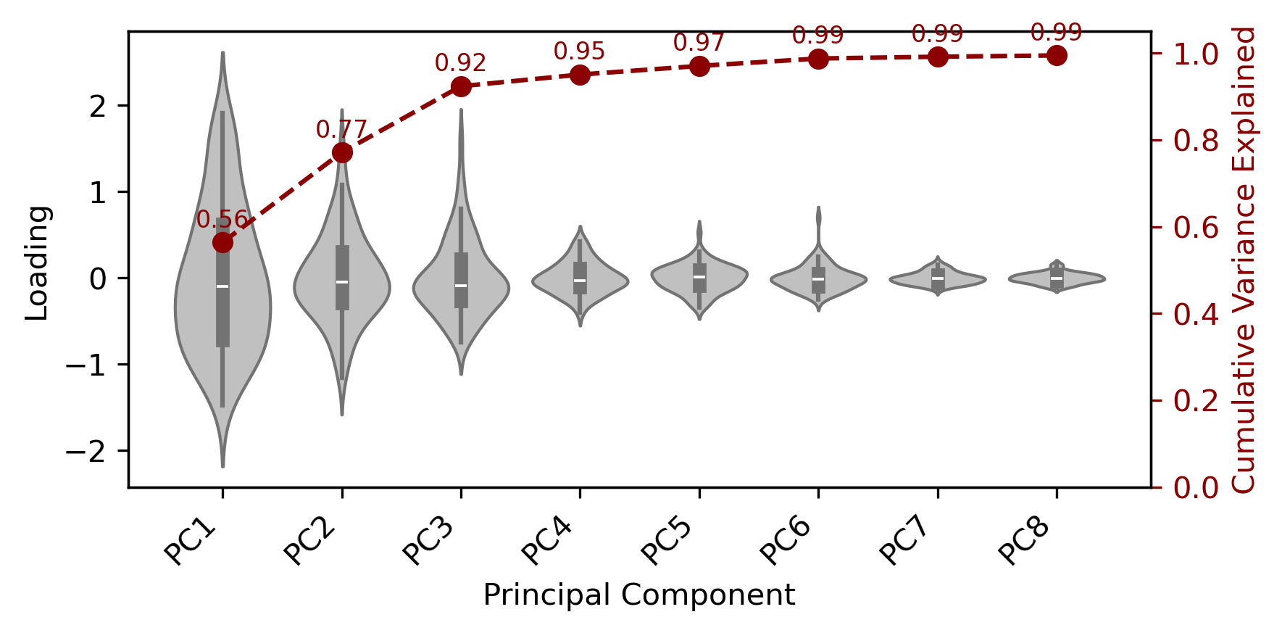
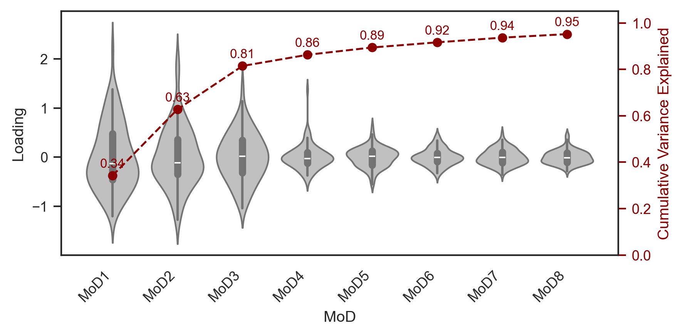
Distal alignment 3 PCs to 92% CVE (CMA: 6 PCs needed)
CMA result

Slide 3
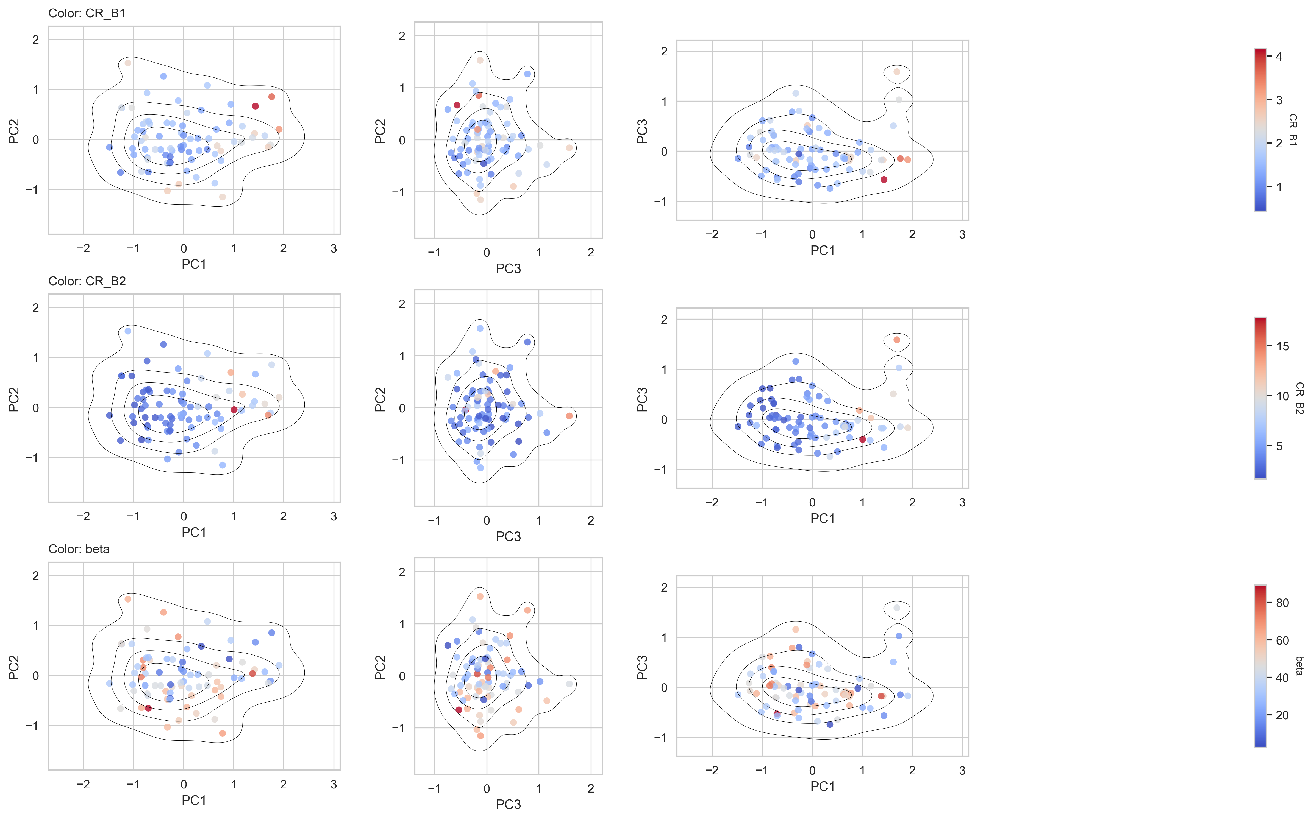
Distal Alignment 1 total cluster

Slide 4
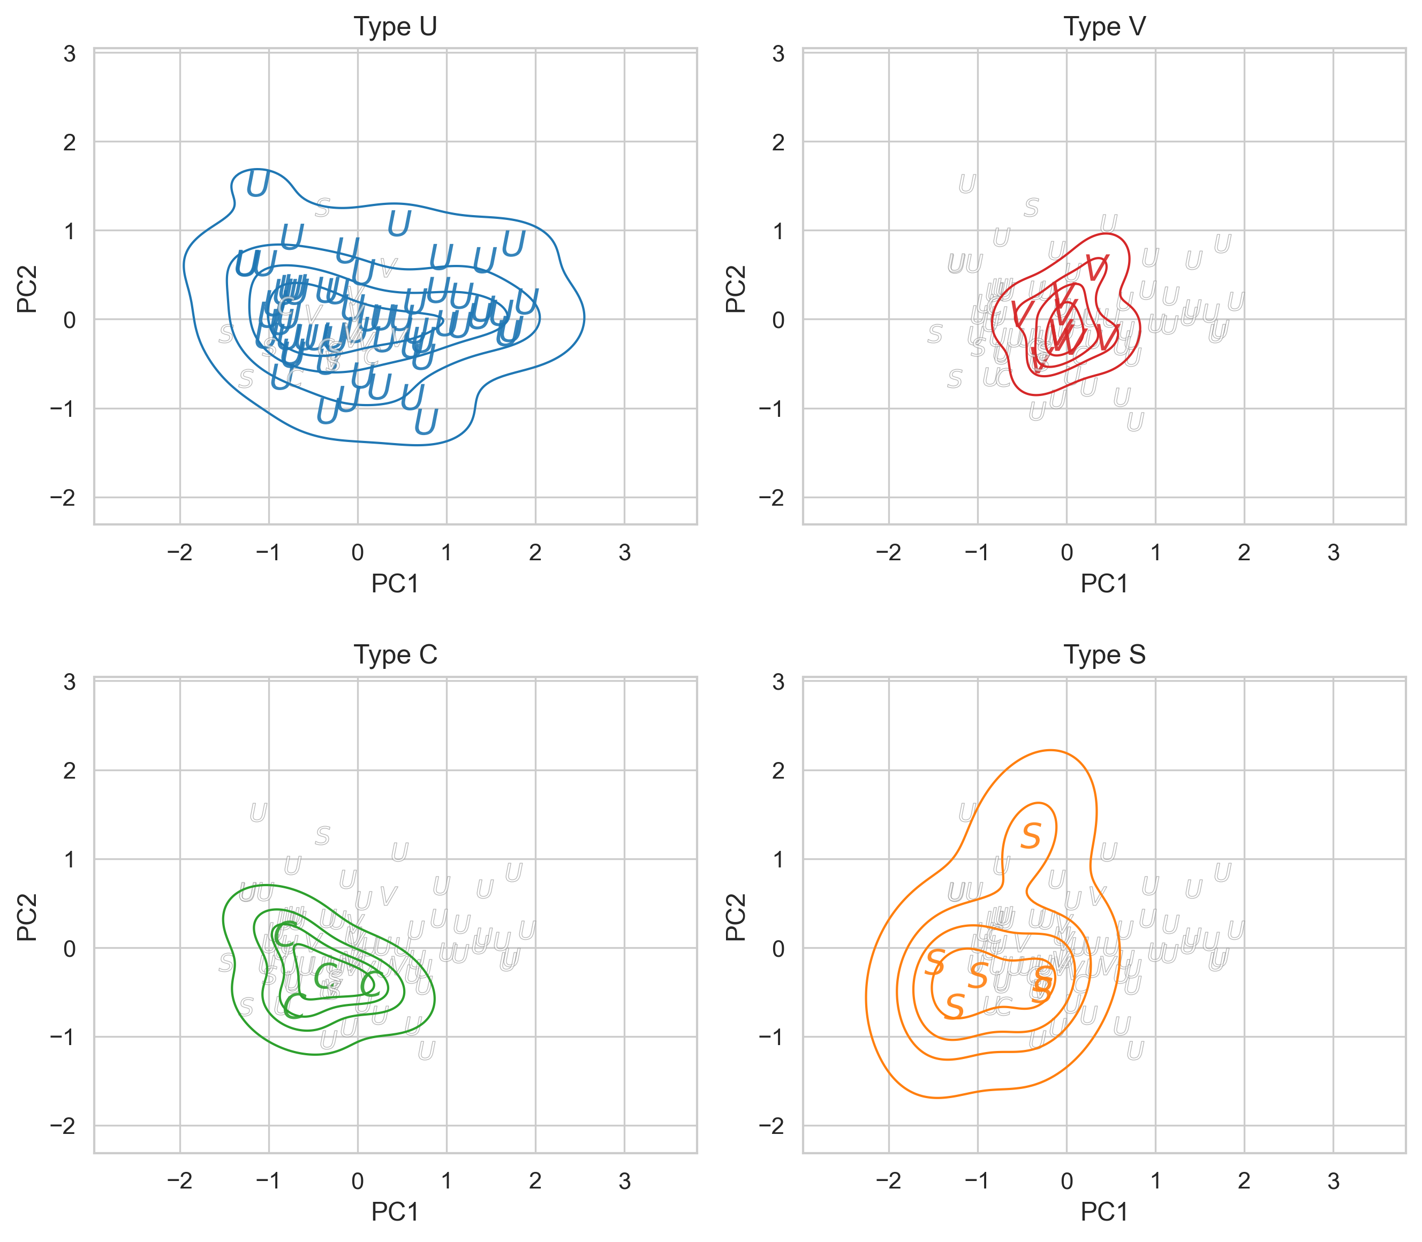
Distal Alignment

Slide 5
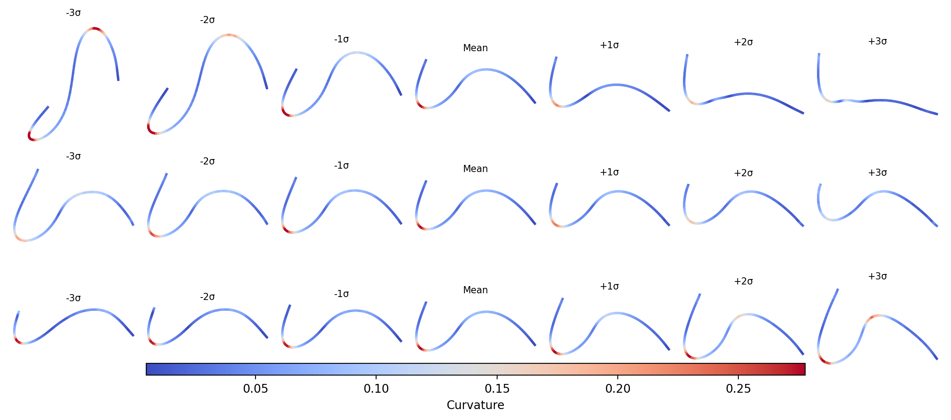
Distal Alignment
PC1
PC2
PC3

Slide 6
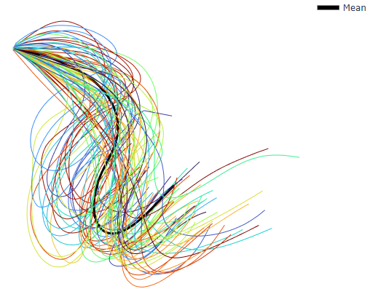
Proximal Alignment
Proximal
B2
Distal
B1

Slide 7
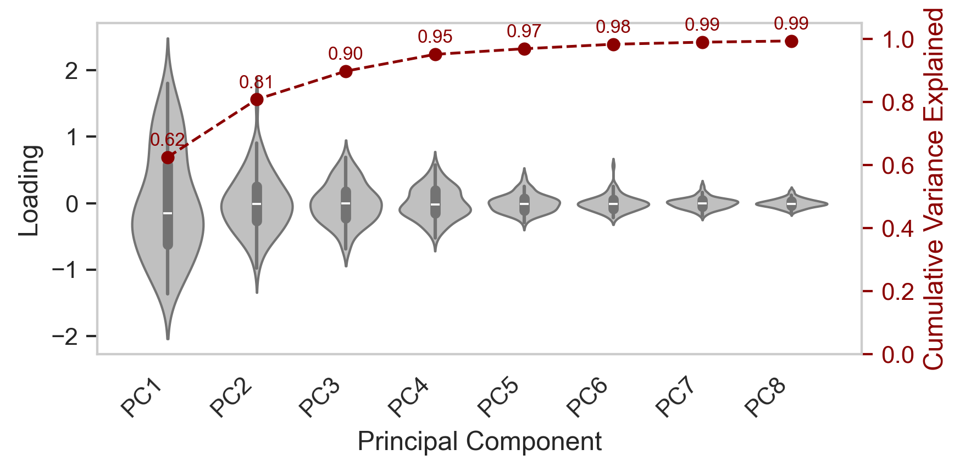
Proximal Alignment 3 PCs to 90% CVE (CMA: 6 PCs needed)
CMA result

Slide 8
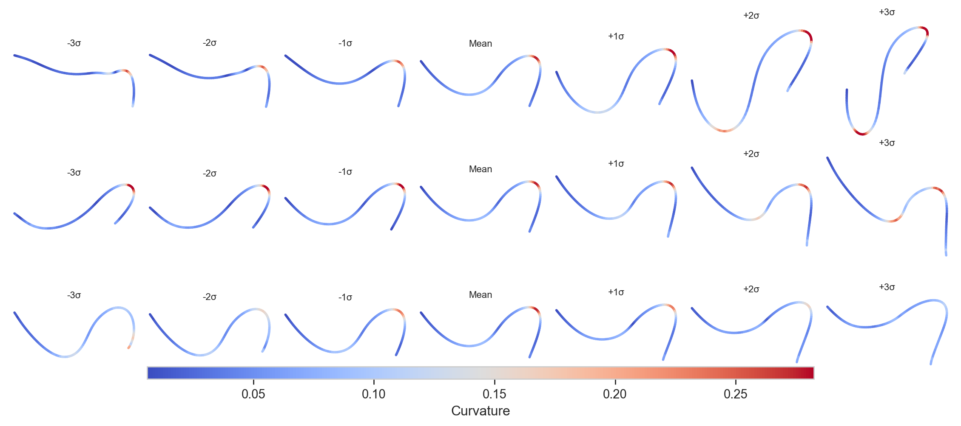
Proximal Alignment
PC1
PC2
PC3

Slide 9
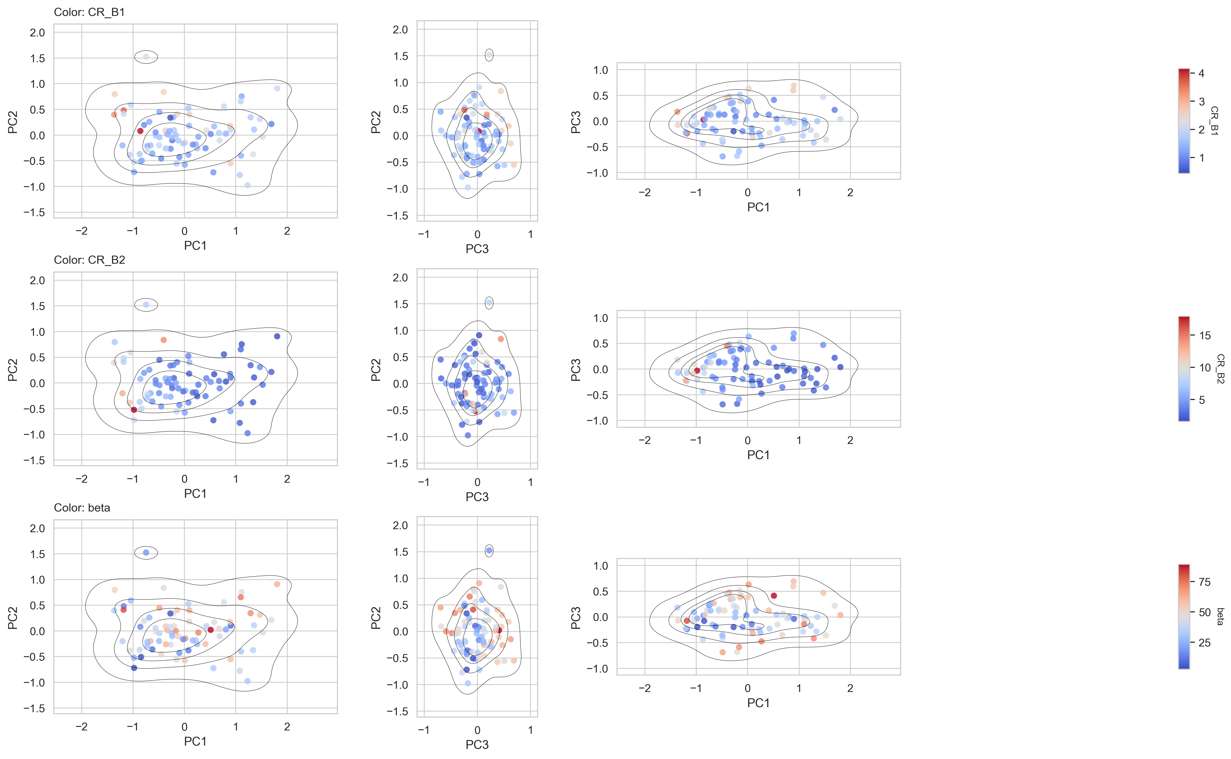
Proximal Alignment 1 total cluster

Slide 10
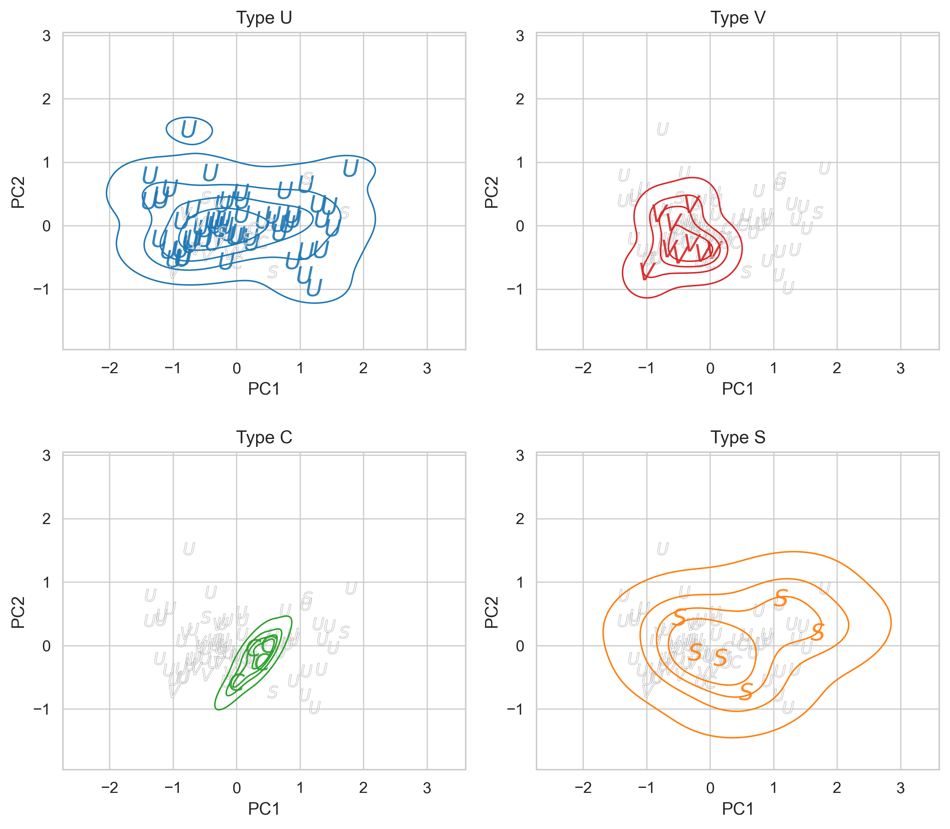
Proximal Alignment

