Slide 1
Image

Slide 2
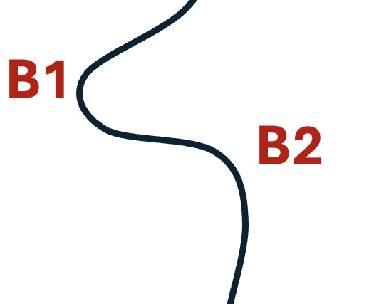
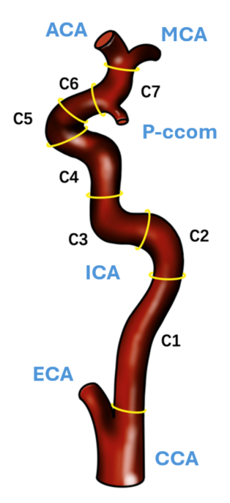
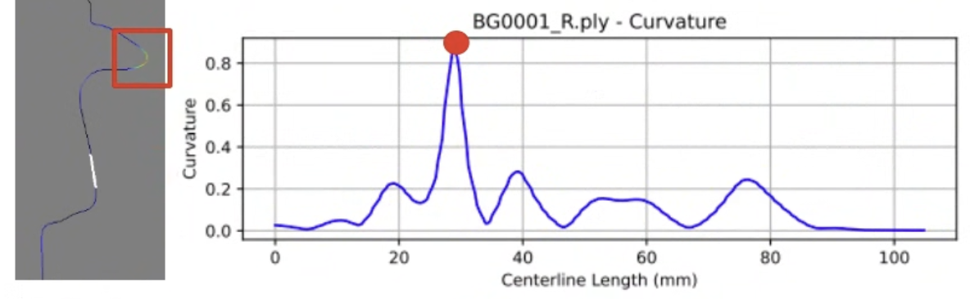
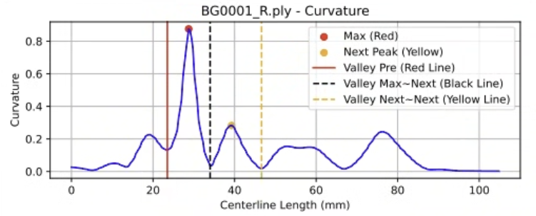
ICA Siphon
ICA Siphon

Slide 3


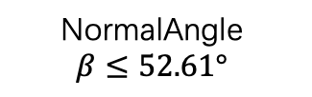
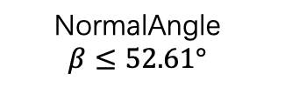
START
No
U Type
Type | B1 Curvature | B1・B2 Torsion | B2 Curvature
U | low | Low or high | Low or high
V | high | low | low
C | high | high | low
S1 | high | high | high
S2 | high | low | high
$$CR_B1≤1.52mm$$
Yes
$$CR_B2≤3.17mm$$
No
Yes
No
$$\text{NormalAngle}$$
$$β≤52.61°$$
$$\text{NormalAngle}$$
$$β≤52.61°$$
No
Yes
Yes
S1 Type
S2 Type
C Type
V Type

Slide 4


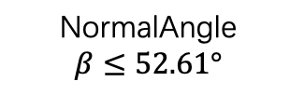
START
No
U Type
$$CR_B1≤1.52mm$$
Yes
$$CR_B2≤3.17mm$$
No
Yes
$$\text{NormalAngle}$$
$$β≤52.61°$$
No
Yes
S Type
C Type
V Type

Slide 5

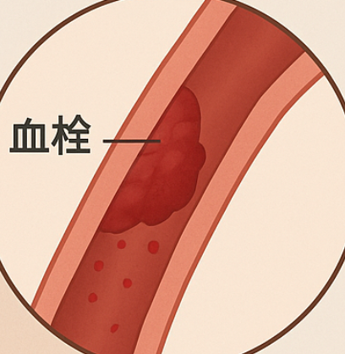

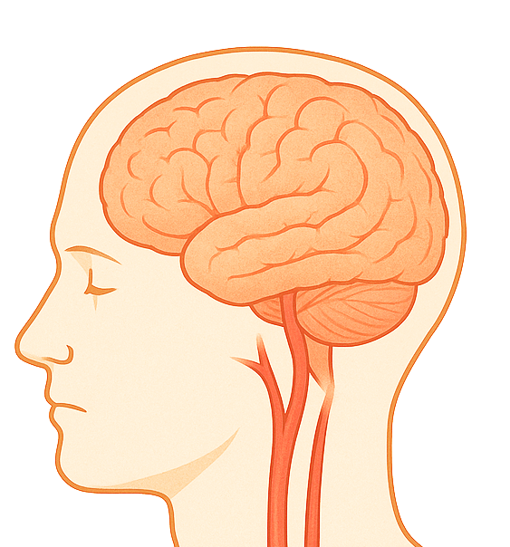
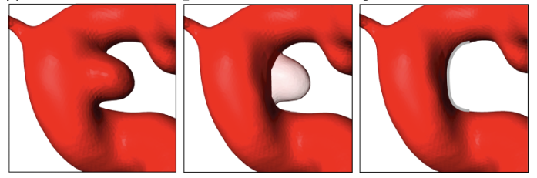

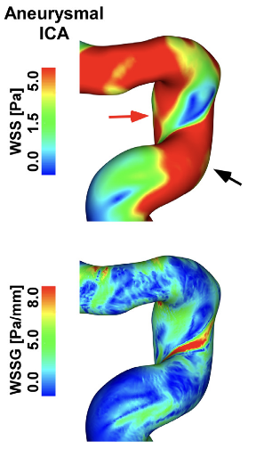
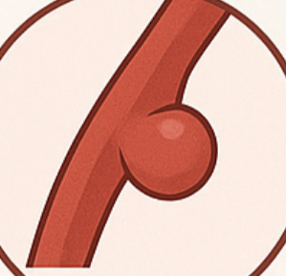
Ischemic
Stroke
Hemorrhagic
Stroke
Aneurysm

Slide 6
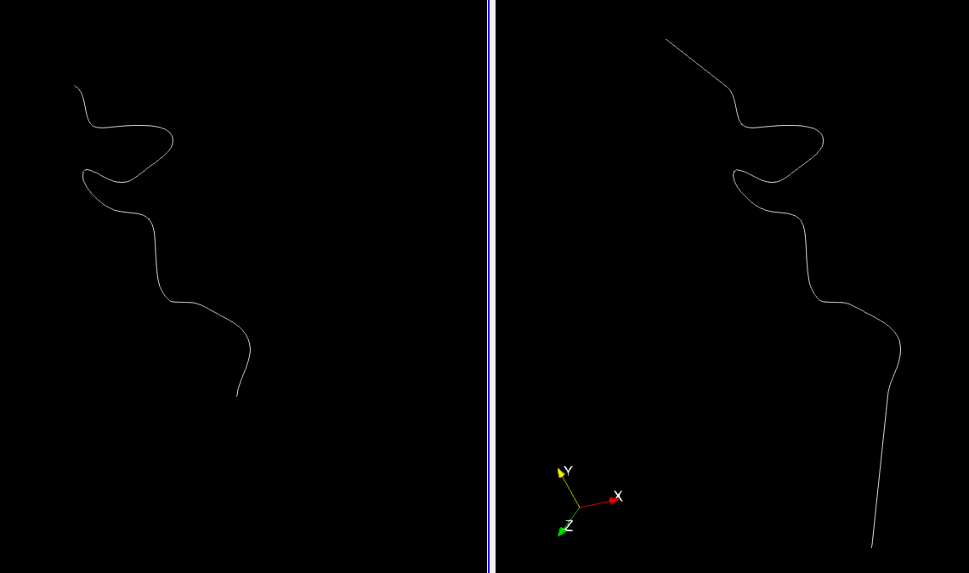
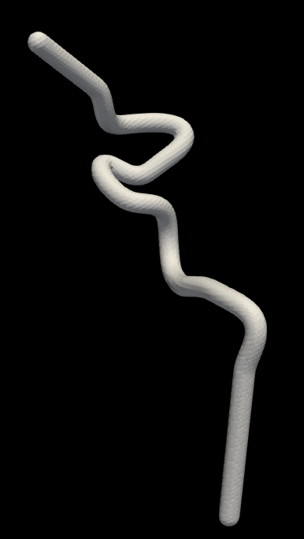
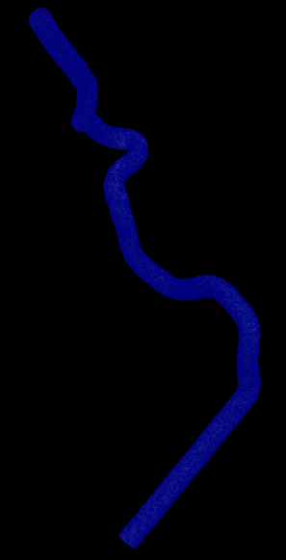
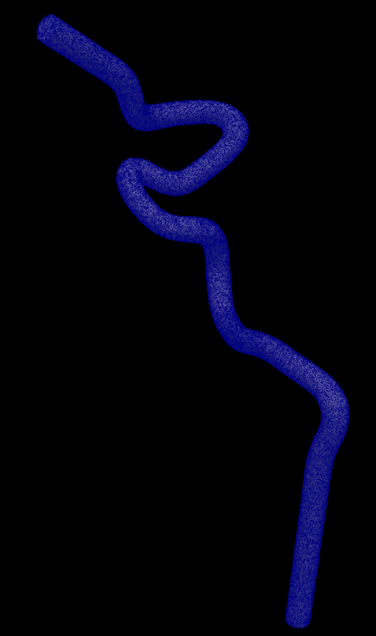
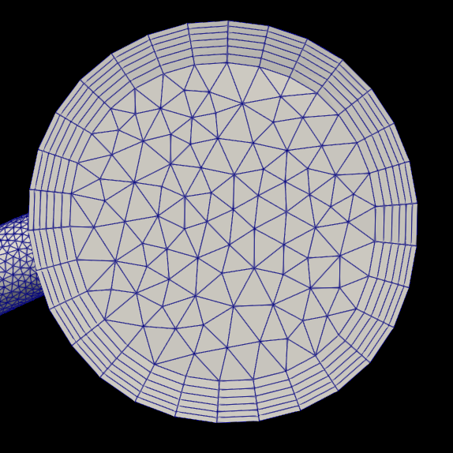
INLET

Slide 7
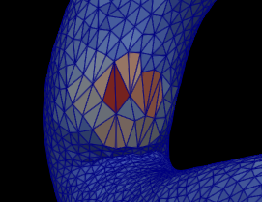
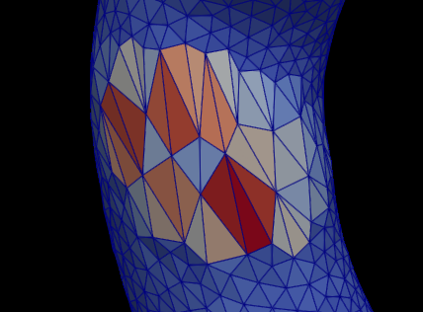
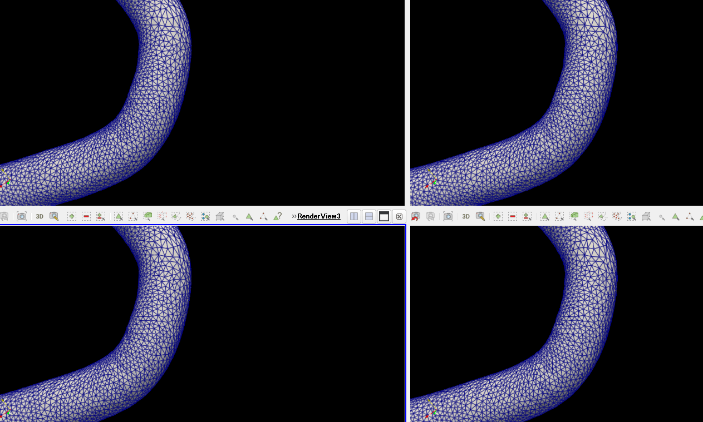
1
2
3
2
300
1
400
3
500
600

Slide 8
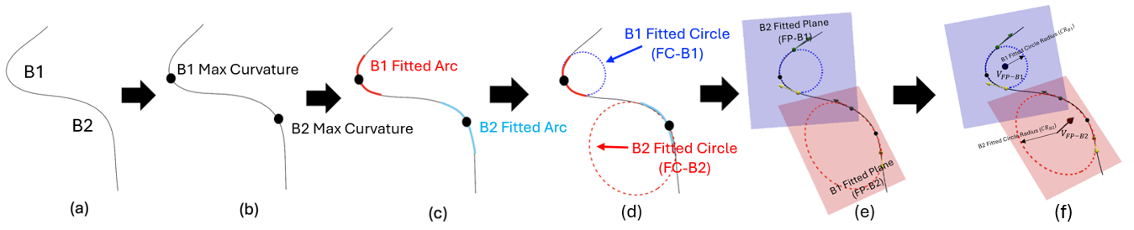
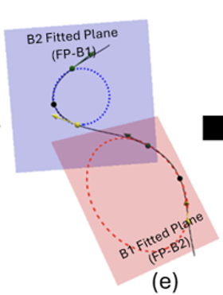



B1 Fitted Circle
(FC-B1)
Arc
B1 Fitted Circle
(FC-B2)

Slide 9
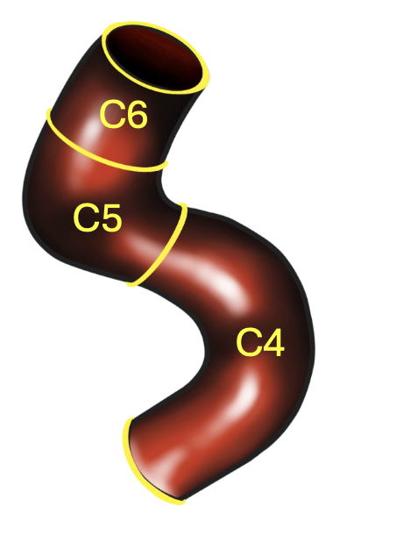
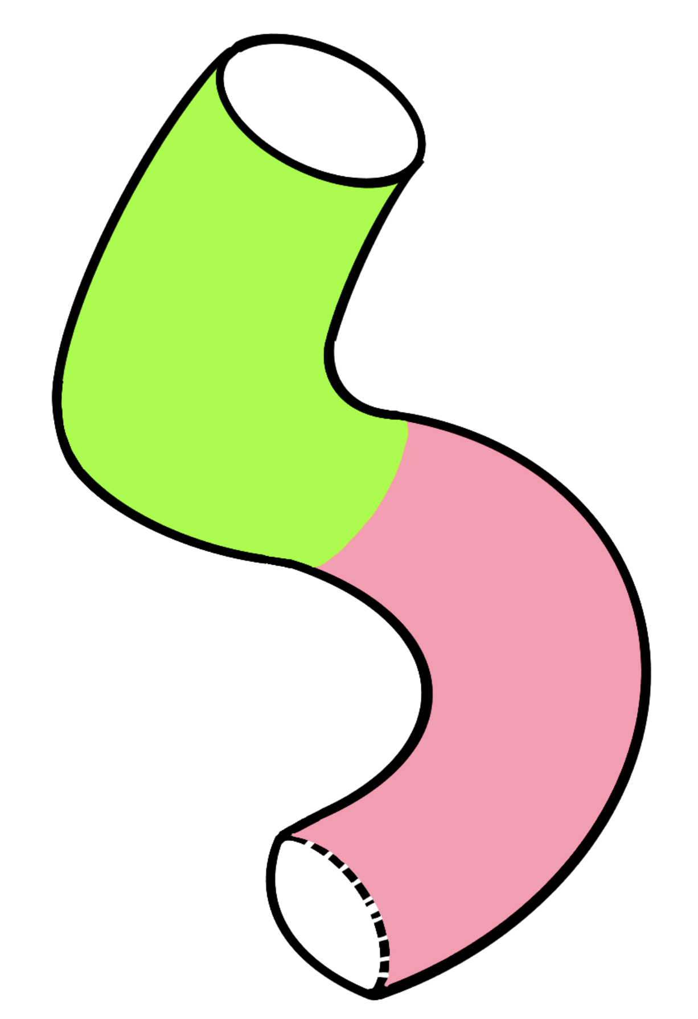
C6
C5
C4
ICA Siphon
Distal end
B1
B2
proximal end

Slide 10

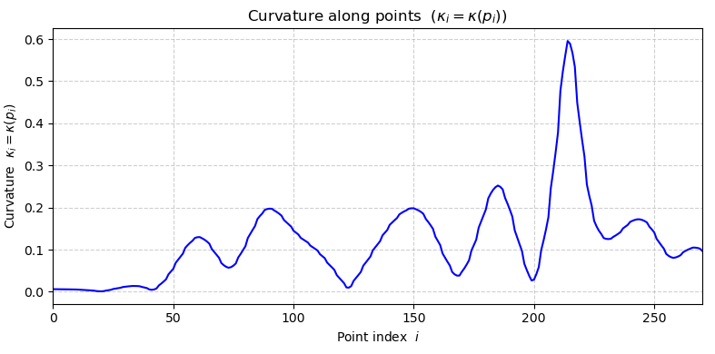













$$p_{i,N}(x_{i,N},y_{i,N},z_{i,N})$$
$$p_{i,N−1}(x_{i,N−1},y_{i,N−1},z_{i,N−1})$$
…
in Centerline $C_{i}$
…
$$p_{i,j}(x_{i,j},y_{i,j},z_{i,j})$$
$$κ_{i,j}=κ(p_{i,j})$$
…
ICA Centerline $C_{i}$
$$κ_{i,N}=κ(p_{i,N})$$
$$κ_{i,1}=κ(p_{i,1})$$
$$j=1$$
$$j=N$$
…
$$j$$
$$p_{i,2}(x_{i,2},y_{i,2},z_{i,2})$$
$$p_{i,1}(x_{i,1},y_{i,1},z_{i,1})$$

Slide 11
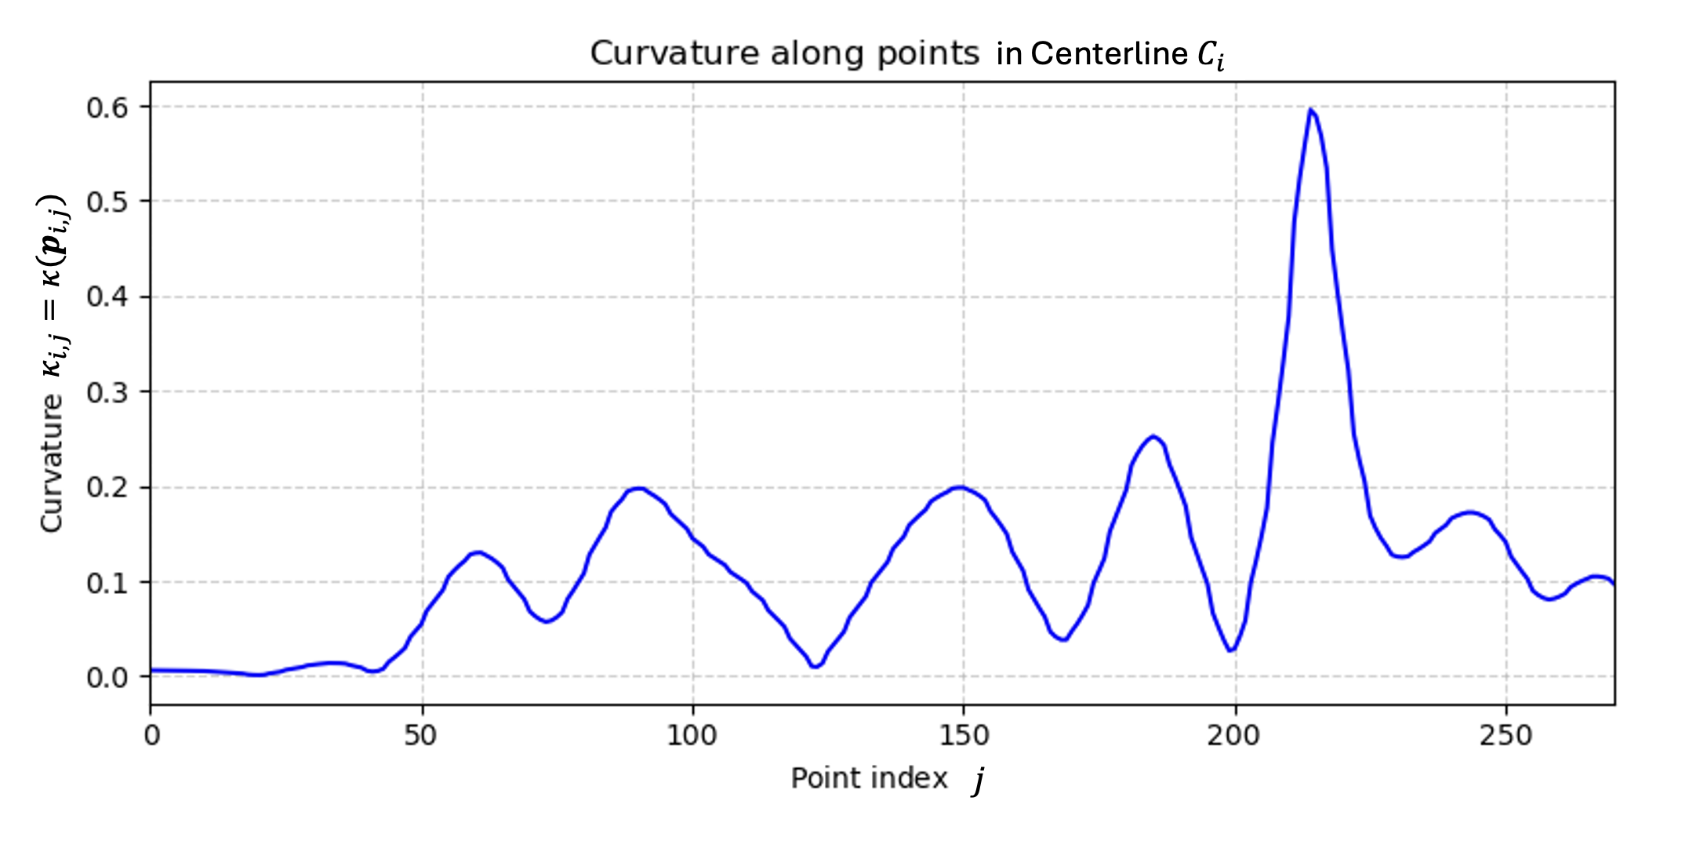










$$κ_{j_{B1}^{Max}}={κ(p}_{i,j_{B1}^{Max}})$$
$$p_{i,j_{B1}^{Max}}$$
$$p_{i,j_{B2}^{Max}}$$
$$κ_{j_{B2}^{Max}}={κ(p}_{i,j_{B2}^{Max}})$$
$$j_{B2}^{max}$$
$$j_{B1}^{max}$$
$$p_{i,j_{B1}^{prox}}$$
B1
$$p_{i,j_{B1B2} }$$
B2
$$p_{i,j_{B1}^{dist}}$$
B2
B1
$$j_{B2}^{prox}$$
$$j_{B1B2}$$
$$j_{B1}^{dist}$$

Slide 12
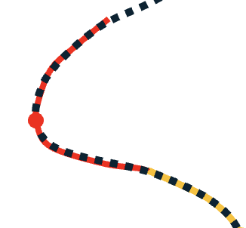
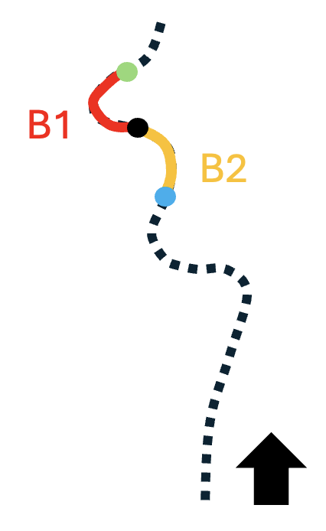







$$p_{i,j_{B1_fit}^{dist}}$$
$$κ_{j_{B1}^{Max}}={κ(p}_{i,j_{B1}^{Max}})$$
$$p_{i,j_{B1}^{Max}}$$
$$ακ_{j_{B1}^{Max}}$$
$$p_{i,j_{B1_fit}^{prox}}$$
B1
$$j_{B1_fit}^{prox}$$
$$j_{B1_fit}^{dist}$$

Slide 13
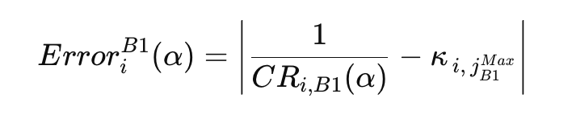
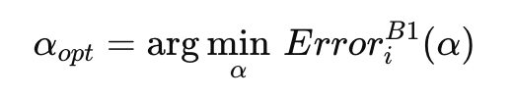




$$p_{i,j_{B1_fit_opt}^{dist}}$$
(α was varied within 0.1 to 0.9.)
$${CR}_{i,B1(α_{opt})}$$
$$p_{i,j_{B1}^{Max}}$$
$$p_{i,j_{B1_fit_opt}^{prox}}$$

Slide 14
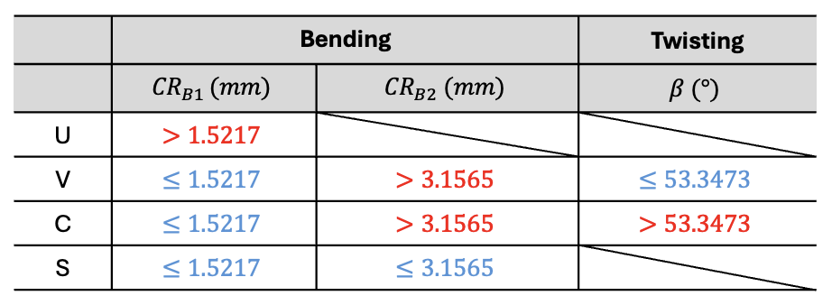
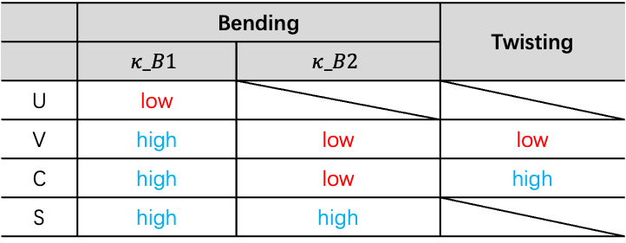
 | Bending |  | Twisting
 | $$κ_B1$$ | $$κ_B2$$
U | low
V | high | low | low
C | high | low | high
S | high | high

Slide 15
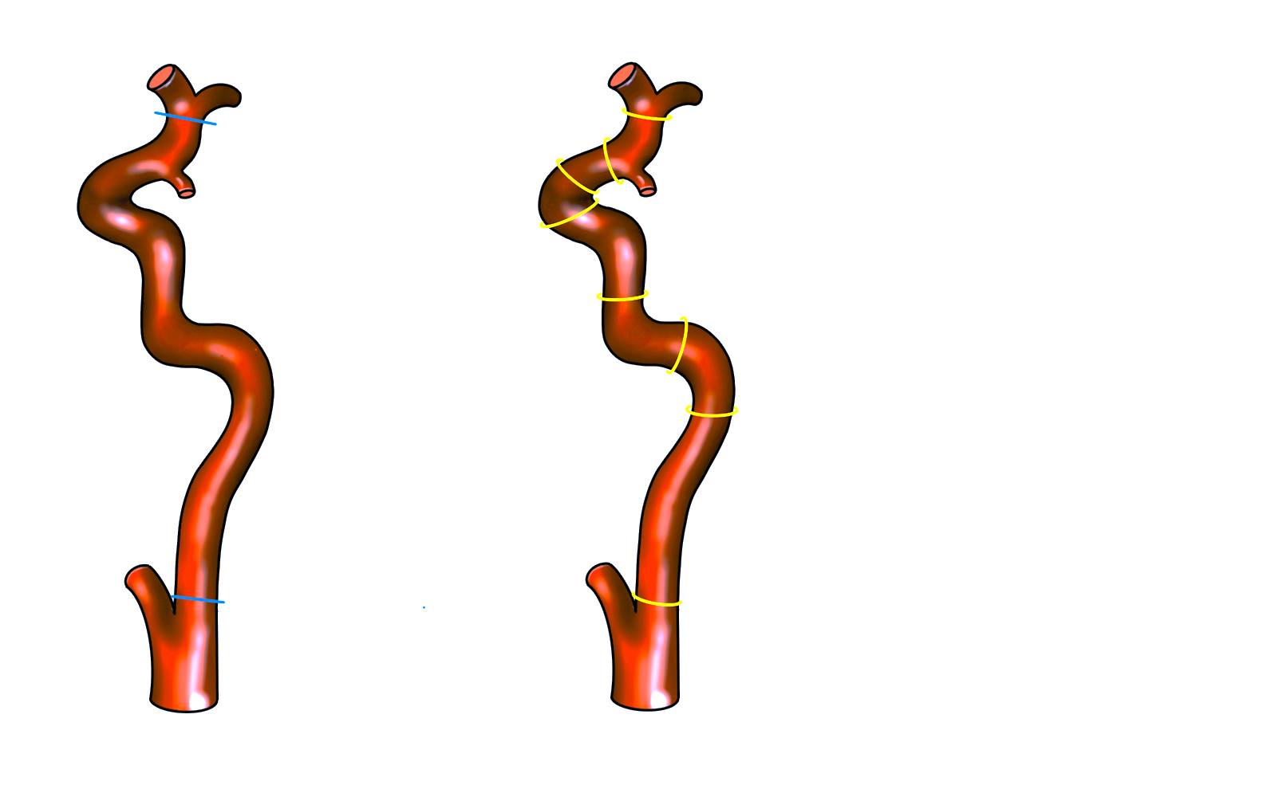
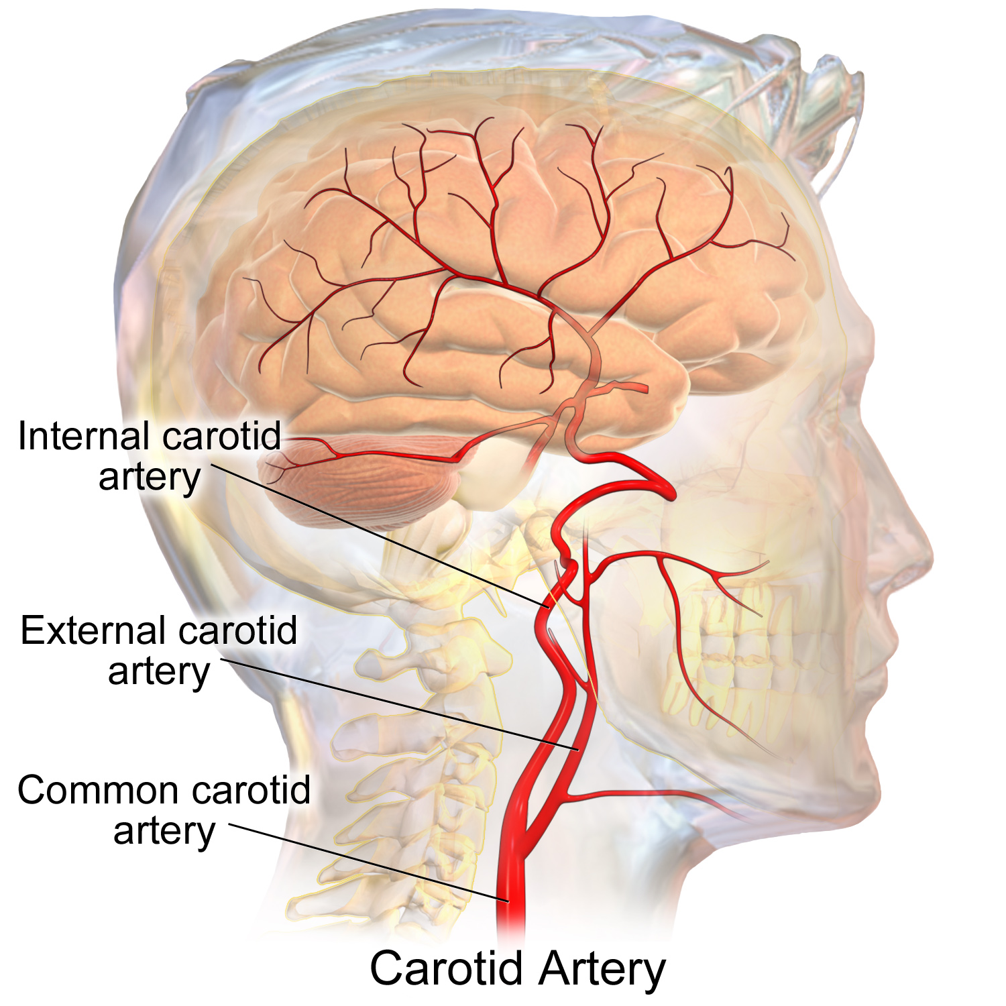
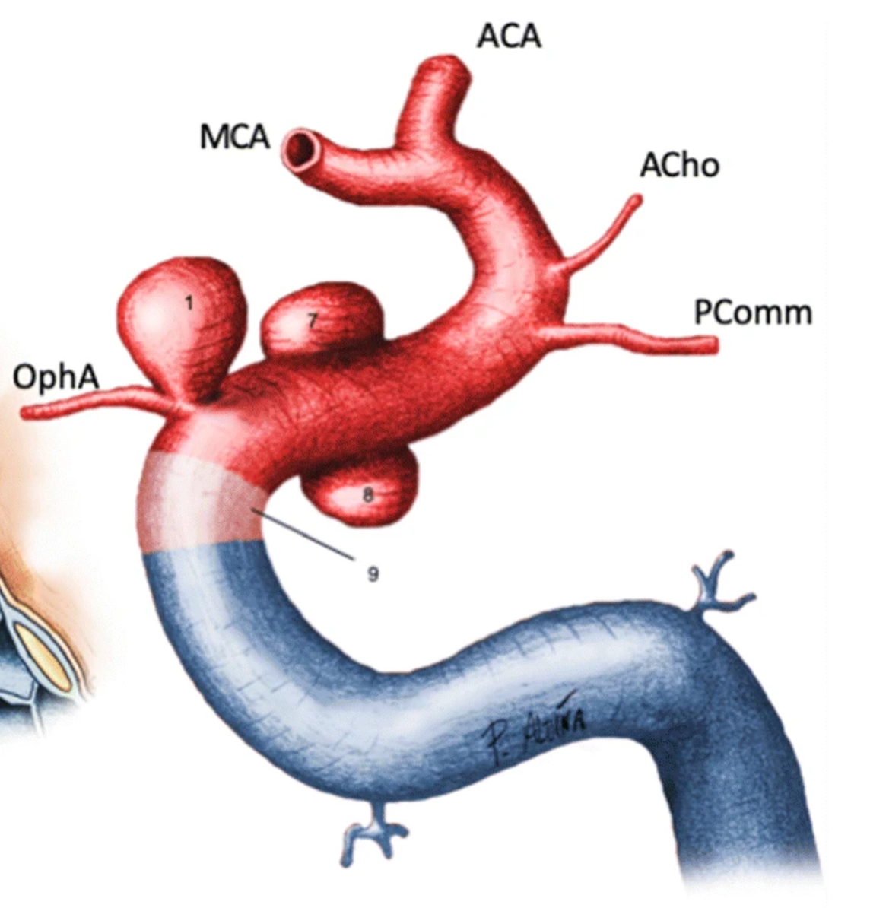

ACA
ICA
Siphon
ICA
ICA Siphon
CCA

Slide 16




Strat
$${CR}_{B1}≤{Q1}_{{CR}_{B1}}$$
Yes
S Type
$${CR}_{B2}≤{Q1}_{{CR}_{B2}}$$
No
$${CR}_{B1}≤{Q1}_{{CR}_{B1}}$$
Yes
$$β≥{Q1}_{β}$$
Yes
C Type
No
No
U Type
V Type

