Slide 1
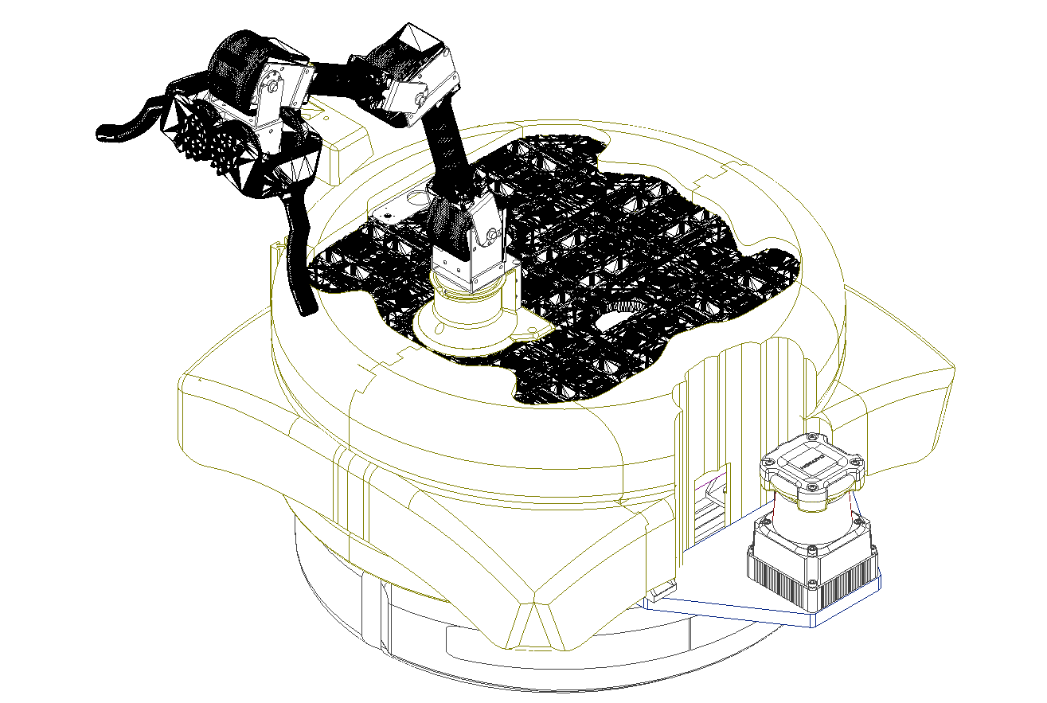
4DOF Robotic Arm
Depth Camera
Roomba 890
2DLidar

