Slide 1
Toilet bowl
800
Camera
Units[mm]

Slide 2
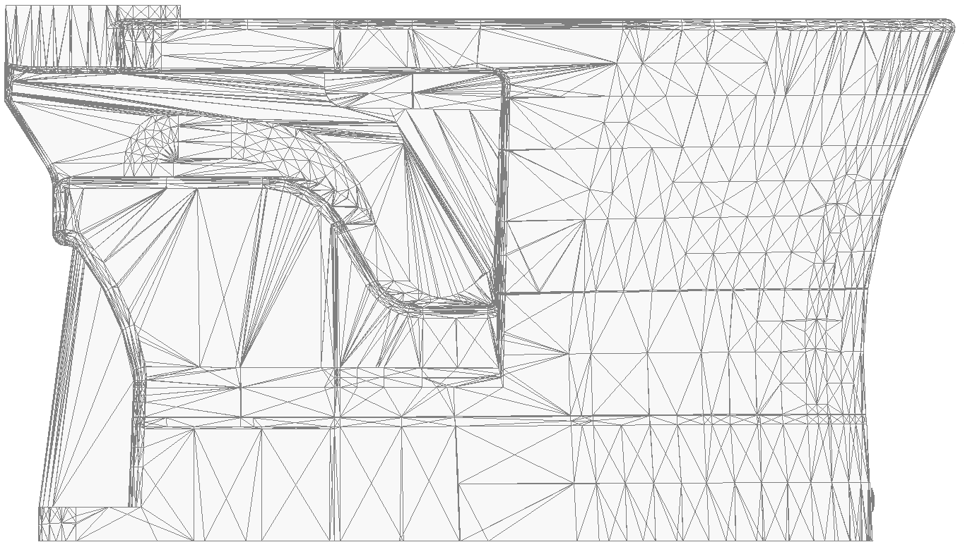
800mm
Toilet bowl
Camera

Slide 3
Camera
Toilet bowl
75mm

Slide 4
Camera
10°
1100mm
Toilet bowl

