Slide 1
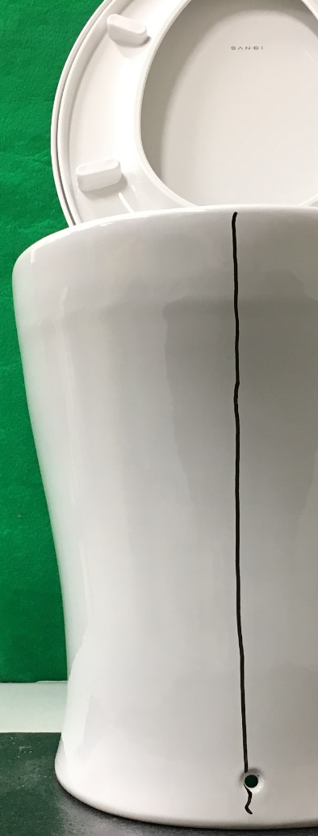

Clean
Cleaning left

