Slide 1
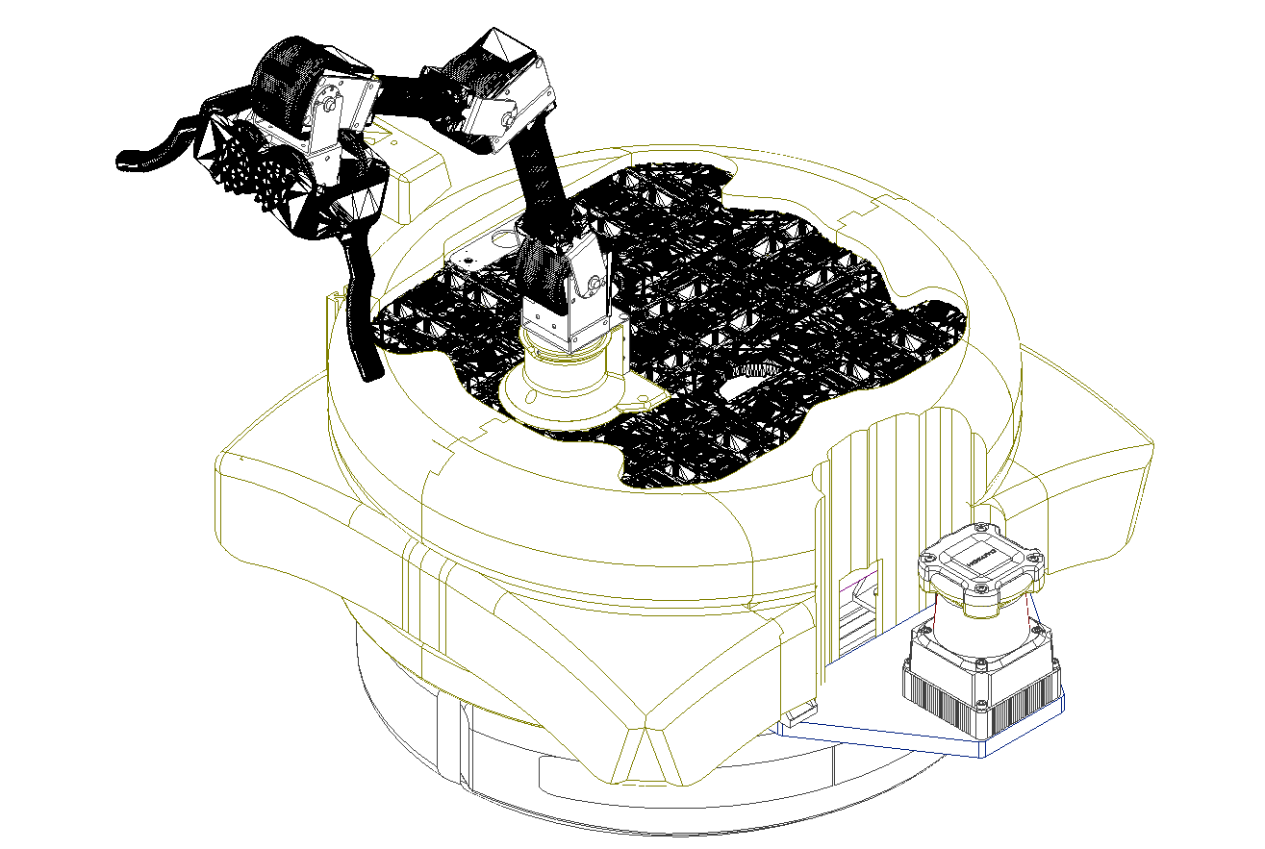
4DOF Robotic Arm
Depth Camera
2DLidar
Roomba 890

Slide 2
4DOF Robotic Arm
Depth Camera
2DLidar
Roomba 890

