Slide 1
HAS Tools Week 11

Slide 2
Announcements:
Goals for this week:
Learn about spatial data and mapping in Python
Office hours:
This Thursday 10-11 in person Harsbarger 324e or by zoom on request
Monday by zoom
Note: I will be there regardless for my office hours so need to schedule in advance if you are coming.
Assignments:
Due Monday November 13th: HW1 + Mid semester Eval
Forecast Judges - Jessi and Jason
Please join our zoom meeting: 836 1742 4890

Slide 3
Steps for creating a new environment
Create a new environment:
conda create --name hastools_mapping python=3.8
Check that it is created and activate it
conda env list
conda activate hastools_mapping
Configure our environment so that it will use conda forge for packages
conda config --add channels conda-forge
conda config --set channel_priority strict
Install packages into our environment and check they are installed
conda install …
conda list
Packages to install:
matplotlib
pandas
numpy
geopandas
fiona
contextily
shapely

Slide 4
Homework Review Warm Up
10 Min to work in groups
Compare answers with your group and come up with one thing to share or ask to the class

Slide 5
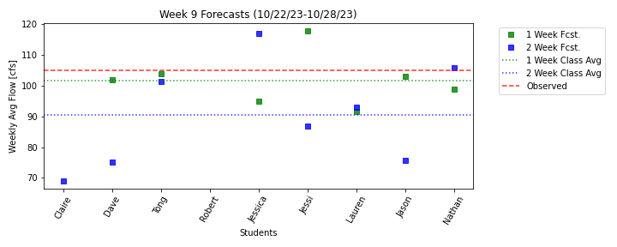
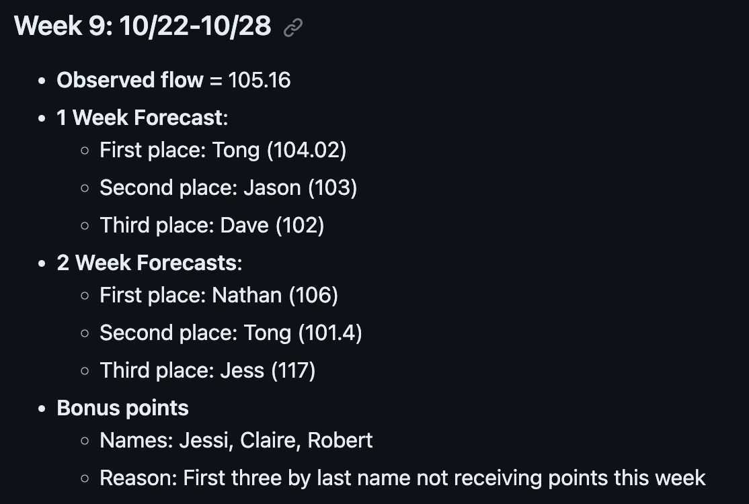
Forecast Results Week 9

Slide 6
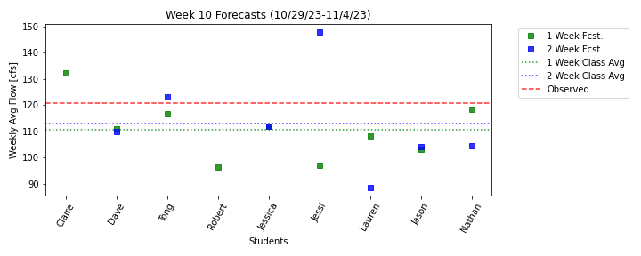
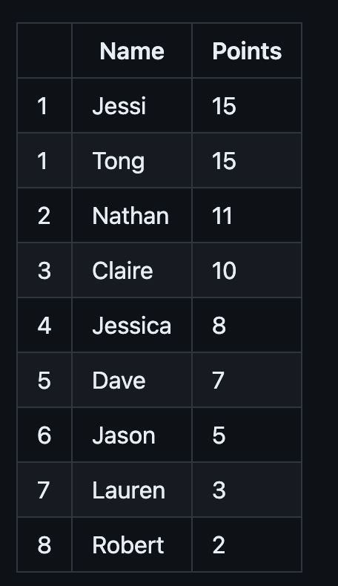
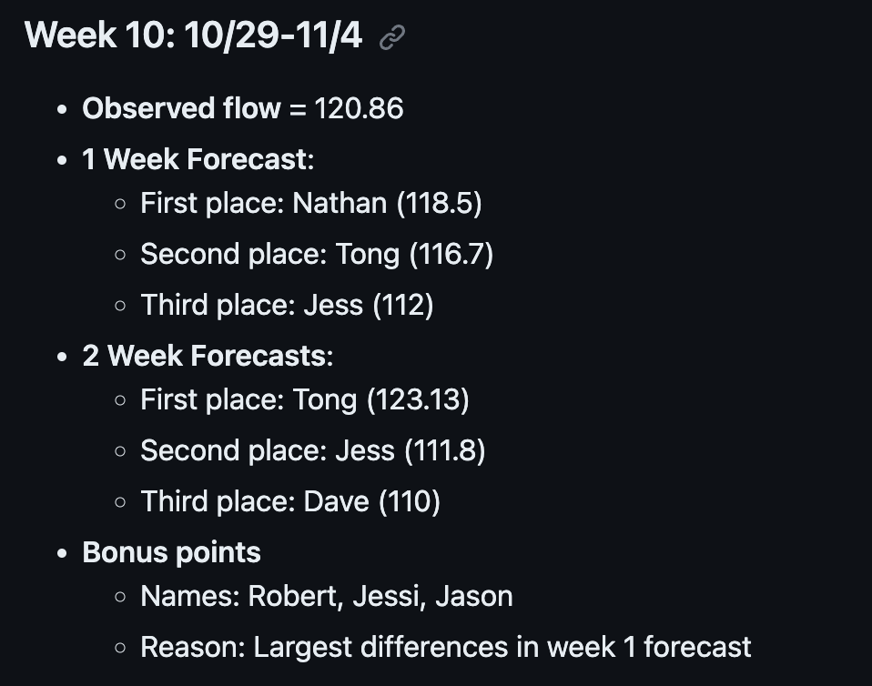
Forecast Results Week 10

Slide 7
Forecast Judging … you’re up!
Dates:
November 13: Jessi and Jason
November 20 Jess, Robert & Lauren
November 27 Dave and Tong
December 4: Nathan and Claire
Instructions can be found in the readme file in the evaluation scripts folder of the forecast repo https://github.com/HAS-Tools-2023/forecasting/tree/main/evaluation_scripts

