Slide 1
HAS Tools Week 9
Functions and Formatting

Slide 2
Announcements:
Goals for this week:
Improve and polish up your forecasting codes so they can be submitted as your first graded script
Office hours:
This Thursday 10-11 in person Harsbarger 324e or by zoom on request
No office hours next Monday I am out of town please email me your questions
Class next week will be on Zoom both days
Assignments Due Monday October 30th:
HW9 Markdown
HW9 Python script (to be graded)
Pandas and Numpy Cheet sheet

Slide 3
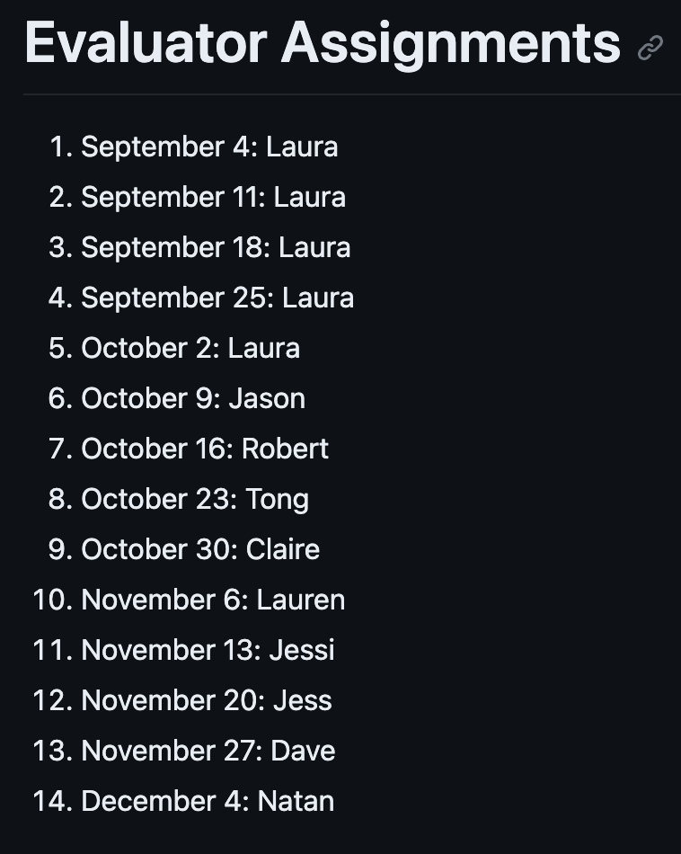
Forecast Judging rescheduling:
Student Judging will now start November 13.
One group of three and the rest groups of 2
November 13: Jessi
November 20: Jess
November 27: Dave
December 4: Nathan
Jason, Robert, Tong, Claire and Lauren need assignments

Slide 4
Learning Objectives for this week :
Code formatting and naming guidelines to make your scripts cleaner and easier for other to follow
Create and use your own functions and build documentation for them

Slide 5
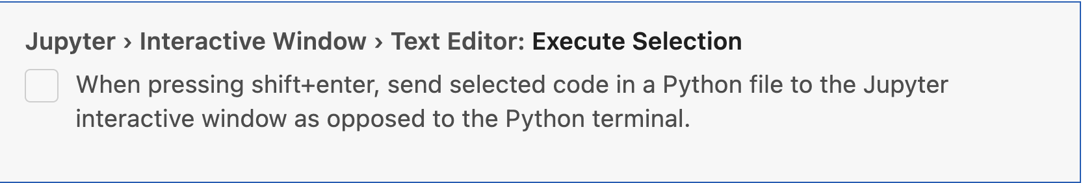
VS Code Tips
Create a workspace for this class so its easy to access all of your files without going back and forth to the file explorer
Setup your VS Code settings so that you can automatically send commands to your interactive window. To do this go to settings and search for: “Jupyter Execute Selection” . You should see a check box option that looks like this. Make sure the box is checked and restart your interactive window for the changes to take effect:

Slide 6
Activity 1: Forecast Submissions
Instructions:
Clone your persons GitHub repo so that you have it locally
Run their python script from their submissions folder.
Submit the forecast numbers that their script outputs to the forecast competition under their name.
Leave them a comment on their github providing comments on the following criteria:
Something you liked about their code
Something you found a bit hard to follow
One suggestion for a specific place they could make their code cleaner
Judging assignments:
Claire will submit for Dave
Dave will submit for Jason
Jason will submit for Jess
Jess will submit for Jessi
Jessi will submit for Lauren
Lauren will submit for Nathan
Nathan will submit for Tong
Tong will submit for Robert
Robert will submit for Claire

Slide 7
Functions:
A block of code that only runs when called.
They can be used to do pretty much anything you would do outside a function
Usually called like this: function_name(arg1, arg2, arg3)
So far we have been getting all of our functions from python packages
But we can also write our own!
Writing your own functions is a great way to organize your code and avoid being repetative

Slide 8
Forecast Competition Results this week:
Coming thursday

Slide 9
Midsemester Eval Results:
Coming Thursday

