Slide 1
Week 6 Class materials

Slide 2
Office Hours Next Week
Monday 1:30-2:30 by Zoom
No office hours next Thursday

Slide 3
Assignments
Homework 6 + Forecast due Monday October 9th by 5pm
No homework due this Monday! (October 2nd)

Slide 4
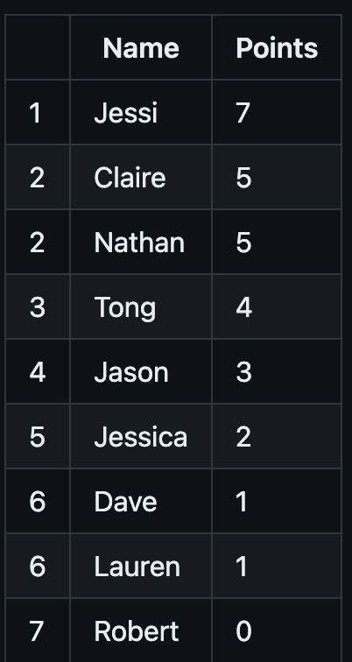
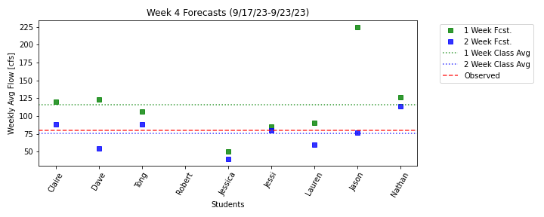
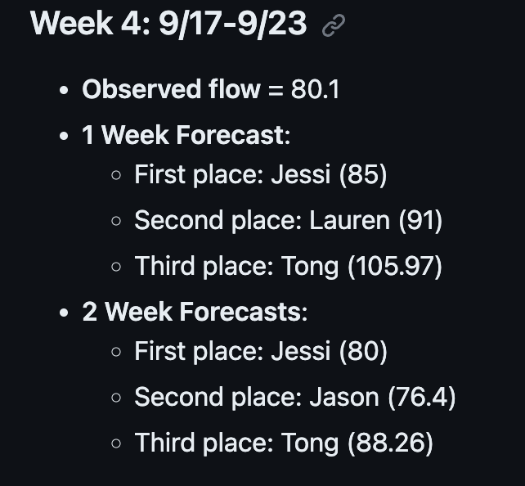
Forecast results

Slide 5
How to get help on a function:
Type help(function_name) into your interactive window
Look at the automatic help that comes up when you start typing a function in vscode
Google the function name to see its documentation.

Slide 6
Tips for debugging
Use the build in variable explorer
Make use of the interactive window to look at the variables you have created
Add print statements!
Set your iterator and look at the inner workings of your for loop
Build your scripts incrementally. Get one thing (and debugged at a time). Have more code blocks early on.

Slide 7
Homework solution review and questions

Slide 8
Warm up Exercise
Assume you have a numpy array called ‘precip’ that hourly precipitation measurements for one month.
The array has three columns [day, hour, precip]
720 rows (24 hours of data for 30 days)
The days numbers are integers which start at 1 and go to 30
Write a script to calculate the daily total precipitation and save it in an array with two columns called ‘daily’ where the first column is the day and the second column is the daily precipitation.

Slide 9
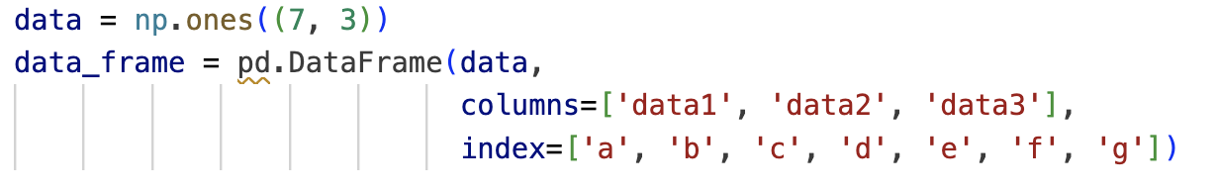
Pandas Exercise One
Start with the following pandas dataframe:
Change the values for all the vowel rows to 3
Multiply the first 4 rows by 7
Make the dataframe into a checkerboard of 0’s and 1’s using loc
Do the same thing using iloc

Slide 10
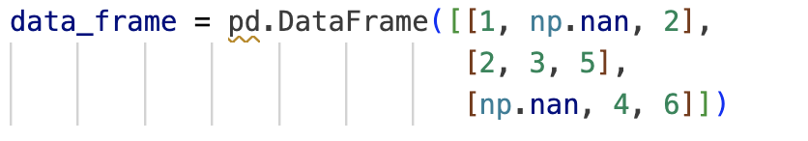
Pandas Exercise Two
Start with the following pandas dataframe:
Fill the NA values with 999

