Slide 1
Week 7 Class materials

Slide 2
Office Hours Reminder
Monday 1:30-2:30 Harsbarger 324e (or on zoom by request)
Thursday 10:00-11:00 Harsbarger 324e (or on zoom by request)

Slide 3
Notes from HW 6
Solution is posted in the HW solutions folder. Please review and come to my office hours on Thursday if you have questions.
Homework is now due by Monday at 5pm to give people time to come to my office hours
For inserting a lot of number you can either:
Create a markdown table using ‘|’ (refer to the markdown cheet sheet)
Take a picture of your table form VS code, Save that picture in your folder and then insert it into your markdown file

Slide 4
Assignments this week
Homework 7 + Forecast due Monday October 10th by 5pm

Slide 5
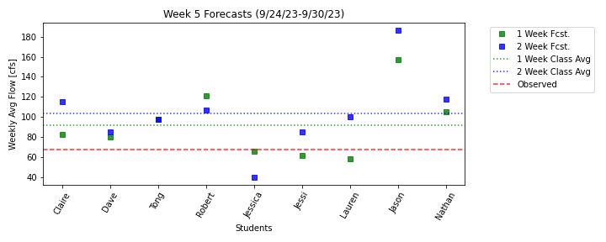
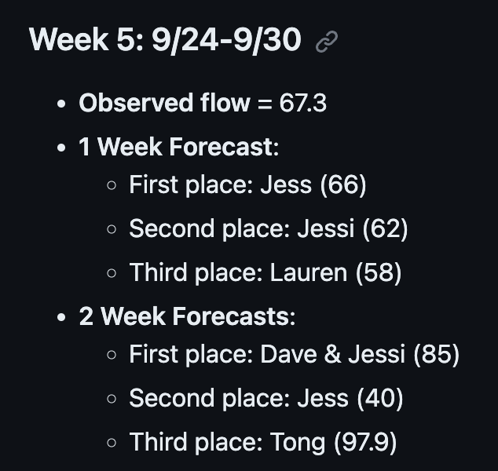
Forecast results 9/24-9/30

Slide 6
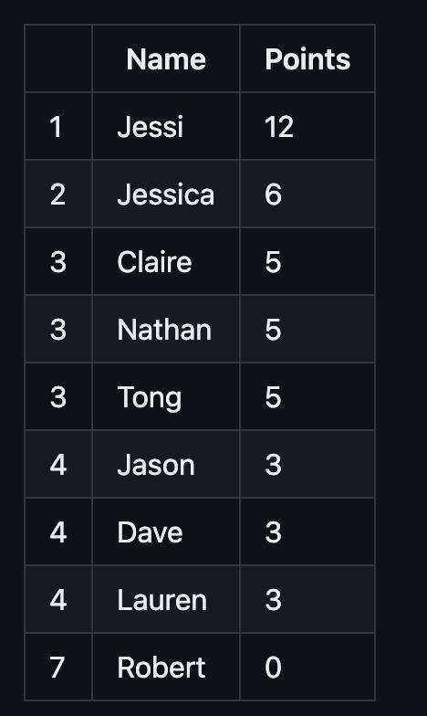
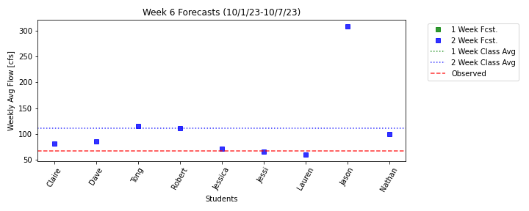
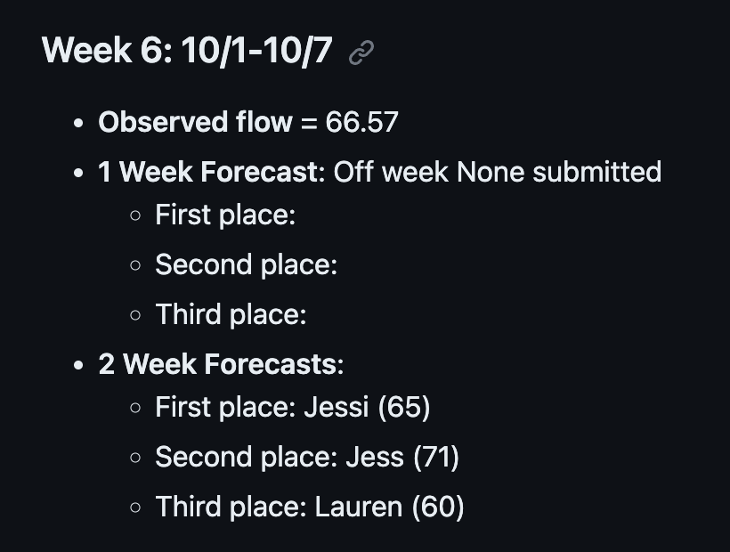
Forecast results 10/1-10/7

Slide 7
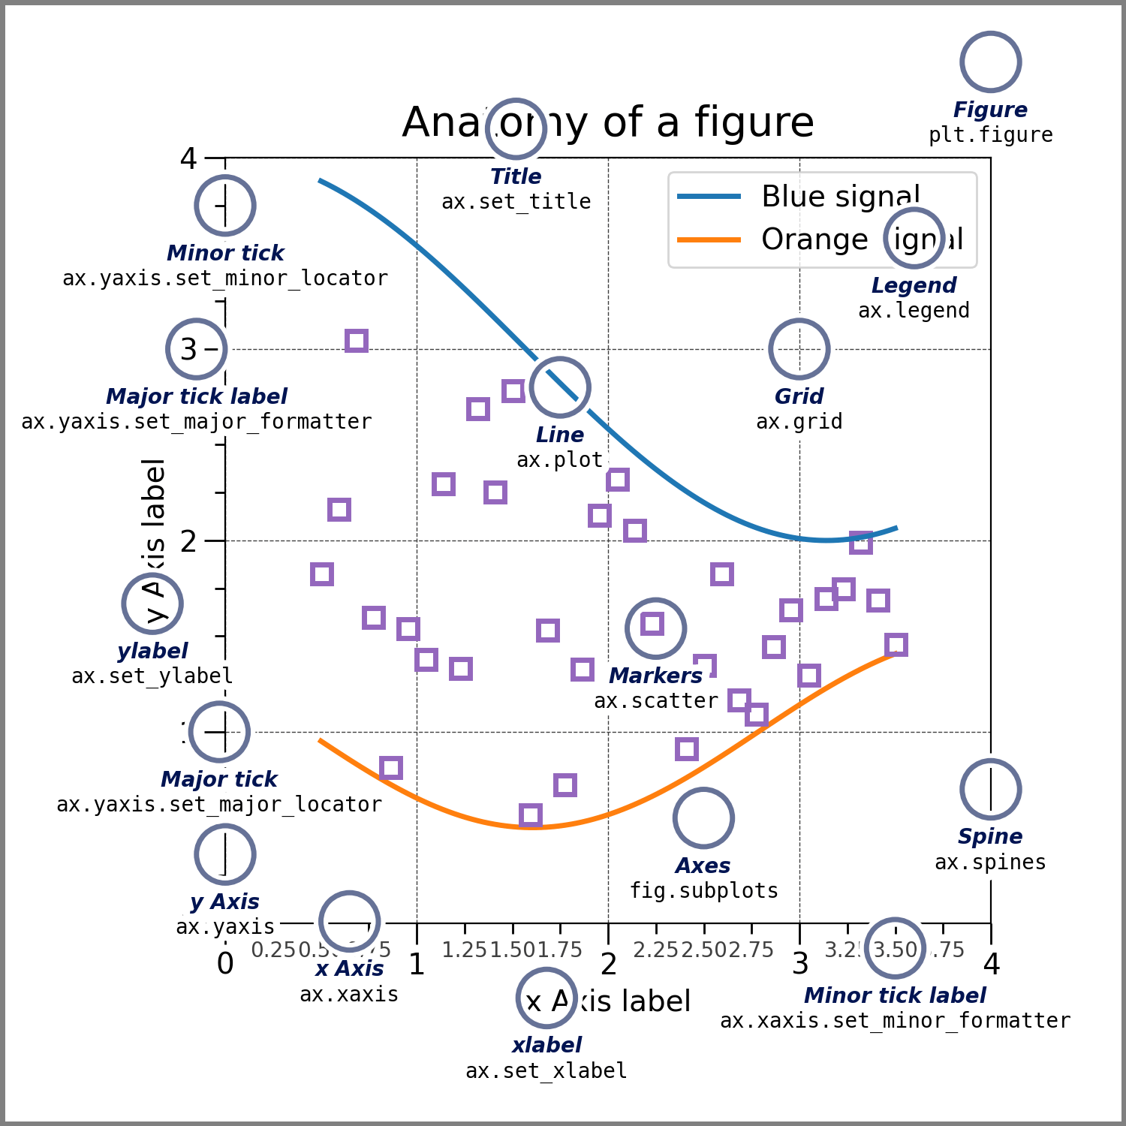
Plotting with Matplotlib
Matplotlib is one of the most commonly used plotting libraries in Python. It is very powerful but also can be a counterintuitive at first
A single plot can contain manly lines of code often we first define what we want to plot and what type of plot and then we define features of the plot like axes titles and legends and grid attributes.
A good place to get started: https://matplotlib.org/stable/users/explain/quick_start.html

Slide 8
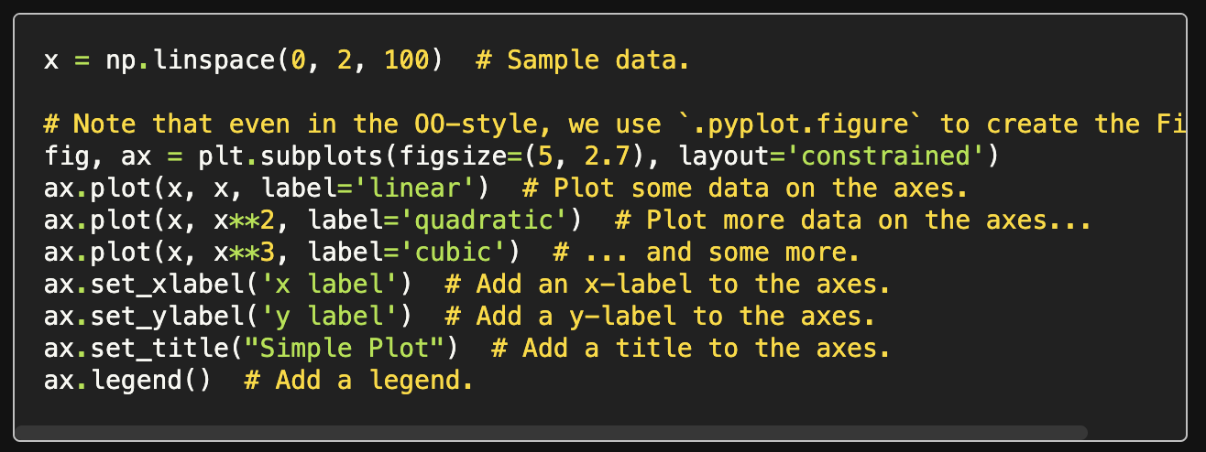
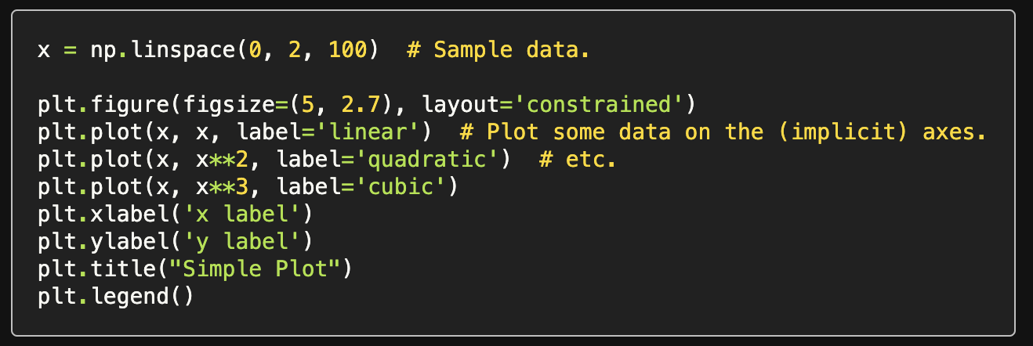
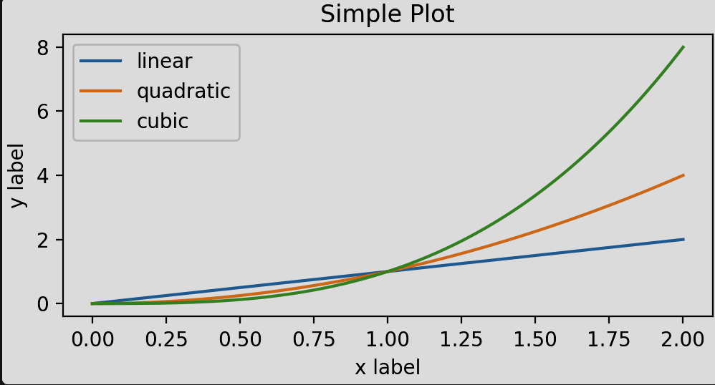
Two commonly used syntax approaches
Object oriented approach – You define Figure and Axes objects and then apply methods to them to build the plot. This can be a bit confusing but gives lots of control especially for multi panel plots
Pyplot (implicit) approach– Using pyplot functions and relying on it to implicitly create Figure and Axes objects for you. This is simpler but you have less control
Both of the snippets above create the same graph shown here
Example from matplot lib user guide

