Slide 1
HAS Tools Week 9
Functions and Formatting

Slide 2
Announcements:
Goals for this week:
Improve and polish up your forecasting codes so they can be submitted as your first graded script
Office hours:
This Thursday 10-11 in person Harsbarger 324e or by zoom on request
No office hours next Monday I am out of town please email me your questions
Class next week will be on Zoom both days
Assignments Due Monday October 30th:
HW9 Markdown
HW9 Python script (to be graded)
Pandas and Numpy Cheet sheet

Slide 3
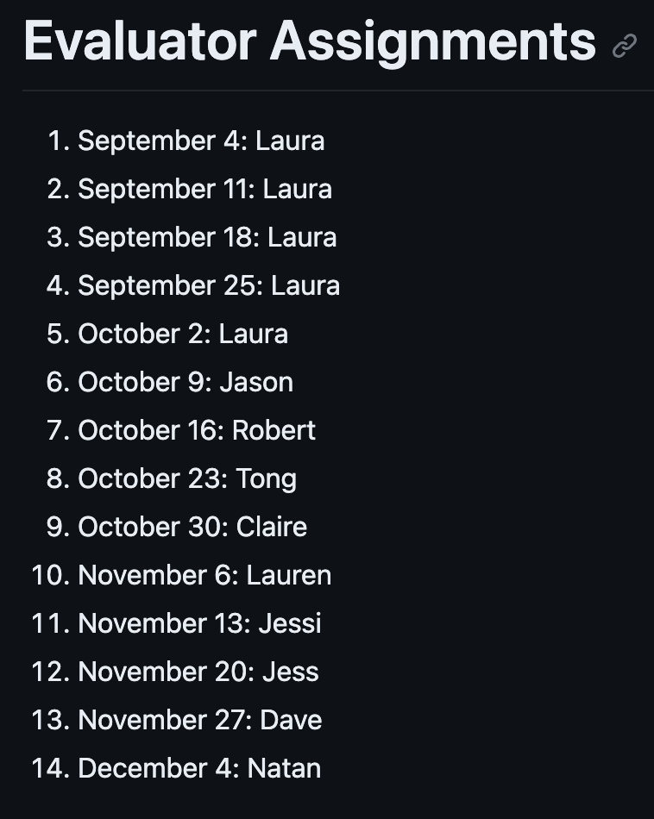
Forecast Judging rescheduling:
Student Judging will now start November 13.
One group of three and the rest groups of 2
November 13: Jessi
November 20: Jess
November 27: Dave, Tong
December 4: Nathan
Jason, Robert, Claire and Lauren need assignments

Slide 4
Learning Objectives for this week :
Code formatting and naming guidelines to make your scripts cleaner and easier for other to follow
Create and use your own functions and build documentation for them

Slide 5
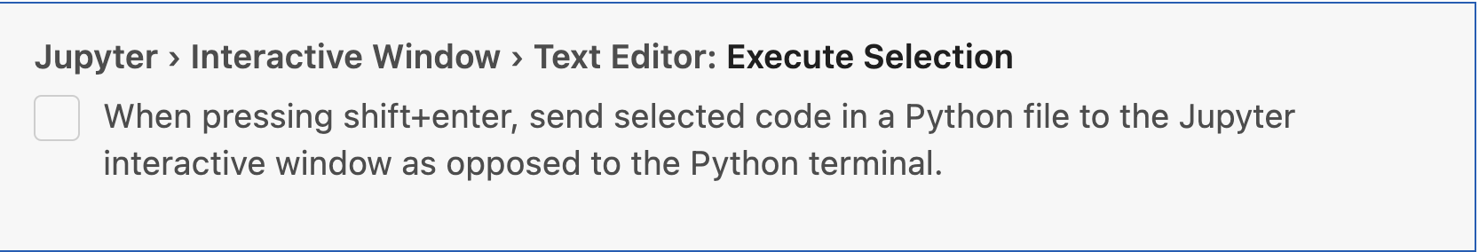
VS Code Tips
Create a workspace for this class so its easy to access all of your files without going back and forth to the file explorer
Setup your VS Code settings so that you can automatically send commands to your interactive window. To do this go to settings and search for: “Jupyter Execute Selection” . You should see a check box option that looks like this. Make sure the box is checked and restart your interactive window for the changes to take effect:

Slide 6
Activity 1: Forecast Submissions
Instructions:
Clone your persons GitHub repo so that you have it locally
Run their python script from their submissions folder.
Submit the forecast numbers that their script outputs to the forecast competition under their name.
Leave them a comment on their github providing comments on the following criteria:
Something you liked about their code
Something you found a bit hard to follow
One suggestion for a specific place they could make their code cleaner
Judging assignments:
Robert will submit for Dave
Dave will submit for Jess
Jess will submit for Jessi
Jessi will submit for Lauren
Lauren will submit for Nathan
Nathan will submit for Tong
Tong will submit for Robert

Slide 7
Functions:
A block of code that only runs when called.
They can be used to do pretty much anything you would do outside a function
Usually called like this: function_name(arg1, arg2, arg3)
So far we have been getting all of our functions from python packages
But we can also write our own!
Writing your own functions is a great way to organize your code and avoid being repetative

Slide 8
Thursday Agenda
Finish up our function exercises
Forecast Competition Results
Course Eval Discussion
Question on timeseries from the last homework
Naming conventions and Formatting

Slide 9
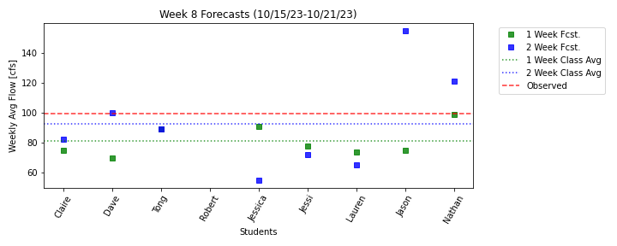
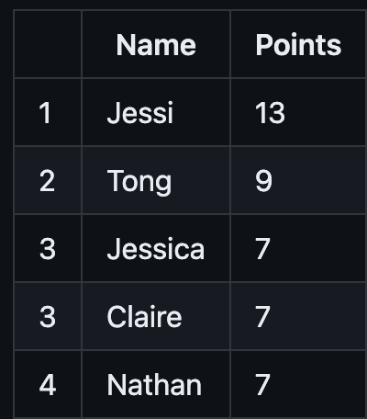
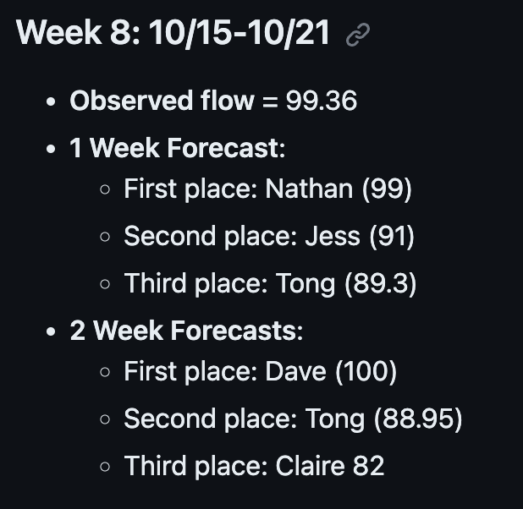
Forecast Competition Results this week:

Slide 10
Midsemester Eval Results:
Things you like:
Group exercises in class
Individual exercises in class
Class lectures with python
Trainaing activities
Running things link by line in class
Overall felt that expectations are fair
Things you don’t:
Lectures can be fast an overwhelming
Hart do jump straight from that into exercises
Hard to figure out content organization on GitHub
Don’t really get to the why behind things
Move pretty fast and don’t feel like you can master anything before we move on

Slide 11
Things you would like to see:
More simple practice problems and assignments
More time doing group reflections of previous HW
More real world applications
More exercises
Flipped classroom
Make python lectures more engaging by having people follow along as we go
Cover more basics of writing from scratch
Review of setting up environments
Review how to look at an understand help documentation

Slide 12
Naming conventions and Formatting
With some material from https://www.codementor.io/@tanakamutakwa/writing-clean-code-naming-1msxn728ht#make-meaningful-distinctions

Slide 13

Why this matters
You want to hijack the tools already in your brain that help you think about language, to help you think about code

Slide 14
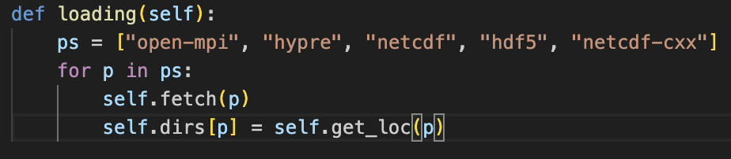
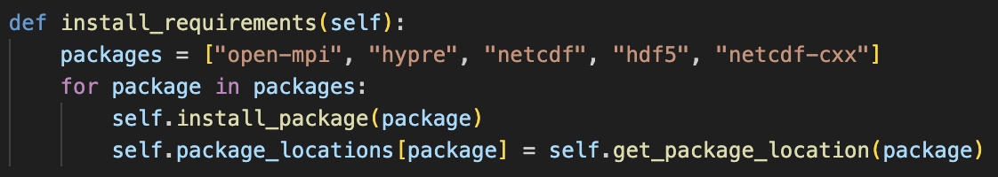
Which of these is easier to read?

Slide 15
Use intention revealing names i.e. spell them out
file_loader
not
fl
Notes:
https://www.codementor.io/@tanakamutakwa/writing-clean-code-naming-1msxn728ht#make-meaningful-distinctions

Slide 16
Classes and objects should have noun or noun phrase names
FlowMax() or flow_max
not
maximizing_flow

Slide 17
Methods and Functions should have verb or verb phrase names
get_data()
not
data()

Slide 18
Make meaningful distinctions
get_snowpack_data() and get_rainfall_data()
not
get_snowpack_data() and fetch_rainfall_data()

Slide 19
Use pronounceable and searchable names
modification_timestep
not
modymhms

Slide 20
Replace magic numbers with ALL_CAPS named constants
DAILY_FEE = 25
GRACE_PERIOD = 6
Fee = DAILY_FEE * (days_overdue - GRACE_PERIOD)
NOT
Fee = 25 * (days_overdue - 6)

Slide 21
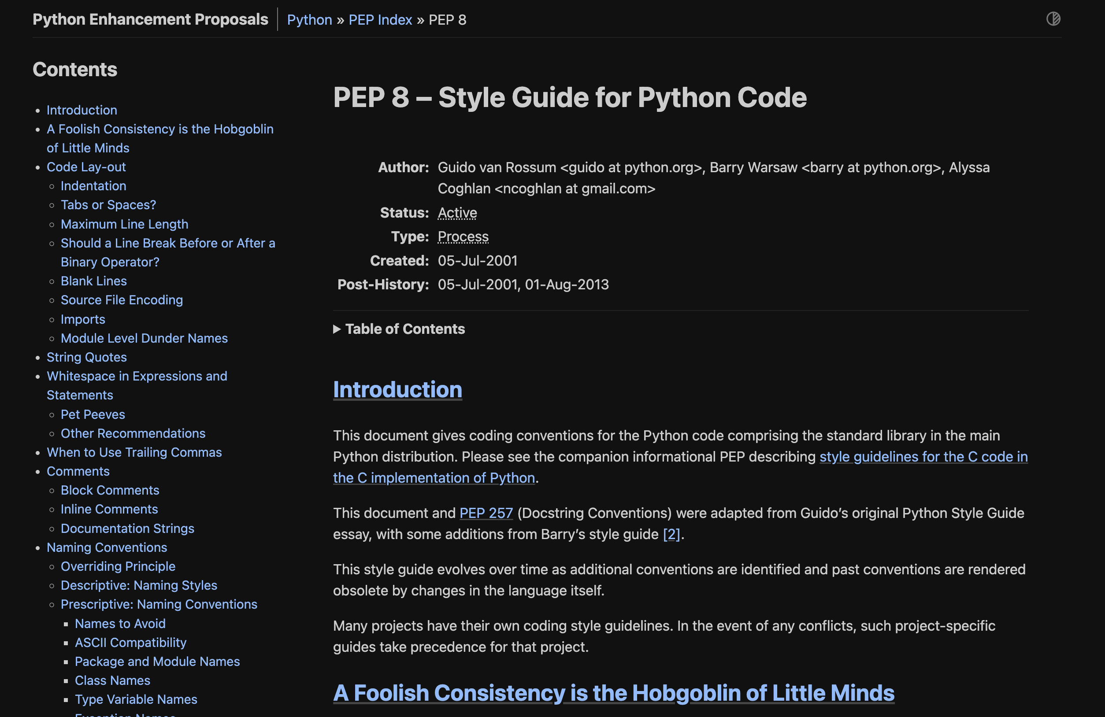
Follow the style conventions of your language
PEP8 is a python style guide that give you guidance on code formatting (https://peps.python.org/pep-0008/)
Linters are tools that can automatically check if you are following the style guide
Refer to this weeks assignment for instructions on how to turn on your linter

