Slide 1
HAS Tools Week 8

Slide 2
Announcements:
Goals for this week:
Review plotting and issues that came up in HW 7
Learn about timeseries functionality
Office hours:
This Thursday 10-11 in person Harsbarger 324e or by zoom on request
No office hours next Monday I am out of town please email me your questions
Assignments:
Due Monday October 23rd: HW8 + Mid semester Eval
Pandas and Numpy Cheet sheet will be due October 30
Do not submit you forecast this Monday
Please join our zoom meeting: 836 1742 4890

Slide 3
Some common issues
Whether to use single or double quotes:
Either as fine as long as you are consistent
General guideline is to use single quotes for strings unless it’s a string that might contain a ‘ for example: “Don’t worry too much about quotation marks”
Histogram Binning:
What does this line of code do?
x = np.linspace(-5 * np.pi, 5 * np.pi, 1000)
Multi index issues
Refer to pandas_multiindex_example.py in the exercises folder

Slide 4
Warm up:
10 min to work with a partner on an issue one of you had with plotting

Slide 5
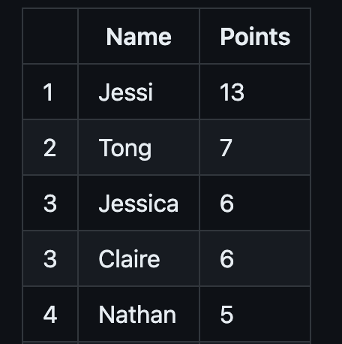
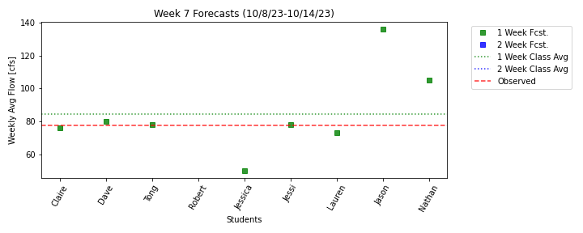
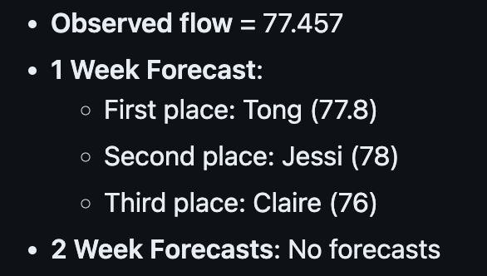
Forecast Results

