Slide 1
HAS Tools Week 13
Documenting your code and improving code structure

Slide 2
Announcements:
Learning Goals for this week:
Doc strings and Chat GPT
No class Thursday (Happy Thanksgiving!)
Office hours:
Monday 1:30-2:30 by zoom
Assignments:
Second graded script and accompanying markdown due Monday at 5pm.
Forecast Judges - Dave and Tong (see instructions here https://github.com/HAS-Tools-2023/forecasting/tree/main/evaluation_scripts)
Please join our zoom meeting: 836 1742 4890

Slide 3
Tuesday Agenda
Partner share on last weeks homework and time for questions
Forecast competition presentation
Explanation of this week’s assignment
Common issues with your first graded script
Doc Strings
Chat GPT

Slide 4
Using ChatGPT for your homework
You can and should use chatGPT to make your code better this week. I request the following:
Try to revise your code first on your own and submit the rough draft which was the best you could do on your own.
Then use chatGPT however you would like and do your best job possible on your final submission.
In your markdown file to me reflect on what chatGPT added to your process and how it made your code better.

Slide 5
This week’s Assignment:
You will be revising and resubmitting your forecast code. This will be your second graded script (*worth more than a regular assignment)
Due Monday Nov 27
Requirements for your revised code:
Code must run for me or I will return it to you without a grade
No local file reads must use Rest APIs to get data
Will need to have at least 2 functions:
Function must have doc strings
Function can't just be to take the mean or get the USGS data exactly as we did in class need to do something more to update it (e.g. adding parameters and outputs) or add an additional function if you are using those
All user input should be in a single block at the top of the code
There should be a ‘forecast_date’ input at the top and the user should be able to change the date and get a forecast and plots for whatever week they enter

Slide 6
Common issues with your first graded script
Comments:
Should describe what you are doing so others can follow.
You do not need to describe anything that is in the doc strings of functions
Avoid using a lot of ----- to make big breaks as these can fold over on to many rows
Long lines of code – much easier to read if you split it up onto multiple lines. Make sure you tab in though so its clear where one line starts and the next begins.
Use blank lines strategically to create clear breaks in your code.
Use the linter!
You don’t have to check year month and days of dates individually you can look for dates all at once like this:
df[(df.index >='2023-10-29') & (df.index <='2023-11-4')]

Slide 7
Doc Strings
Doc strings describe what your function does, what it requires as inputs and what the user can expect as outputs.
When you type help(some_function) what you get back is the docstrings for that function
Refer to this really great guide on writing doc strings: https://pandas.pydata.org/docs/development/contributing_docstring.html
They are very easy to create its just ``` to start and ``` to end
However to do them well you should follow the standard formatting guidelines shown in the link above.

Slide 8
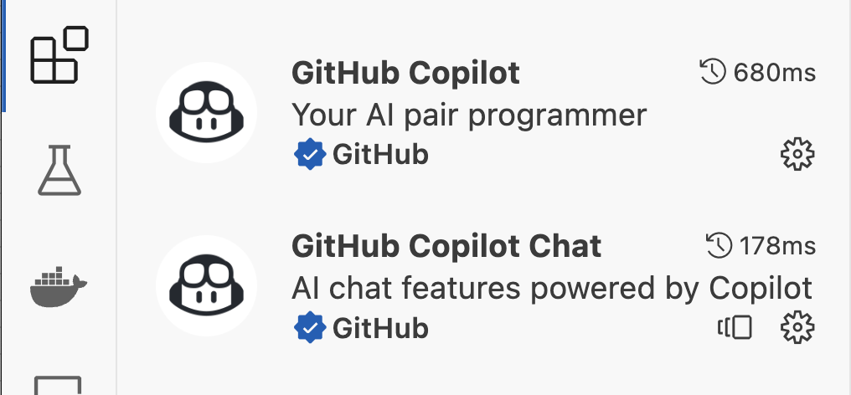
ChatGPT
There are many ways to interact with ChatGPT I recommend two for this class:
Go directly to the web interface and ask questions there: https://chat.openai.com/
Using GitHub co-pilot:
Sign up here: https://github.com/features/copilot (note you will have to hit buy but you will get a free 30 day trial and should get it for free as a student too).
Install the github copilot and copilot chat extensions to vs code

Slide 9
Some useful things you can ask ChatGPT to do
Once you know a little Python ChatGPT can be an incredibly powerful tool helping to to code more efficiently professionally. It can:
Describe water a given code snippet does
Provide suggestions for how to clean up your code
Help write documentation for functions
Debug something that isn’t working
Start a script for you from scratch if you are not sure how to get started
WARNING: Just like with its text response there is no guarantee that what chatGPT hands you will (1) work, (2) work for the right reasons or (3) be what you were thinking it would give you. It is your responsibility to test and understand what you have been given before you use it.

Slide 10
Exercise:
Ask ChatGPT to solve one of our previous class exercises and see how its answer compares to yours?
Provide ChatGPT with your answer from the exercise and ask it to improve it. What did it change? Does it make sense to you?

