Slide 1
Intro to Git
HWRS 401/501

Slide 2
GitHub is a version control system. It allows teams to work collaboratively on the same pieces of code (like track changes for word but much more sophisticated)
https://www.endpoint.com/blog/2014/05/02/git-workflows-that-work

Slide 3
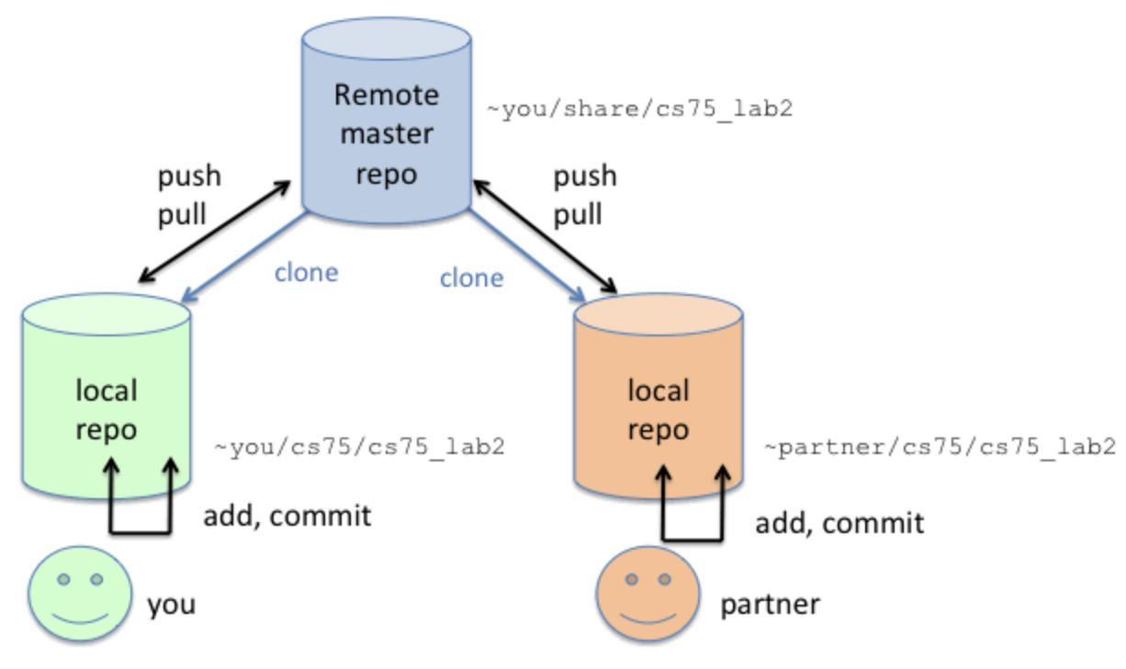
Local and remote version-controlled repositories
https://www.cs.swarthmore.edu/~newhall/unixhelp/git_create.php

Slide 4
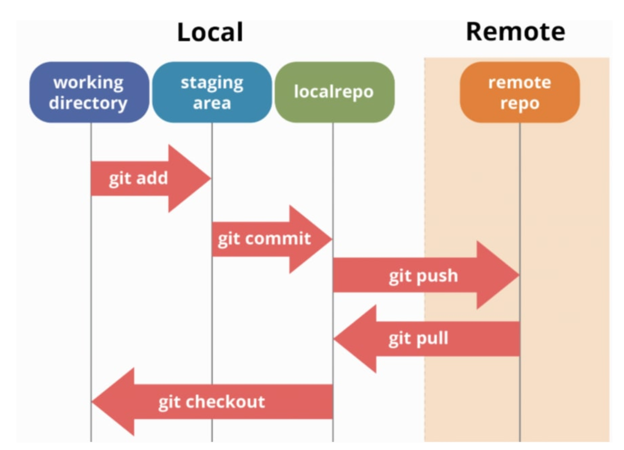
GitHub workflow
https://dev.to/mollynem/git-github--workflow-fundamentals-5496
https://www.reddit.com/r/git/comments/99ul9f/git_workflow_diagram_showcasing_the_role_of/

Slide 5
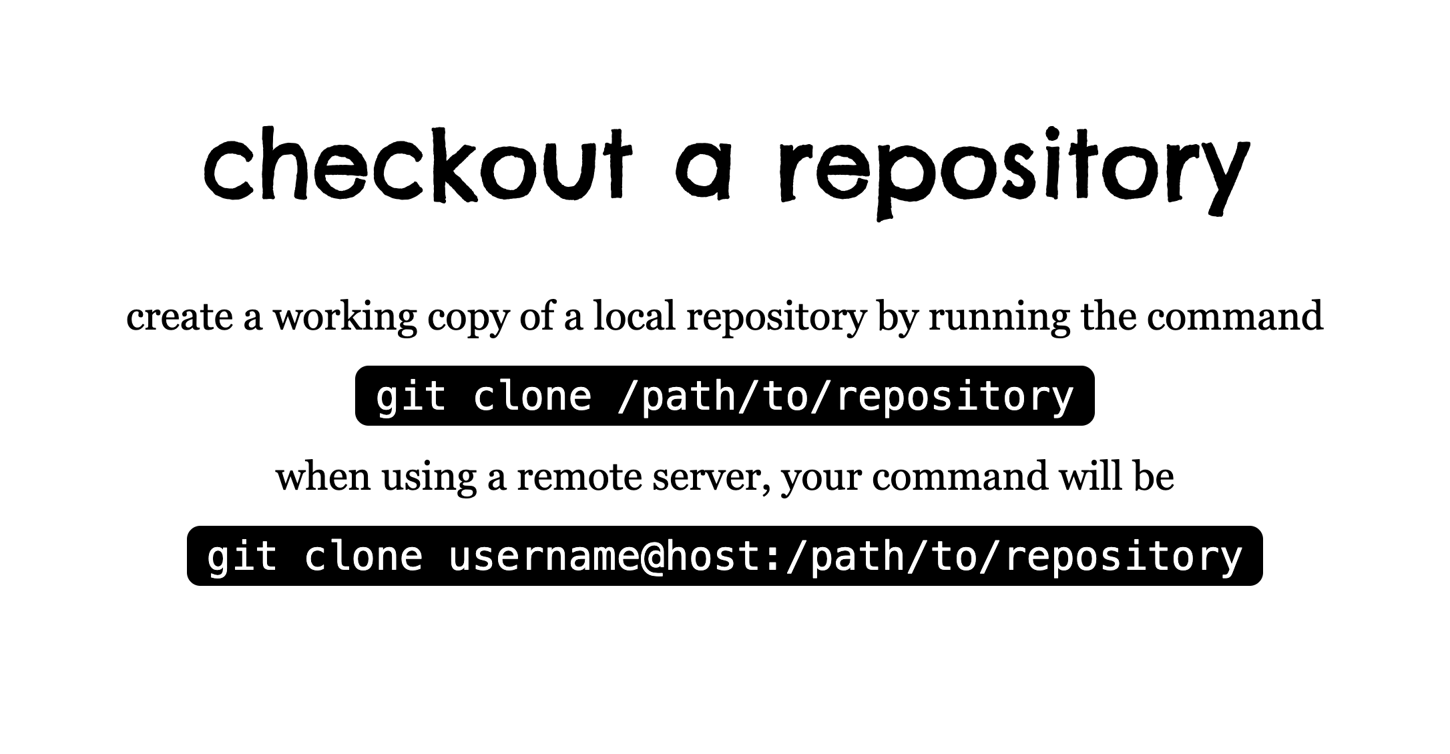
Copied from: http://rogerdudler.github.io/git-guide/

Slide 6
Check your setup (Note you must be inside your repo for these to work)
git status : to see whether your local repo is up to date and what branch you are on
git branch : shows you want branch you are currently working on
git remote: Shows the remote repose you are connected to
git remote show origin: To show the url for a given remote (in this case origin)

Slide 7
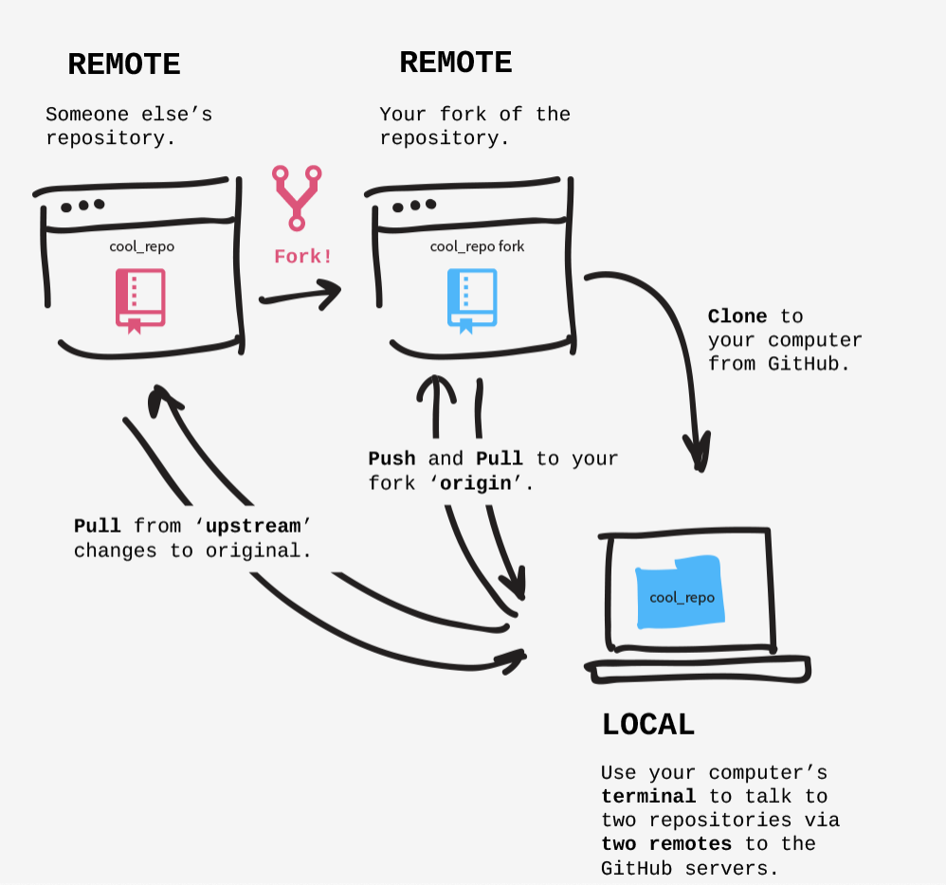
Cloning vs. Forking
Cloning is you making a local copy of a repository
If you Fork first then you have your own version of the repository remotely that you can pull and push changes to
For this class we will just clone but for future work you may want to fork if there is a repo you want to make changes to without changing someone else’s repository
http://jlord.us/git-it/challenges/forks_and_clones.html

Slide 8
GitHub workflow
https://dev.to/mollynem/git-github--workflow-fundamentals-5496
https://www.reddit.com/r/git/comments/99ul9f/git_workflow_diagram_showcasing_the_role_of/

Slide 9
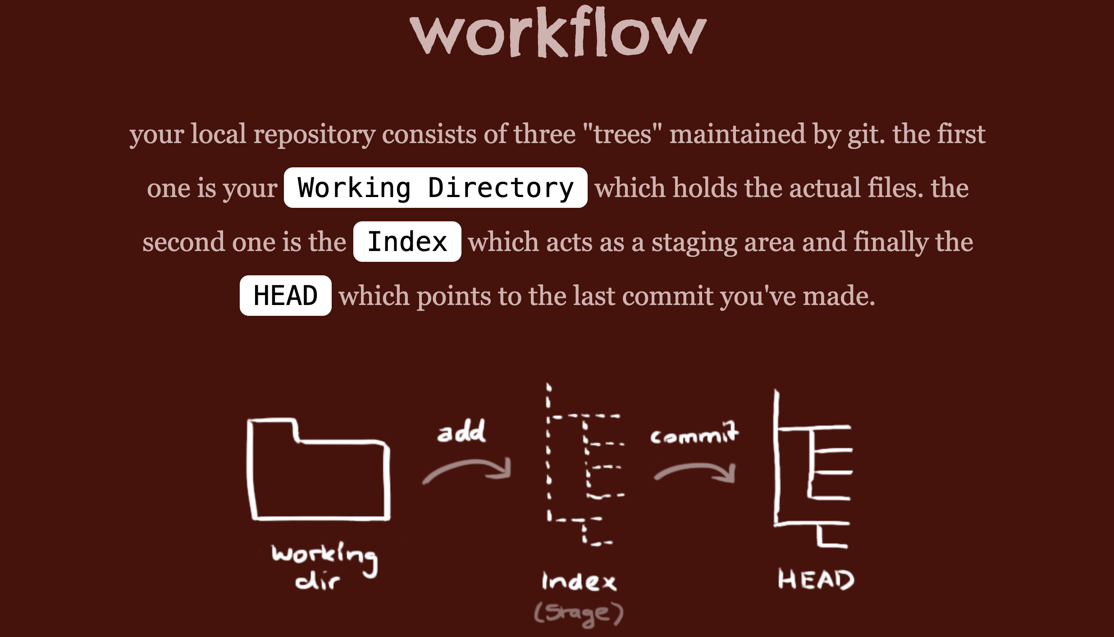
Copied from: http://rogerdudler.github.io/git-guide/

Slide 10
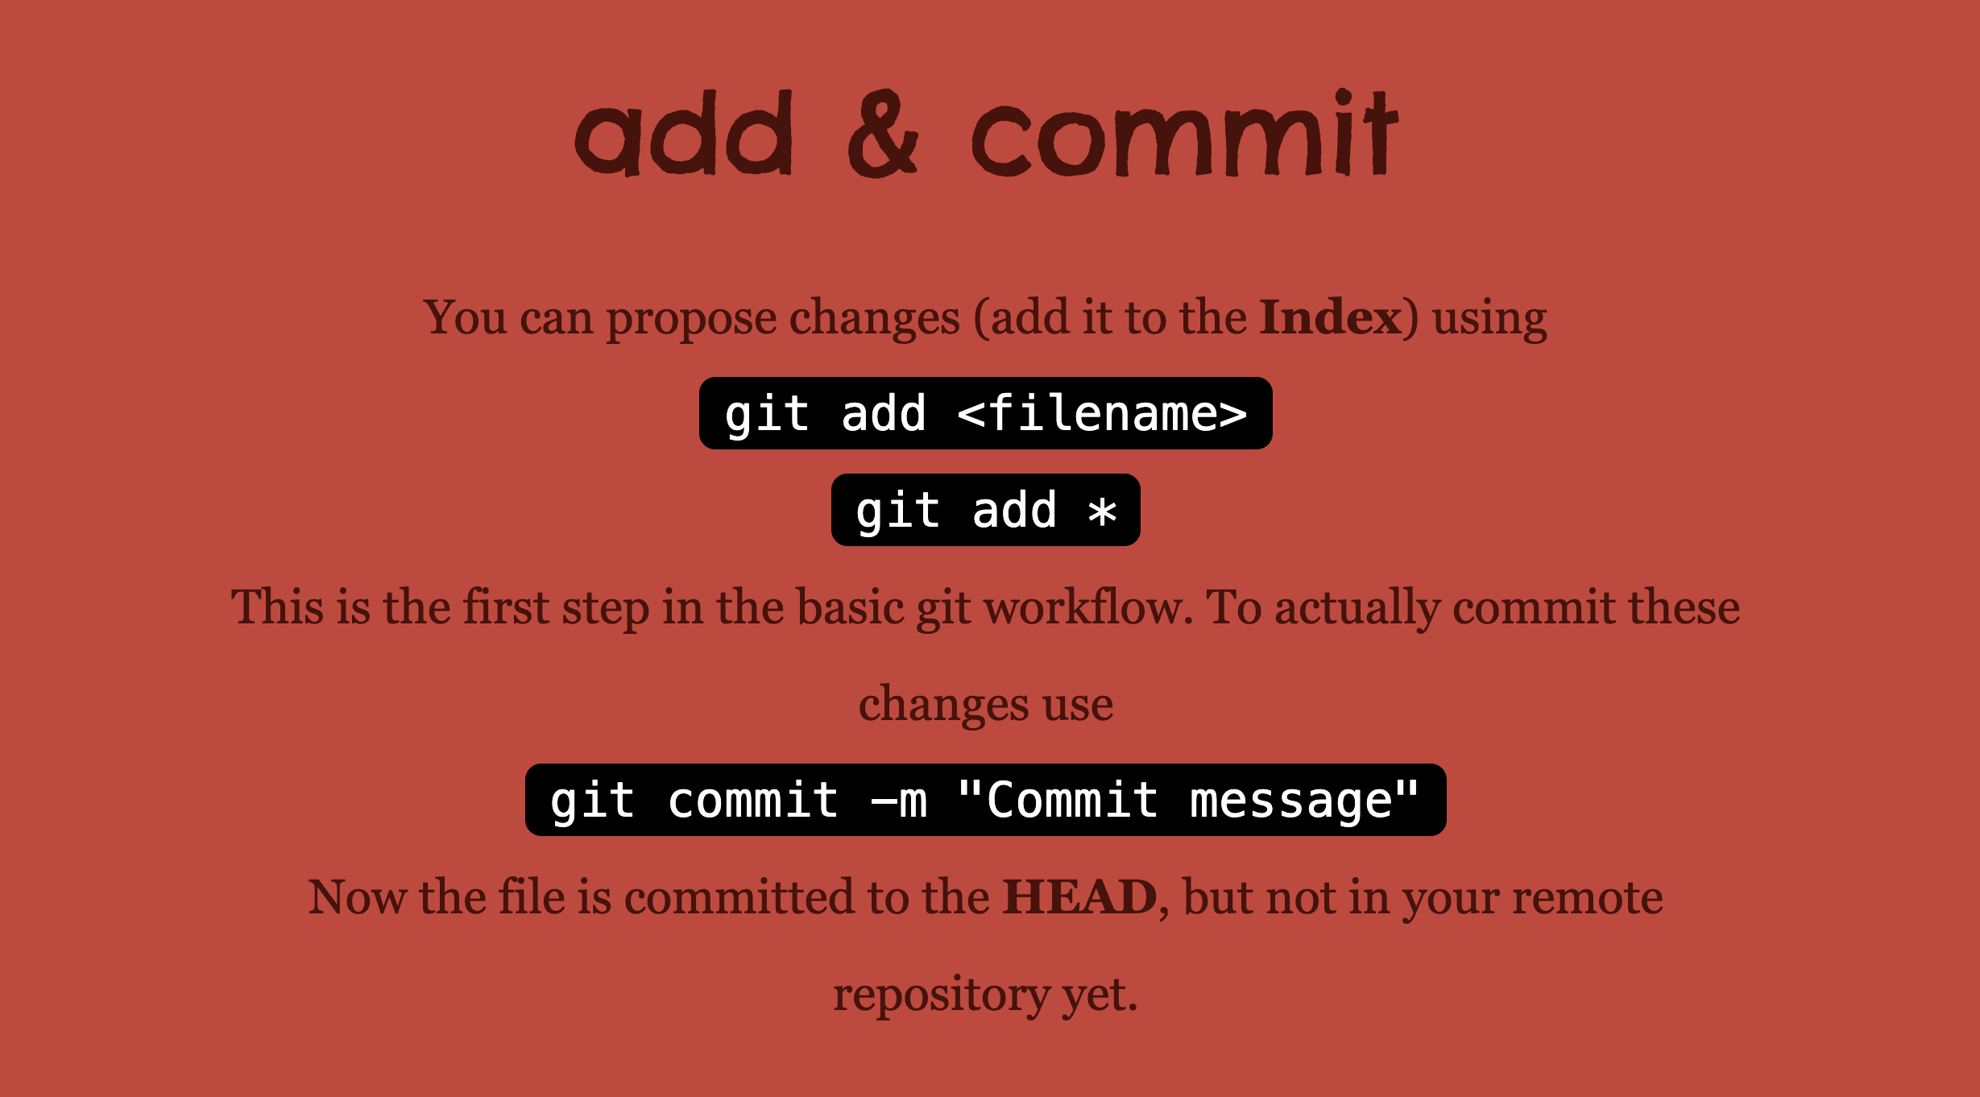
Copied from: http://rogerdudler.github.io/git-guide/

Slide 11
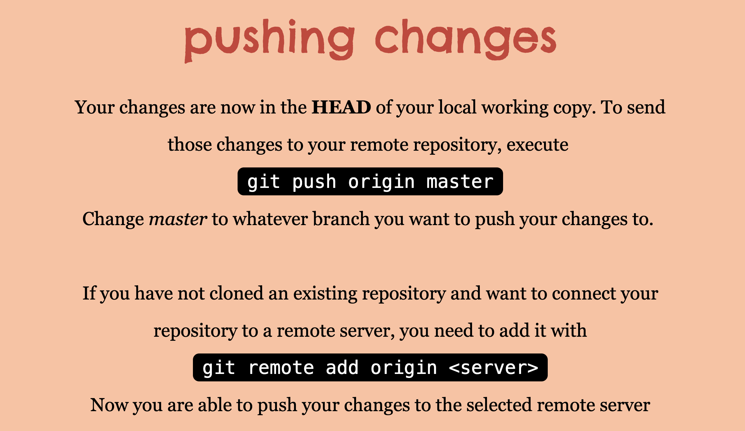
Copied from: http://rogerdudler.github.io/git-guide/

