Slide 1
White board Pics Day 2

Slide 2
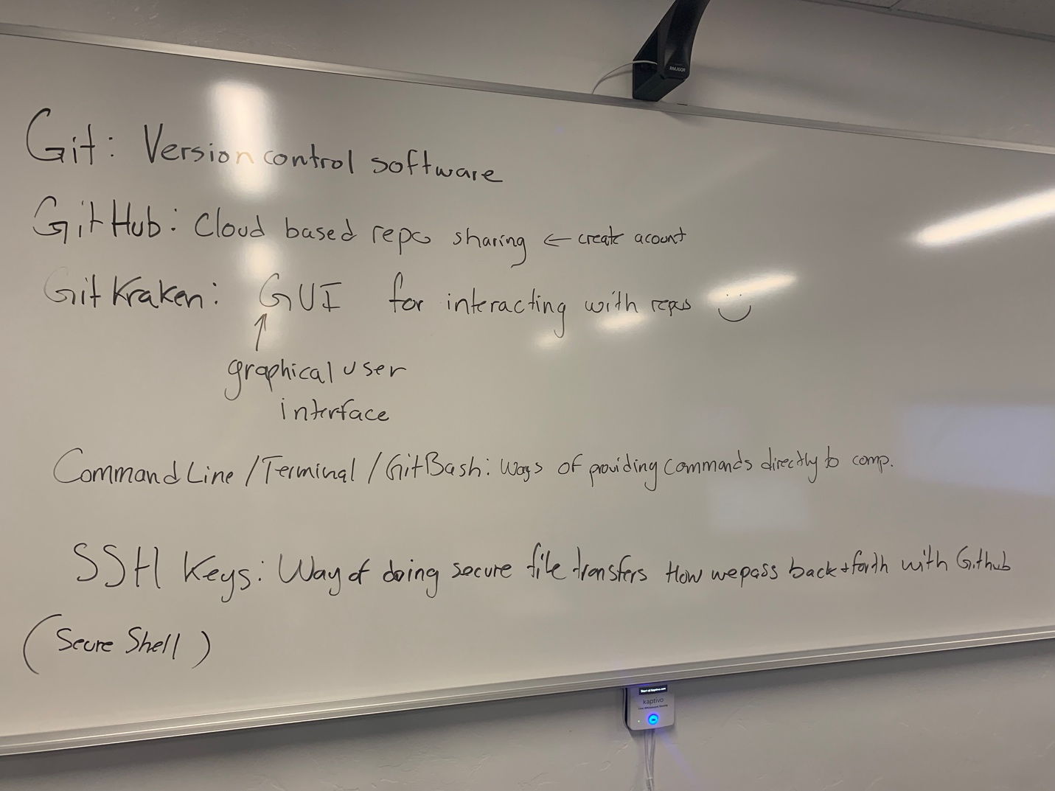
Overview of what we have installed so far

Slide 3
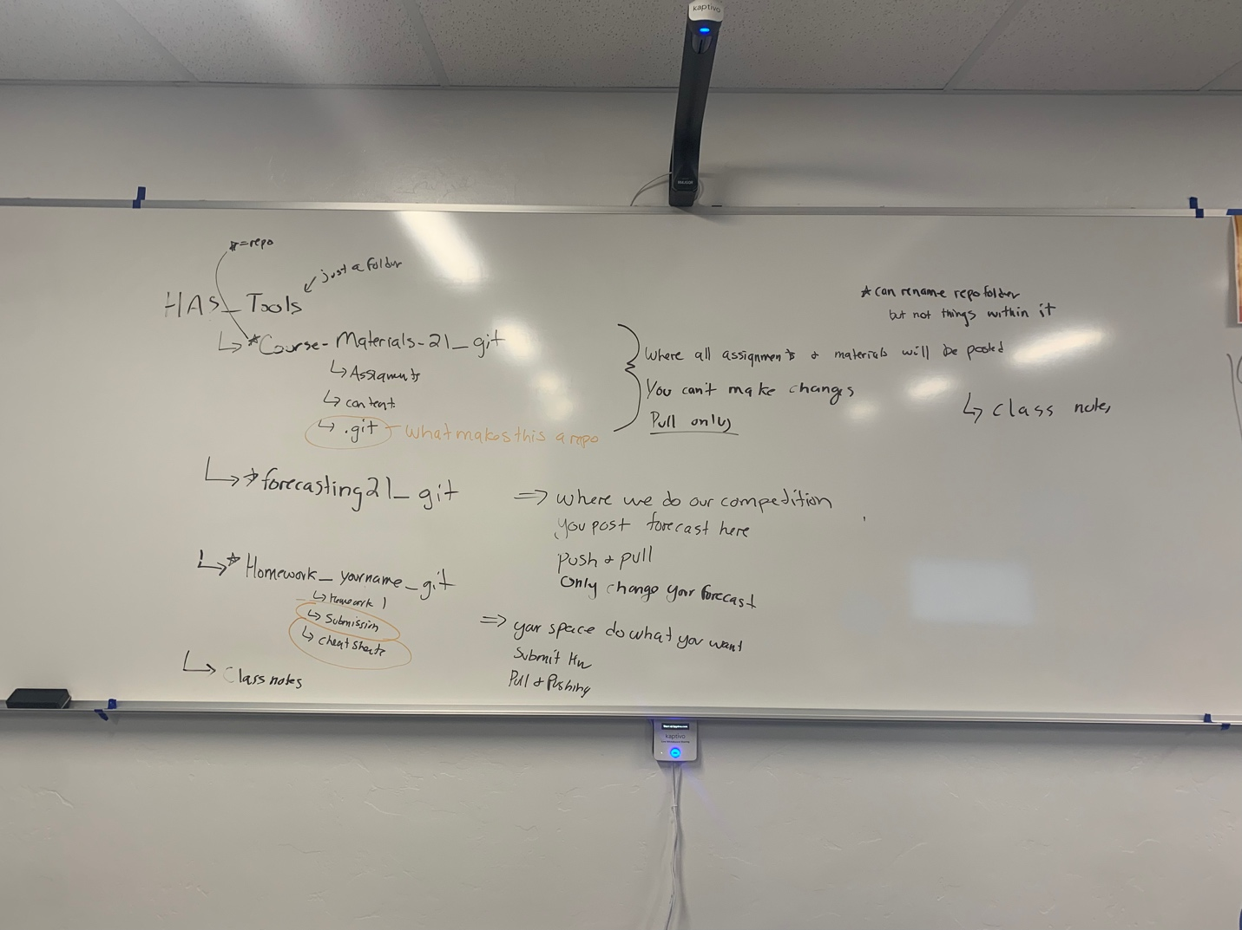
Overview of the repo structure and how to setup your class directory

Slide 4
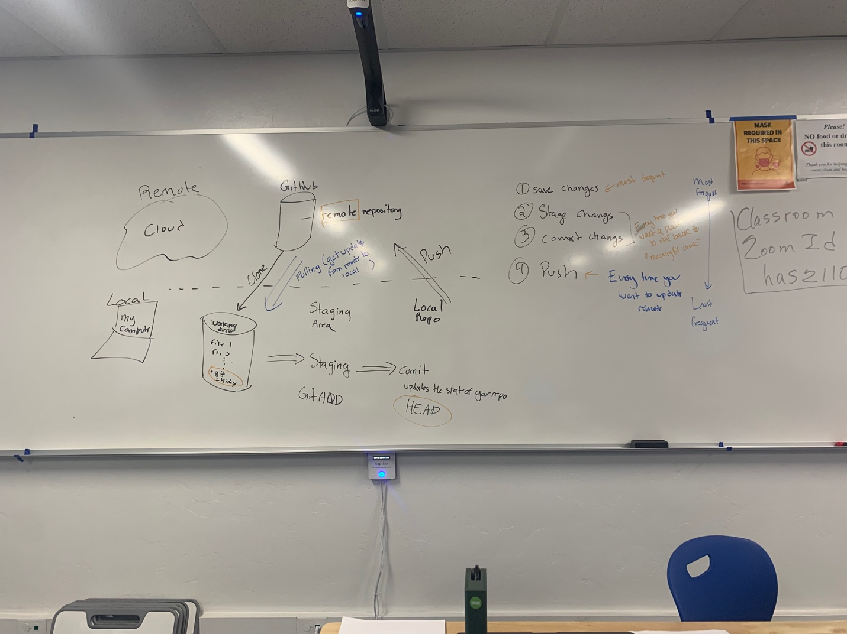
Git Workflow Part 1

