Slide 1
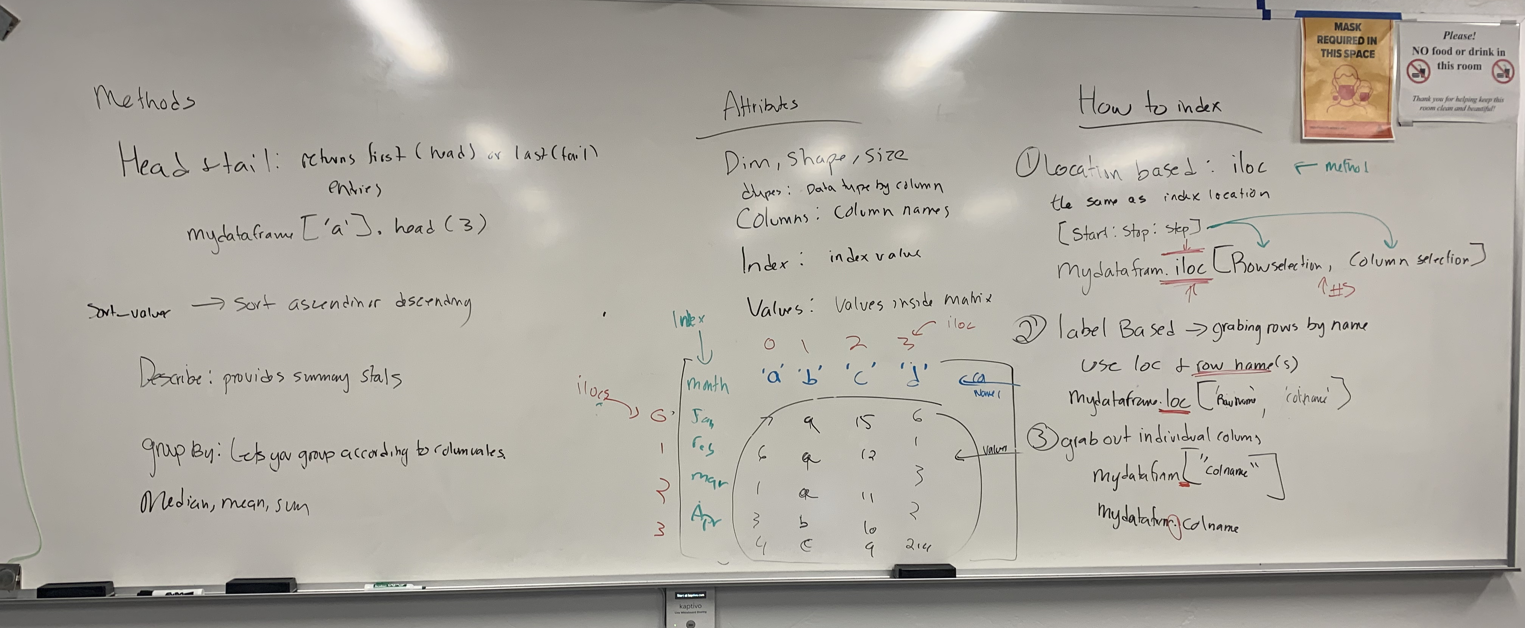
Intro to Pandas

