Slide 1
Week 3 flow forecast evaluation
Xueyan Zhang

Slide 2
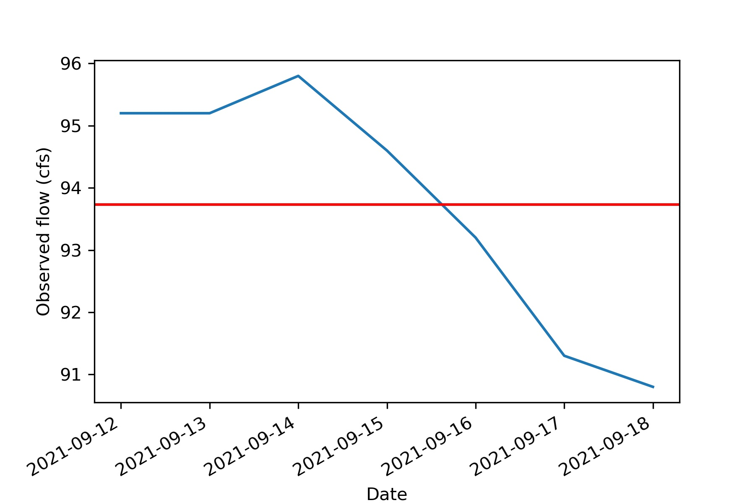
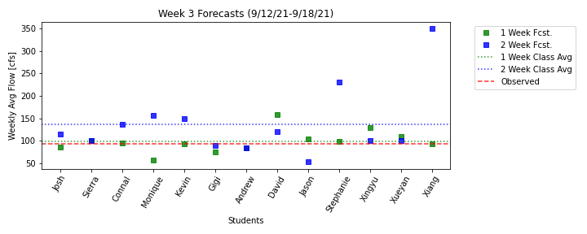
Results
93.7 cfs

Slide 3
Results
1-week lead time
First place | Kevin and Xiang (94 cfs)
Second place | Connal (96 cfs)
Third place | Stephanie (98 cfs)
9/13 got points!
2-week lead time
First place | Gigi (90 cfs)
Second place | Sierra, Xingyu, and Xueyan (100 cfs)
Third place | Andrew (85 cfs)

Slide 4
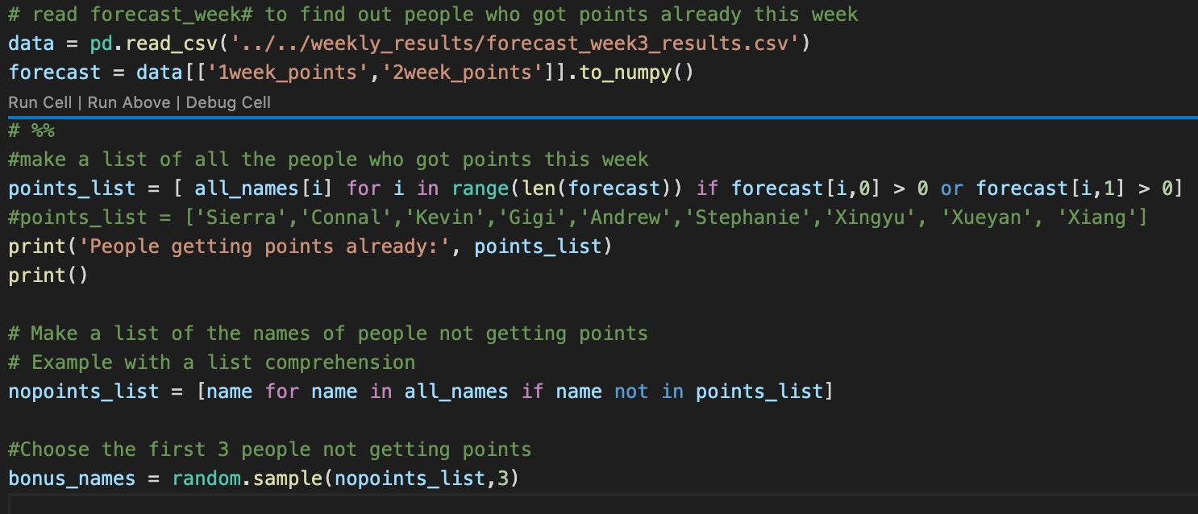
Results
How to assign bonus points?
nonpoints_list = [“Josh”, “Monique”, “David”, “Jason”]
bonus_names= [“Josh”, “Monique”, “Jason”]

Slide 5
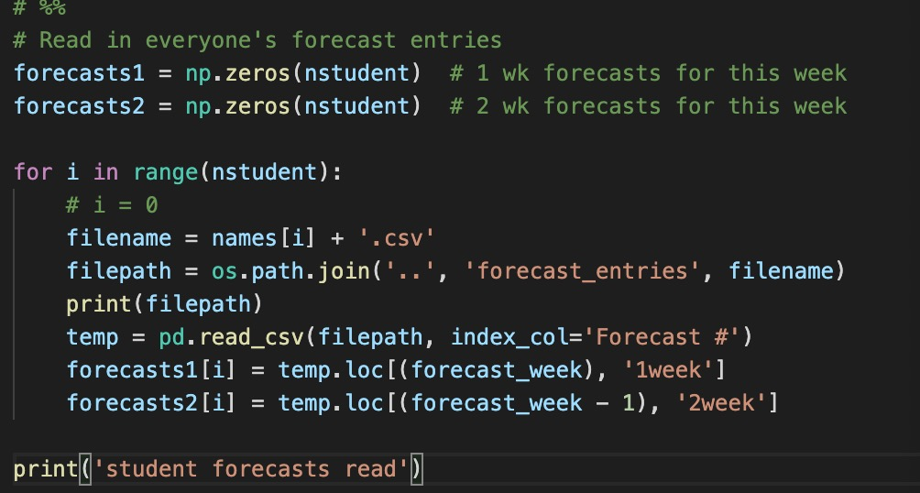
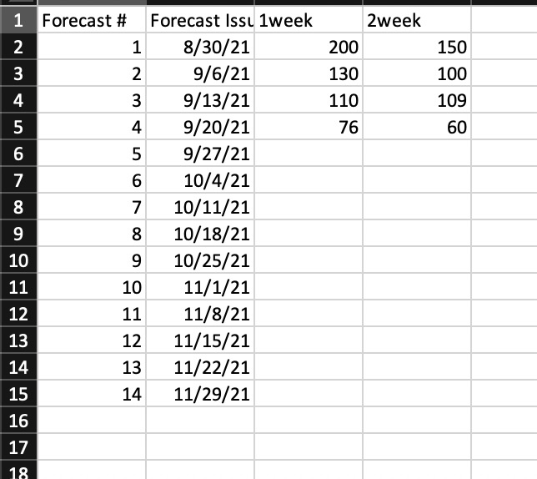
Code explanation
Forecast_week = 3
pd.dataframe.loc: here .loc[] is primarily label based
index_col option in pd.read_csv specifies the column as the row labels of the dataframe.

Slide 6
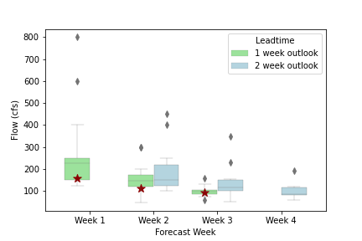
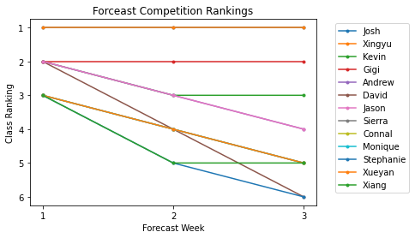
Results
name | total | rank
Josh | 6 | 1
Xingyu | 6 | 1
Gigi | 5 | 2
Kevin | 4 | 3
Notes:
Gigi is next.

