Slide 1
Week 12 forecast evaluation
Xingyu Zhang

Slide 2
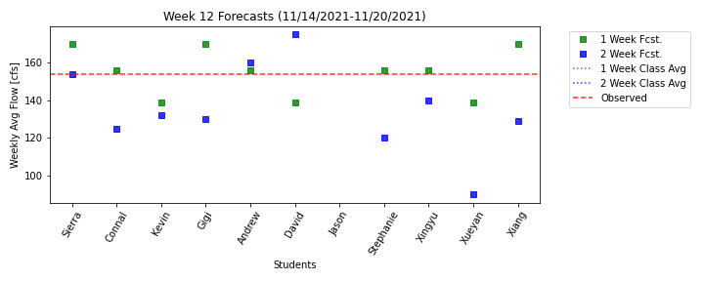
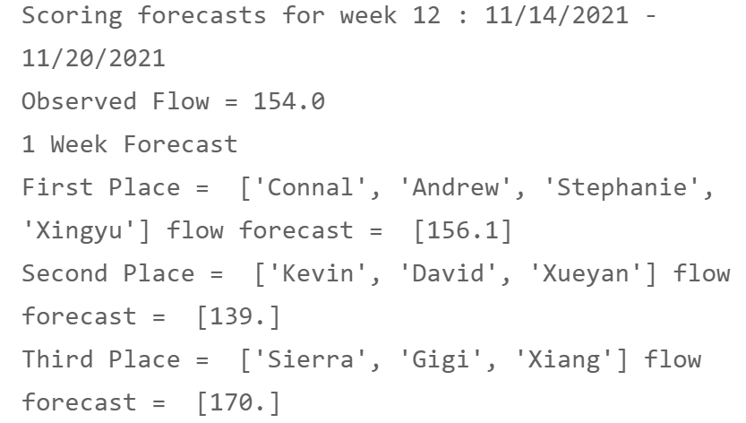
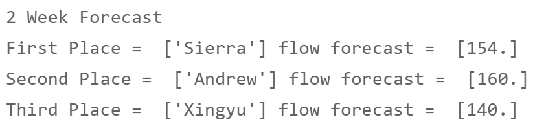
Group 2 win it!

Slide 3
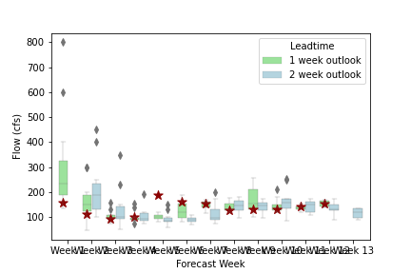
A figure about forecast distribution. All the forecast are near observation

Slide 4
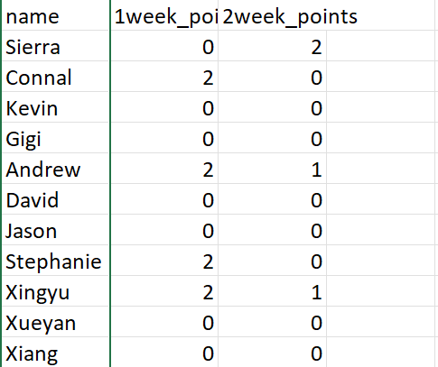
Base on group competition rule, only group2 win 2 points in 1week prediction.
Other groups are 0 points.

Slide 5
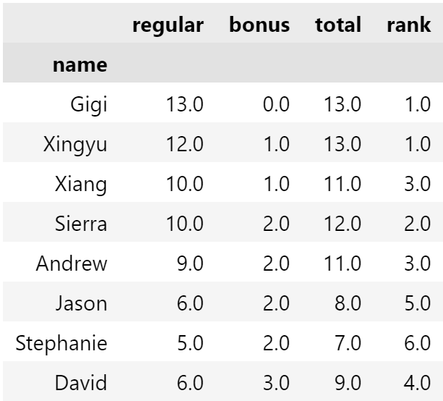
Bonus points:
People who got least bonus points before can get bonus points this week.
Jason is not in class list now so that I don’t give him bonus point
?
['Gigi', 'Xiang', 'David']

Slide 6
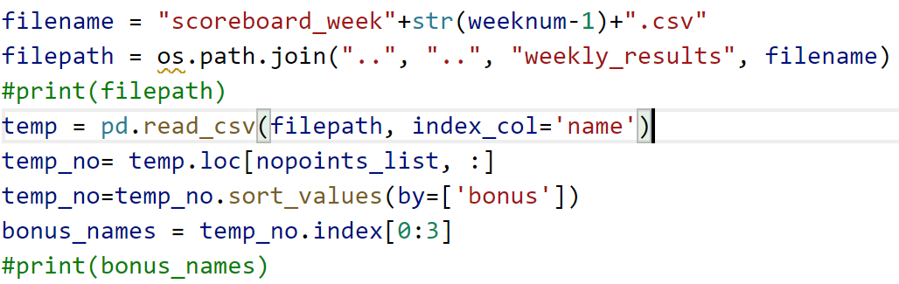
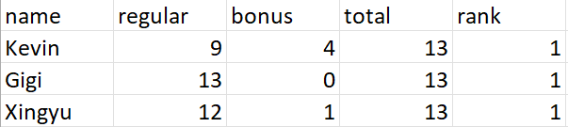
People getting points already: ['Connal', 'Andrew', 'Stephanie', 'Xingyu', 'Sierra’]
People Getting bonus points: ['Gigi', 'Xiang', 'David']

Slide 7
