Slide 1
Week 12 forecast evaluation
Xingyu Zhang

Slide 2
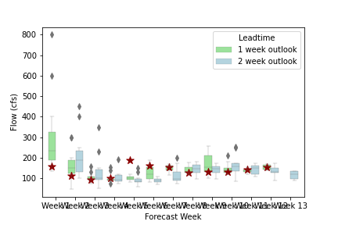
Boxplot about forecast distribution: all the forecast are near observation

Slide 3
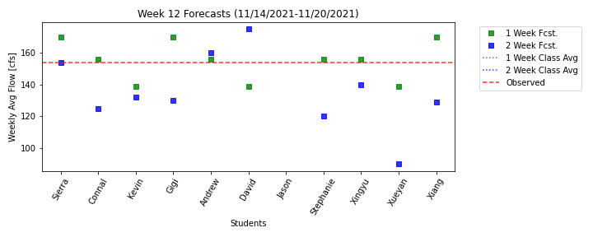
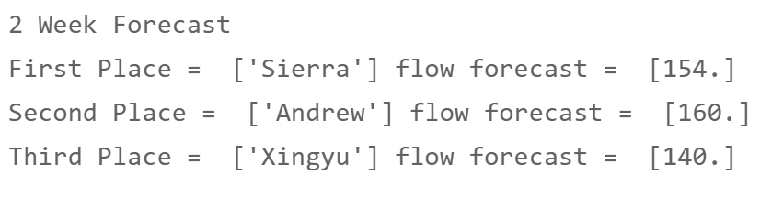
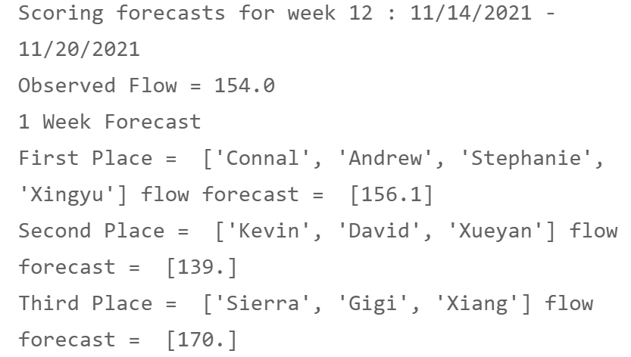
Group 2 win it!
Base on group competition rule, only group2 win 2 points in 1week prediction.
Other groups are 0 points.

Slide 4
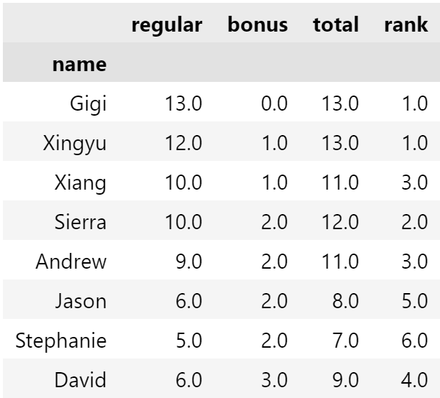
Bonus points:
People who got the lowest bonus points before can get bonus points this week.
Jason is not in class list now so that I don’t give him bonus point
?
['Gigi', 'Xiang', 'David']

Slide 5
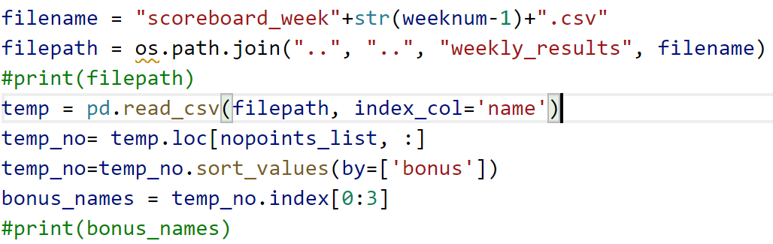
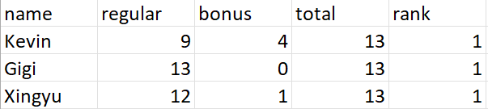
People getting points already: ['Connal', 'Andrew', 'Stephanie', 'Xingyu', 'Sierra’]
People Getting bonus points: ['Gigi', 'Xiang', 'David']

Slide 6
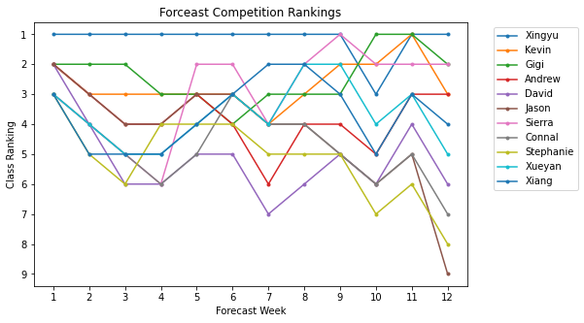
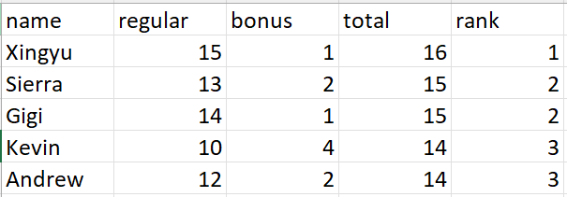

Slide 7
Thanks for listening

