Slide 1
Remote Procedure Calls (RPC)

Slide 2
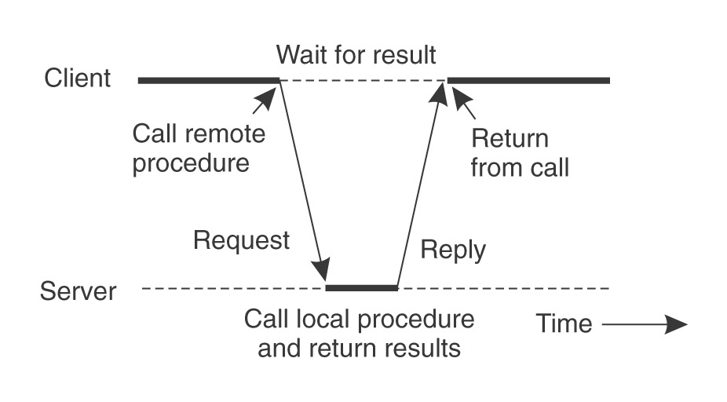
What is RPC?
RPC is a protocol that one program can use to request a service from a program located in another computer on a network without having to understand the network details.
RPC uses the client server model.

Slide 3
Five elements of RPC
The Client
The client stube
The RPC runtime
The server stub
The Server

Slide 4
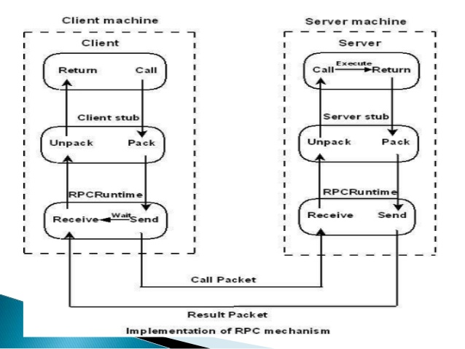
Implementation of RPC

Slide 5
Steps of a Remote Procedure Call
Client procedure calls client stub in normal way
Client stub builds message, calls local OS
Client's OS sends message to remote OS
Remote OS gives message to server stub
Server stub unpacks parameters, calls server
Server does work, returns result to the stub
Server stub packs it in message, calls local OS
Server's OS sends message to client's OS
Client's OS gives message to client stub
Stub unpacks result, returns to client

Slide 6
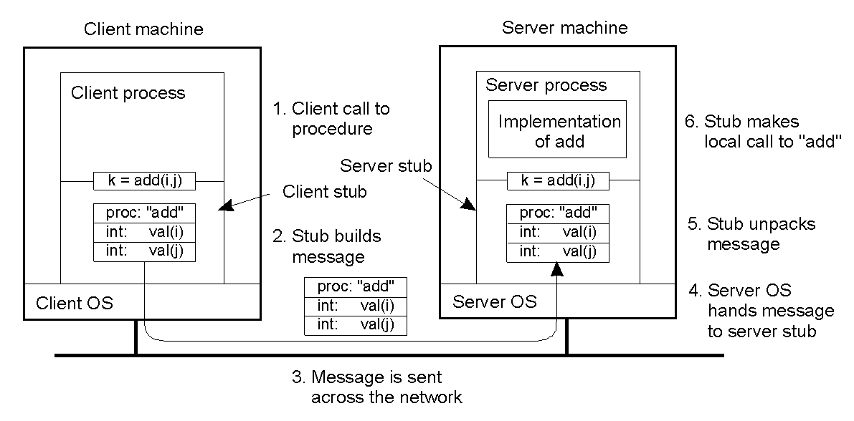
Passing Value Parameters
Steps involved in doing remote computation through RPC
2-8

Slide 7
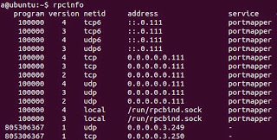
Implementation
Step 1: Check rcpinfo and install rpcbind
Type the following command in the terminal :-$ rpcinfo

Slide 8
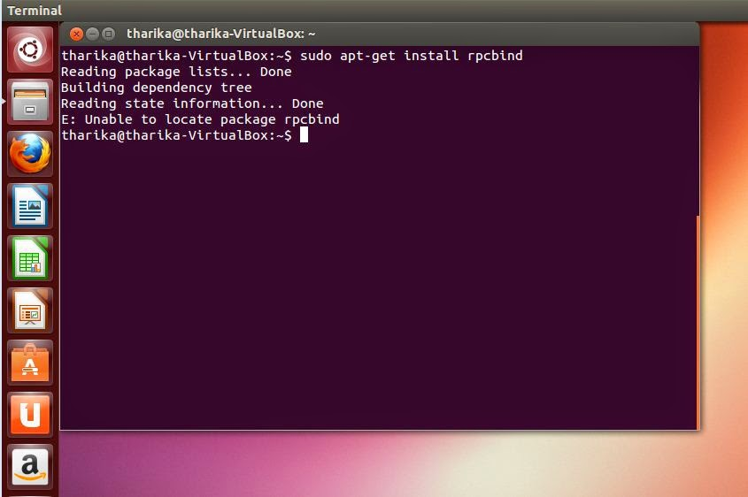
Otherwise, If you don't have the rpcbind package installed in your computer. You will be prompted to enter the following command. :-$ sudo apt-get install rpcbind

Slide 9
Then what you need to do is to run the following command in the terminal. :-$ sudo apt-get update && apt-get upgrade

Slide 10
Step 2: Write and compile your IDL file.
This is IDL file for addition of two numbers.
struct numbers{
int a;
int b; };
program ADD_PROG{
version ADD_VERS{ int add(numbers)=1;
}=1;
}=0x4562877;

Slide 11
Compile IDL file using following command
:-$ rpcgen -a -C add.x
It will generate the following files.
add.h -> header file
add_client.c -> client program
add_clnt.c -> client stub
add_server.c -> server program
add_svc.c -> server skeleton
add_xdr.c -> XDR routines used by both the client and the server
Makefile.add -> Makefile

Slide 12
Step 3 : Edit client and server program.
//server program
#include "add.h" int *
add_1_svc(numbers *argp, struct svc_req *rqstp)
{
static int result;
printf("add(%d,%d) is called\n",argp->a,argp->b);
result = argp->a + argp->b; return &result;
}

Slide 13
//client program
#include "add.h“
void add_prog_1(char *host,int x,int y)
{
CLIENT *clnt; int *result_1; numbers add_1_arg; #ifndef DEBUG
clnt = clnt_create (host, ADD_PROG, ADD_VERS, "udp");
if (clnt == NULL) { clnt_pcreateerror (host);
exit (1);
}
#endif /* DEBUG */
add_1_arg.a=x;
add_1_arg.b=y; result_1 = add_1(&add_1_arg, clnt); if (result_1 == (int *) NULL) { clnt_perror (clnt, "call failed"); } else{ printf("Result:%d\n", *result_1 ); }

Slide 14
#ifndef DEBUG
clnt_destroy (clnt);
#endif /* DEBUG */ }
int main (int argc, char *argv[])
{
char *host;
if (argc < 4) {
printf ("usage: %s server_host\n", argv[0]);
exit (1);
}
host = argv[1];
add_prog_1 (host,atoi(argv[2]),atoi(argv[3]));
exit (0); }

Slide 15
Now we have changed those two program so we have to compile all the files again by following command
:-$ make -f Makefile.add
Now open up two terminals and run the server in a one and client in the other.
:-$ sudo ./add_server
:-$ sudo ./add_client

Slide 16
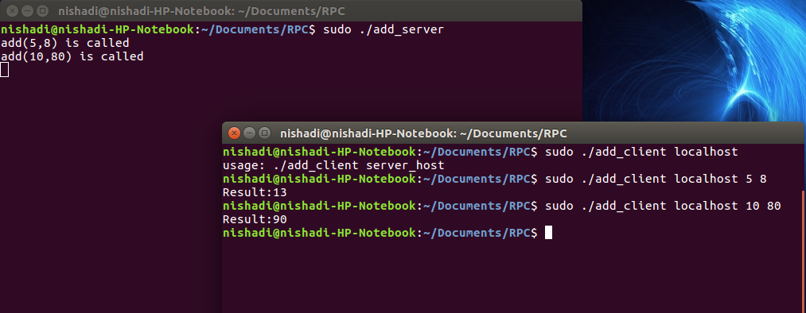
Output

