Slide 1
Task 1 Slides Presentation

Slide 2
Does the IT sector have similarly amount of total revenue from 2012-2016 or doesn't
On the left, is a bar chart of aggregated revenues for all IT’s sub industries. Shows the levels of aggregated revenues for them in the available period from 2012-2016.
The chart shows the data is right-skewed or positively data, that leads us the mean of the data is higher than the median.
The mean is $228 billion, and the median is $89 billion, that leads us there is a high spread out within IT’s sub industries’ revenues. So, the amount of total revenue in each sub industry isn’t similarly. To prove that, the standard deviation is $285 billion, and the range is $1,065 billion. Therefore, that refers to there is high spread out within the data.
<visualization or summary statistics used for finding>

Slide 3
Is the Data Processing & Outsourced Services' revenue growth more than the rest of sub industries from 2012-2016 or not?
As we see on the left, the aggregated proportion to revenue growth of Data Processing & Outsourced Services sub industry is 0.31%, which is in green.
It’s important to know, there isn’t a relationship between the proportion of revenue growth and the aggregated amount of revenue. So, that the Computer Hardware Sub Industry gains the highest total amount of revenues within the IT Sector, However, it doesn’t have growth in revenue for the 3 years ago.
In contrast, the Data Processing & Outsourced Services has $30 billion and the Computer Hardware has $1.071 billion, really differ!. But our sub industry has higher growth than the Computer Hardware Industry.
So, keep in mind when you want to invest, with which one will you invest?, More Growth or More amount of revenue.
Note: Some sub industries were deleted, because they don’t matter in answering the question.

Slide 4
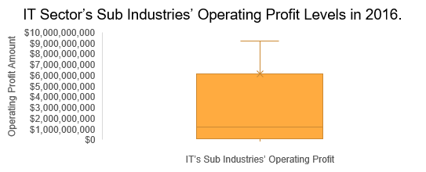
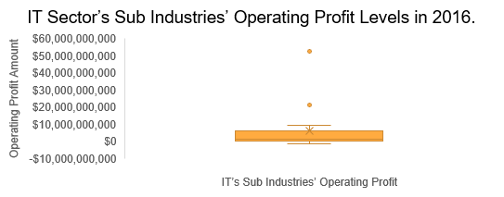
Does the IT Sector's sub industries have similar Operating Profit or EBIT Levels in 2016 (Last year in NYSE Stock Dataset)?
We have two plots here, one with outliers and negative numbers, or (losses) and the one in the bottom without them. At first, we will present the above plot, which is have not exact similar EBIT Levels, and its St. dev is $13.5 billion and its mean is $6.1 billion, that is doubled!. But In general, 50% of EBIT amounts or more are similar, because the St. dev without outliers and losses is $2.9 billion and its mean $2.4 billion.
And that's what you are seeing in the bottom plot, there are similar EBIT amounts, and the right-skewed plot showing clearly. This plot without outliers and losses in presenting data not in dataset which plots based on it.
To sum them up, there are similar EBIT amounts in the IT Sector.

