Slide 1

CLOUDERA
Nimra Shabbir
MSDSF23M017
BIG DATA ANALYTICS

Slide 2
■ Introduction
■ Introducing the Enterprise Data Cloud
■ Cloudera Complete data lifecycle
■ Cloudera Data Platform Overview
■ Data in Motion
■ Data Warehousing and Analytics
■ Data Science and Machine Learning
01-2

Slide 3
Introduction:
It is an easy, fast and secure enterprise data analytics management platform.
Cloudera is a company that provides tools and services to help businesses manage and analyze large amounts of data using a platform built on Apache Hadoop and other open-source technologies. Essentially, Cloudera helps organizations store, process, and gain insights from their big data efficiently and securely.

Slide 4
CLOUDERA
Introducing the Enterprise Data Cloud
The Enterprise Data Cloud of Cloudera, known as the Cloudera Data Platform (CDP), is a comprehensive data management and analytics platform designed to address the diverse needs of modern enterprises. CDP integrates various data services, providing a unified framework for data engineering, data warehousing, machine learning, and analytics.

Slide 5
Introducing the Enterprise Data Cloud
■ The Evolution of CDP
■ Characteristics of an Enterprise Data Cloud
■ From the Edge to AI: An End-to-End Use Case
■ Essential Points
02-3

Slide 6
History: New Approaches for Data Storage
The Google File System
Sanjay Ghemawat, Howard Gobioff, and Shun-Tak Leung Google-
MapReduce: Simplified Data Processing on Large Clusters
Jeffrey Dean and Sanjay Ghemawat
jeff@googlc.com. sanjay@googlc.com
Google, Inc.
ABSTRACT
Wt* have detdgne tem, a scalable d data* intensive ap running on inexp high aggregate p< While sharing tributed file syst< vat ions of our ap| ronmcnt, both cu departure from s has led us to reex ically different dc The file systcn It Is widely deplo for the generatio vice as well as ref large data sets, dreds of terahytt over a thousand by hundreds of cl
Abstract
MapReduce is a programming model and an associated implementation for processing and generating large data sets. Users specify a map function that processes a key/value pair to generate a set of intermediate key/value pairs, and a reduce function that merges all intermediate values associated with the same intermediate key. Many real world tasks arc expressible in this model, as shown in the paper.
Programs written in this functional style arc automatically parallelized and executed on a large cluster of commodity machines. The run-time system takes care of the details of partitioning the input data, scheduling the program’s execution across a set of machines, handling machine failures, and managing the required inter-machine communication. This allows programmers without any experience with parallel and distributed systems to easily utilize the resources of a large distributed system.
Our implementation of MapReduce runs on a large
given day. etc. Most such computations arc conceptually straightforward. However, the input data is usually large and the computations have to be distributed across hundreds or thousands of machines in order to finish in a reasonable amount of time. The issues of how to parallelize the computation, distribute the data, and handle failures conspire to obscure the original simple computation with large amounts of complex code to deal with these issues.
As a reaction to this complexity, we designed a new abstraction that allows us to express the simple computations we were trying to perform but hides the messy details of parallelization, fault-tolerance, data distribution and load balancing in a library. Our abstraction is inspired by the map and reduce primitives present in Lisp and many other functional languages. We realized that most of our computations involved applying a map operation to each logical "record'* in our input in order to compute a set of intermediate key/value pairs, and then applying a reduce operation to all the values that shared
.
02-5

Slide 7
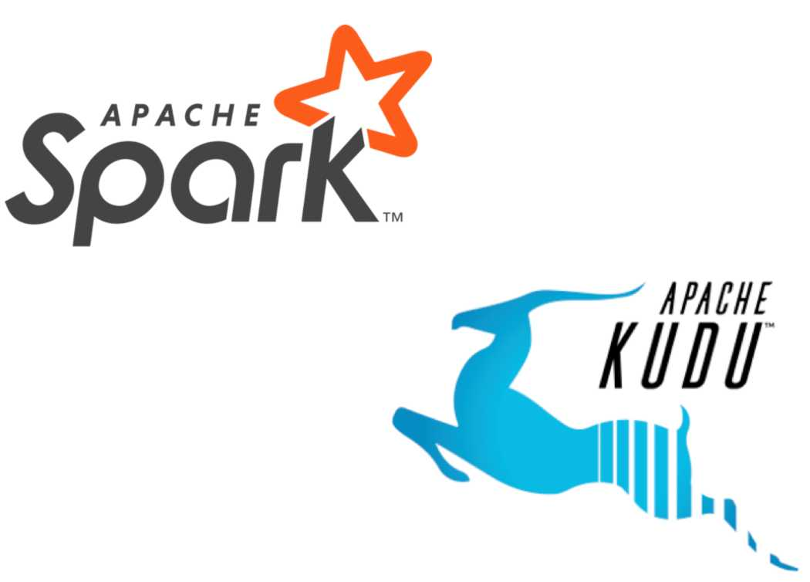
The Platform Evolves
Apache Spark is an open-source platform for large-scale data processing, with built-in modules for SQL, streaming, machine learning, and graph processing. It is known for its speed and ease of use compared to traditional MapReduce.used for ETL, graph processing.
Apache Kudu is an open-source columnar storage manager developed for the Hadoop ecosystem. It is designed for fast analytics on fast data, combining the advantages of both HDFS and HBase.
02-8

Slide 8
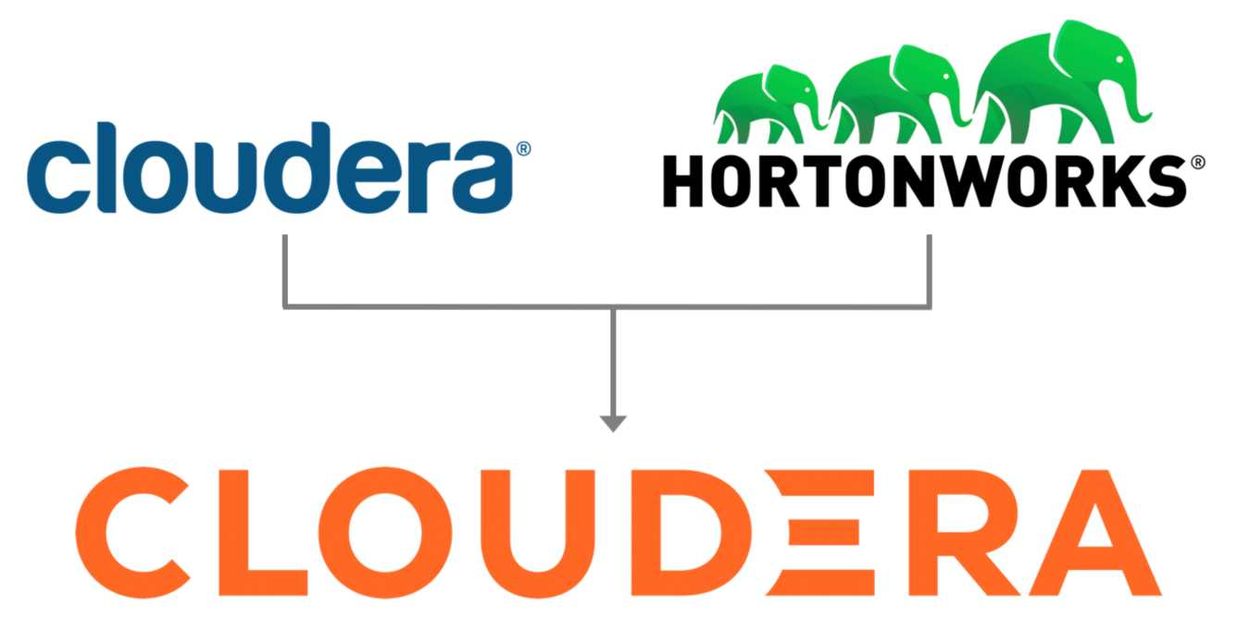
2019: Cloudera and Hortonworks Merge

Slide 9
The Original Data Platforms: CDH and HDP
cloudera
®
HORTONWORKS
®
Cloudera CDH
Hortonworks HDP
Apache Hadoop Apache Hive Apache Spark Apache Flume Apache Kudu
Apache Hadoop Apache Hive Apache Spark Apache NiFi
Apache Druid

Slide 10
Introducing the Enterprise Data Cloud
■ The Evolution of CDP
■ Characteristics of an Enterprise Data Cloud
■ From the Edge to AI: An End-to-End Use Case
■ Essential Points

Slide 11
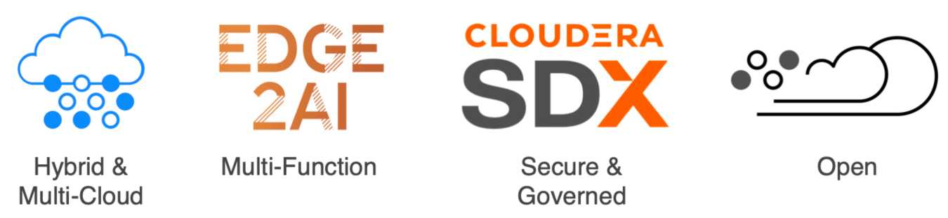
Characteristics of the Enterprise Data Cloud

Slide 12
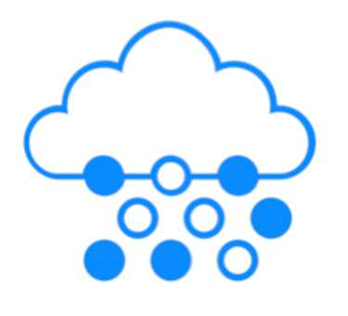
Hybrid and Multi-Cloud
It means you can use both your own data centers (on-premises) and public cloud services together.
■ Flexibility(sensitive data, scalability).
■ Runs workloads where it makes most sense (performance, cost, and data security requirements.)
■ Helps you to control cost
■ Avoids cloud vendor lock-in (not dependent on single cloud provider)
Provides consistent experience on public cloud, multi-cloud and private cloud deployments.

Slide 13
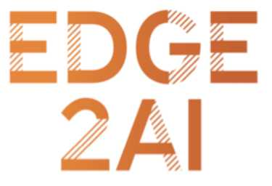
Multi-Function
■ Supports many types of workloads (ingest, manage and deliver any types of workloads).
■ Avoids data duplication
■ Reduces operational expense

Slide 14
Secure and Governed
CLOUDERA
SDX
■ Protect sensitive data across all environments
■ Regulatory compliance(rules for security and privacy)
■ Respond to business opportunities
Enterprise grade security and governance for complete data lifecycle anywhere.

Slide 15

Open
■ Open source
■ Open for integration
■ Reduces technology and business risk
02-15

Slide 16
Introducing the Enterprise Data Cloud
■ The Evolution of CDP
■ Characteristics of an Enterprise Data Cloud
■ From the Edge to AI: An End-to-End Use Case
■ Essential Points

Slide 17
Traditional Maintenance
■ Maintenance must be regularly scheduled for factory equipment
⁻ During maintenance, equipment is unavailable
⁻ Equipment downtime means a loss in profit and productivity
■ Maintenance was traditionally either reactive or preventive
⁻ Reactive maintenance: Respond to equipment failures after they occur
⁻ Example: Updating a light fixture whenever a bulb burns out
⁻ Preventive maintenance: Prevent such failures through routine check-ups
⁻ Example: Changing a car's oil every 3000 miles

Slide 18
A Metric for Production
■ Overall equipment effectiveness (OEE) is a key performance indicator
■ OEE is determined by three factors:
_ Availability: Percentage of time the equipment is running when needed _ -Performance: Relative quantity of generated output
_ Quality: Relative grade of the output
■ Used to determine which maintenance procedures yield the highest profits
■ Downtime due to traditional maintenance diminishes OEE significantly

Slide 19
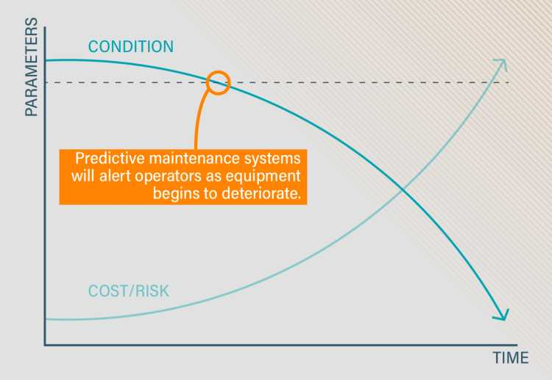
Predictive Maintenance
■ A predictive maintenance system leverages the problems faced by more reactive systems
_ Incorporates data about realtime condition of equipment
_ Also analyzes real-time environmental data, such as weather or acoustic readings
_ Compares data to previous readings and against data from other equipment
■ Used to minimize deterioration of equipment and optimize maintenance procedures

Slide 20
Predictive Maintenance and the Internet of Things
(loT)
■ The Internet of Things (loT) is the intersection of computers with everyday objects
■ Predictive maintenance architectures typically use IoT-based data sources
■ Predictive maintenance often leverages existing or custom-built IoT-based architectures
■ IoT-based maintenance can result in positive business outcomes
_ Cut 10-40% of maintenance costs on factory equipment _ Increase OEE of equipment significantly
02-20

Slide 21
Predictive Maintenance Workflow
■ Ingest
_ Takes data from sensors as input
■ Store
_ Sensor data stored in large database
■ Process
_ Data compressed into a usable format
■ Analyze
_ Machine learning predicts when components need replacement
02-22

Slide 22
■ Introduction
■ Introducing the Enterprise Data Cloud
■ Cloudera Complete Data Lifecycle
■ Cloudera Overview
■ Workload and Data Management
■ Data in Motion
■ Data Warehousing and Analytics
■ Data Science and Machine Learning
03-2

Slide 23

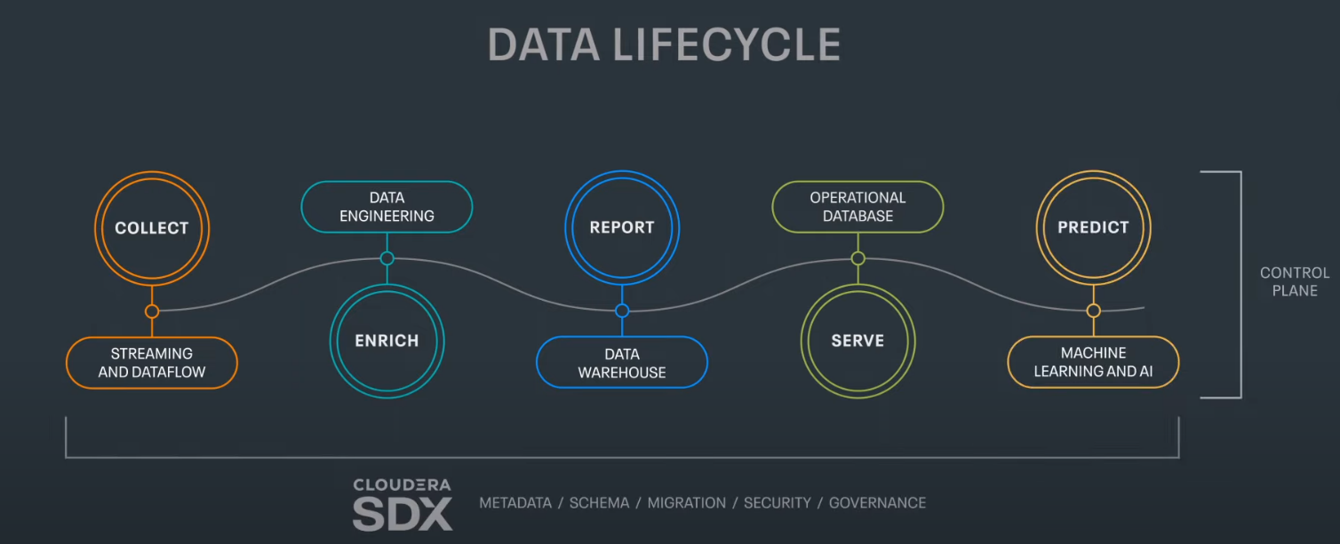
CLOUDERA
Cloudera Complete Data Life cycle

Slide 24
Simple Case Study: Marketing Analytics Optimization for "FashionHub"
FashionHub, a small online retailer specializing in trendy clothing and accessories, aims to enhance its marketing strategies by leveraging data analytics.
1. Data Collection
Sources: Website traffic logs, customer purchase history, email marketing data, social media engagement metrics.
Tools: Apache NiFi for seamless data ingestion.
2. Data Storage
Data Lake: Utilize CDP’s data lake capabilities to store structured and unstructured data efficiently.
3. Data Processing and Integration
Processing: Use Cloudera Impala for running SQL queries and data transformations.
Integration: Ensure all data is integrated into a centralized repository for easy access and analysis.

Slide 25
4. Data Analysis
Customer Segmentation: Segment customers based on purchasing behavior and demographics using SQL queries.
Trend Analysis: Analyze trends in website traffic, sales patterns, and customer engagement.
Campaign Performance: Evaluate the performance of different marketing campaigns by tracking key metrics like open rates, click-through rates, and conversions.
5. Reporting and Visualization
Dashboards: Create user-friendly dashboards using Cloudera Data Visualization tools.
Reports: Generate regular reports highlighting key findings and actionable insights.
6. Iterative Improvement
Feedback Loop: Continuously refine data collection and analysis processes based on insights and feedback.
A/B Testing: Implement A/B testing to compare the effectiveness of different marketing strategies.

Slide 26
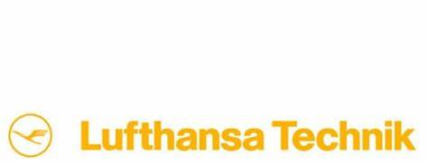
Cloudera Customer Experience: Lufthansa Technik
■ Lufthansa Technik
Uses Cloudera’s platform to optimizes aircraft availability and reliability
⁻ Provides its broad range of predictive services to 800 customers Observed a 40% decrease in component removal
⁻ Experience a significant reduction in airline operating costs
02-23

Slide 27
Lufthansa Technik: A Complex Use Case
Lufthansa Technik aims to optimize aircraft maintenance schedules, reduce downtime, and improve overall operational efficiency using data analytics.
Steps and Implementation:
1. Data Collection:
- Collect large volumes of data from various sources, including aircraft sensors, maintenance logs, flight operations data, and external data sources like weather information.
- Use Apache NiFi to ingest and manage data flows from these diverse sources in real-time.
2. Data Storage:
- Store the ingested data in Cloudera's data platform, utilizing a scalable data lake architecture that can handle both structured and unstructured data.

Slide 28
3. Data Processing and Analysis:
- Use Apache Spark and Apache Hive for processing and analyzing the data. This includes cleaning, transforming, and aggregating data to prepare it for advanced analytics.
- Implement machine learning models using Cloudera Machine Learning (CML) to predict potential equipment failures and optimize maintenance schedules.
4. Predictive Maintenance:
- Develop predictive maintenance algorithms to identify patterns and anomalies that indicate potential issues before they lead to equipment failures.
5. Operational Dashboards and Reporting:
- Use Cloudera Data Visualization to create interactive dashboards and reports that provide real-time insights into aircraft health, maintenance status, and operational performance.
6. Continuous Improvement:
- Continuously refine and update predictive models with new data to improve their accuracy and effectiveness.
- Use feedback from maintenance operations to enhance data analytics processes and outcomes.

Slide 29

Cloudera Customer Experience: Navistar
■ Navistar
_ Manufactures vehicles with predictive maintenance capabilities
_ Collects telematics and sensor data from more than 300,000 connected vehicles
_ Reports that predictive maintenance has reduced maintenance cost and downtime by 40%
02-24

Slide 30
Cloudera Data Platform Overview
■ Key Concepts
■ Cloudera Runtime
■ Core Services
■ Types of CDP Deployments
■ Custom Deployments with Data Hub
■ Self-Service Experiences
■ A Tour of the CDP User Interface
03-3

Slide 31
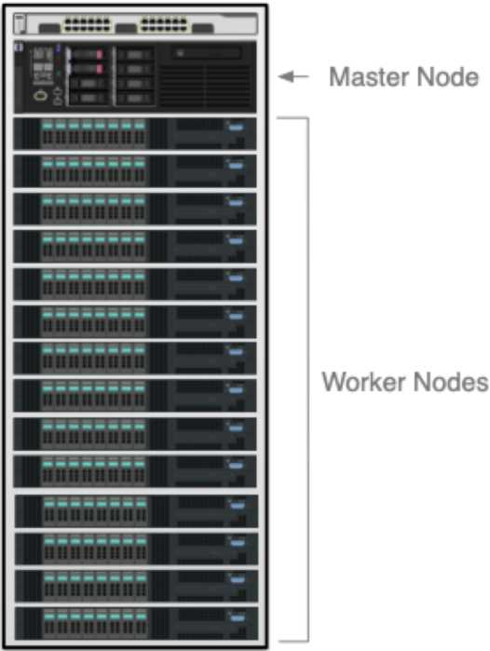
System Architecture: Running on Bare Metal
■ Deployed directly on server hardware
■ A cluster is a group of related servers
_ These servers are called nodes ~ Clusters may have thousands of nodes
■ There are two main types of nodes
_ Master (manages resources and status) _ Worker (performs the actual work)
■ Nodes both store and process data
_ Hadoop’s storage layer is called HDFS
03-4

Slide 32
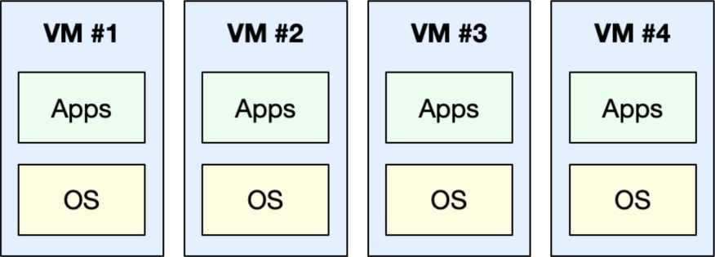
System Architecture: Virtualization
■ Virtualization abstracts away details of server hardware
_ Makes it possible to run multiple virtual machines (VMs) on a single server _ Each VM has its own operating system and applications
■ Amazon EC2 and Azure Virtual Machines are cloud services for VMs
Virtualization Software
Operating System
03-5

Slide 33
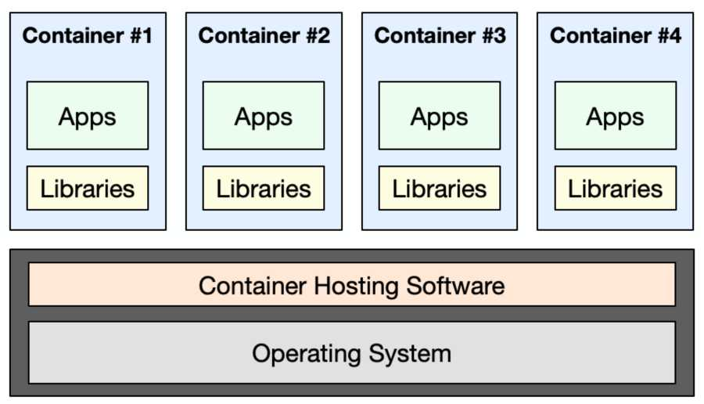
System Architecture: Cloud-Native Applications
■ Virtual machines work well, but consume a lot of resources
_ Each VM has its own complete operating system
■ Containerization offers a more efficient alternative to virtualization
_ Each container shares the underling operating system
03-6

Slide 34
Cloudera Data Platform Overview
■ Key Concepts
■ Cloudera data platform: Cloudera Runtime
■ Cloudera data platform: Core Services
■ Types of CDP Deployments
03-9

Slide 35
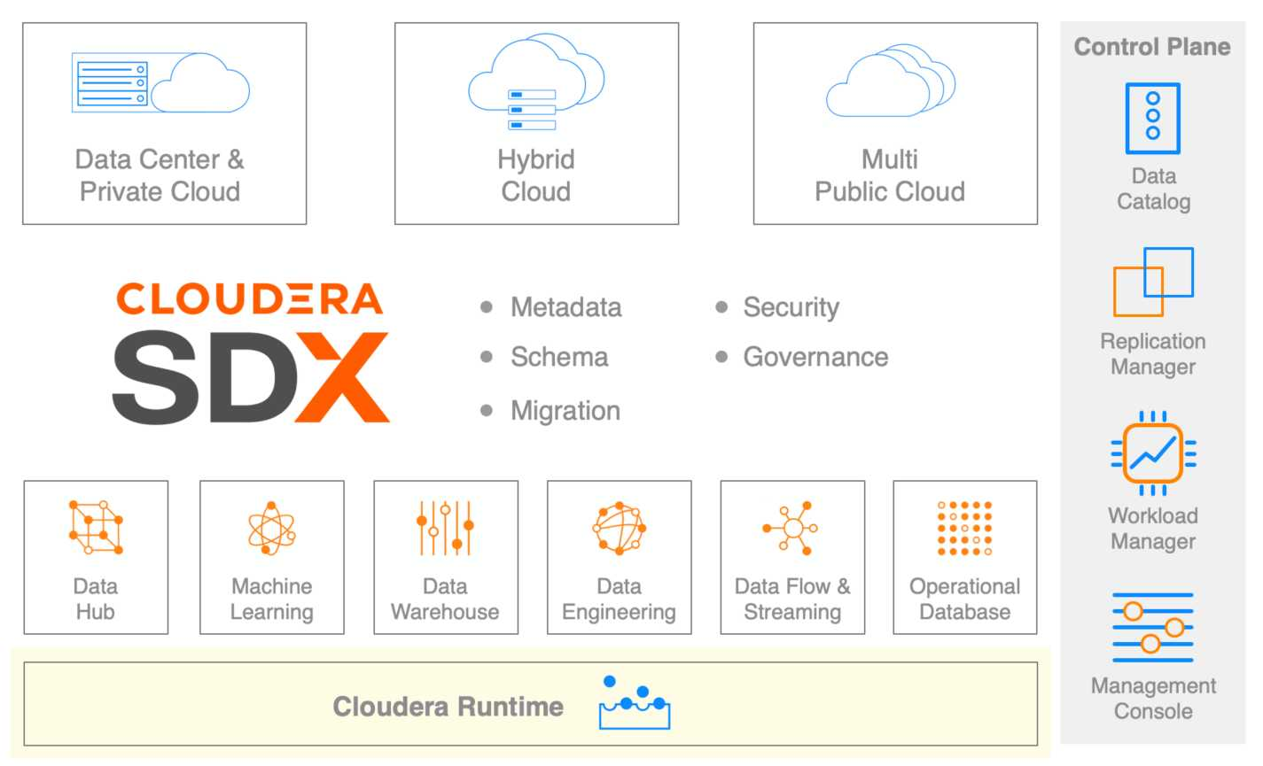
The Cloudera Data Platform: Cloudera Runtime

Slide 36

The Role of Cloudera Runtime
■ Open source distribution of Big Data components
■ Result of CDH and HDP convergence
■ The foundation of CDP
Cloudera Runtime is like a toolbox filled with open-source tools for handling big data tasks like storing, processing, and analyzing large volumes of data.

Slide 37
Cloudera Data Platform Overview
■ Key Concepts
■ Cloudera Runtime
■ Core Services
■ Types of CDP Deployments

Slide 38
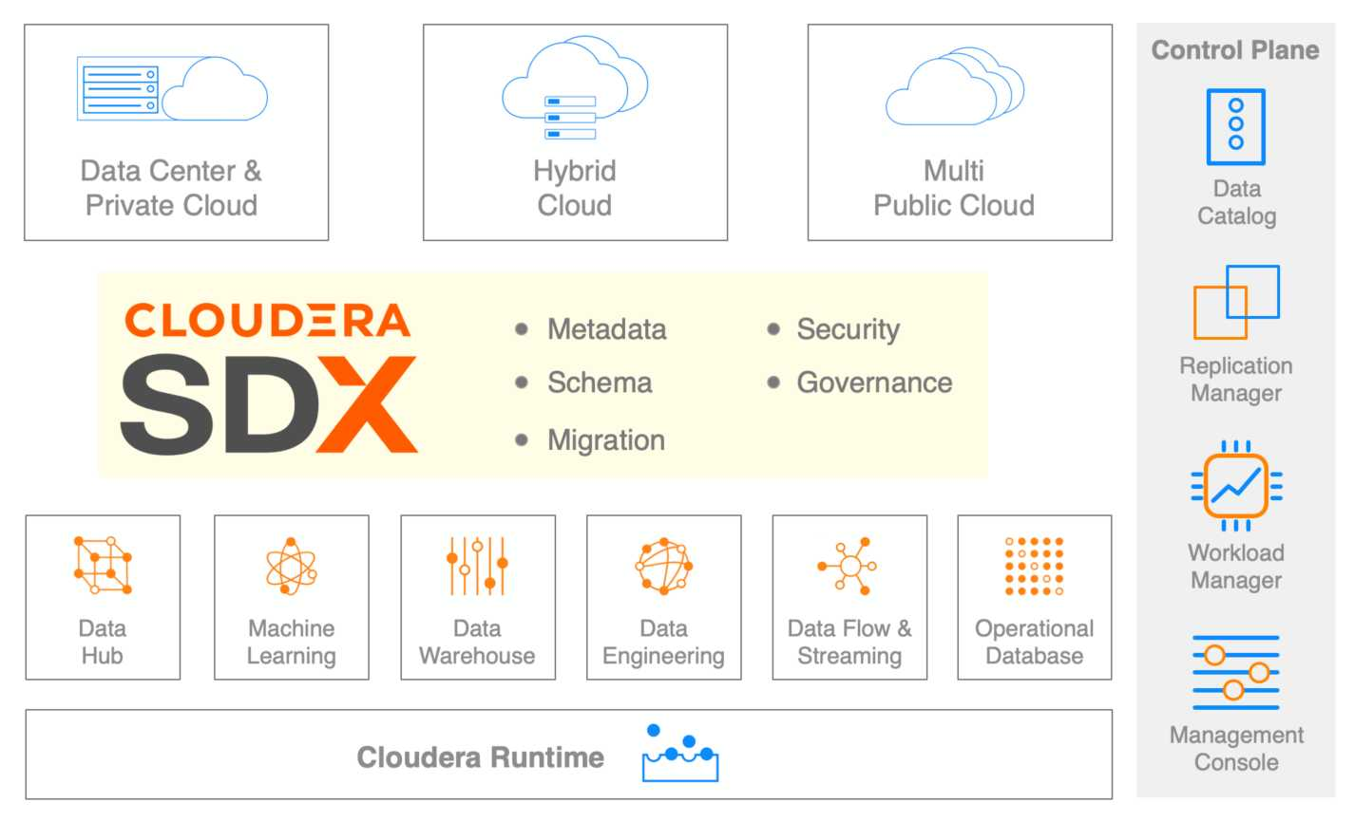
SDX

Slide 39
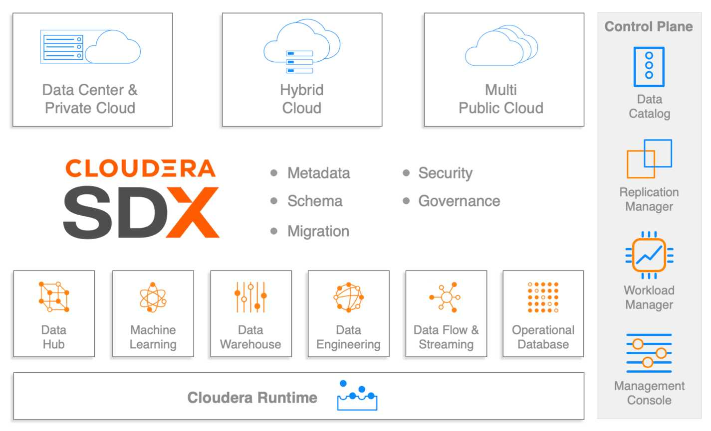
Control Plane

Slide 40
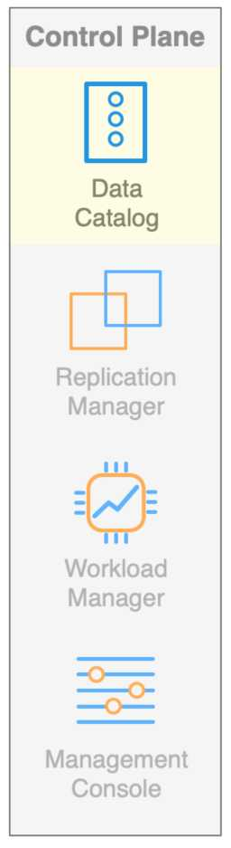
Data Catalog
■ Primarily intended for data stewards
A data catalog is like a library index for data, helping data stewards find, organize, and protect data assets.
03-16

Slide 41
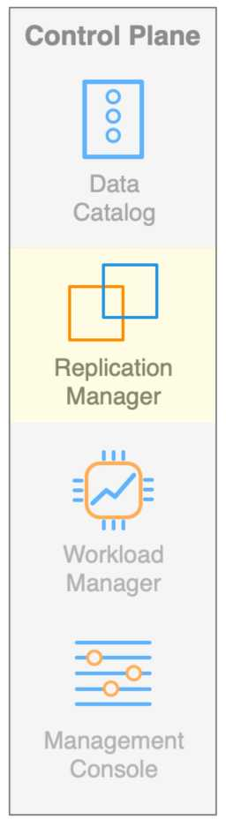
Replication Manager
■ Primarily intended for administrators
_ Used to replicate migrate data and metadata between environments

Slide 42
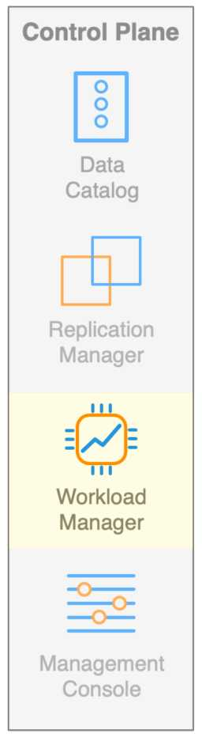
Workload Manager
■ Primarily intended for database administrators
_ Used to analyze, troubleshoot, and optimize workloads
03-18

Slide 43
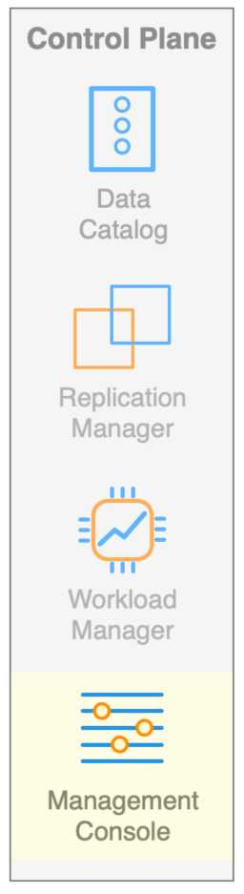
Management Console
■ Primarily intended for administrators
A management console is like a control center for administrators, offering a unified interface control all clusters within an organization.

Slide 44
Cloudera Data Platform Overview
■ Key Concepts
■ Cloudera data platform: Cloudera Runtime
■ Cloudera data platform: Core Services
■ Types of CDP Deployments
03-20

Slide 45
One Platform for Two Types of Deployments
■ CDP will be available in different formats
_ CDP Public Cloud
_ CDP Private Cloud
03-21

Slide 46
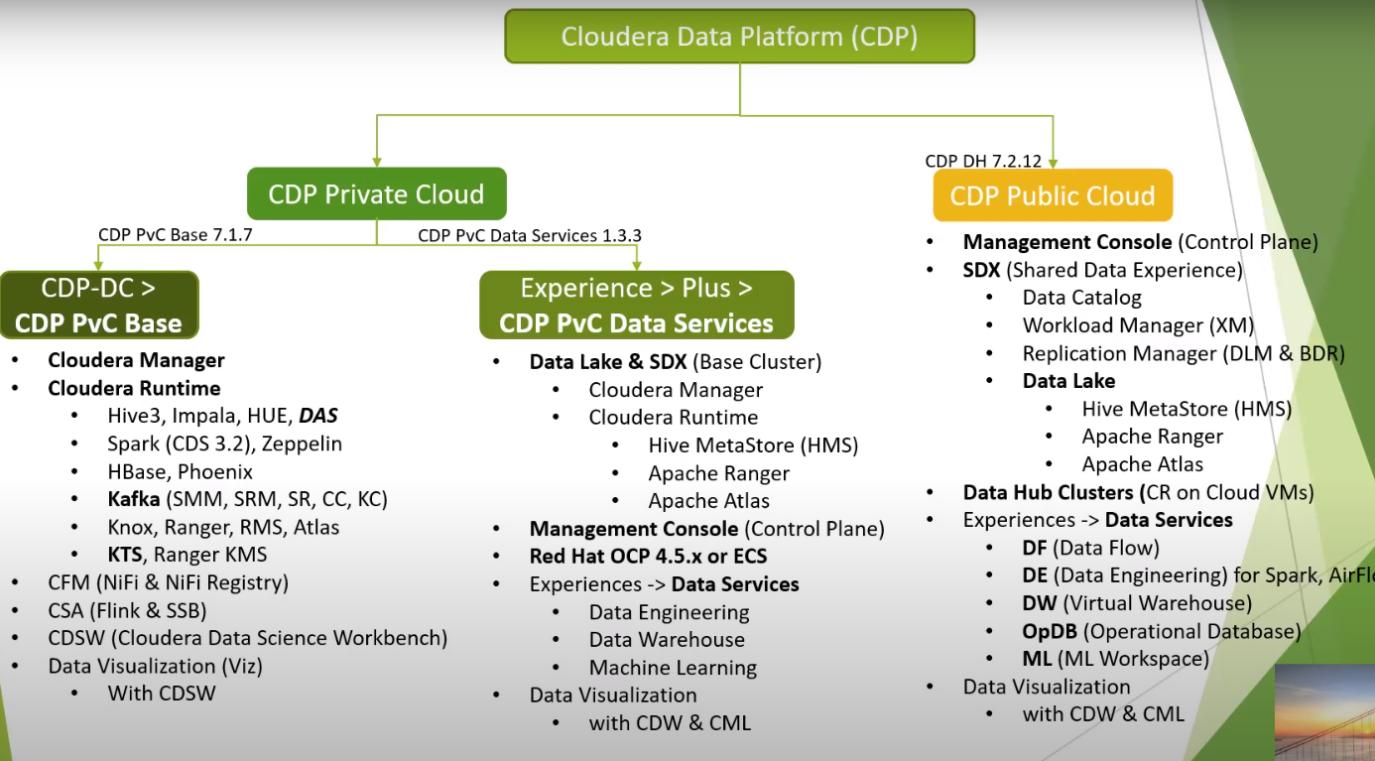

Slide 47
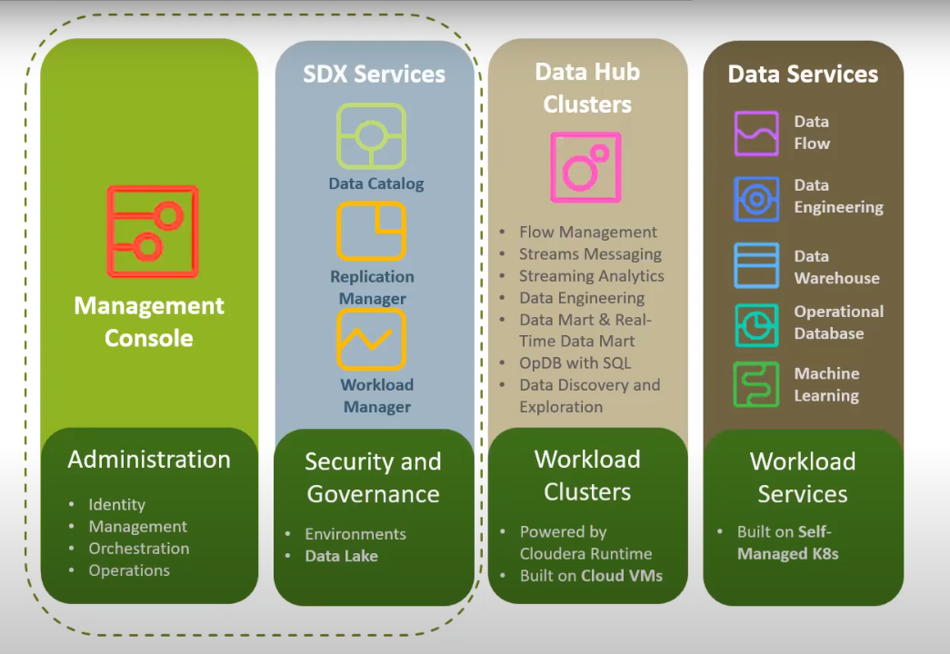
CDP Public Cloud
03-22

Slide 48
Comparing CDP Public Cloud to CDH and HDP
■ CDH and HDP favored “bare metal” installations
_ CDP Public Cloud is a cloud service
■ CDH and HDP collocated storage and compute on each node
_ CDP Public Cloud favors separating storage from compute
■ CDP Public Cloud is a great choice for intermittent or transient workloads
03-23

Slide 49
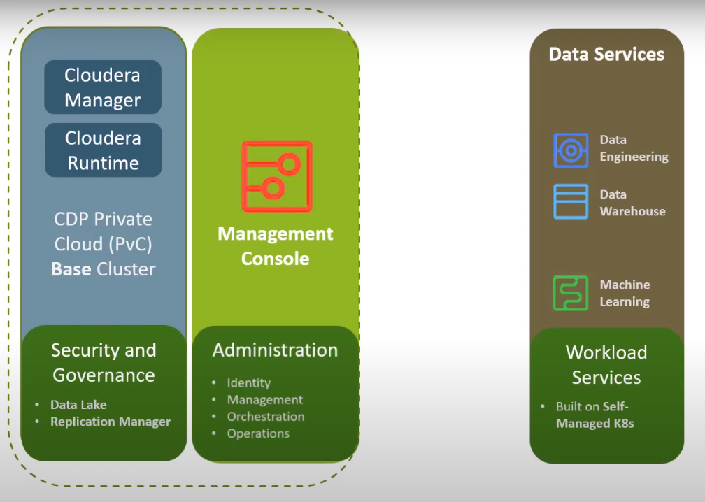
CDP Private Cloud
03-25

Slide 50
CLOUDERA
Data in Motion
In simple terms, "data in motion" in Cloudera refers to data that is actively being transferred from one location to another. This could include data being streamed from sources like sensors, social media feeds, or transaction logs to a central system for processing and analysis in real-time.

Slide 51
Data in Motion
■ Cloudera DataFlow
■ Essential Points
05-7

Slide 52
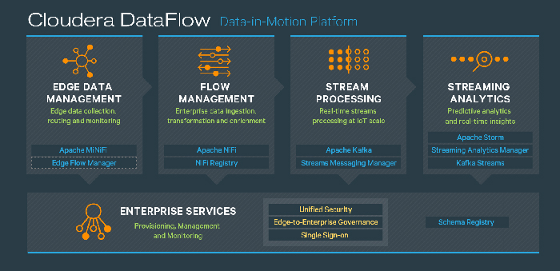
Cloudera Flow Management
Cloudera DataFlow Platform

Slide 53
Data in Motion
■ Cloudera DataFlow
■ Essential Points

Slide 54
Essential Points
■ Cloudera DataFlow Platform provides several capabilities to work with data
_ Edge Management: Collect, route, and monitor data from IoT devices
_ Flow Management: Ingest, transform, and enrich data from nearly any source
_ Stream Processing: Scalable messaging for streaming data use cases
_ Streams Management: Monitor, manage, and replicate stream processing systems
_ Streaming Analytics: Enable predictive analytics on streaming data
05-14

Slide 55
CLOUDERA
Data Warehousing and Analytics

Slide 56
Cloudera Data Warehouse
■ Cloudera Data Warehouse provides self-service experience.
_ Optimized for data warehouse and data mart workloads _ Available in CDP Public Cloud and CDP Private Cloud
■ Virtual warehouses maintain high performance through isolation
_ SDX allows safe access to shared data with consistent security and governance
_ Manages cost and performance through auto-scaling and auto-suspend features
06-8

Slide 57
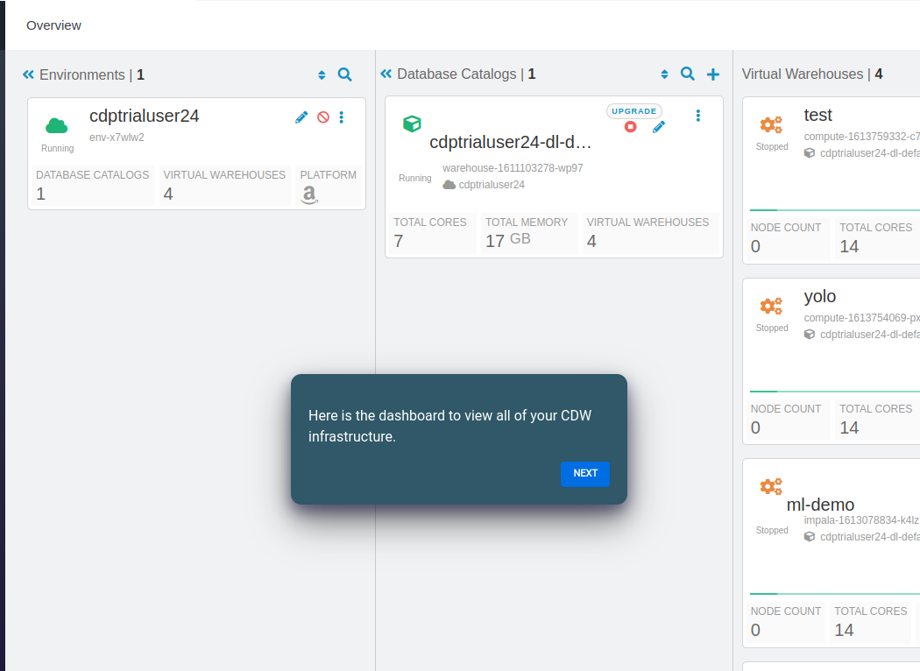

Slide 58
CLOUDERA
Data Science and Machine Learning

Slide 59
Data Science and Machine Learning
■ Cloudera Data Science Workbench (CDSW)
■ Cloudera Machine Learning
■ Cloudera Fast Forward Labs
07-7

Slide 60
Cloudera Data Science Workbench
■ CDSW allows multiple data scientists to work together on big projects.
■ Provides data science teams with web-based access to a secure cluster
_ Users can start working on data science tasks immediately without having to install any special software on their computers.
_ everyone gets fair share of the resources.
_ Each user's work session is kept separate.
07-8

Slide 61
Data Science and Machine Learning
■ Cloudera Data Science Workbench (CDSW)
■ Cloudera Machine Learning
■ Cloudera Fast Forward Labs
07-9

Slide 62
Cloudera Machine Learning
■ Provides data scientists with self-service access to governed data
■ Fosters collaboration among data scientists
■ Delivers a consistent experience

Slide 63
Data Science and Machine Learning
■ Cloudera Data Science Workbench (CDSW)
■ Cloudera Machine Learning
■ Cloudera Fast Forward Labs

Slide 64
Cloudera Fast Forward Labs
■ Cloudera Fast Forward Labs, led by expert Hilary Mason and acquired by Cloudera in 2017, helps businesses apply new machine learning techniques to solve real-world problems. They provide advice, strategy, and research reports to bridge the gap between academic research and practical industry applications.

Slide 65
Thank
You.

Slide 66
QUESTIONS
Q1: What is the primary focus of Cloudera's solutions?
Ans: Cloudera focuses on providing a comprehensive data platform that supports the entire data lifecycle, from data ingestion to analysis and machine learning.
Q2: What does 'Data in Motion' refer to in the context of Cloudera?
Ans: 'Data in Motion' refers to the real-time processing and streaming of data as it flows through an organization’s systems, enabling timely insights and actions.
Q3: Which cloudera tools used during the complete data lifecycle steps?
Data Ingestion:
Apache NiFi: Used for data flow management and automation (data in motion).
Apache Kafka: Used for real-time data streaming and ingestion.
Data Storage:
Hadoop Distributed File System (HDFS): Provides scalable and reliable storage.
Apache HBase: A scalable, distributed database for structured data.
Data Processing:
Apache Spark:Used for large-scale data processing and analytics.
Apache Hive: Provides a data warehouse infrastructure and supports SQL-like queries.
Data Analysis:
Cloudera Data Warehouse (CDW): Supports complex queries and data warehousing.
Apache Impala: Enables high-performance SQL queries on large datasets.
Machine Learning:
Apache Spark MLlib:A machine learning library integrated with Spark.era runtime to provide security and governance.

Slide 67
Q4: What is cloudera runtime?
It is an Open source distribution of Big Data components
Result of open source tools of CDH and HDP convergence
The foundation of CDP
Cloudera Runtime is like a toolbox filled with open-source tools for handling big data tasks like storing, processing, and analyzing large volumes of data.
Q5: What is mean by muti-function :edge to AI characteristic of the cloudera?
It means Cloudera's platform supports various data functions, from capturing data at the source (edge) to advanced analytics and AI, all within a single, integrated system.
Q6: What functionalities cloudera sdx provides?
It provides these functionalities:
meta data, schema, security, governance and migration.
Q7: What are the two types of cdp deployments and how security and governance provided in them?
Two types of cdp deployments are
Cloudera Public Cloud: Sdx services includes data catalogue, replication manager and workload manager for providing the security and governance.
Cloudera Private Cloud: While it combines cloudera manager and cloudera runtime to provide security and governance.
Q8: Define cloudera fast forward labs?
Cloudera Fast Forward Labs, led by expert Hilary Mason and acquired by Cloudera in 2017, helps businesses apply new machine learning techniques to solve real-world problems. They provide advice, strategy, and research reports to bridge the gap between academic research and practical industry applications.

