Slide 1
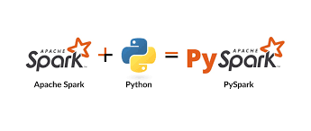
Parallel Processing and Pyspark
Course: Big Data Analytics
Instructor: Dr. Adnan Abid
Presenters:
Muhammad Ibrahim (MSDSF22M028)
Imran Nazir (MSDSF22M002)

Slide 2
Journey
Parallel Processing
Apache Spark
Introduction of PySpark
Installation & Setup
PySpark Data Structures
Hands on PySpark

Slide 3
Parallel Processing
Apache Spark
Introduction of PySpark
Installation & Setup
PySpark Data Structures
Hands on PySpark

Slide 4
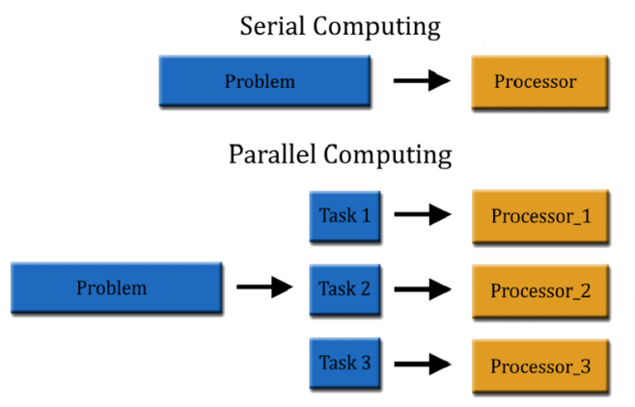
Parallel Processing
Parallel processing refers to the simultaneous execution of multiple tasks (processes) on multiple processors or cores within a computer to achieve faster computational speeds.
Objective
To reduce the execution time of large-scale computations by dividing tasks into smaller, concurrent sub-tasks.

Slide 5
Parallel Processing
Apache Spark
Introduction of PySpark
Installation & Setup
PySpark Data Structures
Hands on PySpark

Slide 6
Apache Spark:
An open-source unified analytics engine used for large-scale.
It a popular choice for processing large-scale data sets.
Spark runs operations on billions and trillions of data on distributed. clusters 100 times faster than traditional applications.
Spark can run on single-node machines or multi-node machines(Cluster).
Apache Spark can also process real-time streaming
It is also a multi-language engine, that provides APIs (Application Programming Interfaces) and libraries for several programming languages like Java, Scala, Python, and R.

Slide 7
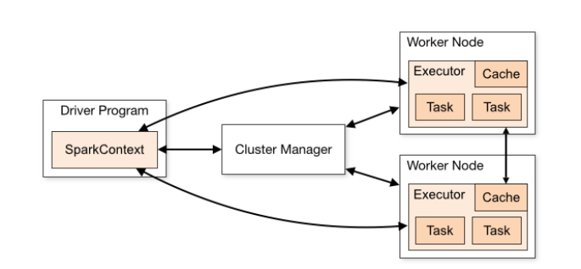
Apache Spark Architecture

Slide 8
PySpark architecture consists of:
Driver program
That coordinates tasks and interacts with a cluster manager to allocate resources. The driver communicates with worker nodes, where tasks are executed within an executor’s JVM.
SparkContext
Manages the execution environment, while the DataFrame API enables high-level abstraction for data manipulation.
SparkSession provides a unified entry point for Spark functionality. Underneath, the cluster manager oversees resource allocation and task scheduling across nodes, facilitating parallel computation for processing large-scale data efficiently
Cluster Managers
Are responsible for resource allocation and task scheduling across nodes in a distributed computing environment

Slide 9


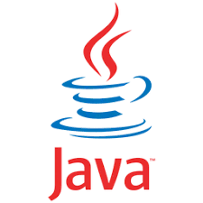

Multi-Language Engine
Spark SQL
Spark Streaming
Mllib (Machine Learning)
GraphX (Graph Computation)

Slide 10
Python API for Spark (PySpark)
Spark SQL
Spark Streaming
MLlib (Machine Learning)
GraphX (Graph Computation)
Python API for Spark (PySpark)

Slide 11
Parallel Processing
Apache Spark
Introduction of PySpark
Installation & Setup
PySpark Data Structures
Hands on PySpark

Slide 12
PySpark
PySpark is the Python API for Apache Spark.
PySpark enables developers to write Spark applications using Python, providing access to Spark’s rich set of features and capabilities through Python language.
It supports Apache Spark's various features, including its machine learning library (MLlib), DataFrames, and SparkSQL.
Using PySpark, you can also transition between Apache Spark and Pandas, perform stream processing and streaming computation, and interface with Java virtual machine (JVM) objects.

Slide 13
Why PySpark?
Easy to learn
Distributed Computing
Active Community
Why PySpark
Machine Learning Capabilities
Better Code Readability

Slide 14
Parallel Processing
Apache Spark
Introduction of PySpark
Installation & Setup
PySpark Data Structures
Hands on PySpark

Slide 15
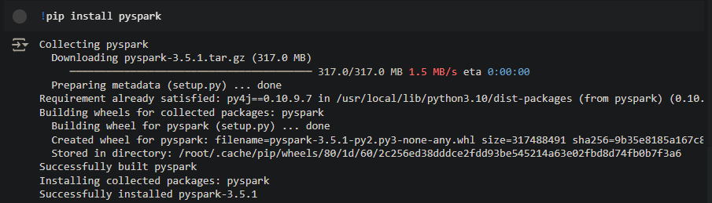
Quick Installation on Google Collaboratory

Slide 16
Parallel Processing
Apache Spark
Introduction of PySpark
Installation & Setup
PySpark Data Structures
Hands on PySpark

Slide 17
PySpark RDD – Resilient Distributed Dataset
Fundamental data structure that is fault-tolerant, immutable, and distributed collections of objects. RDDs are immutable.
Any transformation on an RDD results in a new RDD.
Each dataset in RDD is divided into logical partitions, which can be computed on different nodes of the cluster.
RDD Creation
In order to create an RDD, first, you need to create a SparkSession which is an entry point to the PySpark application.
SparkSession can be created using a builder() or newSession() methods of the SparkSession.

Slide 18
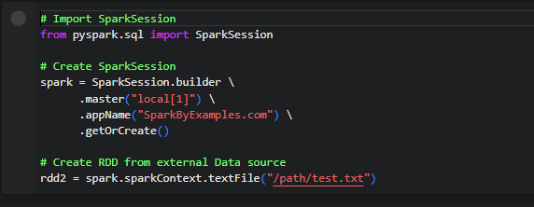
Spark session internally creates a sparkContext variable of SparkContext. You can create multiple SparkSession objects but only one SparkContext per JVM.
In case you want to create another new SparkContext, you should stop the existing Sparkcontext (using stop()) before creating a new one.

Slide 19
Parallel Processing
Apache Spark
Introduction of PySpark
Installation & Setup
PySpark Data Structures
PySpark
Case Study

Slide 20
PySpark Fundamentals and Comparison Case Study
https://colab.research.google.com/drive/1noFYykNMxwkBVPtgXrumlsaPTBzBJZoG?usp=sharing
Performance Comparison
Model Name | Google Colab Processing Time (Seconds) | PySpark Processing TIme (Seconds)
Logistic Regression | 3.064 | 116.217
Decision Tree | 35.251 | 91.291
Random Forest Classifier | 420.312 | 115.143
Gradient Boosting Classifier | 952.241 | 227.006

