Slide 1


Amazon Web Services
MSDSF22M006 Qandeel Fatima
MSDSF22M017 Shabana Allah Ditta

Slide 2

What is Cloud Computing?
Cloud computing is on-demand delivery of IT resources like compute power, storage, databases, networking, software, analytics, intelligence, and more over the internet with pay-as-you-go pricing.
Offers scalability and flexibility
Eliminates the need to manage physical infrastructure

Slide 3
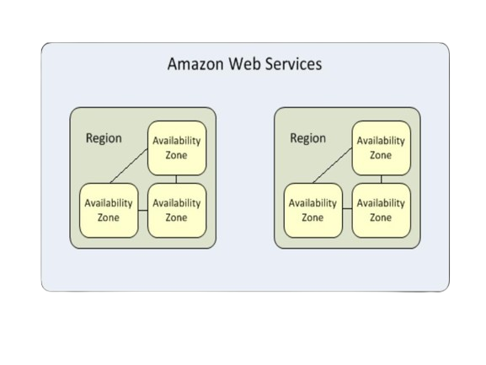
Why AWS?
The world’s most comprehensive and broadly adopted cloud platform
Offers a wide range of services to meet diverse business needs
Scalability to handle fluctuating workloads
High level of security and reliability
Pay-as-you-go pricing model for cost efficiency
Global infrastructure with high availability

Slide 4
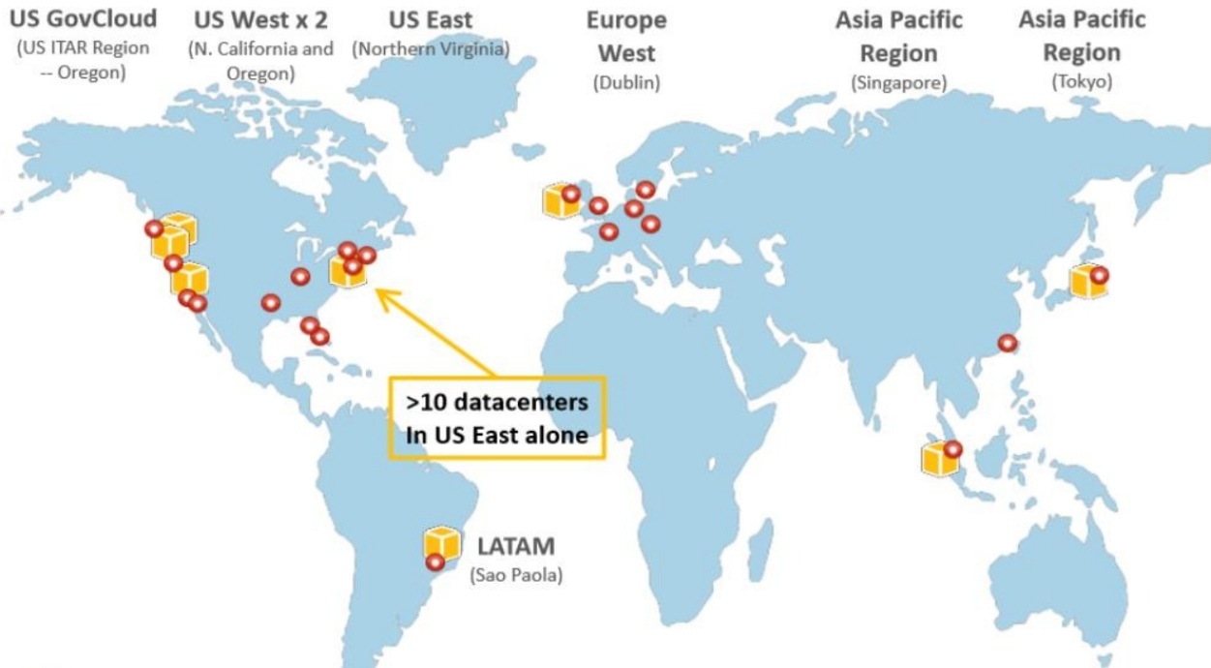
AWS Data Center
8 AWS regions and growing
21 AWS edge location for CDN and DNS

Slide 5
Key AWS Services
Amazon Web Services Cloud Platform provides services for
Compute
Networking
Storage
Content Delivery
Database
Deployment and Management
Application Services

Slide 6
Key AWS Services
Amazon EC2 (Elastic Compute Cloud): Provides virtual servers in the cloud for running various applications.
Amazon S3 (Simple Storage Service): Highly scalable storage solution for data of any kind – objects, archives, backups, etc.
Amazon RDS (Relational Database Service): Manages a variety of relational databases like MySQL, PostgreSQL, and Aurora.
Amazon DynamoDB: NoSQL database service for high performance and scalability for big data applications.

Slide 7
Key AWS Services
Amazon CloudFront: Content Delivery Network (CDN) for fast and secure delivery of content to users globally.
Amazon Lambda: Serverless compute service for running code without provisioning or managing servers
Amazon SQS (Simple Queue Service): Messaging service for decoupling applications and ensuring reliable message delivery.
Amazon SNS (Simple Notification Service): Provides push notifications to mobile devices and other applications.
Amazon Kinesis: Real-time data streaming service for processing and analyzing large data streams.

Slide 8
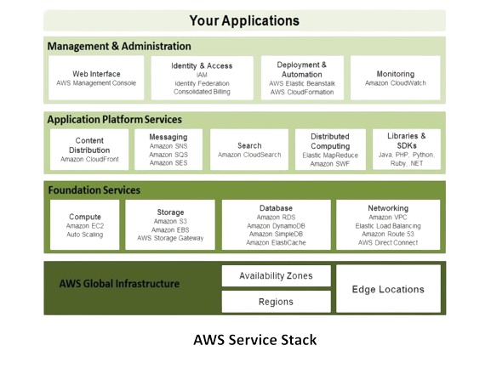
AWS
-

Slide 9

Amazon Elastic Compute Cloud (EC2)

Slide 10
Amazon Elastic Compute Cloud (EC2)
Amazon Elastic Compute Cloud (EC2) is a web service that provides secure, resizable compute capacity in the cloud.
EC2 allows users to launch virtual servers (instances) on-demand, enabling them to scale computing resources up or down based on their needs.
EC2 is designed for flexibility, making it suitable for a range of applications such as web hosting, data processing, and machine learning.
Amazon Machine Images (AMIs) are the basic building blocks of Amazon EC2.
An AMI is a template that contains a software configuration (operating system, application server and applications) that can run on Amazon’s computing environment.
AMIs can be used to launch an instance, which is a copy of the AMI running as a virtual server in the cloud.

Slide 11
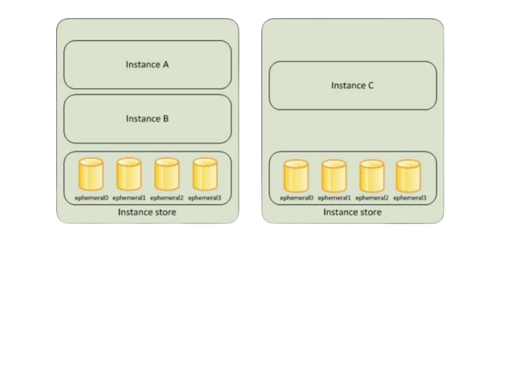
EC2 Instance store
.

Slide 12
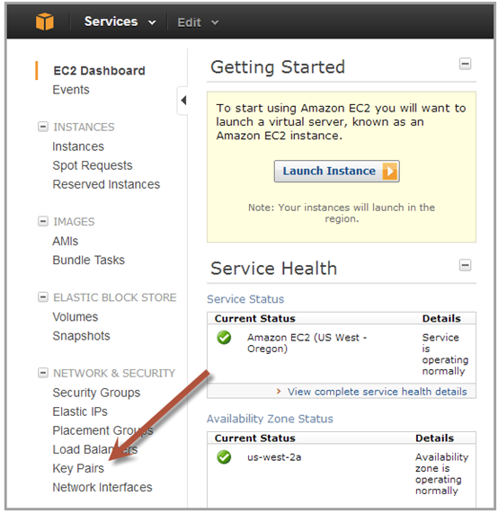
Getting Started with Amazon EC2
Step 1: Sign up for Amazon EC2
Step 2: Create a key pair
Step 3: Launch an Amazon EC2 instance
Step 4: Connect to the instance
Step 5: Customize the instance
Step 6: Terminate instance and delete the volume created

Slide 13
Key Features of Amazon EC2
Resizable Compute Capacity
Easily scale instances up or down based on demand.
Wide Selection of Instance Types
Choose from a variety of instance types optimized for different tasks.
Auto Scaling and Load Balancing
Automatically adjust capacity to maintain steady, predictable performance.
Security and Compliance
Secure infrastructure with compliance certifications and encryption.

Slide 14
Use Cases of EC2
Web Hosting:
Host scalable websites and web applications.
Use Elastic Load Balancing to distribute traffic and ensure high availability.
Big Data Analytics:
Process and analyze large volumes of data.
Integrate with other AWS services like Amazon S3, Amazon RDS, and Amazon Redshift.
Machine Learning:
Train and deploy machine learning models.
Use GPU instances to accelerate training.
High Performance Computing (HPC):
Run large-scale compute-intensive tasks.
Utilize clusters of instances for simulations, scientific computing, and financial modeling.

Slide 15
Key Features of Amazon EC2
Resizable Compute Capacity
Easily scale instances up or down based on demand.
Wide Selection of Instance Types
Choose from a variety of instance types optimized for different tasks.
Auto Scaling and Load Balancing
Automatically adjust capacity to maintain steady, predictable performance.
Security and Compliance
Secure infrastructure with compliance certifications and encryption.

Slide 16

Amazon Simple Storage Service (Amazon S3)

Slide 17
S3
It's an object storage service, meaning it stores data as objects that can contain anything from a simple file to a complex database.
Here are some key features of Amazon S3:
Scalability: S3 can store any amount of data, from a few megabytes to petabytes.
Durability: S3 offers high durability for your data, with Amazon guaranteeing 99.999999999% (11 nines) of data durability.
Security: S3 provides a variety of security features to control access to your data.
Performance: S3 offers high performance for data access, making it suitable for a variety of applications.

Slide 18
Key Features of Amazon S3
Storage Classes:
Standard: General-purpose storage with high durability.
Intelligent-Tiering: Automatic cost savings by moving data between two access tiers.
Standard-IA: Infrequent access storage with lower cost.
One Zone-IA: Lower-cost option for infrequently accessed data stored in a single availability zone.
Glacier: Low-cost storage for data archiving.
Glacier Deep Archive: Lowest-cost storage for long-term data retention.
Buckets and Objects:
Buckets: Containers for storing objects.
Objects: The actual data stored in S3, identified by a unique key within a bucket.
Versioning:
Maintain multiple versions of objects to protect against accidental deletion or overwrites.

Slide 19
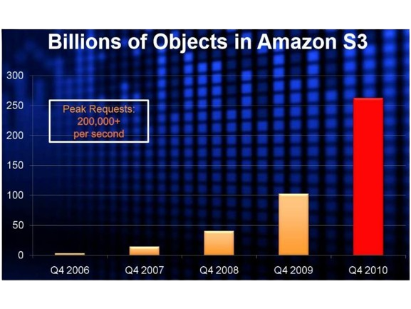
-
.

Slide 20
Data Management and Access Control in Amazon S3
Lifecycle Policies:
Automate the transition of objects to different storage classes.
Define actions such as transitioning objects to cheaper storage or deleting them after a specified time.
Access Control:
Bucket Policies: Define permissions for all objects within a bucket.
Access Control Lists (ACLs): Set permissions at the individual object level.
IAM Policies: Define permissions for users and groups within your AWS account.
Encryption:
Server-Side Encryption (SSE): Encrypts data at rest using AWS-managed keys (SSE-S3), AWS Key Management Service (SSE-KMS), or customer-provided keys (SSE-C).
Client-Side Encryption: Encrypts data client-side before uploading to S3.

Slide 21
Use Cases
Backup and Restore:
Use S3 for reliable and secure backup storage.
Implement disaster recovery solutions.
Content Storage and Distribution:
Store and distribute static content (e.g., images, videos).
Integrate with Amazon CloudFront for content delivery.
Data Lakes and Big Data Analytics:
Build data lakes for storing vast amounts of structured and unstructured data.
Integrate with AWS analytics services like Amazon Athena, Amazon Redshift, and Amazon EMR.
Archiving:
Long-term archiving with Amazon S3 Glacier and S3 Glacier Deep Archive.

Slide 22
Amazon Simple Storage Service (Amazon S3)

Slide 23
Amazon Athena
Amazon Athena is an interactive query service that makes it easy to analyze data in Amazon S3 using standard SQL. Athena is serverless, so there is no infrastructure to manage, and you pay only for the queries you run.
As a serverless offering, Athena eliminates the need for managing infrastructure, allowing users to focus solely on querying their data without the overhead of provisioning or scaling clusters.
With its robust capabilities, Athena empowers businesses to derive actionable insights swiftly from vast datasets stored in Amazon S3, making it a preferred choice for data analysts and engineers alike.

Slide 24
Key Features of Amazon Athena
Serverless:
No need to manage infrastructure.
Standard SQL:
Use familiar SQL queries.
Data Formats:
Supports CSV, JSON, ORC, Avro, Parquet.
Integration:
Works with AWS Glue for metadata management.
Pay-Per-Query:
Cost-effective, pay only for the data scanned.

Slide 25
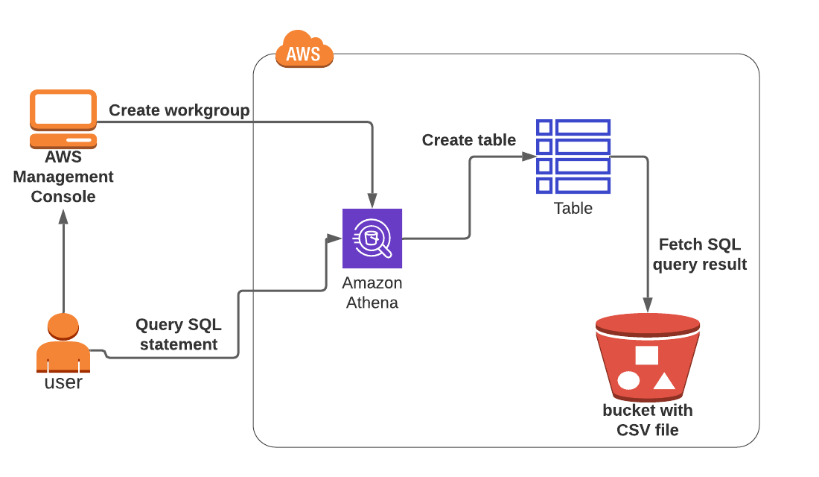
Use Case: Log Analysis
Storing Logs in S3:
Store application logs, web server logs, and other logs in Amazon S3.
Querying Logs with Athena:
Use SQL queries to analyze logs for patterns, trends, and insights.

Slide 26

AWS Identity and Access Management (IAM)

Slide 27
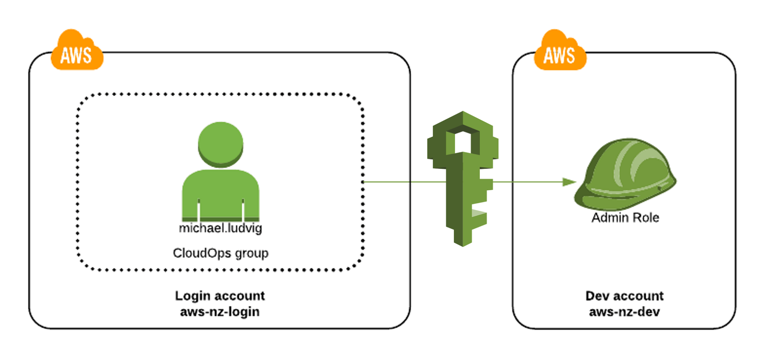
AWS IAM
AWS Identity and Access Management (IAM) enables you to manage access to AWS services and resources securely.
Allows you to create and manage AWS users and groups, and use permissions to allow and deny their access to AWS resources.

Slide 28
AWS Identity and Access Management (IAM) enables you to manage access to AWS services and resources securely.
Allows you to create and manage AWS users and groups, and use permissions to allow and deny their access to AWS resources.
AWS Identity and Access Management (IAM) enables you to manage access to AWS services and resources securely.
Allows you to create and manage AWS users and groups, and use permissions to allow and deny their access to AWS resources.
Key Features of AWS IAM
Granular Permissions: Fine-grained access control to AWS services and resources.
Multi-Factor Authentication (MFA): Enhance security with MFA.
Role-Based Access: Create roles with specific permissions for different tasks.
Temporary Security Credentials: Issue short-term credentials for IAM roles.
Centralized Management: Manage access and permissions centrally across your AWS environment.

Slide 29
IAM Users, Groups, Roles, Policies
IAM Users and Groups:
IAM Users: Represent individuals or applications that interact with AWS services.
IAM Groups: Collection of IAM users managed as a single entity.
Permissions: Assign permissions to users and groups using policies.
IAM ROLES:
Roles: Assign permissions to entities you trust without creating individual IAM users.
Assume Role: Allow users or services to assume roles for accessing AWS resources.
Use Cases: Ideal for granting permissions to AWS services, cross-account access, or federated users.
IAM Policies:
Policies: JSON documents that define permissions.
Managed Policies: AWS provides predefined policies that you can attach to users, groups, or roles.
Inline Policies: Custom policies embedded directly in a user, group, or role.
Policy Structure: Statements defining actions, resources, and conditions.

Slide 30

AWS Lambda

Slide 31
AWS Lambda
AWS Lambda is a serverless compute service that lets you run code without provisioning or managing servers.
You pay only for the compute time you consume—there are no charges when your code is not running.
Automatically scales your application by running code in response to each trigger.
Simplifies backend code execution for web, mobile, and IoT applications. Executes code in response to events from various AWS services.

Slide 32
How its works:
Supported Languages: AWS Lambda supports multiple programming languages including Node.js, Python, Ruby, Java, Go, and .NET Core.
Execution Duration: Lambda functions can run up to a maximum of 15 minutes per invocation.
Resource Allocation: Configure memory allocation between 128 MB to 10 GB. CPU power and other resources scale proportionally with the memory.
Concurrency: AWS Lambda can handle tens of thousands of concurrent function executions.
Integration: Works with over 200 AWS services like S3, DynamoDB, Kinesis, SNS, and API Gateway.
Invocation Types: Supports synchronous (wait for response) and asynchronous (fire and forget) execution models.
Development Tools: AWS provides SDKs, CLI tools, and integrated development environments (IDEs) for efficient function development, deployment, and management.
Security: Use AWS IAM roles to securely grant Lambda functions permissions to access other AWS services. Environment variables can be encrypted with AWS KMS.

Slide 33
Key Features
Serverless:
No server management.
Scalability:
Automatically scales your application by running code in response to triggers.
Event-Driven:
Respond to events from over 200 AWS services and SaaS applications.
Supports Multiple Languages:
Node.js, Python, Java, Ruby, Go, and .NET Core.
Pay-Per-Use:
Pay only for the compute time you use.

Slide 34
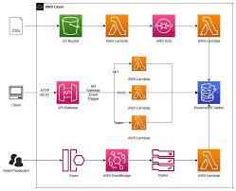
Use Cases for AWS Lambda
Data Processing:
Process real-time streams from Kinesis or DynamoDB.
Real-Time File Processing:
Trigger functions to process files uploaded to S3.
Web Applications:
Build serverless backends using API Gateway and Lambda.
Automation:
Automate operational tasks using CloudWatch Events.

Slide 35

AWS Glue

Slide 36
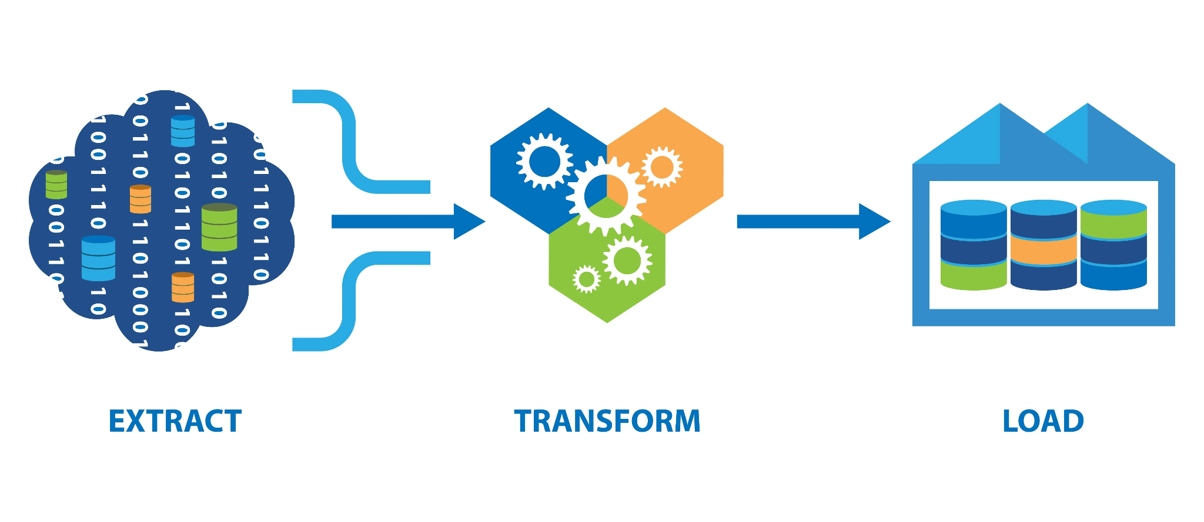
AWS Glue
AWS Glue is a fully managed ETL (Extract, Transform, Load) service that makes it easy to prepare and load data for analytics.
Automates the process of data discovery, cataloging, and schema generation.
Designed to work with data lakes and data warehouses.

Slide 37
Key Features
Serverless:
No infrastructure to manage; automatically scales to handle the workload.
Integrated Data Catalog:
Central repository to store metadata.
Automated Data Discovery:
Crawlers automatically scan and catalog data.
Job Scheduling:
Schedule ETL jobs to run at specific times or trigger them based on events.
Support for Various Data Sources:
Works with data in Amazon S3, RDS, Redshift, and other sources.

Slide 38
Integration with Other AWS Services
Amazon S3: Store and retrieve data used in ETL jobs.
Amazon RDS: Extract and load data from/to relational databases.
Amazon Redshift: Transform and load data into Redshift for analytics.
AWS Lambda: Trigger Glue jobs using AWS Lambda functions.
AWS IAM: Secure access and manage permissions for Glue jobs and resources.

Slide 39
Use Cases for AWS Glue
Data Warehousing:
Prepare and load data into data warehouses for BI and analytics.
Data Lakes:
Build and manage data lakes with automated data discovery and cataloging.
Log Processing:
Transform and analyze log data stored in Amazon S3.
Machine Learning:
Prepare and preprocess data for machine learning models.
Data Migration:
Migrate data between different databases and data stores.

Slide 40

Amazon Relational Database Service (Amazon RDS)

Slide 41
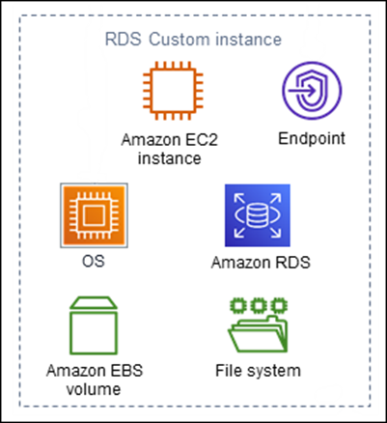
Amazon RDS
Amazon RDS (Relational Database Service) is a fully managed relational database service.
Supports multiple database engines including MySQL, PostgreSQL, MariaDB, Oracle, and SQL Server.
Simplifies database administration tasks such as backups, patching, and scaling.

Slide 42
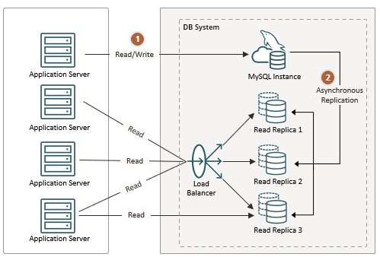
Key Features of Amazon RDS
Multiple Engine Support: MySQL, PostgreSQL, MariaDB, Oracle, and SQL Server.
Automated Backups: Scheduled automatic backups and user-initiated backups.
Patching: Automatic software patching.
High Availability: Multi-AZ (Availability Zone) deployments for fault tolerance.
Read Replicas: Scale read-heavy workloads with read replicas.

Slide 43
Database Engines Supported
MySQL: Popular open-source database, ideal for web applications.
PostgreSQL: Advanced open-source database with extensive features.
MariaDB: Community-developed fork of MySQL with additional features.
Oracle: Enterprise-grade database with robust features.
SQL Server: Microsoft's enterprise database, widely used in corporate environments.

Slide 44
Monitoring and Performance Tuning
Amazon CloudWatch: Monitor RDS instance metrics such as CPU utilization, storage space, and I/O activity.
Performance Insights: Visualize database performance and identify bottlenecks.
Enhanced Monitoring: Provides real-time metrics for the operating system that your DB instance runs on.
DB Parameter Groups: Tune database parameters for optimal performance.

Slide 45
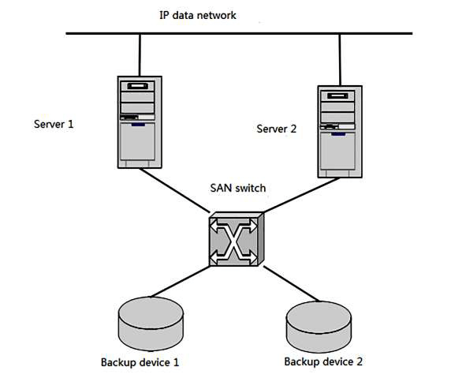
Backup and Recovery
Automated Backups:
Daily backups with a user-defined retention period.
Transaction logs are captured and retained for point-in-time recovery.
Manual Snapshots:
Create and manage snapshots manually for specific use cases.
Snapshots can be shared between AWS accounts.
Point-In-Time Recovery:
Restore a database instance to any second within the retention period.

Slide 46
Getting Started with Amazon RDS
Step 1: Sign in to the AWS Management Console.
Step 2: Choose RDS from the services menu and create a new database instance.
Step 3: Select the database engine and configure the instance settings.
Step 4: Set up security and network configurations.
Step 5: Launch the instance and connect to the database.

Slide 47
Use Cases for Amazon RDS
Web Applications: Scalable and reliable database backend for web applications.
Mobile Applications: Managed databases for mobile application data storage.
E-commerce Platforms: High availability and scalability for e-commerce applications.
Analytics: Store and analyze relational data for business intelligence.
Enterprise Applications: Secure and compliant database solutions for enterprise applications.

Slide 48
Security in AWS
Shared security model: AWS is responsible for the security of the cloud infrastructure, while you are responsible for the security of your data and applications running on AWS.
Extensive security features: AWS offers a wide range of security features to help you secure your data and applications, including encryption, access controls, identity and access management (IAM), and security best practices.
Compliance certifications: AWS is compliant with a wide range of industry standards and regulations, including HIPAA, PCI DSS, and GDPR.

Slide 49
Cost Management with AWS
Pay-as-you-go pricing model: Only pay for the resources you use
Reserved Instances: Purchase AWS resources for a fixed term at a discounted rate
Spot Instances: Utilize unused EC2 capacity for significant cost savings
AWS Cost Explorer: Provides detailed insights into your AWS spending to identify cost-saving opportunities

Slide 50
Conclusion
Comprehensive Cloud Platform: AWS offers a wide range of services including computing, storage, databases, analytics, networking, mobile, developer tools, management tools, IoT, security, and enterprise applications.
Scalability and Flexibility: AWS services are designed to scale with your business needs, providing the flexibility to choose the right tools for your specific requirements.
Cost-Effective: Pay-as-you-go pricing and reserved instances offer cost-effective solutions for various workloads.
Global Reach: AWS has a global infrastructure that ensures low latency and high availability.
Security and Compliance: Robust security features and compliance certifications ensure data protection and regulatory adherence.

Slide 51
Any Questions?

Slide 52
Thankyou

