Slide 1
Big Data Analytics “Databricks”
Big Data
Made by:
Laraib Ahmad
Syeda Faiqa

Slide 2
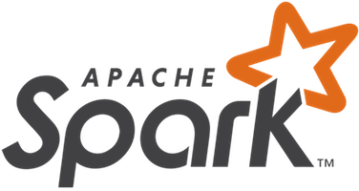
What is Databricks?
Databricks is a data and AI platform that combines data lakes and data warehouses to help organizations manage and use structured and unstructured data.
It offers a unified workspace for data scientists, engineers, and business analysts to process, store, share, analyze, model, and monetize datasets.
It is Built on Apache Spark

Slide 3
Apache Spark in Databricks
A powerful distributed data processing engine. Spark enables Databricks to process large volumes of data quickly and efficiently through parallel computing.

Slide 4
Warehouse and lake create Complexity
Two Separates copies of data
Warehouses Proprietary | Lakes Open
Incompatible Interface
Warehouses SQL | Lakes Python
Incompatible security and governance models
Warehouses Tables | Lakes Files

Slide 5
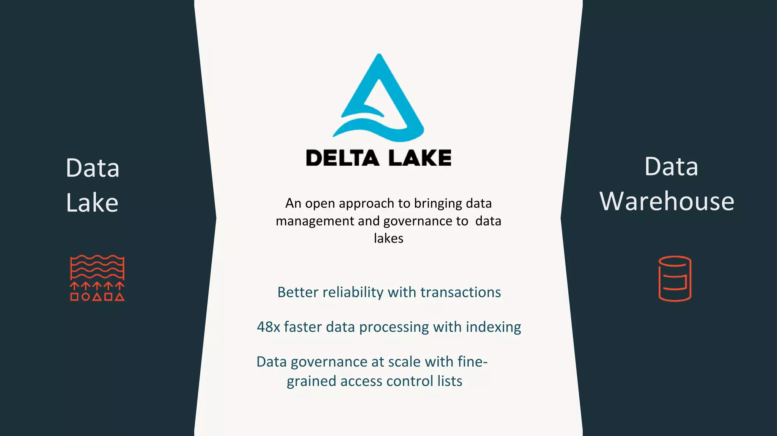

Slide 6
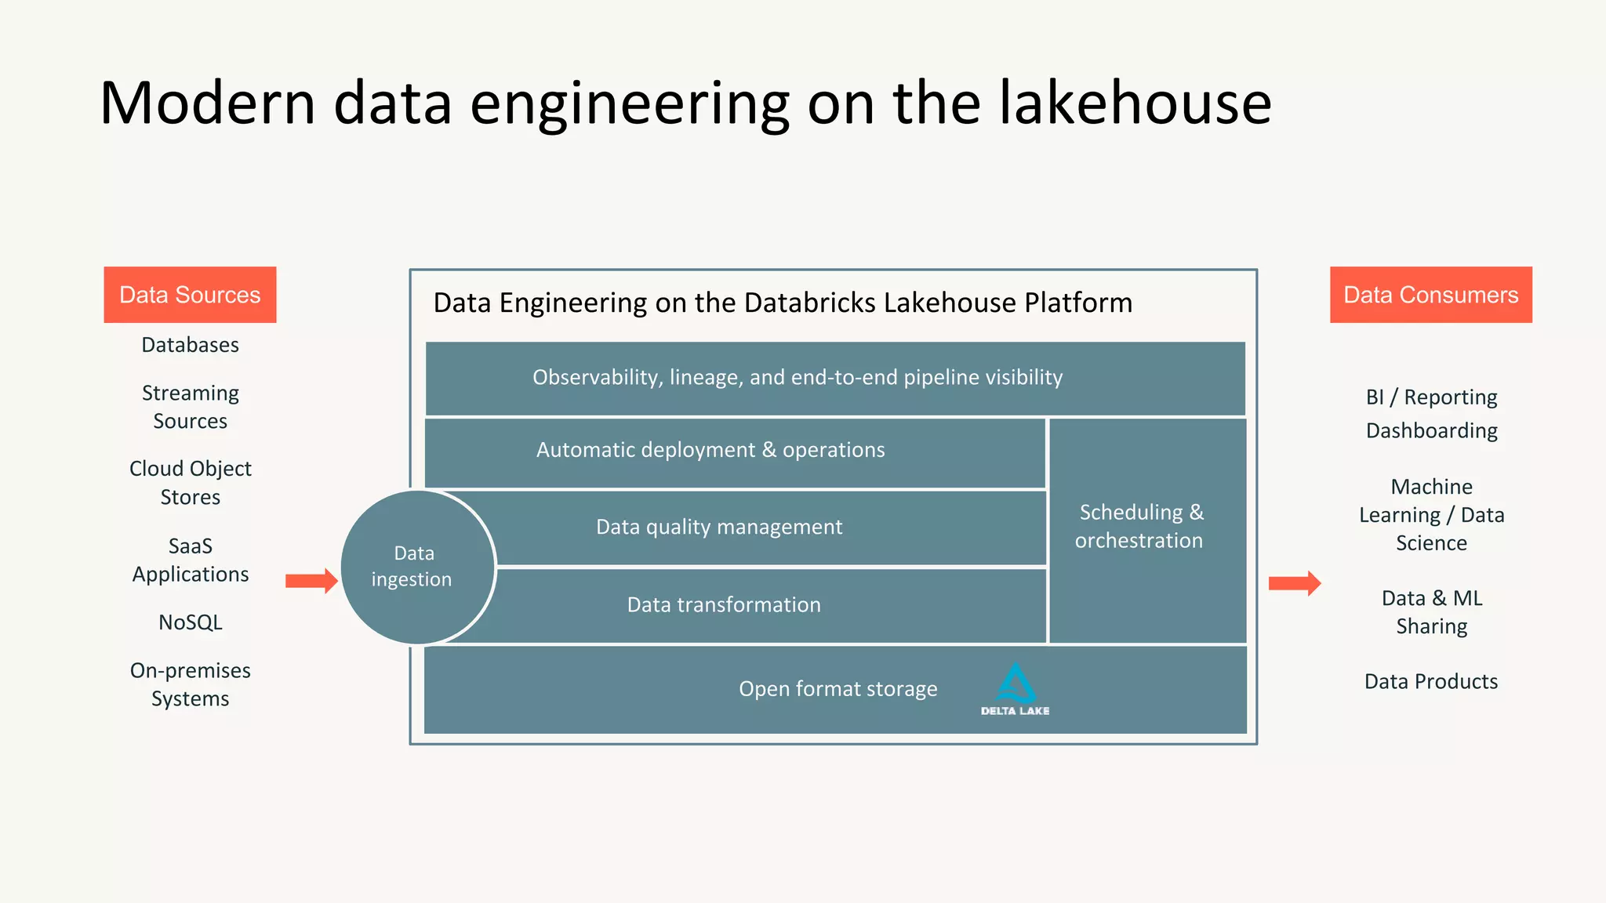

Slide 7
Integration with Cloud Platforms
Azure
AWS
Google Cloud

Slide 8
Azure Databricks
The data and AI service from Databricks available through Microsoft Azure to store all your data on a simple open Lakehouse and unify all your analytics and AI workloads.

Slide 9
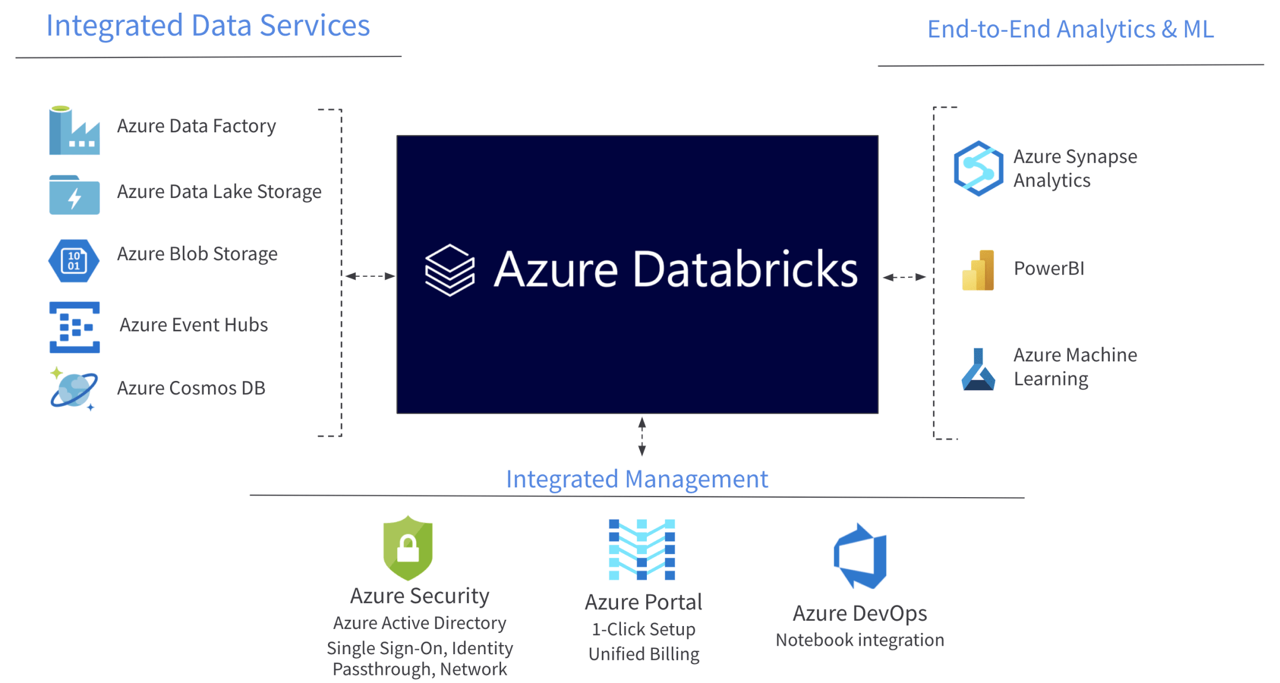

Slide 10
Azure Databricks Architecture

Slide 11
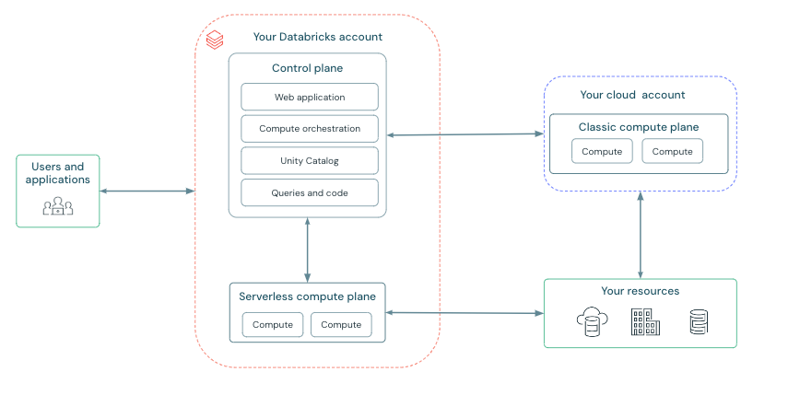

Slide 12
Azure Databricks Architecture Flow

Slide 13
1. User Interaction
2. Control Plane Management
3. Task Distribution
4. Compute Resource Execution
5. Data Interaction

Slide 14
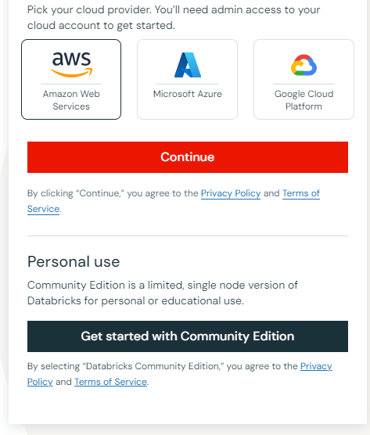
Create Databricks Community Edition Account

Slide 15
Contents Of Databricks Interface
Home
Workspace
Data
Clusters
Jobs
Machine Learning
Collaborate

Slide 16
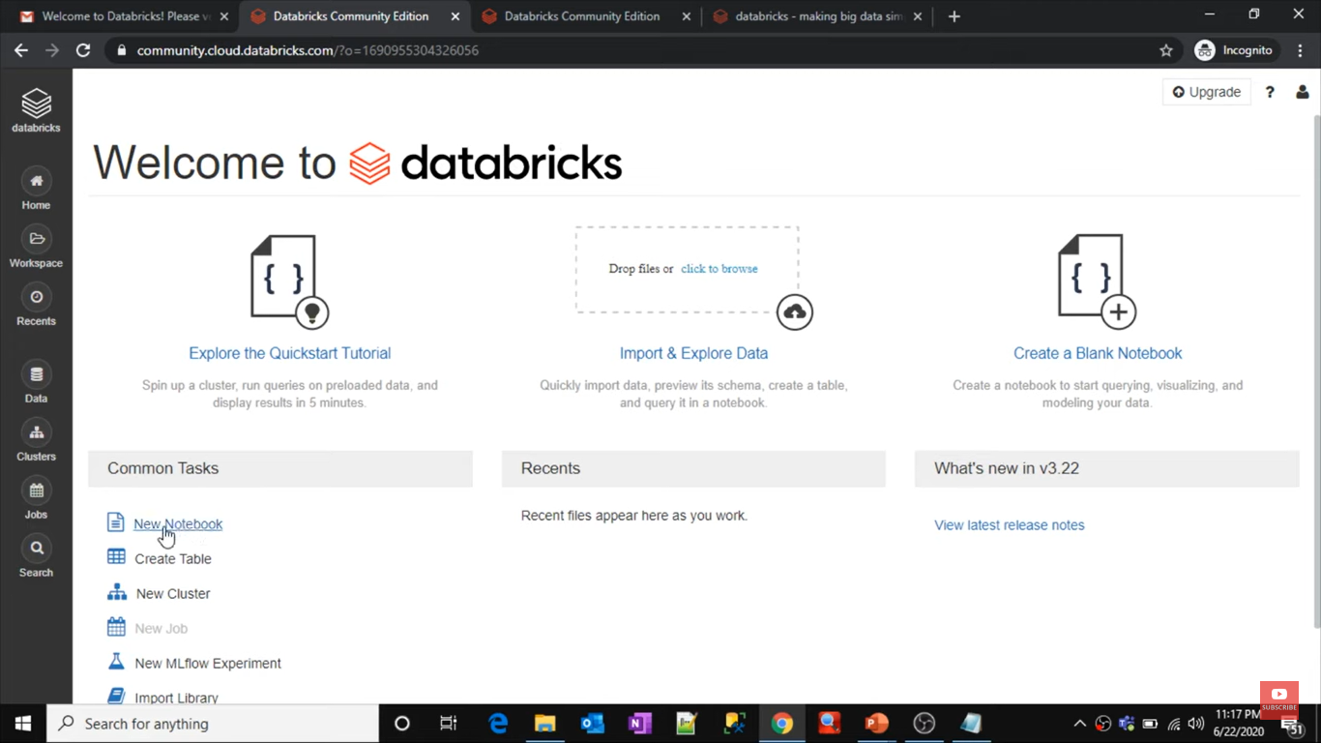
HOME
WORKSPACE
DATA
CLUSTER
JOBS

Slide 17
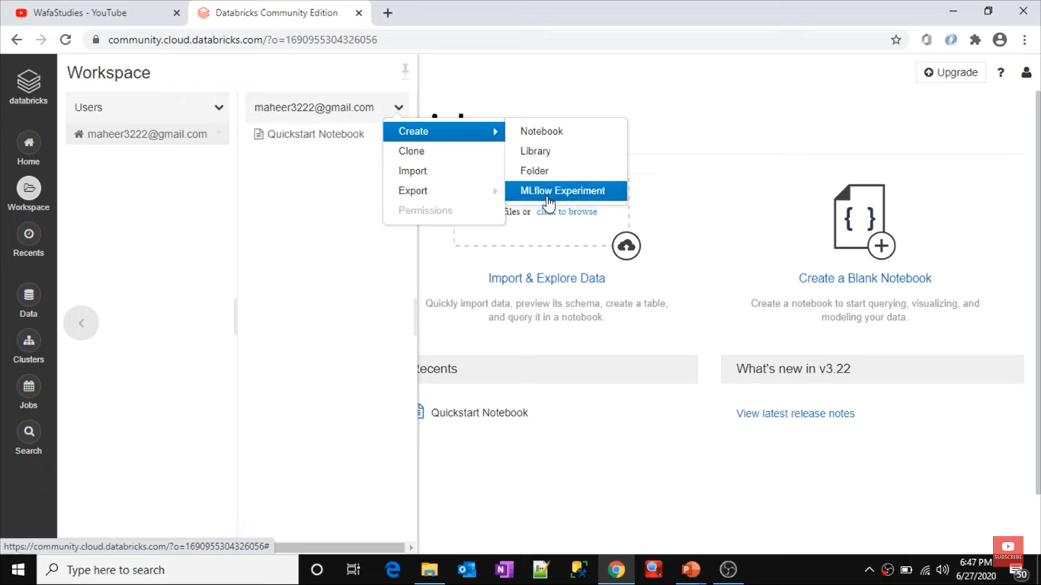
Workspace
Databricks workspace is an environment for accessing all your databricks assets.
The workspace organizes below objects into folders:
Notebooks
Library
Mlflow experiment

Slide 18
Data
Tables: Create and manage tables for structured data.
Data Sources: Connect to various data sources such as cloud storage (e.g., S3, Azure Blob Storage), databases, and more.
Delta Lake: Use Delta Lake for reliable and scalable data storage with ACID transactions.

Slide 19
Data Pipeline
Data source
(databases, data lakes, cloud storage)
Data Ingestion
(Streaming Ingestion
Batch Ingestion)
Data Preprocessing
(Batch Processing
Stream Processing)
Data Transformation
(data cleaning, aggregation, filtering, joining)
Advance Analytics
(Machine Learning
Graph Processing)
Data Storage
(Delta Lake)
Data Access & Visualization
(Databricks notebooks, BI tools like Tableau or PowerBI)

Slide 20
Clusters
A cluster in Databricks is a collection of virtual machines configured to work together as a single unit to execute tasks.
These tasks can include data processing, analytics, and machine learning workloads.
Cluster Lifecycle
Creation
Initialization
Execution
Scaling
Termination
Cluster Components:
Driver Node: The central coordinator that manages the execution of Spark tasks. It handles the distribution of tasks to the worker nodes and collects results from them.
Worker Nodes: Execute the tasks assigned by the driver node. These nodes perform the heavy lifting of data processing and computation.

Slide 21
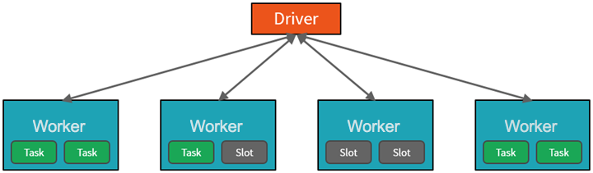

Slide 22
Jobs
Jobs in Databricks allow you to automate tasks like running notebooks or Spark jobs on a schedule. They help ensure that your data processing and analysis tasks run reliably and on time.
Key Features of Databricks Jobs:
Job Scheduling
Task Management
Job Monitoring and Alerts
Error Handling and Retries
Integration with Databricks Components
Version Control and Logging

Slide 23
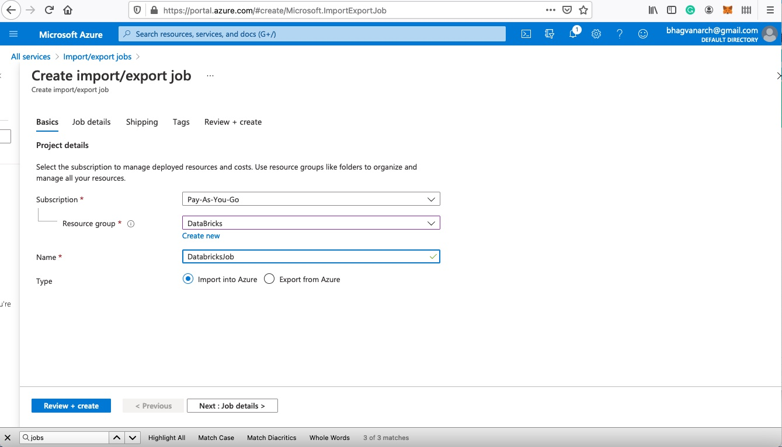

Slide 24
Collaborate
The Collaborate section emphasizes the collaborative nature of Databricks. It provides features that facilitate teamwork, such as shared notebooks, comments, and version control.
Users can work together on the same projects, share insights, and track changes, making it easier to develop and refine data and AI solutions collaboratively.
This section is designed to enhance communication and cooperation among team members.

Slide 25
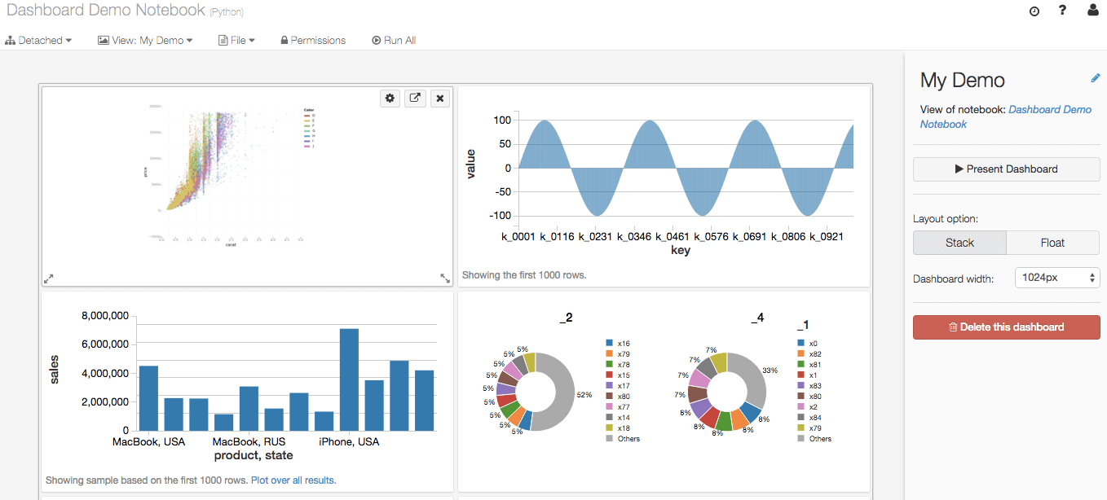
Dashboards

Slide 26
Machine Learning on Databricks
With Databricks, you can implement the full ML lifecycle on a single platform with end-to-end governance throughout the ML pipeline.

Slide 27
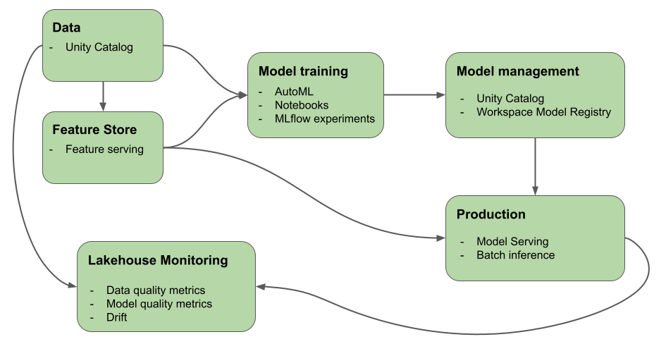
ML workflow

Slide 28
Large language models (LLMs) and Generative AI on Databricks
Libraries and Integrations:
MLflow Integration
Hugging Face Transformers and LangChain
MLflow Integration
Integration with Transformer Pipelines
Model Registry
Tracking Service:
AI Functions for SQL Users
SQL Integration
OpenAI Integration
Foundation Model APIs
Access to State-of-the-Art Models
Ease of Use

Slide 29
Benefits of Using Databricks
01
Extract, Transform, Load (ETL) process
04
API Integrations
02
Benefits of Using Databricks
Batch Processing
05
Cost Optimization
03
Collaborative Environment

Slide 30
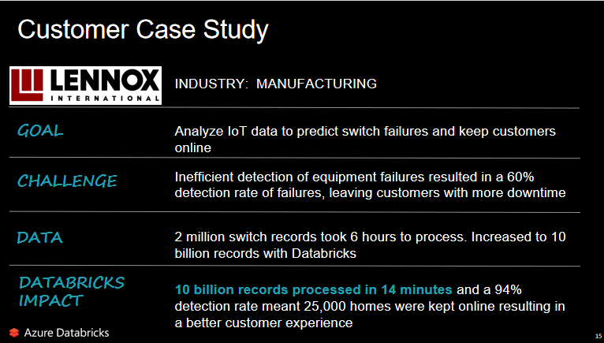

Slide 31
Vedio

Slide 32
Material
5 Questions with answers
YouTube Tutorial
Handle Unstructured Data to Dashboard

Slide 33
Thank you!

