Slide 1
ELSE
Think out loud.
See what else matters.
A voice-first conversational canvas
AssemblyAI Voice Agent Hackathon 2026
Notes:
ELSE helps people notice what their conversation is missing while they are still talking. The canvas surfaces questions and preserves a useful record.
Source: https://github.com/HASHQIX/else-voice-canvas/tree/29b4483e752b9d4e261cdf02e9a111ebaecd7b34

Slide 2
THE PROBLEM
The question
nobody asked
“What happens
if we miss
the date?”
Topics move quickly.
Assumptions stay unchallenged.
Important questions get left behind.
A transcript records what was said. Missing questions remain invisible.
Notes:
An illustrative planning question shows the problem. These are product observations, not research statistics. A conversation can finish before anyone notices a missing dependency or unanswered question.
Source: https://github.com/HASHQIX/else-voice-canvas/tree/29b4483e752b9d4e261cdf02e9a111ebaecd7b34

Slide 3
THE SOLUTION
A canvas that follows
the conversation
The current topic stays in the center.
Eight directions help reveal what to explore next.
To clarify
Next steps
Settled
ELSE keeps a live transcript and saves a Summary
with decisions, open questions and the full conversation.
Notes:
The priority lists live in the fixed sidebar. To clarify contains unresolved questions, Next steps contains stated actions, and Settled contains explicitly confirmed points. The visual field follows the active topic as the discussion moves. Summary opens a saved, copyable report with the complete chronological transcript.
Source: https://github.com/HASHQIX/else-voice-canvas/tree/29b4483e752b9d4e261cdf02e9a111ebaecd7b34

Slide 4
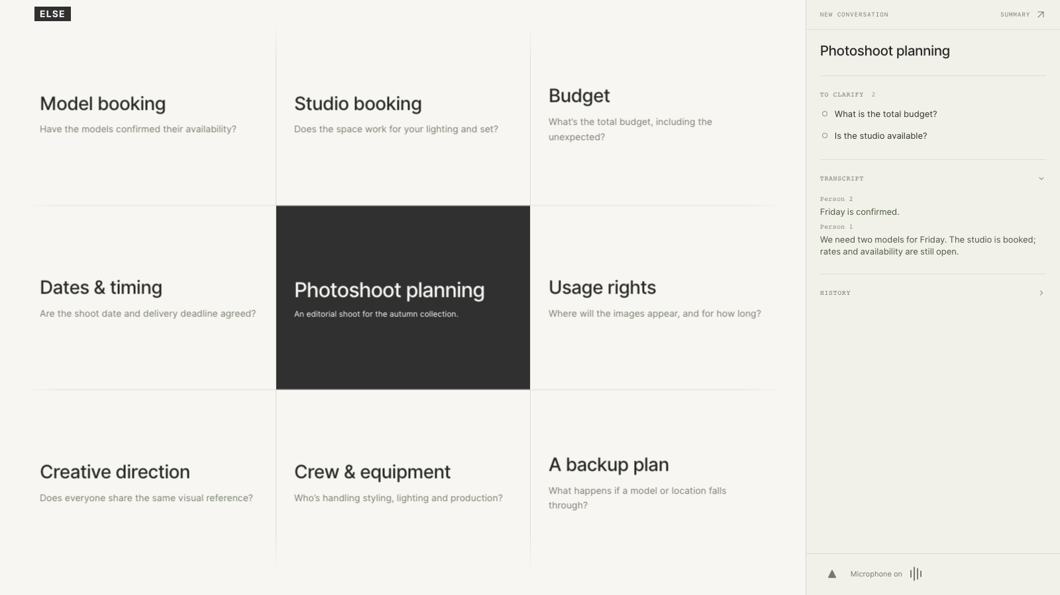
Current topic. Eight directions.
Notes:
Actual ELSE interface rendered from a synthetic photoshoot-planning demo. The center is the current topic. Surrounding cells offer questions and directions. The sidebar preserves priorities and the live transcript. This image illustrates the prototype, not an external customer conversation.
Source: https://github.com/HASHQIX/else-voice-canvas/tree/29b4483e752b9d4e261cdf02e9a111ebaecd7b34

Slide 5
HOW IT WORKS
Speech becomes useful context
Microphone
AssemblyAI
Gemini
Live canvas
Browser audio
PCM16 at 16 kHz
Streaming STT
Speaker labels
Via OpenRouter
Questions and priorities
Current focus
Useful next questions
Fastify routes the stream. Validation checks model output. SQLite saves the conversation.
Notes:
The browser sends microphone audio to the Fastify server over WebSocket. Fastify streams audio to AssemblyAI Streaming Speech-to-Text v3. Completed turns feed Google Gemini through OpenRouter. The server validates structured output and supporting quotes, stores state in SQLite and updates the React canvas. The configured models are universal-3-6-pro and google/gemini-3.8-flash. Source files: server/providers.ts, server/index.ts, server/field.ts, shared/report.ts.
Source: https://github.com/HASHQIX/else-voice-canvas/tree/29b4483e752b9d4e261cdf02e9a111ebaecd7b34

Slide 6
THE VOICE LAYER
AssemblyAI
Live transcription
Partial turns appear
as people speak.
Streaming Speech-to-Text v3
Universal-3.6 Pro Realtime
Speaker diarization
Person 1, Person 2 and more.
Unknown when uncertain.
People keep talking.
ELSE keeps listening.
Completed turns
Trigger context analysis.
Notes:
ELSE uses AssemblyAI Streaming Speech-to-Text, not the Voice Agent API or LLM Gateway. Speaker labels are automatic, use the dominant speaker for each turn, and are scoped to each microphone session. They do not identify a person by name or infer a role. Short, noisy or overlapping speech can produce uncertain labels. ELSE responds visually and has no spoken response in the current experience.
Source: https://github.com/HASHQIX/else-voice-canvas/tree/29b4483e752b9d4e261cdf02e9a111ebaecd7b34

Slide 7
WHERE IT HELPS
See what still
needs to be said
Project planning
Missing constraints
Negotiations
Questions and commitments
Interviews
ELSE extends the conversation
while people remain in control.
Unanswered areas
Brainstorming
Overlooked directions
github.com/HASHQIX/else-voice-canvas
Notes:
The intended use cases are project planning, negotiations, interviews and creative brainstorming. These are product applications, not claims of customer adoption or measured outcomes. The repository is public. A hosted application URL has not been supplied.
Source: https://github.com/HASHQIX/else-voice-canvas/tree/29b4483e752b9d4e261cdf02e9a111ebaecd7b34

